Slide 1
Kinetoplast & MITO-EPI species calcium
Abbrevations used in following presentation:
BSF : bloodstream form
PCF : procyclic (insect) form
There are multiple other studies comparing proteomics in these forms including:
Dejung2016 (good study and design, lower proteomics coverage than us)
Dolezelova2020 (in vitro differentiation) timecourse from PCF -> metacyclics (similar to going from PCF toward bloodstream form), this has quite good coverage (similar to ours)

Slide 2
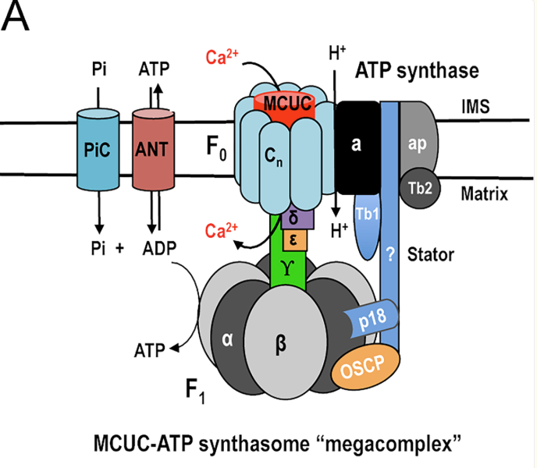
Calcium and kinetoplasts
Calcium-related genes are BSF-upregulated in our Trypanosoma BSF-vs-PCF dataset
Nearly all calcium-related genes are increased in BSF-vs-PCF (including all 3 EF-hand mito proteins)
The #1 most significantly BSF-upregulated protein is calpain (“calcium-dependent cysteine-type endopeptidase activity”)
MCUs are amongst most highly BSF-upregulated of all mito proteins (although not as strong as AOX) in our data
Consistent with our data, MCUs are up-regulated in Dolezelova2020 (in vitro differentiation) timecourse from PCF -> metacyclics
  This upregulation was noted in a sentence in Dolezelova2020
  Also “TbMCU in BSF trypanosomes appears necessary for the generation of acetyl-CoA, not as a substrate of the Krebs cycle (tricarboxylic acid cycle) that is absent but, as either a source of intramitochondrial ATP through substrate level phosphorylation, needed for intramitochondrial anabolic reactions⁴⁰ or maintenance of the membrane potential by the ATPase¹, or for mitochondrial³⁶ and/or cytosolic fatty-acid synthesis⁴¹.” – Huang et al, Nat Communications 2013
Note: only half of acidocalcisome genes are BSF-upregulated
Acidocalcisomes : acidic, calcium-rich organelles found in various organisms, including kinetoplasts; characterized by a high concentration of phosphorus, primarily in the form of PPI and polyp; play important roles in calcium signaling, osmoregulation, autophagy
Reports show physical link between acidocalcisome & mitos in Tryps, and mito Ca influx thought to be mediated through acidocalcisome
Questions:
Why are MCUs and nearly all cellular EF-hand proteins increased in BSF vs PCF? Probably no computational way to answer this
Does MCU form a complex in complexome? Is it with Complex V (as reported in literature)?
  No: 2 MCUs detected, but neither are similar to each other or anything else
  Complex V has beautiful profile, and its mucher high MW than either MCU
Anything else?
https://pmc.ncbi.nlm.nih.gov/articles/PMC10424509/

Slide 3
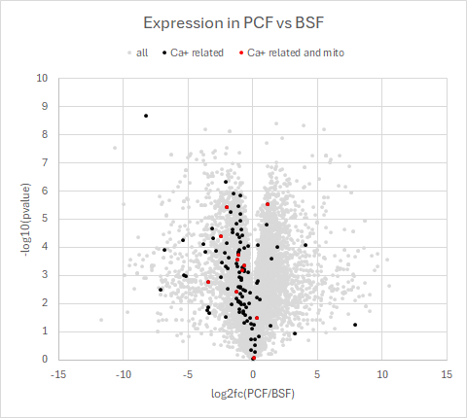
Calcium-related gene (GO molecular function) are BSF-increased;
The most significantly BSF-increased protein is calpain (nothing else close)
Many calpain family members in Tryps.
This one has PFAM DUF1935|Peptidase_C2
calpain
expression site-associated gene 3 (ESAG3)
Similar to VSG
Higher in BSF
Higher in PCF

Slide 4
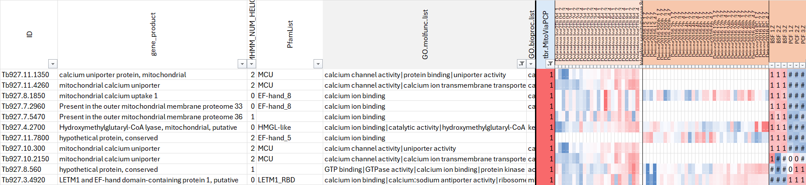
All mito proteins with “calcium” in GO molecular function – most up BSF

Slide 5
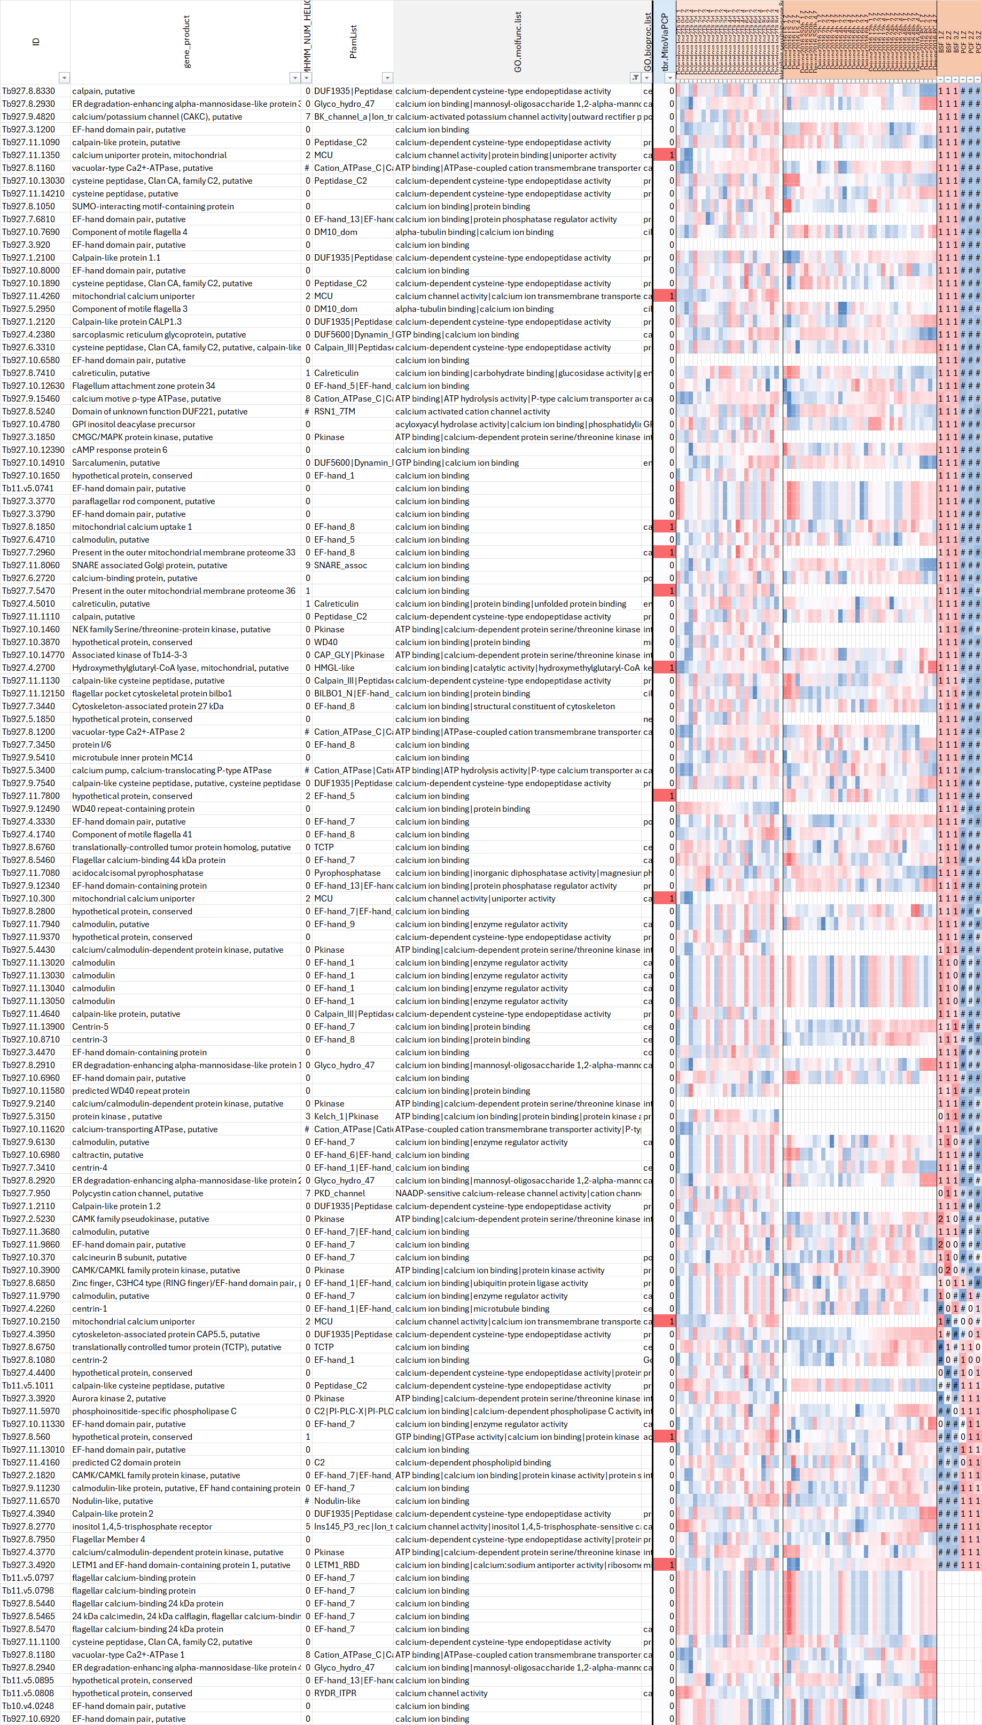
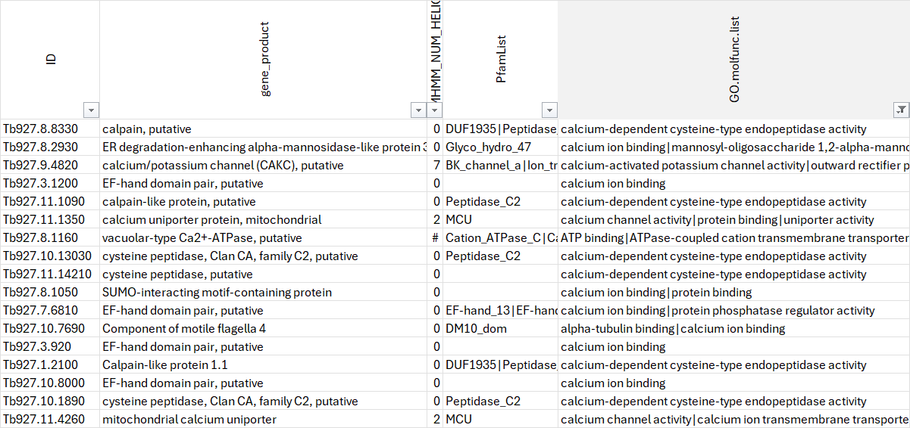
All proteins with “calcium” in GO molecular function
Most are up in BSF – here’s the top of the list based on BSF-increase sensitivity score

Slide 6
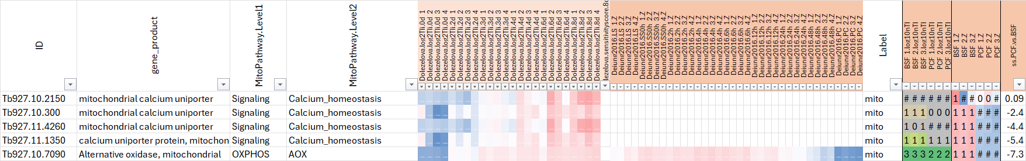
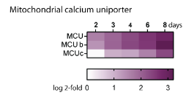
Interestingly mito calcium uniporter homologs (MCUs) are all up in BSF vs PCF in our study and in Dolezelova (not detected in Dejung)
Dolezelova2020: “The activity of mitochondrial dehydrogenases is dependent on Ca²⁺ ions, which are imported into the mitochondrion via a heterooligomeric mitochondrial calcium uniporter (MCU) [33,34]. Changes in expression in three out of four known MCU subunits were among the most notable features in our proteomic data, showing 6-fold up-regulation at day 6 following RBP6 induction (Fig 3A).”
One hypothesis is that mito calcium increases phosphorylation & activity of some key mito dehydrogenases
Does it make sense for MCU to be down regulated in procyclic form (primarily uses aerobic ETC for ATP) and up in BSF (high glycolysis, AOX-mito function with complex V in forward direction as ATPsynthase)?

Slide 7
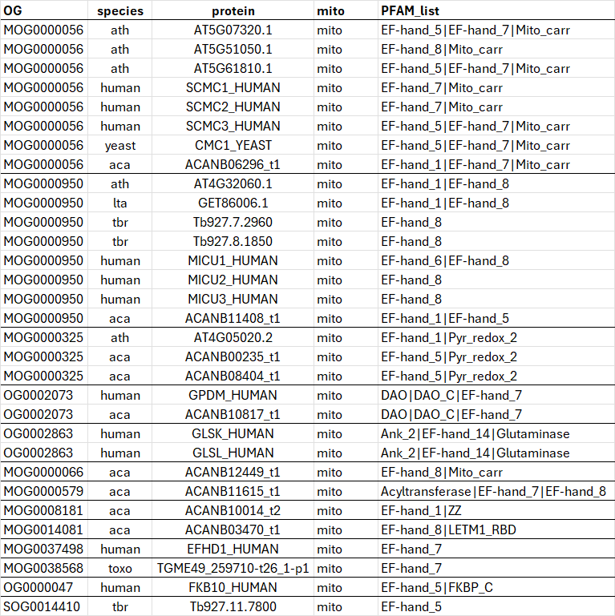
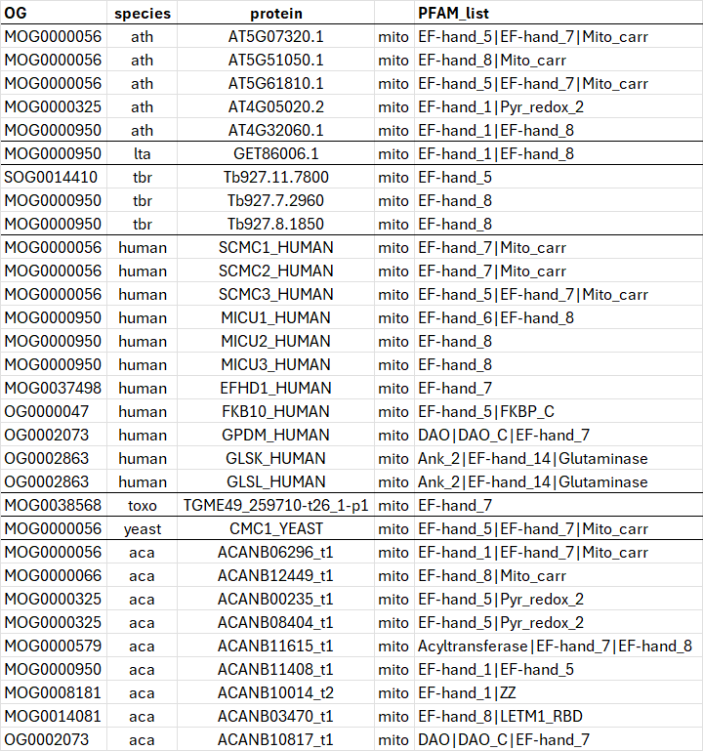
EF-hand domains across all our MitoCartas – organized by OG and by species
Ordered by OG
Ordered by species

Slide 8
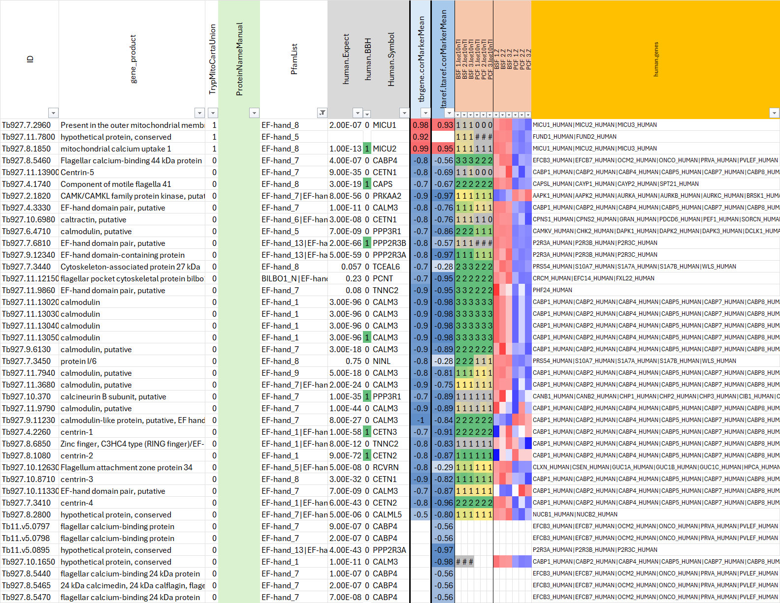
EF-hand ome in Tb: top 3 are in MitoCarta (two MICUs and a hypothetical)
Nearly all of these increased in BSF

Slide 9
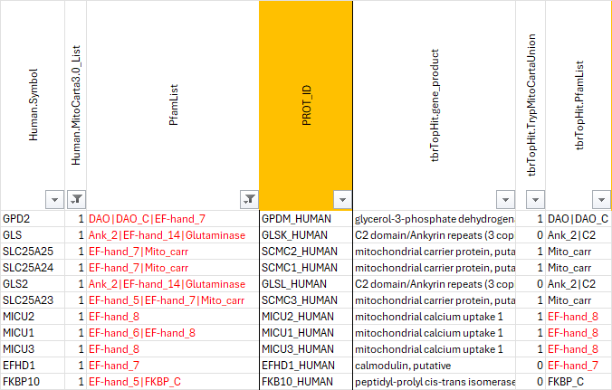
Of the human mito EF-hand_ome, how many homologs in Tb also have EF-hands? Only MICUs

Slide 11
Appendix

Slide 12
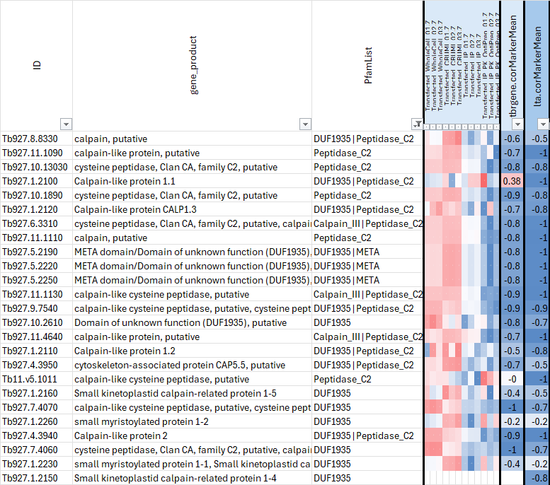
Calpains: proteins with DUF1935 and/or Peptidase_C2

Slide 13
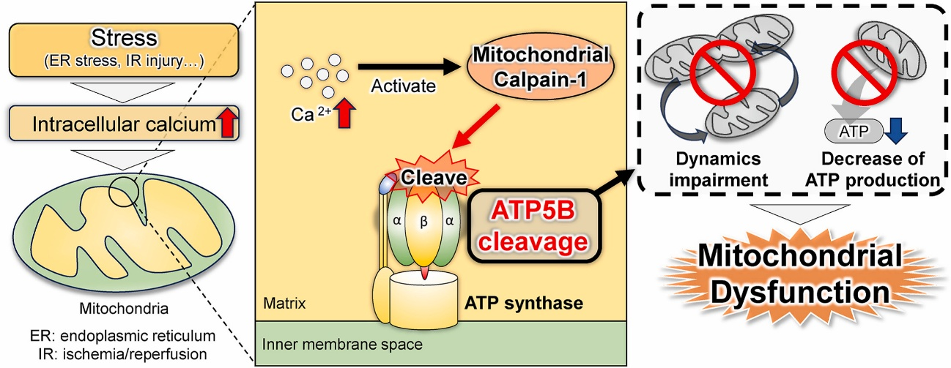
In mice, mitochondrial calpain-1 cleaves and inactivates ATP5B
ABSTRACT: Calpains cleave proteins in a calcium concentration-dependent manner, modulating their intracellular functions. Calpain-1, a member of the calpain family, is localized in the cytosol and mitochondria. Mitochondrial calpain-1 induces mitochondrial dysfunction and apoptosis by cleaving its substrate. Thus, identifying the substrate of calpain-1 is essential to understand its function. However, little is known about the substrates of mitochondrial calpain-1. To address this issue, we screened mitochondrial proteins using bioinformatics approaches and two-dimensional gel electrophoresis. We identified ATP5B as a potential substrate of mitochondrial calpain-1. Calpeptin, a pan-calpain inhibitor, and Tat-μCL, a mitochondrial calpain-1 specific inhibitor, prevented the truncation of ATP5B during in vitro Ca²⁺ incubation. Using recombinant human calpain-1 and ATP5B proteins, we demonstrated that calpain-1 directly cleaved ATP5B, generating a fragment of ATP5B. Based on the predicted cleavage sites in ATP5B, this cleavage may disrupt its interaction with ATP5A1, leading to mitochondrial dysfunction in ATP production. This study identified ATP5B as a novel substrate of mitochondrial calpain-1. The results provide new insights into mitochondrial dysfunction.
INTRODUCTION:
Calpains are calcium-dependent proteases that regulate intracellular processes by cleaving their substrates [1]. In total, 15 calpain isoforms are localized to the cytosol [2]. Among the calpain isoforms, calpains-1, -2, -5, -10, and -13 are localized in the mitochondria [[3], [4], [5], [6]]. In mitochondria, calcium influx mediates mitochondrial dysfunction and causes cell death via intercellular endoplasmic reticulum stress and ischemia/reperfusion injury [[6], [7], [8]]. Therefore, understanding the behavior of mitochondrial calpains will improve our understanding of the mechanisms underlying these diseases and contribute to the development of an approach for treating mitochondria-associated diseases.
The functions of each mitochondrial calpain have been previously reported [9]. Previously, we revealed that mitochondrial calpain-1 cleaves apoptosis-inducing factor (AIF) [6], and mitochondrial calpain-2 promotes the release of AIF from mitochondria via the cleavage of the voltage-dependent anion channel complex and Bcl-2-associated X protein [10]. Additionally, specific inhibition of mitochondrial calpain-1 suppresses retinal degeneration in retinitis pigmentosa [11]. Thus, mitochondrial calpain-1 promotes cell injury, whereas cytosolic calpain-1 triggers synaptic plasticity and neuroprotection [12]. This discrepancy between mitochondrial and cytosolic calpain-1 likely reflects the difference in their substrates, depending on their localization. Thus, identifying a mitochondrial calpain-1 substrate is conducive to a better understanding of disease-associated cellular conditions.
This study aimed to identify a novel substrate for mitochondrial calpain-1. We screened mitochondrial proteins and selected ATP synthase subunit beta (ATP5B) as a potential substrate of mitochondrial calpain-1. The results of this study provide new insights into activated mitochondrial calpain-1.
https://www.sciencedirect.com/science/article/abs/pii/S0006291X25005431

Slide 14
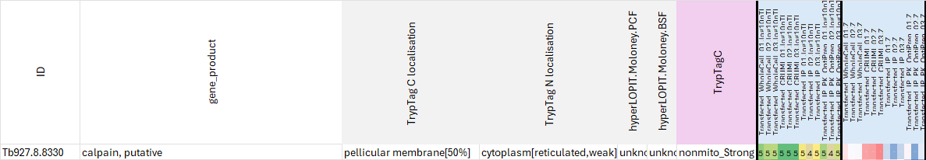
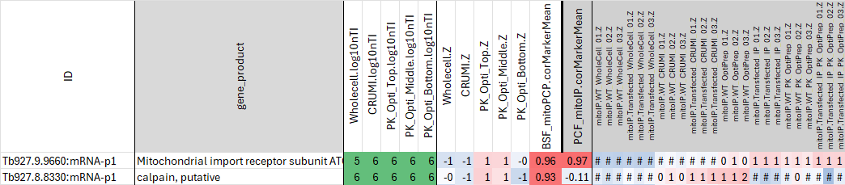
Is calpain mitochondrial in Tbr PCF or BSF?
TrypTag C = pellicular membrane, TrypTag N = cytoplasm
In our PCF.mitoPCP using only transfected samples, it looks clearly non-mito (enriched in CRUMI)
In our PCF.mitoPCP using only WT and transfected samples (right Z-scores below) it looks enriched in WT but not TF OptiPrep (2nd row)
In our BSF.mitoPCP pilot, it looks similar to Tom40 (top row), but many proteins show this pattern so it’s not definitive
Possibilities: could calpain be mito? Could it be mito only in BSF? It would make sense that (like AOX) calpain could be a strong regulator to turn off mito bioenergetics in BSF. Since it’s the strongest hit BSF-vs-PCF it seems worth following up more. But it could easily be a non-mito morphogenesis type gene

Slide 15
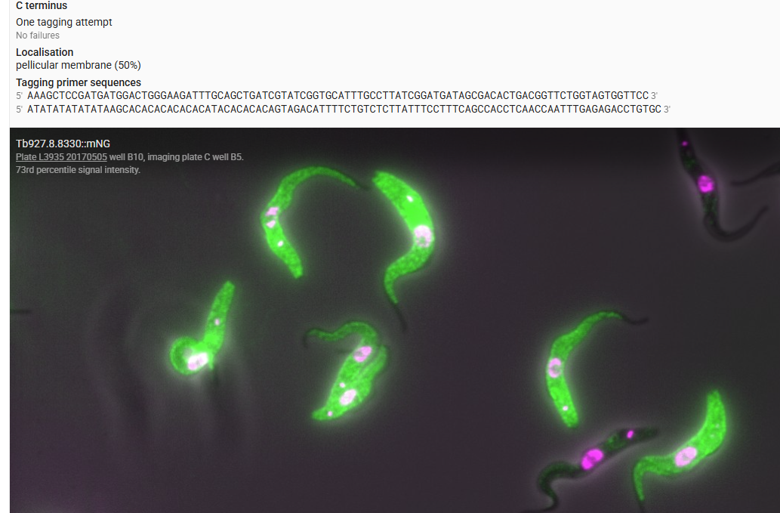
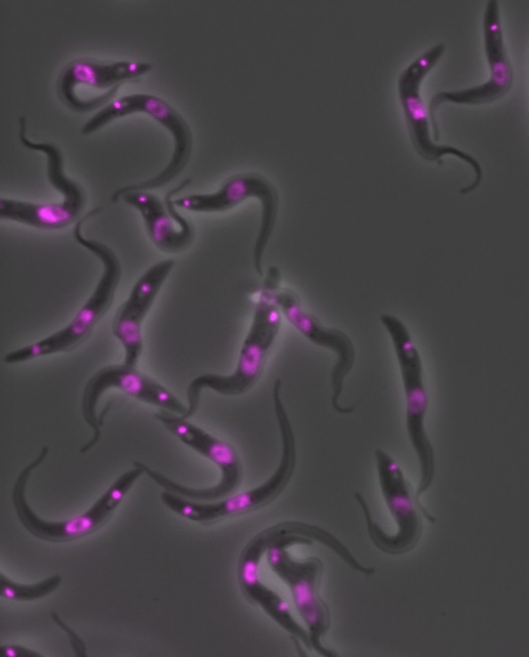
Calpain tagging by TrypTag http://tryptag.org/?query=Tb927.8.8330
The pellicular membrane in Trypanosoma, a protozoan parasite, is a unique structure composed of a single membrane plus underlying microtubules. It forms the cell's outer boundary and is crucial for its motility and interaction with the host environment. Unlike the pellicles of some other motile organisms, the trypanosome pellicle consists of a single membrane layer, not multiple layers, along with a supporting network of microtubules. The pellicle is essential for the trypanosome's movement, helping it navigate through viscous fluids like blood. It also plays a role in cell shape, endocytosis, and exocytosis. The pellicular membrane is often covered by a dense coat of VSGs, which are proteins that allow the trypanosome to evade the host's immune system by constantly changing its surface structure.
N terminal tagging very faint results

Slide 16
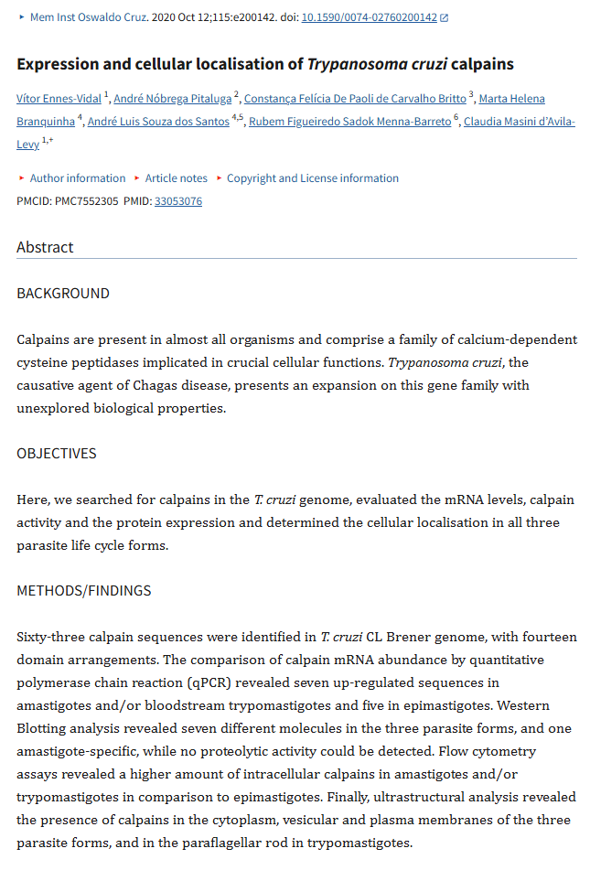
Calpains in T.cruzi
https://pmc.ncbi.nlm.nih.gov/articles/PMC7552305/

Slide 17
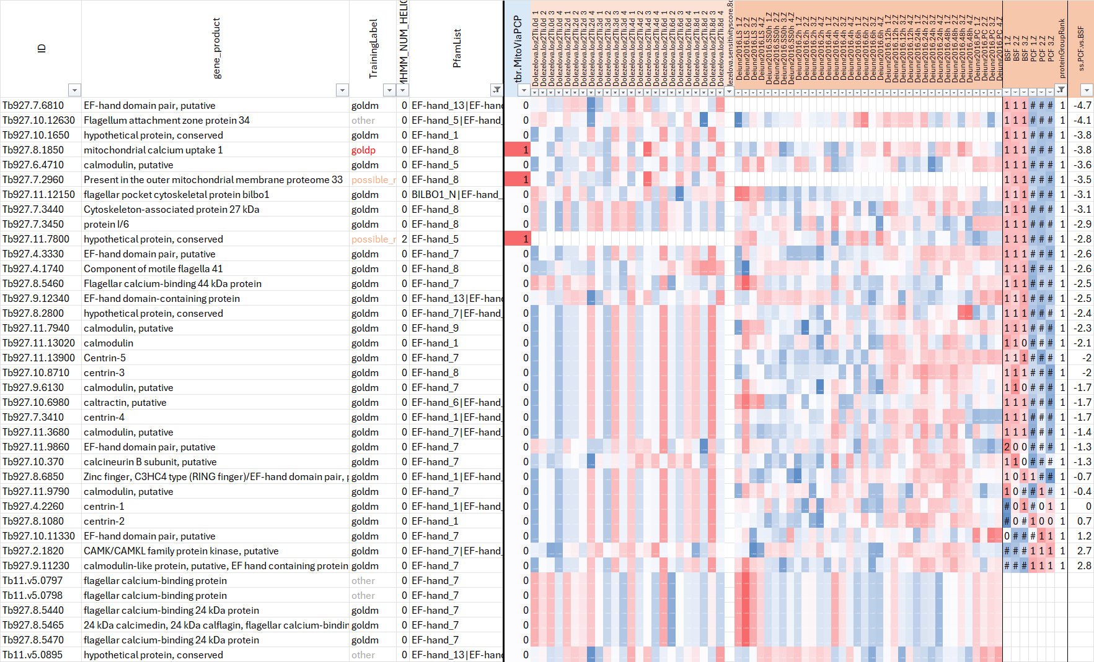
What’s happening to other calcium related proteins during PCF/BSF?
42 EF-hand containing proteins (only 3 mito)
Almost all are up in our BSF (like MCU), somewhat consistent with Dolezelova2020
LETM1 up in PCF (in our data & Dejung2016)

Slide 18
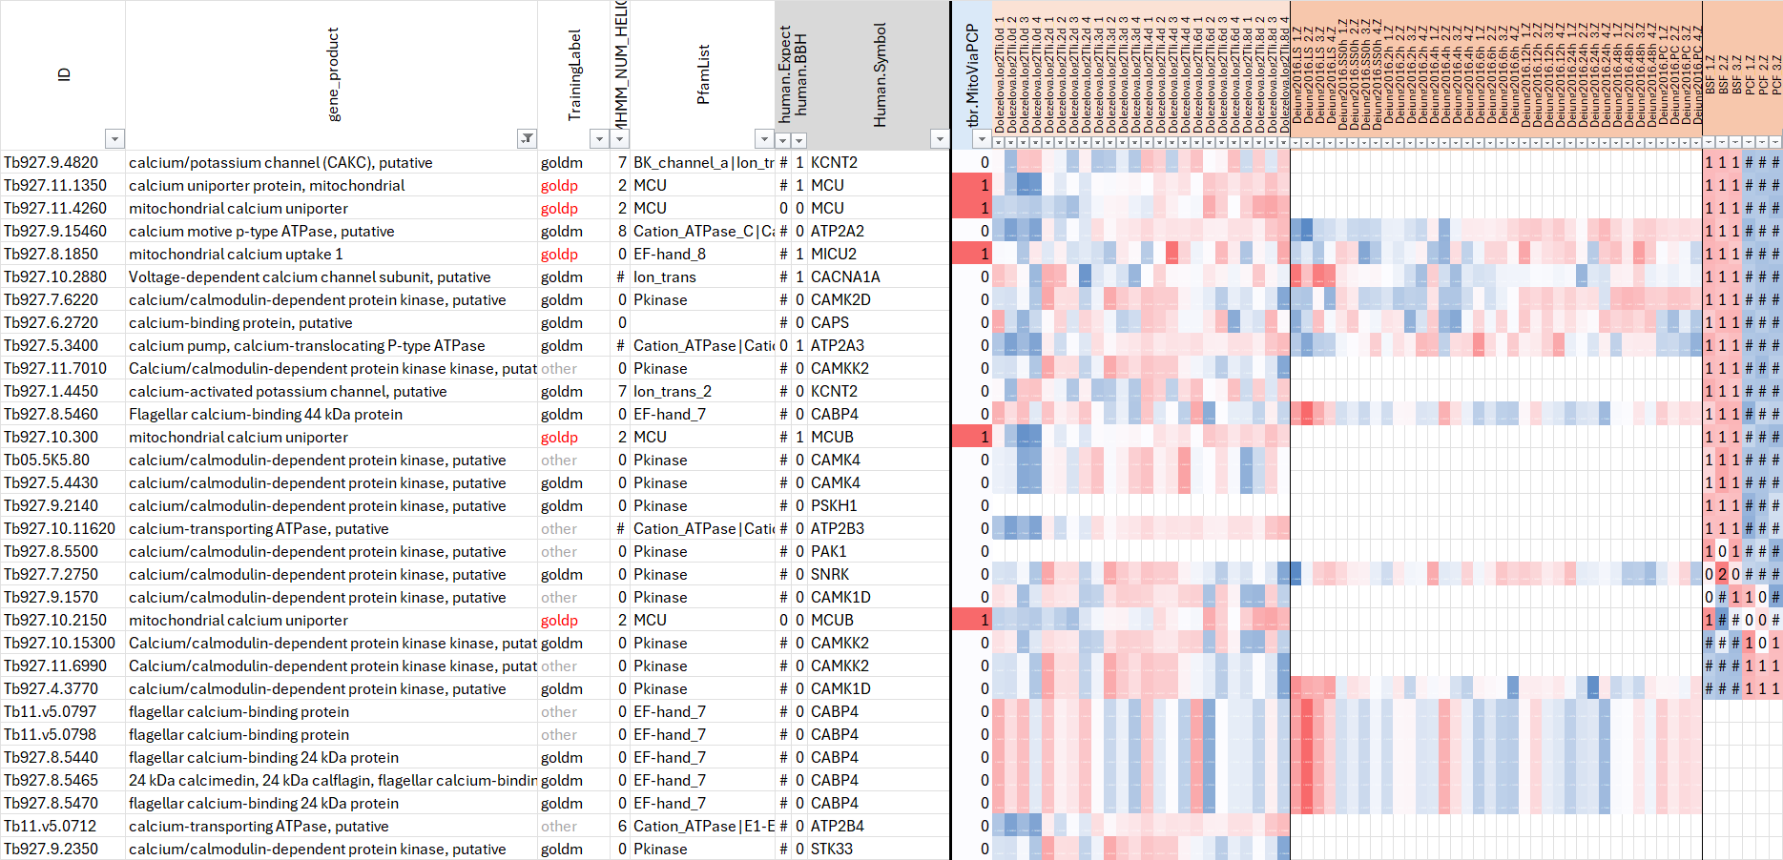
What’s happening to other calcium related proteins during PCF/BSF?
All proteins with “calcium” in gene description – mostly up in BSF in our data

Slide 19
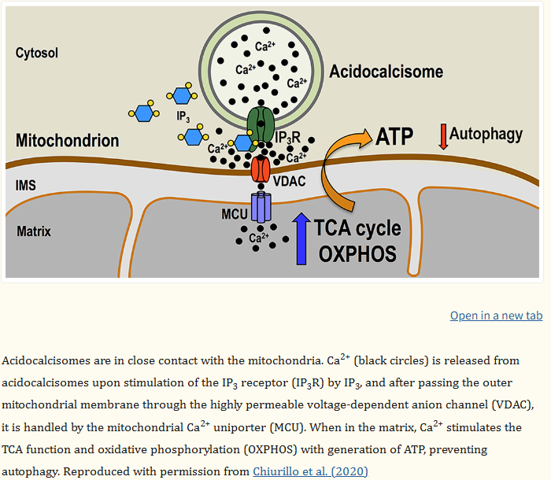
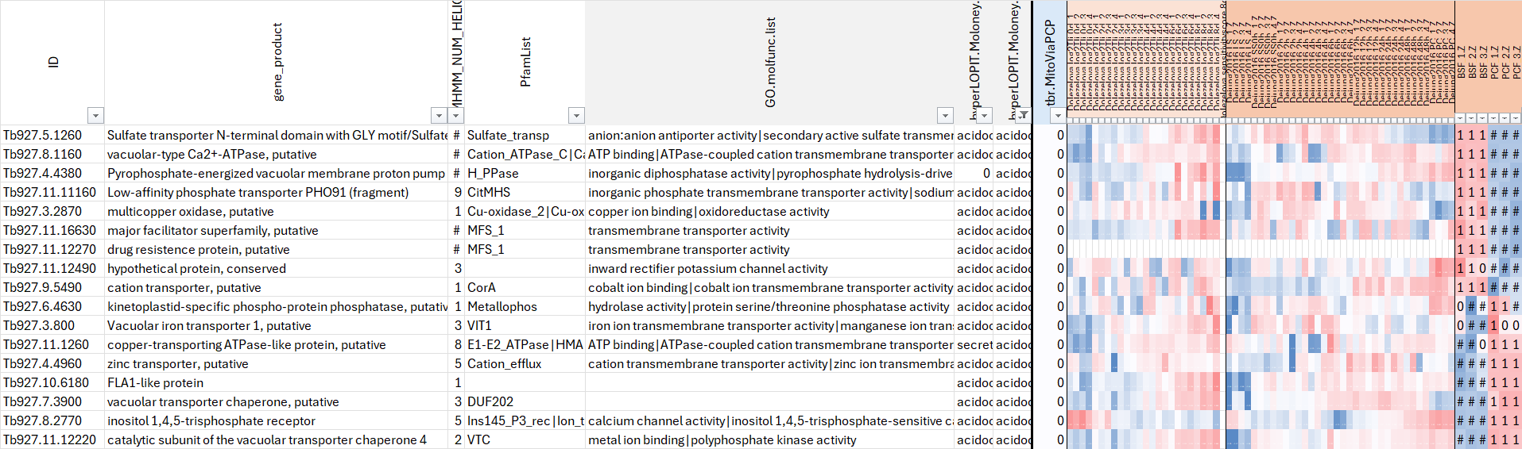
Acidocalcisomes
Acidocalcisomes are acidic, calcium-rich organelles found in various organisms, including protozoans like Trypanosoma brucei and Trypanosoma cruzi. They are characterized by a high concentration of phosphorus, primarily in the form of pyrophosphate (PPi) and polyphosphate (polyP). These organelles play important roles in calcium signaling, osmoregulation, and autophagy. -- chatGPT
Acidocalcisomes are electron-dense organelles rich in polyphosphate and inorganic and organic cations that are acidified by proton pumps, and possess several channels, pumps and transporters. They are present in bacteria and eukaryotes and have been studied in greater detail in trypanosomatids. Biogenesis studies of trypanosomatid acidocalcisomes found that they share properties with lysosome-related organelles of animal cells. In addition to their described roles in autophagy, cation and phosphorus storage, osmoregulation, pH homeostasis, and pathogenesis, recent studies have defined the role of these organelles in phosphate utilization, calcium ion (Ca²⁺) signaling, and bioenergetics, and will be the main subject of this review. -- https://pmc.ncbi.nlm.nih.gov/articles/PMC10350294/ (see figure at right)
Cytosolic Ca²⁺ buffering system.
Experiments with T. brucei expressing the genetically-encoded Ca²⁺ indicator aequorin targeted to the mitochondria found that intramitochondrial Ca²⁺ concentrations can reach values much higher than cytosolic Ca²⁺ levels when Ca²⁺ influx through the plasma membrane or Ca²⁺ release from acidocalcisomes are stimulated (Xiong et al., 1997). Mitochondrial Ca²⁺ uptake can be induced at both nano- and micromolar Ca²⁺ concentrations (Xiong, Ruben, 1998), suggesting a very close proximity of these organelles and the presence of microdomains of high Ca²⁺ concentration in the vicinity of the plasma membrane or acidocalcisomes (Xiong et al., 1997). Such membrane contact sites between acidocalcisomes and mitochondria were reported in both T. brucei (Ramakrishnan et al., 2018) and T. cruzi (Miranda et al., 2000). The inositol 1,4,5-trisphosphate receptor is located in acidocalcisomes of both trypanosome species (Huang et al., 2013a; Lander et al., 2016) and close contacts between these organelles facilitate the mitochondrial Ca²⁺ transfer to the mitochondria when the IP₃ receptor is activated (Chiurillo et al., 2020). -- https://pmc.ncbi.nlm.nih.gov/articles/PMC10424509/
In our data, only half acidocalcisome proteins (from hyperLOPIT) are BSF-increased:

Slide 20
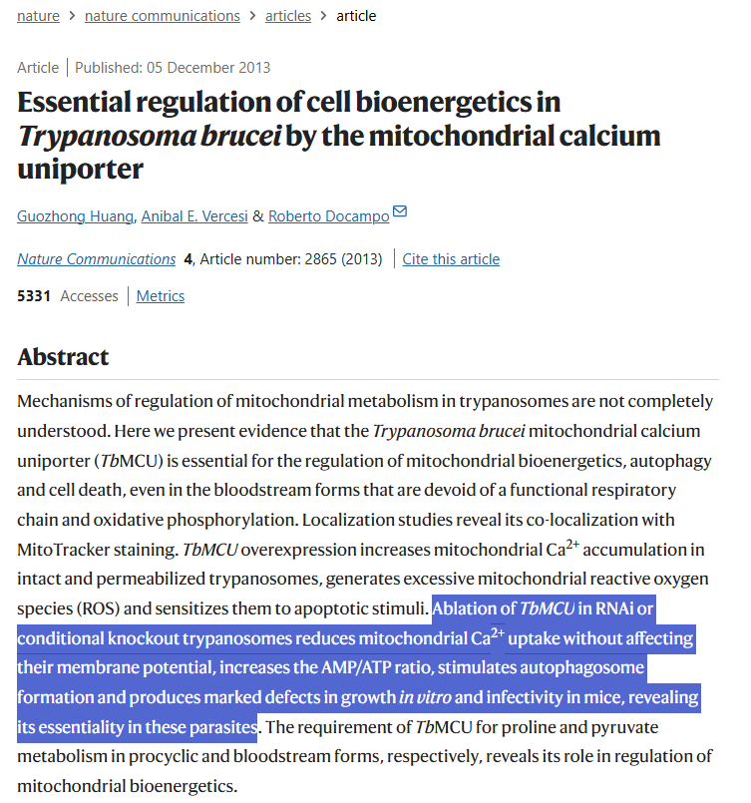
The most significant finding of our studies is that the MCU is essential in BSF trypanosomes, which are organisms devoid of oxidative phosphorylation. This pathway has been reported to be the main target of intramitochondrial Ca²⁺ in vertebrate cells^{13,14,15,16}. The partial rescue by threonine of the lethal effect of the TbMCU-KO suggests that, in contrast to what occurs in vertebrate cells, TbMCU in BSF trypanosomes appears necessary for the generation of acetyl-CoA, not as a substrate of the Krebs cycle (tricarboxylic acid cycle) that is absent but, as either a source of intramitochondrial ATP through substrate level phosphorylation, needed for intramitochondrial anabolic reactions⁴⁰ or maintenance of the membrane potential by the ATPase¹, or for mitochondrial³⁶ and/or cytosolic fatty-acid synthesis⁴¹.

