Slide 1
TCEB2 (aka ELOB) analysis background and plan
Requested from Vamsi: We are interested in the potential role of TCEB2 as a post-transcriptional regulator of OXPHOS:
Using the CCLE / DepMap cell lines;
By cell lineage;
Generate S-plots for co-expression between TCEB2 and all other RNAs' (gray) and color in red the OXPHOS subunits,
Generate S-plots for co-expression between TCEB2 and all other proteins (gray) and color in red the OXPHOS subunits
We'd love to see the nearest 100 neighbors positively correlated RNAs and nearest 100 neighbors anti-correlated proteins within each lineage
Sarah’s analysis
Use DepMap “Custom Analyses” to download correlation data between TCEB2 and all other genes for
Proteomics
mRNA expression
CRISPR score
We should be able to do the above specifically for certain lineages with enough data (Lung, Skin, Bowel)
Currently this functionality is broken – I put in Help request for a bugfix
Map to MitoCarta3.0 OXPHOS subunits using gene symbol
Generate S-plots and gene lists for all genes and OXPHOS subunits
Run GSEA on custom OXPHOS_subunits set to generate p-value for enrichment/depletion
Not done yet: lineage-specific analyses (waiting on bugfix; also in my experience these are never helpful for solid tumors – as shown in the Gygi proteomics paper on the next slide)

Slide 2
TCEB2 (aka ELOB) summary
ELOB Is highly expressed across all human tissues in GTEX, and shows one main transcript isoform (so, well-behaved)
ELOB itself has significant positive correlation between its mRNA and protein levels
This is true across all tissues (p=8e-10) and per lineage (although only significant in 3 tissues due to power)
ELOB Co-expression analysis:
mRNA: ELOB mRNA positively and strongly correlates with OXPHOS (except neg corr with mtDNA transcripts)
Protein: ELOB protein negatively correlates with OXPHOS protein expression
CRISPR: ELOB KO score positively correlates with OXPHOS KO score
ELOB Co-expression pre-ranked GSEA KEGG analysis:
mRNA: OXPHOS is top-scoring pathway (positive correlation)
Protein: OXPHOS is negatively correlated but not significant
CRISPR: OXPHOS is top-scoring pathway (positive correlation)

Slide 3
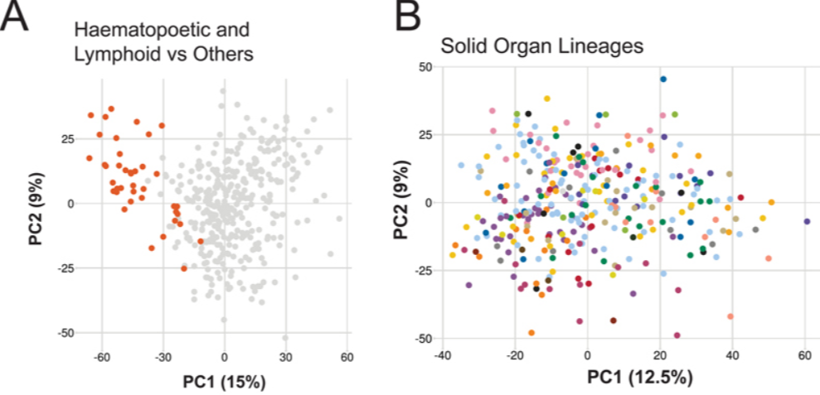
Note: CCLE cell lines do not cluster by lineage in protein space for solid organs (so I’m not enthusiastic about doing lineage-specific analyses for protein data)
Nusinow, …, Gygi “Quantitative Protemics of the Cancer Cell Line Encyclopedia” Cell 2020

Slide 4
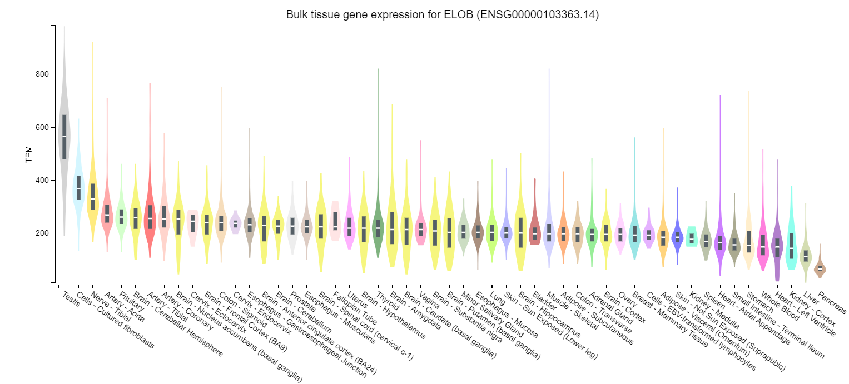
GTEX: ELOB is highly expressed in all tissues

Slide 5
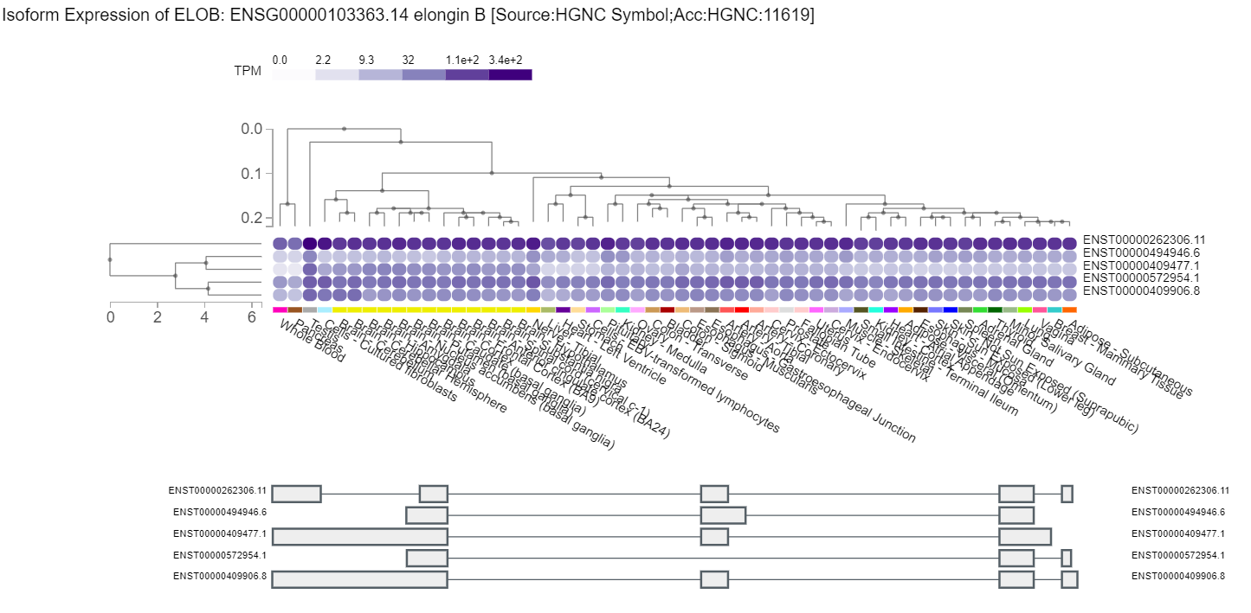
GTEX: ELOB has one main isoform in all tissues

Slide 6
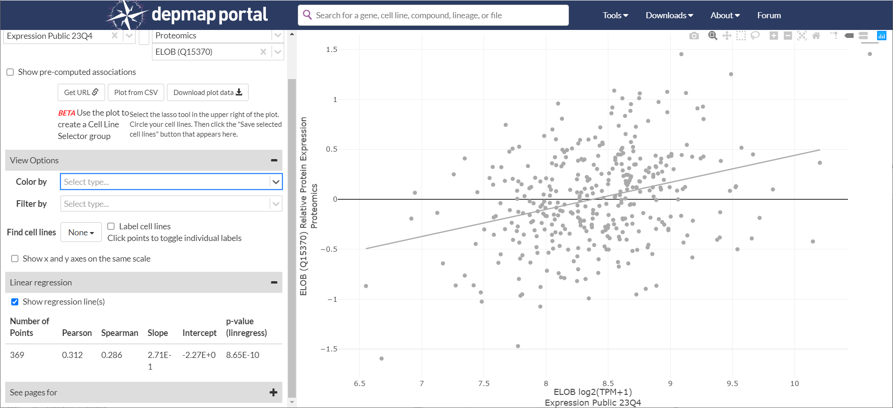
Depmap positive correlation of ELOB mRNA vs protein expression (p=8e-10)

Slide 7
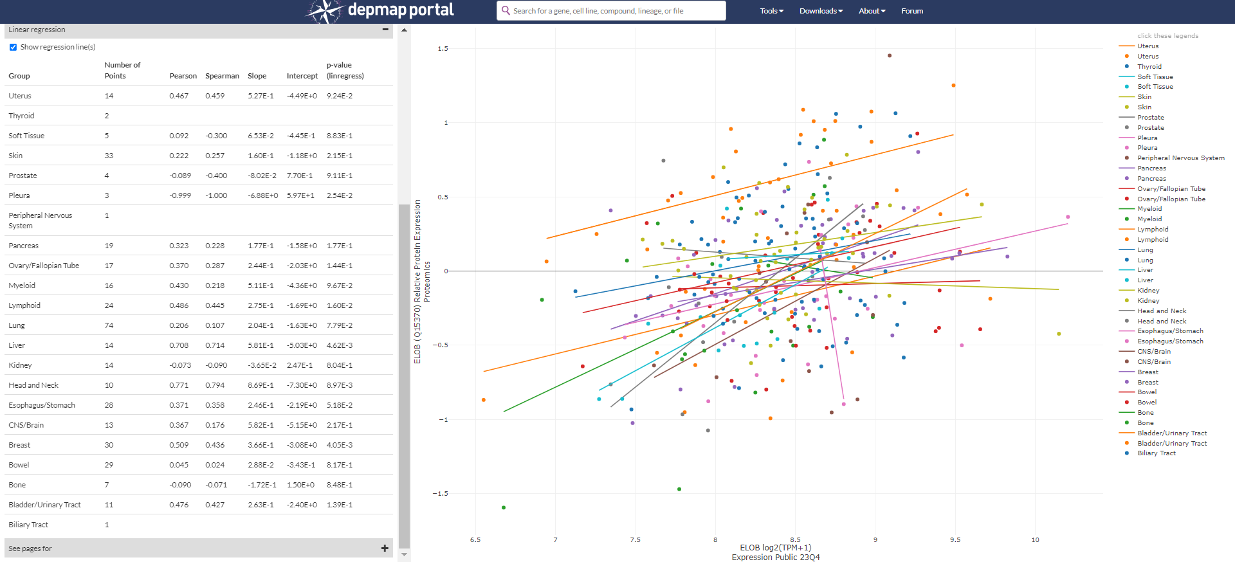
Depmap correlation of ELOB mRNA vs protein expression by lineage
Note: max 5 lineages possibly powered for lineage-specific analyses: lung n=74, skin n=33, breast n=30, bowel n=29, stomach n=28

Slide 8
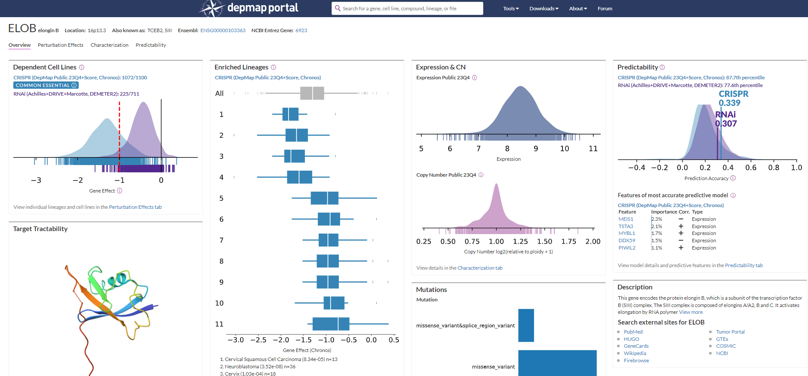
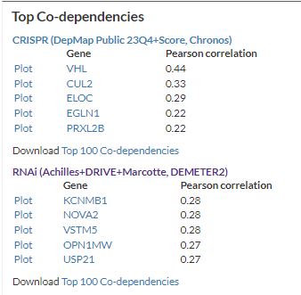
DepMap ELOB is essential in most cell lines, similar profile to VHL, EGLN1, CUL2 (ubiquitin system), ELOC (ElonginC)

Slide 9
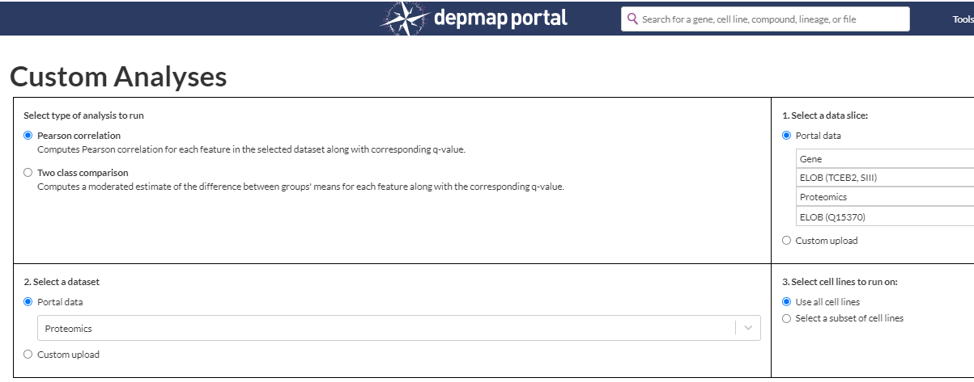
DepMap Data download and analysis methods
Use depmap portal “Custom Analyses” to download the correlation of each datatype with ELOB
Download results data table for all genes
Map gene symbols to OXPHOS_subunits using downloaded MitoCarta3.0 pathway data and symbols

Slide 10
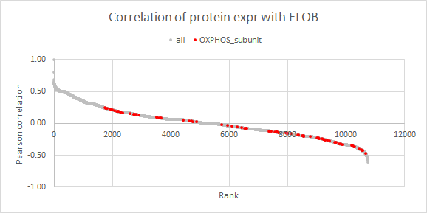
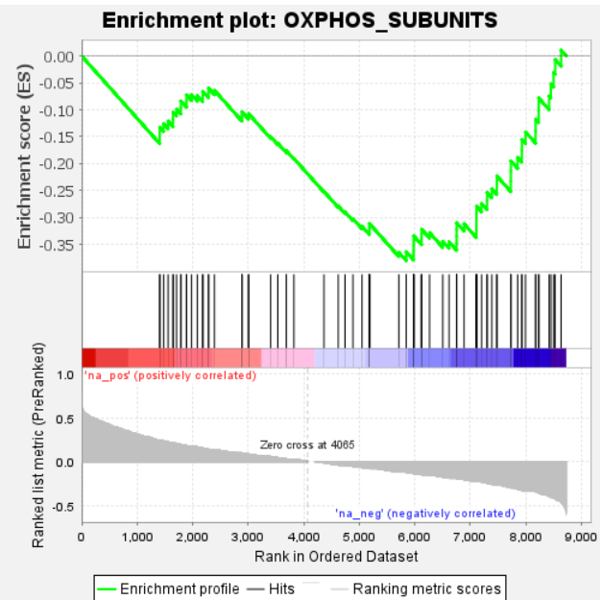
Protein expression across cell lines (proteins with data in >=200/375 cell lines)
OXPHOS subunits
Top co-expression

Slide 11
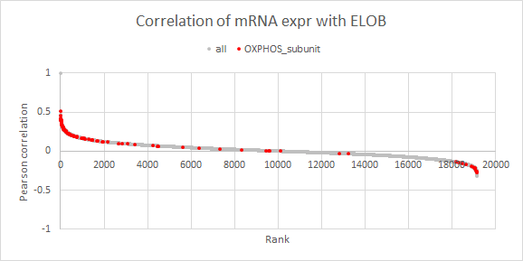
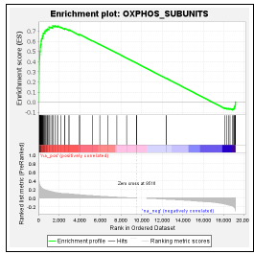
mRNA expression across cell lines (mRNA, all data has 1479 cell lines)
OXPHOS subunits
Top co-expression
mtDNA subunits

Slide 12
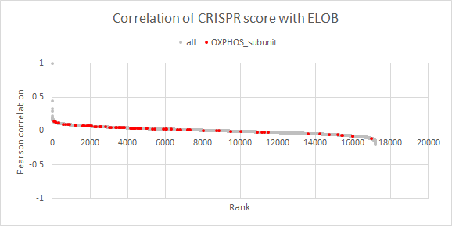
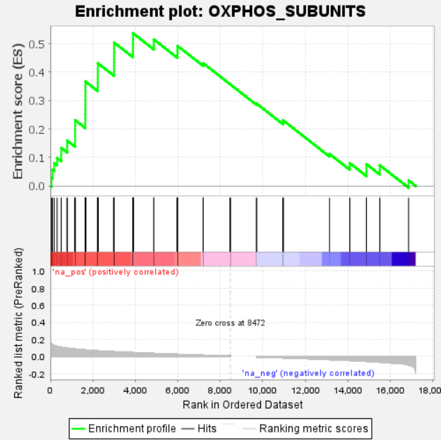
CRISPR score across cell lines (genes with data in >=1000 cell lines)
OXPHOS subunits
Top co-expression

Slide 13
GSEA KEGG analysis for ELOB.protein_cor (FWER pval<0.05) – OXPHOS not significant

Slide 14
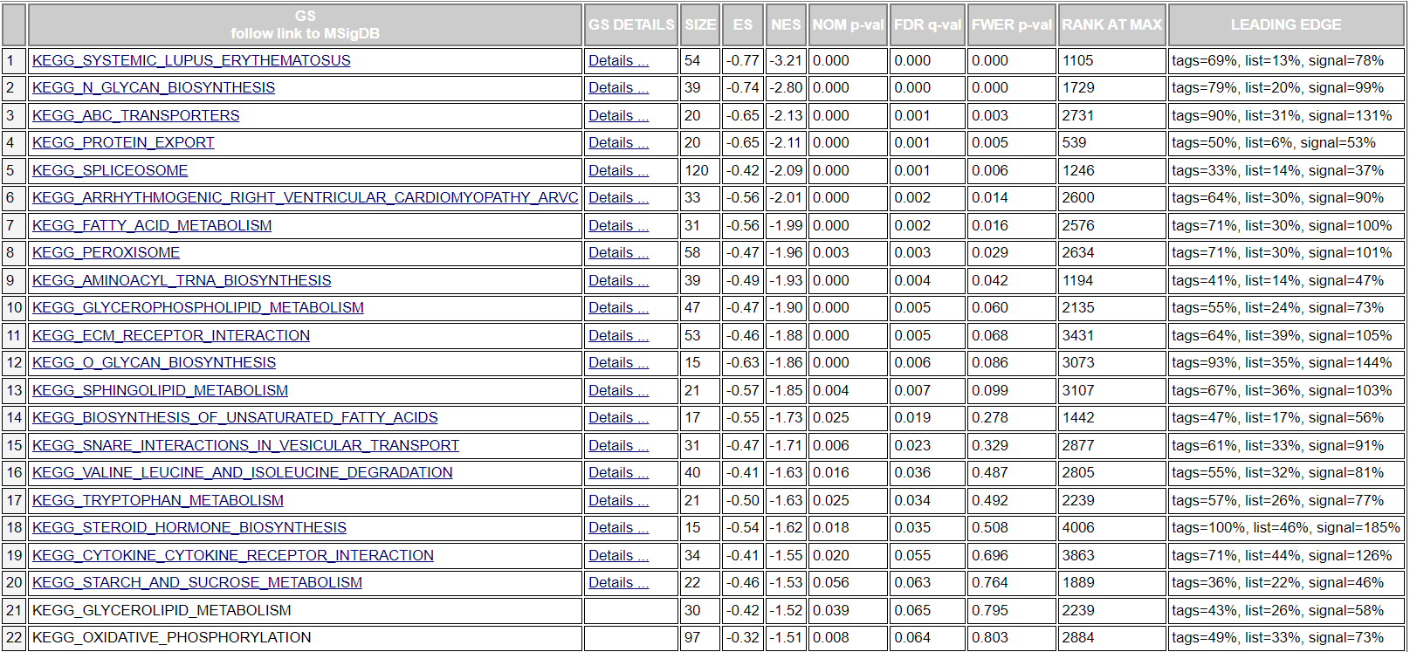
GSEA KEGG analysis for ELOB.protein_cor : OXPHOS FWER pval = 0.83

Slide 15
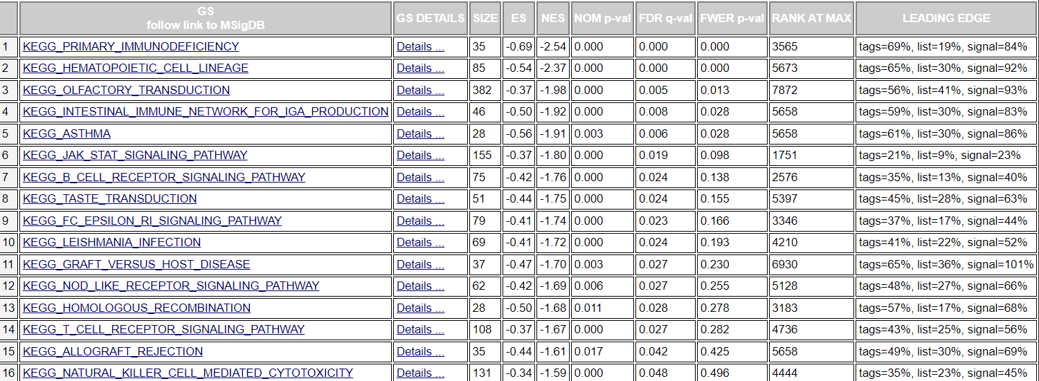
GSEA KEGG analysis for ELOB.mRNA_cor (FWER pval<0.05) – OXPHOS is top

Slide 16
GSEA KEGG analysis for ELOB.CRISPR_cor (FWER pval<0.05) – OXPHOS is top

