Slide 1
Who is donating electrons to FDX2 besides FDXR?
DepMap Analysis
identify cells lines are tolerant (cell set A) and are NOT tolerant of FDXR loss (cell set B)
identify MitoCarta genes that are particularly highly expressed in cell set A vs B
identify subset with FMN or other flavo domains

Slide 2
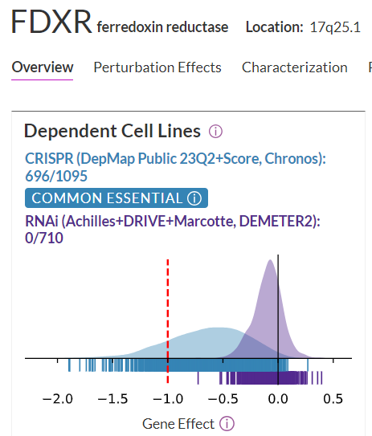
Identify cell lines tolerant (setA) & NOT tolerant (setB) of FDXR loss
Set B: not tolerant
176 cell lines Chronos < -1
Set A: tolerant
140 cell lines Chronos > -0.25

Slide 3
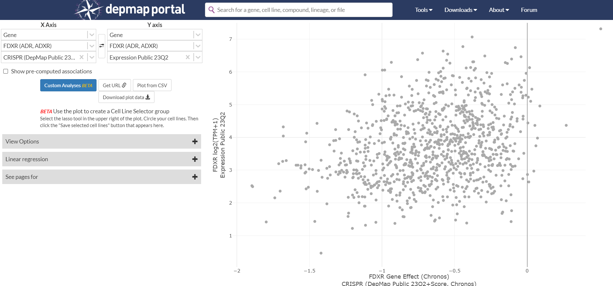
Strangely, cells with higher FDXR expression are MORE tolerant of its loss

Slide 4
MitoCarta genes w/ higher expression in FDXR loss tolerant vs dependent cells
Show top 30
based on pvalue

Slide 5
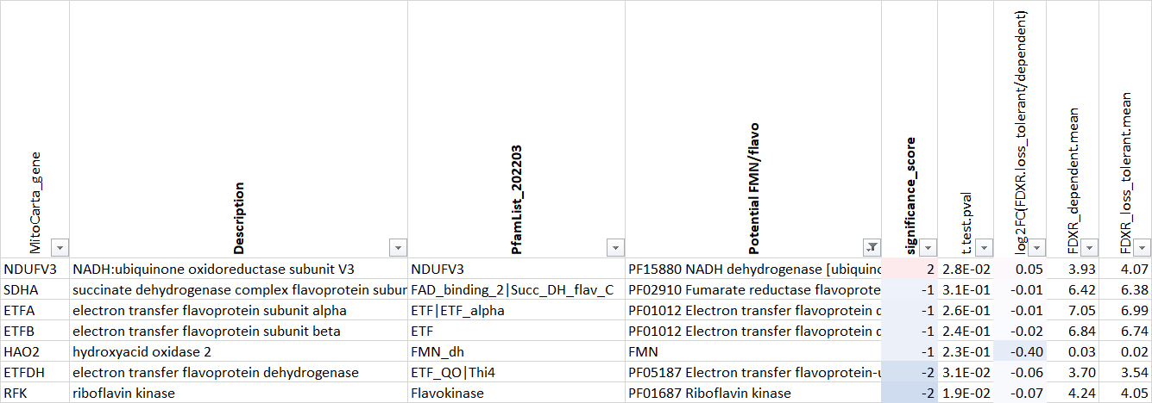
MitoCarta genes with FMN or flavo domains
Only NDUFV3 has higher mean expression in FDXR loss tolerant cells vs FDXR dependent cells

Slide 6
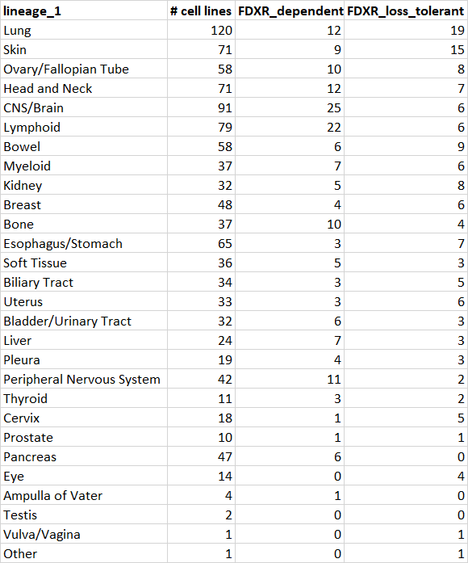
Lineage specific analyses
Perform lineage-specific analyses on
LUNG
SKIN
OVARY
For each lineage, calculate mean of
cell lines with Chronos < -1 (FDXR_dependent), vs
mean cell lines with Chronos > -0.25 (FDXR_loss_tolerate)

Slide 7
MitoCarta genes with FMN or flavo domains (include lineage specific scores)
Note none of the significance scores are > 2 (so pval < 0.01 and increased in loss_tolerant vs dependent cell lines)

