Slide 1
mtDNA deletion analysis: pilot study of blood WGS data
Research question: What nuclear regions control the accumulation of mtDNA deletions?
Background
mtDNA deletions, particularly the 4977bp “common deletion”, has been shown to accumulate with age and are present in many cancers and neurodegenerative disorders
Rare mtDNA deletion/depletion syndromes are known to be caused by errors in nuclear genes
Pilot Study 1: QTL analysis of mtDNA deletions in human blood from MI/A.fib studies
Identify mtDNA deletions in WGS data from > 3000 patients with MI/A.fib
Incidence? Correlate with age/other traits?
Enough variation for QTL analysis?
Research Study 2: QTL analysis of mtDNA deletions across human tissues from GTEx
Experimentally quantify mtDNA deletions via qPCR in many individuals/tissues
Incidence? Correlate with age/other traits?
QTL analysis per tissue

Slide 2
Outline
Background:
mtDNA common deletion
what rate of mtDNA deletions do we expect in different tissues?
what heteroplasmy of mtDNA deletions do we expect in different tissues?
Method to identify mtDNA deletions
Results on positive controls
Results on 3766 WGS data from Sek Kathiresan’s data from Myocardial Infaction (MI) and Atrial Fibrillation (Afib)

Slide 3
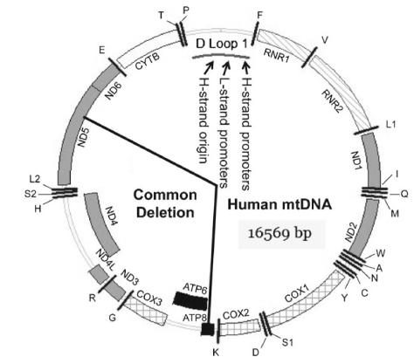
mtDNA deletions: general background
mtDNA deletions in general
oxidative damaged DNA prone to mispairing of repetitive elements and correlates with DNA deletions
mtDNA deletions are most likely to occur during repair of damaged mtDNA (Krishnan et al. 2008).
>100 mtDNA deletions associated with various diseases (http://www.mitomap.org/)
In Parkinson’s disease: large scale deletions in individual neurons from the substantial nigra of patients were detected, with various sizes ranging from 1,763bp to 9,445bp within the major arc (Reeve et al. 2008).
mtDNA “common deletion” m.8470_13446del4977
4,977-bp deletion m.del8470-13447
between two 13-bp direct repeats:
m.8470–8482 and m.13447–13459
underlies sporadic diseases including
Pearson’s disease(PD),
Kearns-Sayre syndrome (KSS) (one of ~150 dels)
mitochondrial myopathies (MM) and
progressive external ophthalmoplegia (PEO)
therefore called the “common” deletion
accumulates in many tissues during aging
has been used as an mtDNA damage biomarker (Meissner et al. 2008).
13bp insertion at deletion boundary
AACACAAACTACCACCTACCTCCCTCACCATTGGCAGCCTAGCATTA
Sequence may vary (Bogliolo 1999)
Li et al “Physiology and Pathophysiology of Mitochondrial DNA” 2012

Slide 4
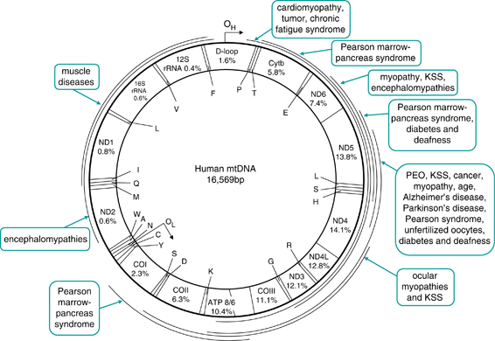
mtDNA deletion map
Chen et al, Journal Human Genetics 2011

Slide 5
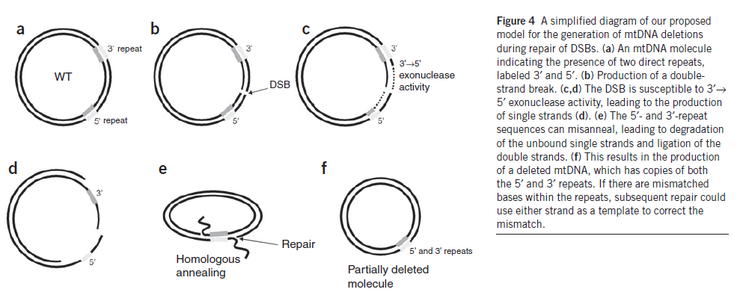
mtDNA deletion mechanisms
More likely to be caused by repair mechanisms rather than replication errors
Consistent with distribution of repeats where deletions are observed (more in major arc vs minor)
Consistent with experimental evidence (when you introduce double-stranded break, you get deletions)
Current models of replication not consistent with location of observed deletions
Catalytic mutations in POLG and PEO1 cause stalling, likely causing depletion in dividing cells and DSB then deletions in post-mitotic cells
Imbalance of nucleotide pools (eg ANT1 KOs) could cause DSB then deletions
in vitro studies: mt_dels occur after exposure to UV radiation, singlet O2, ionizing radiation (likely after mtDNA repair)
High mt_dels in substantia nigra in PD?
Hypothesis: increased oxidative stress through the metabolism of dopamine, which produces ROS; Could cause DSBs by direct DNA damage or replication stalling
Consistent with this: higher conc. MUTYH DNA repair enzyme in substantia nigra from PD vs control
High heteroplasmy by drift or selection?
Krishnan, Chinnery, Turnbull et al “What causes mtDNA deletions in human cells” Nature Genetics 2008

Slide 6
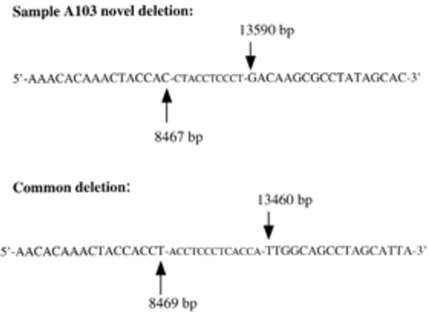
m.8470_13446del4977 novel sequence
Add 13bp (ACCTCCCTCACCA) at boundary – but this exact sequence & length may not be conserved
Bogliolo, Mutagenesis 1999

Slide 7
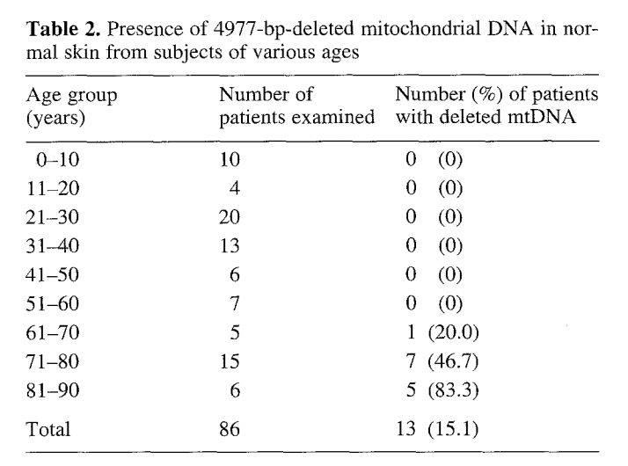
mtDNA deletion presence across tissues
What % of individual have any amount of mtDNA deletion (PCR)?
Skin 0-83% based on age (Arch Dermatol Res 1994)
Other tissues 3%-100% (Nie et al, PLoS One 2013)
Meta analysis of 33 studies (>1500 patients)
Overall, less mtDNA deletion in tumor vs adj normal
Arch Dermatol Res 1994

Slide 8
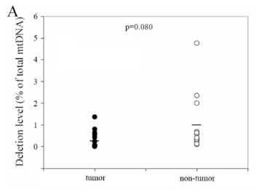
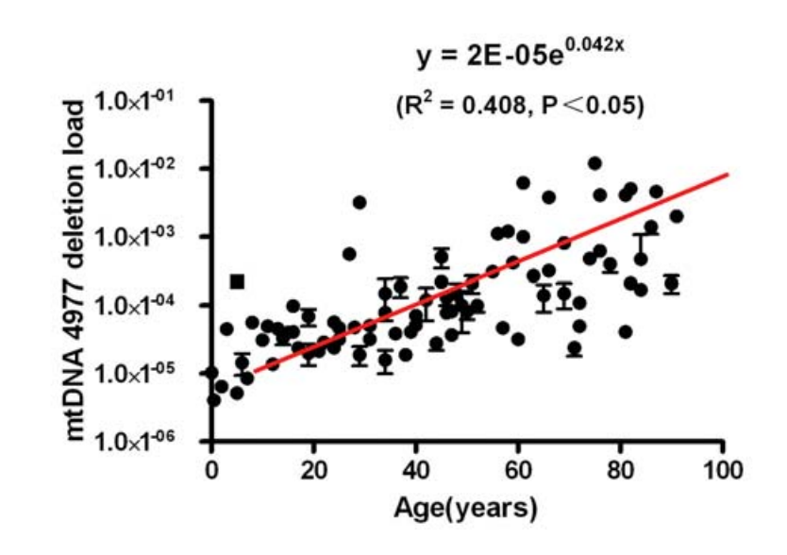
mtDNA deletion heteroplasmy levels across tissues
Chen BMC Med Genet 2011
Heart “middle-aged”: 0.001 (Cortopassi, Arnheim NAR 1990)
Colorectal ~65yr: ~0.01 (Chen BMC Med Genet 2011)
Hair ~20yr: 0.00001 (Zheng BJBMS 2012)
Hair ~80yr: 0.001 (Zheng BJBMS 2012)
Zheng BJBMS 2012

Slide 9
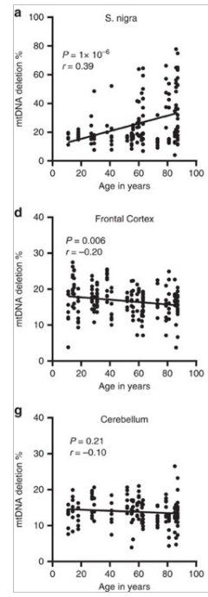
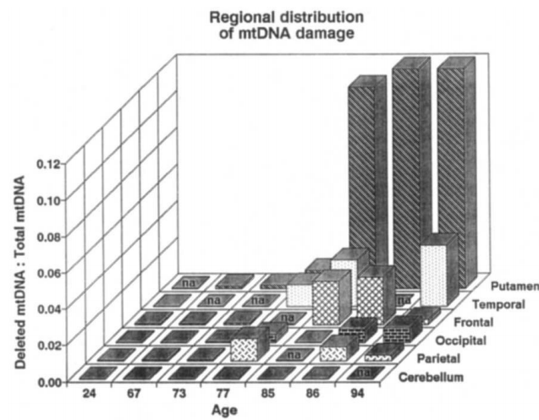
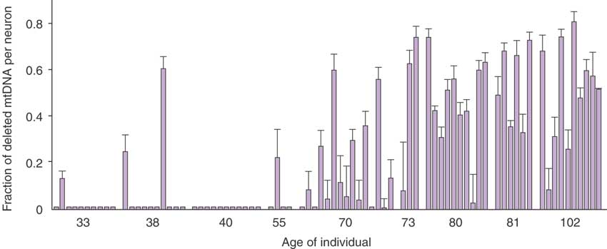
mtDNA deletion heteroplasmy: Brain
Chen BMC Med Genet 2011
Brain regions Corral-Debrinski Nat Genet 1992
Cortex 67-77yo: 0.0023-0.012
Cortex 80yo: 0.03
Putamen 67-77yo : 0.001-0.01
Putamen 80yo : 0.12
Measurement of individual neurons
S. nigra ~80: 5-70% (Kratysberg Nat Genet 2006)
Brain ~20yr: 15-20% (Dolle Nat Commun 2016)
S. nigra ~80: 10-80% (Dolle Nat Commun 2016)
Substantia nigra
Corral-Debrinski et al. Nat Genet 1992
Kratysberg Nat Genet 2006
Dolle Nat Commun 2016

Slide 10
Outline
Background:
mtDNA common deletion
what rate of mtDNA deletions do we expect in different tissues?
what heteroplasmy of mtDNA deletions do we expect in different tissues?
Method to identify mtDNA deletions
Results on positive controls
Results on 3766 WGS data from Sek Kathiresan’s data from Myocardial Infaction (MI) and Atrial Fibrillation (Afib)

Slide 11
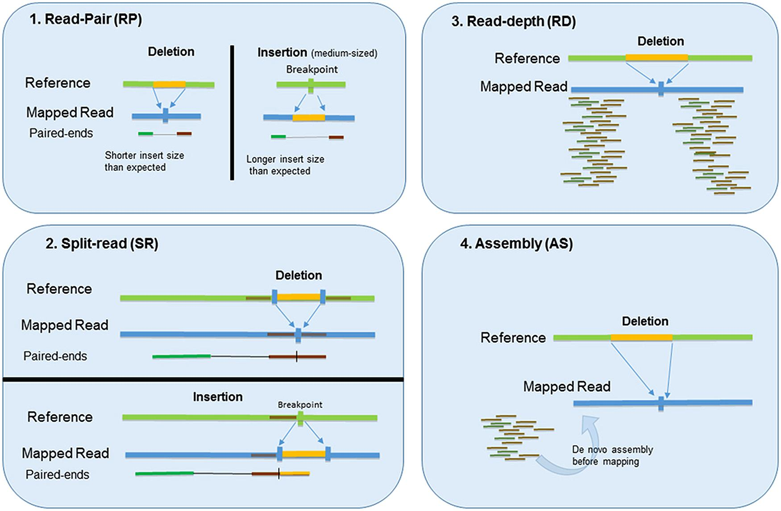
Detecting deletions: 4 possible methods
Pirooznia, Front. Genet., 13 April 2015

Slide 12
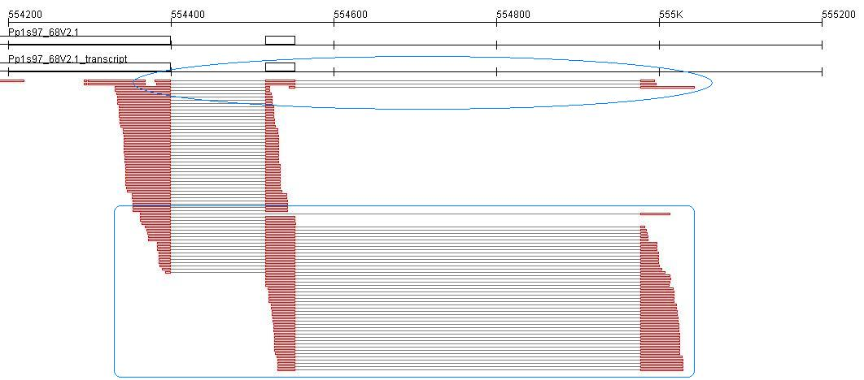
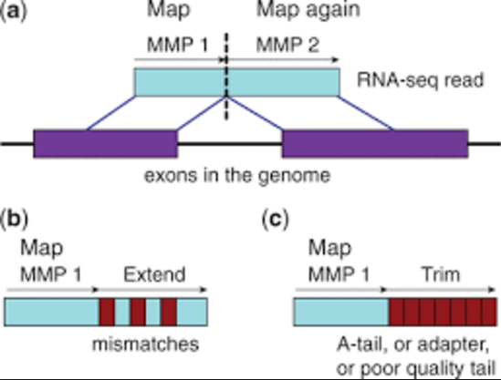
Detecting deletions by split-reads (STAR aligner)
STAR aligner: Dobin, Gingeras et al, Bioinformatics 2013
Used for mapping RNA-seq data to references genome (eg ENCODE project, Regev lab, etc)
Eran wrote a wrapper for this for the mtDNA
http://rackj.sourceforge.net/RNAseqExample/pphy2.EC6S.Pp1s97_68V2.1.jpg

Slide 13
Outline
Background:
mtDNA common deletion
what rate of mtDNA deletions do we expect in different tissues?
what heteroplasmy of mtDNA deletions do we expect in different tissues?
Method to identify mtDNA deletions
Results on positive controls
Results on 3766 WGS data from Sek Kathiresan’s data from Myocardial Infaction (MI) and Atrial Fibrillation (Afib)

Slide 14
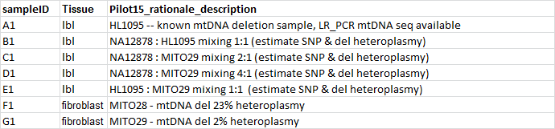
mtDNA deletion calling: positive controls
15 samples selected for WES (ICE=Illumina catpure exome)+mtDNA_bait spike-in:

Slide 15
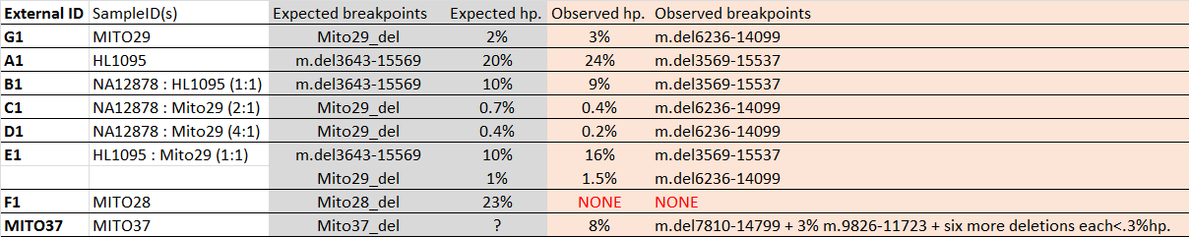
mtDNA deletion calling: positive controls
Method: look for “split-reads” across deletions.
Results in positive controls
100% deletion detection rate (8/8 samples, hp from 0.2%-24%)
No deletion in Mito28 (fibroblast), expected 23% hp;
In fact, MCRI recently did LR-PCR and sees no deletion, so probably lost during cell culture
Note breakpoint of HL1095 (m.del3569-15537 ) slightly offset from Baylor coordinates (m.del3643-15569)
Deletion coordinates from split-read analysis map to region with 10bp microhomology (unlike Baylor)
MITO37 deletion coordinates m.del7810-14799 match ~7000bp deletion expected from gel, but 8% hp “seems low” according to Alison, but hard to compare since smaller DNA molecule would be preferentially amplified
fibroblast
lbl

Slide 16
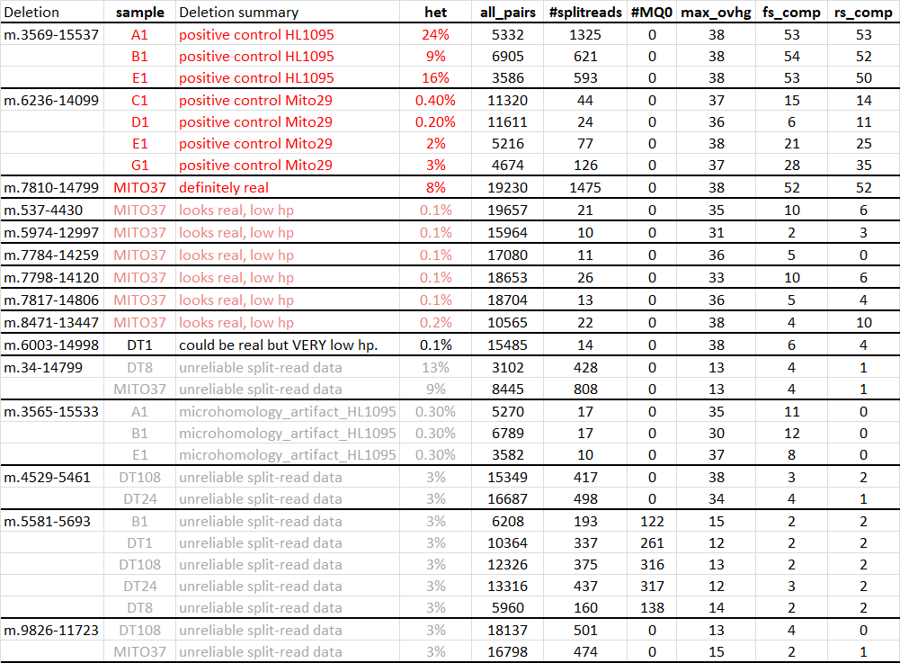
mtDNA deletion calling: all data
8 positive controls (expected deletions, shown red below)
21 potential deletions, of which 7 probably real but low heteroplasmy (pink) and 14 very likely artifact (gray):
6 in Mito37 (multiple deletion case?? Or artifact, since 3 are very close coords to real deletion)
DT1?

Slide 17
Outline
Background:
mtDNA common deletion
what rate of mtDNA deletions do we expect in different tissues?
what heteroplasmy of mtDNA deletions do we expect in different tissues?
Method to identify mtDNA deletions
Results on positive controls
Results on 3766 WGS data from Sek Kathiresan’s data from Myocardial Infaction (MI) and Atrial Fibrillation (Afib)

Slide 18
WGS cohort
Note – these are not necessarily older patients. I got Age data from Krumholz set: ~40-55 so clearly early-onset MI. I’m not sure about the others.

Slide 19
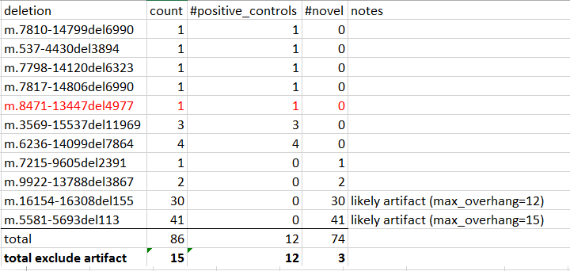
3 mtDNA deletions detected in WGS blood
11 distinct deletions detected (total 86 samples)
7 deletions in controls (including one common deletion)
3 deletions in MI/A.fib cases
2 deletions (71 samples) likely artifact (only in this dataset, maybe related to 151bp reads)

Slide 20
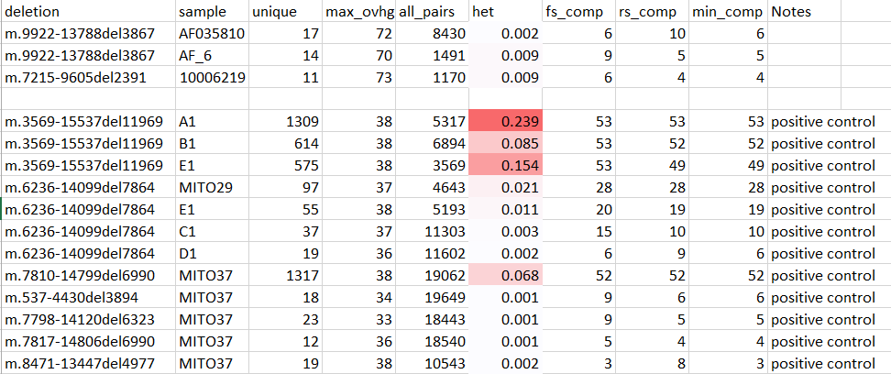
3 mtDNA deletions detected in WGS blood
Very low heteroplasmy (0.002 – 0.009)

Slide 21
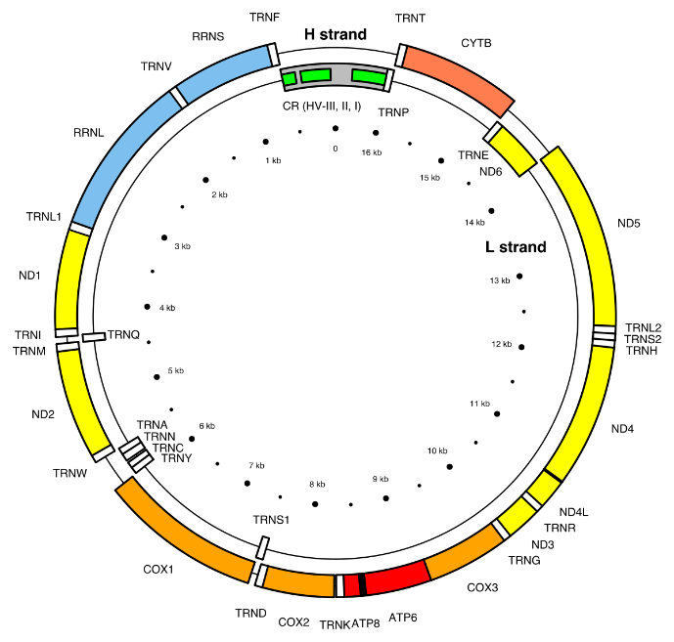
2 mtDNA deletions detected
m.9922-13788
m.7215-9605

Slide 22

3 mtDNA deletions detected in WGS blood: 2 artifacts
m.16154-16308del155
m.5581-5692del113
Removes tRNA-Ala
Removes half tRNA tRNA-Asn

Slide 23
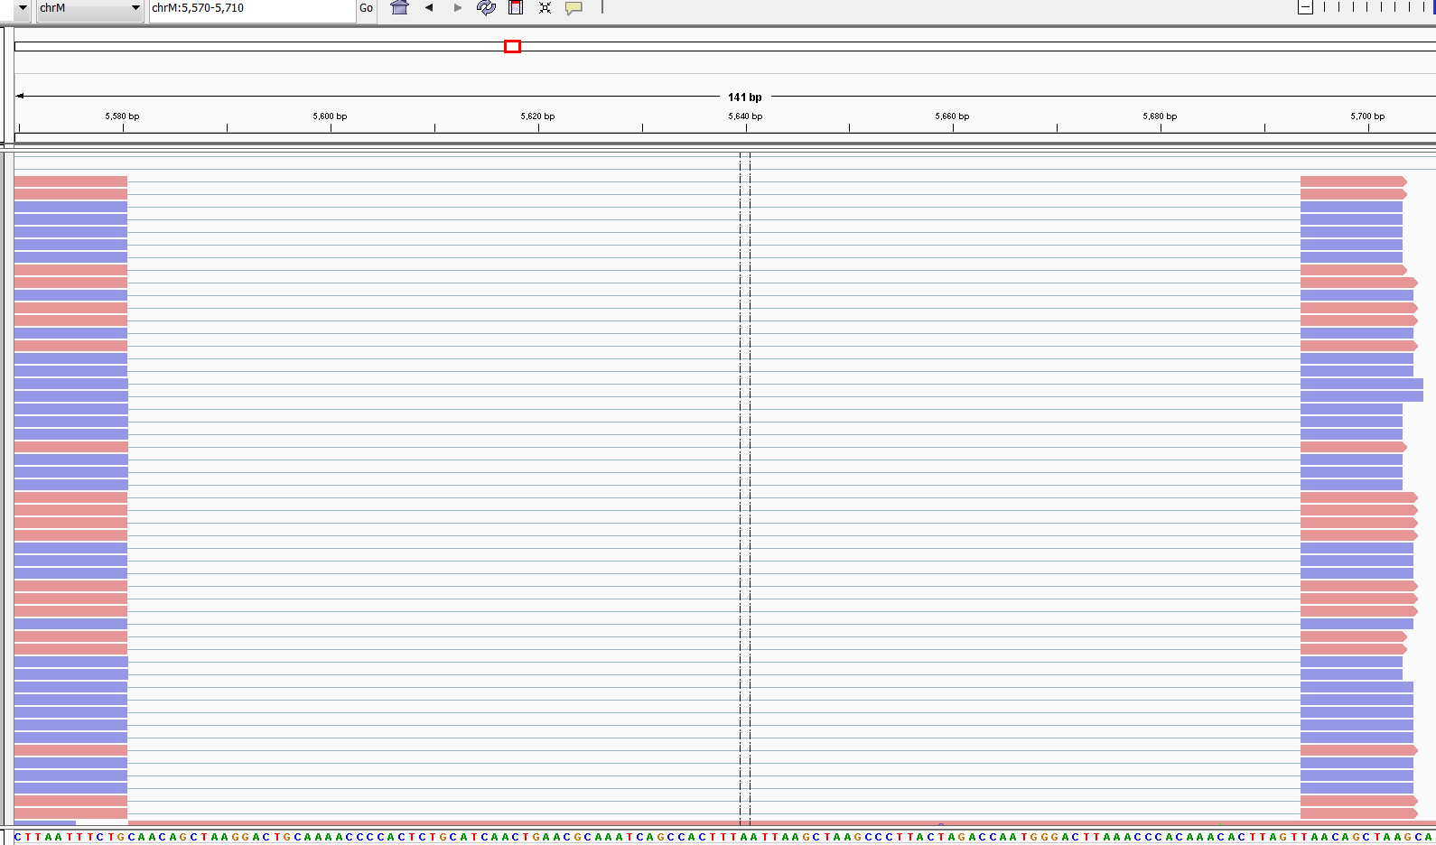
m.5581-5692del113
Likely due to SNP at splice border. Would need to re-align to reference that has the SNP and see what the aligner does. Could be real deletion

Slide 24
Artifacts are not interesting
Simply a mapping issue.
Person has a SNP versus reference genome.
Because of SNP, get perfect match if you break read and split it to a micro-homology region nearby
Get max overhang of 12bp because after that the reference genome diverges from read
Longer overlap would lead to more mismatches with break, so all reads are exactly 10-12bp overhang
Eg m.5581-5692del113
REFERENCE GENOME: …CAATACTTAATTTCTGCAACAGCTAAGGACTGCAAACCCC… … TAACAGCTAAGCACCC
READ1: …CAATACTTAATTTCTGTAACAGCTAAGGACTGCAAACCCC [1 MISMATCH]
READ2: …CAATACTTAATTTCTGTAACAGCTAAGGACTGCA [1 MISMATCH]
READ3: …CAATACTTAATTTCTGTAACAGCTA [1 MISMATCH]
READ4: …CAATACTTAATTTCTG----------------------------TAACAGCTAAG [0 MISMATCH WILL MAP]
READ4: …CAATACTTAATTTCTG----------------------------TAACAGCTAA [0 MISMATCH WILL MAP]
READ4: …CAATACTTAATTTCTG----------------------------TAACAGCTAAG [0 MISMATCH WILL MAP]
READ4: …CAATACTTAATTTCTG----------------------------TAACAGCTAAGGA [2 MISMATCH, WON’T MAP]

