Slide 1
Mitochondrial Genomics
Sarah Calvo, Ph.D.
Senior Computational Biologist
Laboratory of Vamsi Mootha
Broad Institute (Cambridge, MA)
Massachusetts General Hospital (Boston, MA)
BBS Genetics Course 04/21/2023

Slide 2
Even at rest, a human body requires
as much power as a 100-watt lightbulb
Peter Rich The cost of living. Nature 2003

Slide 3
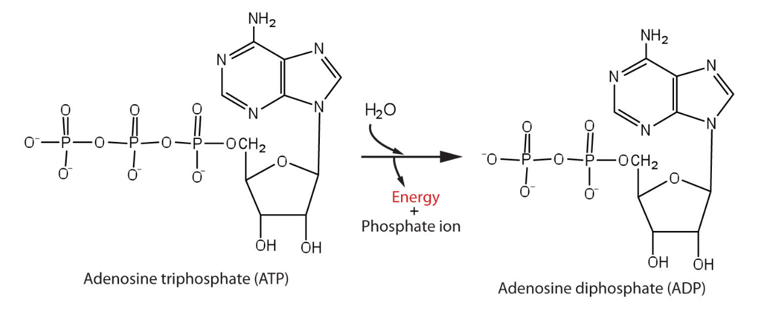
Mitochondrial oxidative phosphorylation (OXPHOS)
100 kilocalories/hr
20% brain (only 2% body mass)
Mitochondria generate 90% cellular ATP
65kg (140lbs) ATP/day
The basics of general organic ahd biologicalchemistry
Rich Nature 2003

Slide 4
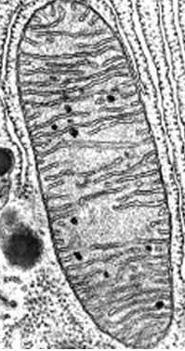
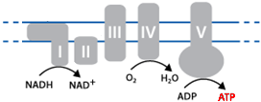
Mitochondrial oxidative phosphorylation (OXPHOS)
100 kilocalories/hr
20% brain (only 2% body mass)
Mitochondria generate 90% cellular ATP
65kg (140lbs) ATP/day
380 liters oxygen/day (90% used in OXPHOS)
H+
H+
H+
H+
OXPHOS
Rich Nature 2003

Slide 5
Mitochondrial oxidative phosphorylation (OXPHOS)
100 kilocalories/hr
20% brain (only 2% body mass)
Mitochondria generate 90% cellular ATP
65kg (140lbs) ATP/day
380 liters oxygen/day (90% used in OXPHOS)
mito inner membrane 14,000m²
H+
H+
H+
H+
OXPHOS
Rich Nature 2003

Slide 6
Mitochondrial genomics: outline
Background
Mitochondrial genome (mtDNA)
Human mtDNA variation
Human mtDNA variation in common disease
Oocyte transfer to prevent mt disease transmission
Somatic mtDNA alterations (tissues & cancer & aging)

Slide 7
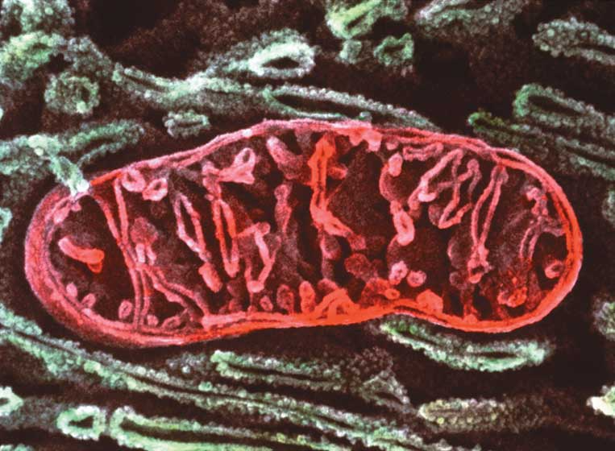
Mitochondria
μιτος or mitos, thread
κουδριον or khondrion, granule
Discovery
1840s by Richard Altmann (German pathologist/ histologist) – called BioBlasts
1898 named by Carl Benda (German physician)

Slide 8
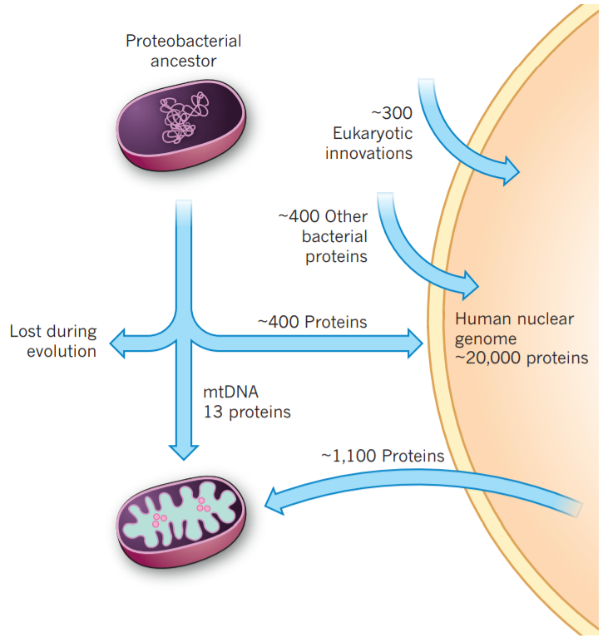
Evolutionary origin of mitochondria
Proteobacterial
ancestor
~2 billion years ago
mtDNA
13 proteins
~1,100 Proteins
Modern-day mitochondria
Adapted from Vafai & Mootha, Nature 2012

Slide 9
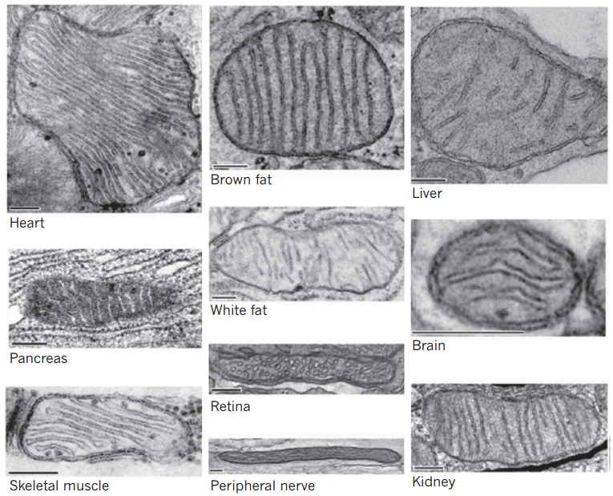
Diverse structures & functions across tissues
Vafai and Mootha, Nature 2012

Slide 10
Can form tight junctions (“synapses”)
Picard, Trends in Neurosciences 2015

Slide 11
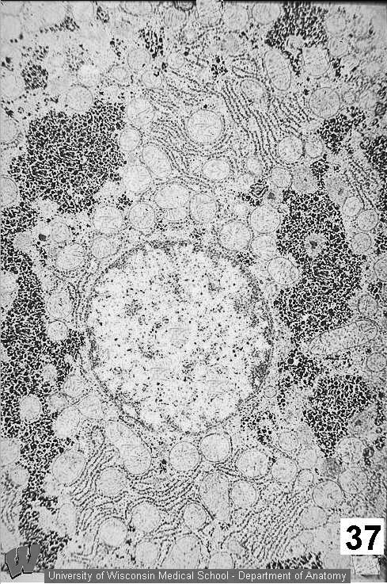
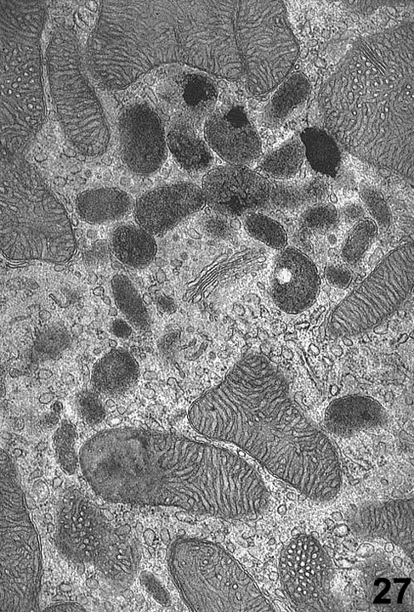
Highly interactive with other structures
University of Wisconsin Medical School – department of anatomy

Slide 12
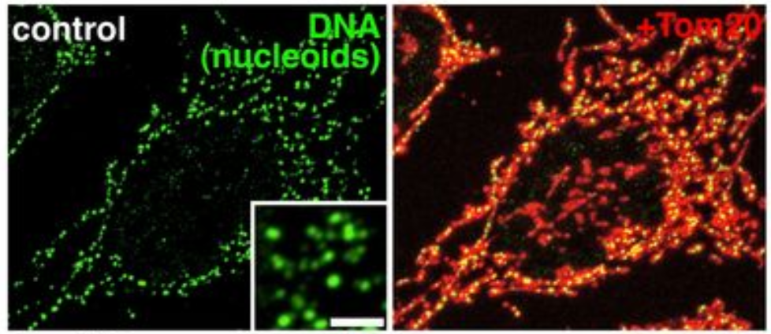
100s to 1000s of mtDNA per cell
green = mtDNA
red = mitochondria
Ban-Ishihara et al, PNAS 2013

Slide 13
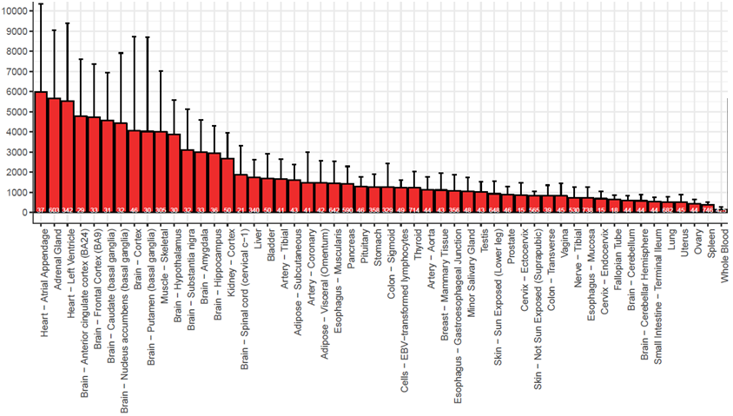
mtDNA copies/cell varies across human tissues
heart ~6000
brain ~5000
muscle ~4000
liver ~2000
blood ~200
mtDNA copies/cell (qPCR)
Human tissue (GTEx)
Rahul Gupta

Slide 14
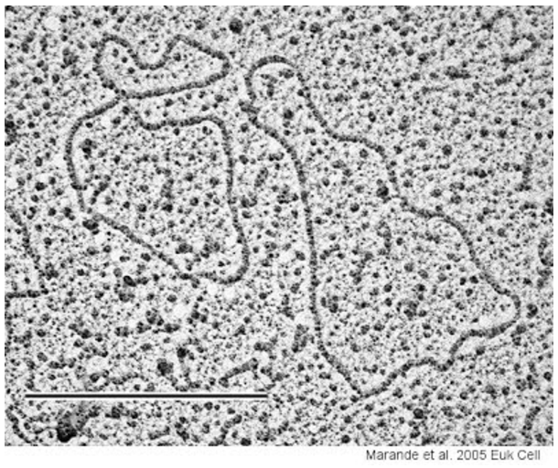
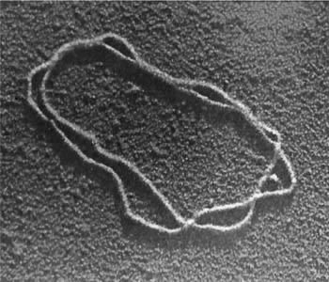
Mitochondrial genome (mtDNA)
Circular genome
Discovery 1960s
EM by Margit & Sylvan Nass
Biochemistry: Haslbrunner, Tuppy, Schatz
www.fidelitysystems.com/unlinked_dna_em_1.JPG

Slide 15
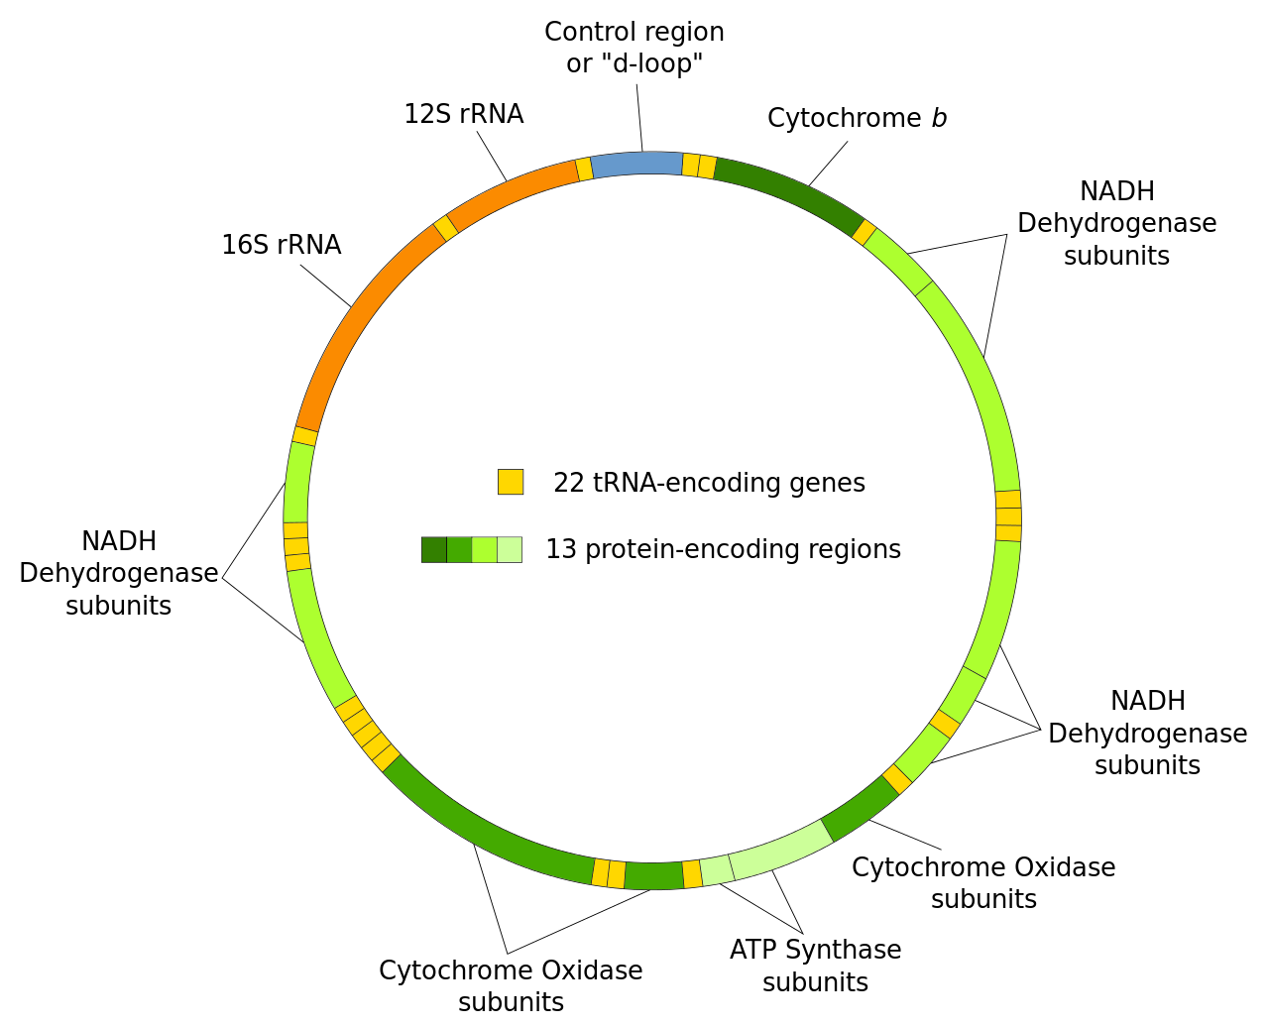
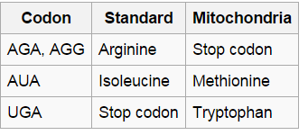
Human mitochondrial genome
Circular 16,569bp molecule
37 genes:
13 protein-coding
22 tRNA
2 rRNA
Slightly different genetic code
Mutation rate 10x higher than nDNA
en.wikipedia.org/wiki/Mitochondrial_DNA

Slide 16
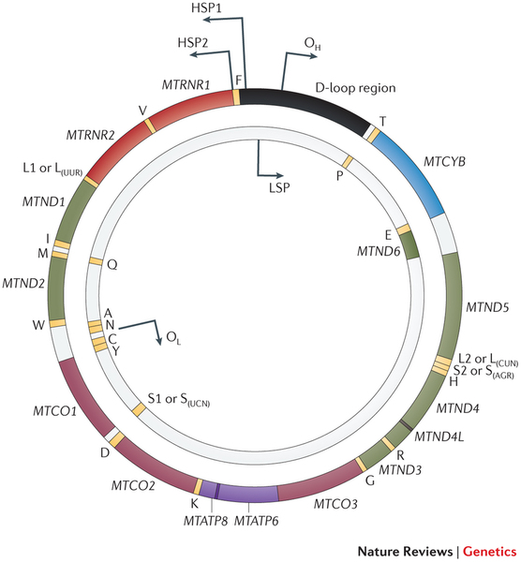
Human mitochondrial transcription
Polycistronic (like bacteria)
No introns
“Heavy” strand
More “G”s (fewer “C”s)
28 genes
“Light” strand
Fewer “Gs” (more “Cs”)
9 genes
Note rCRS sequence is the light strand, containing 12/13 “sense” transcripts
Overlapping genes (different frames)
ATP8 / ATP6
ND4 / ND4L
Stewart & Chinnery, Nature Reviews Genetics 2015

Slide 17
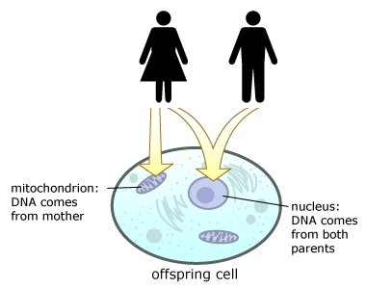
Maternal mtDNA transmission
Paternal mtDNA
diluted (50-100 sperm vs 100,000 egg)
specifically degraded
imprinted & ubiquitinated
if lysosome blocked →paternal transmission
nazaroo.blogspot.com
“Biparental Inheritance of mtDNA in Humans”
Luo et al, PNAS 2018
Shown to be technical artifact

Slide 18
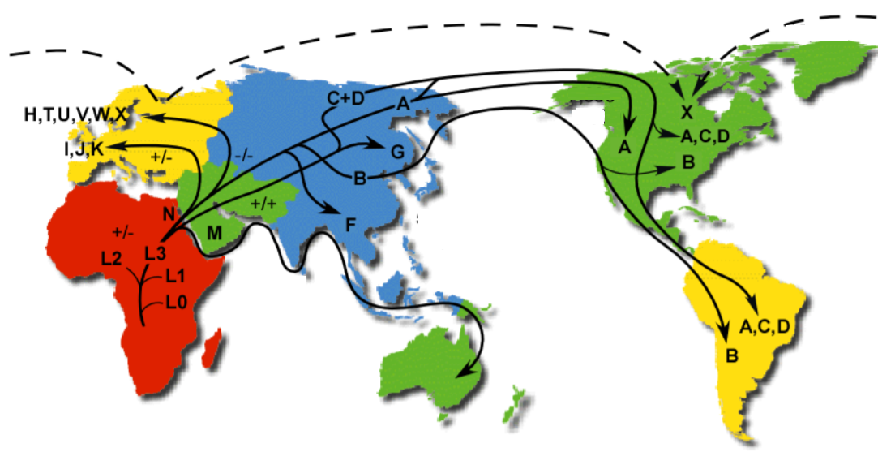
Mitochondrial DNA sequences form “haplogroups”, transmitted maternally
Different haplogroups have ~50 differences from ancestral reconstruction
~200bp hypervariable region sequencing has been used to track human migration (maternal lineage)
www.mitomap.org

Slide 19
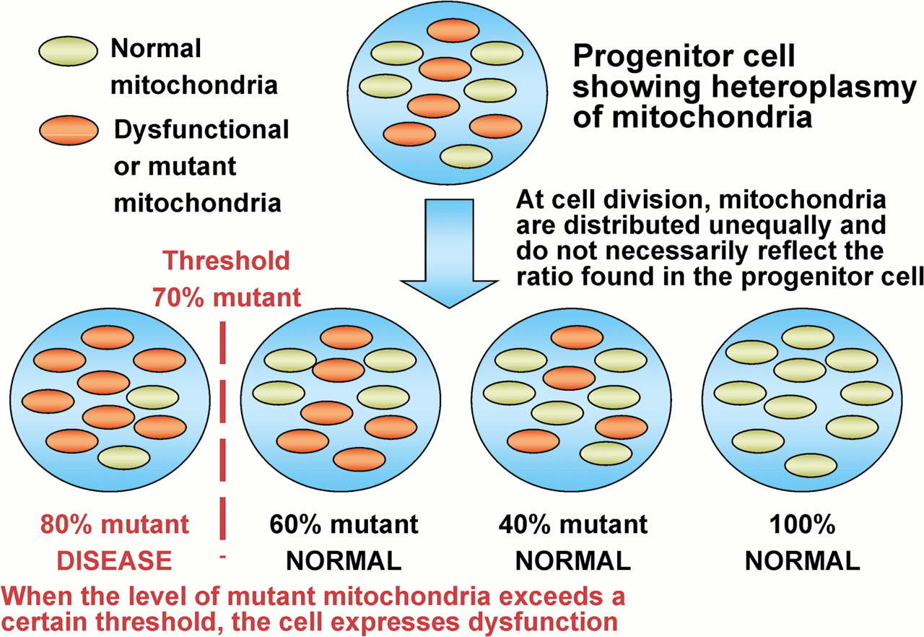
Heteroplasmy
sti.bmj.com/content/77/3/158/F3.large.jpg

Slide 20
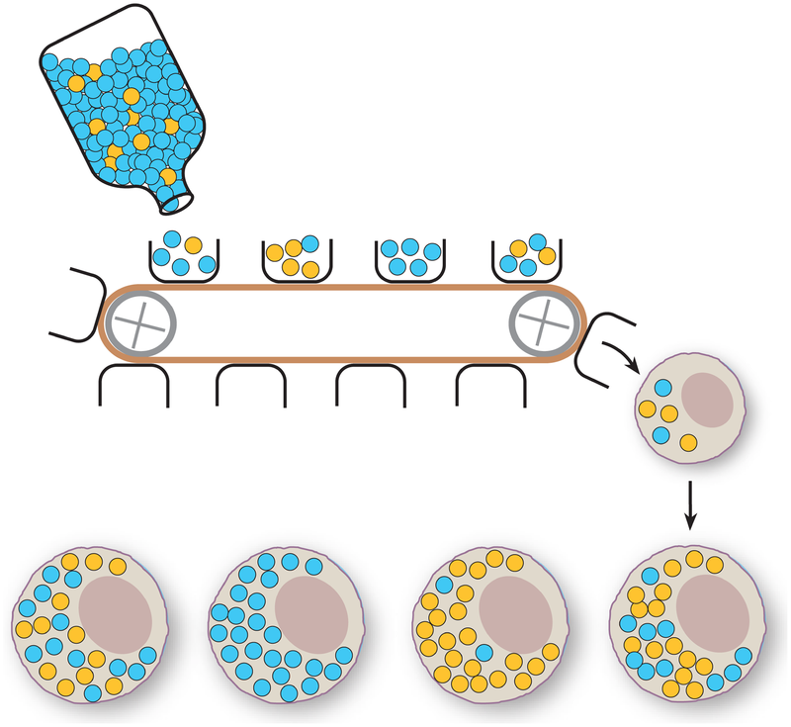
Heteroplasmy and maternal inheritance
Wikipedia Heteroplasmy

Slide 21
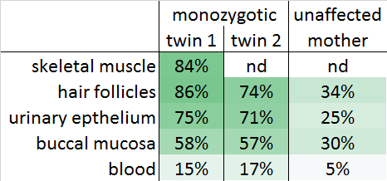
Heteroplasmy: different across tissues
m.14487T>C; ND6:p.M63V
_
_
Near-Identical Segregation of mtDNA Heteroplasmy …
in Twins With Optic Atrophy, Ptosis, and Intractable Epilepsy.
Spyropoulos et al, JAMA Neurology 2013
Detecting mtDNA mutations in blood may be problematic (preferred urine sediment/buccal)
High mtDNA coverage needed to detect low-heteroplasmy events

Slide 22
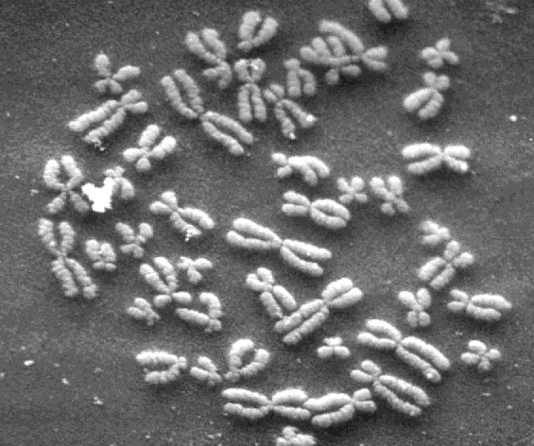
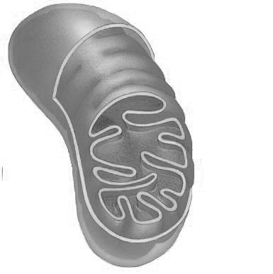
Mitochondrial proteins encoded by two genomes
mtDNA
13 proteins
Nuclear DNA
~1100 mito proteins
~80% adult-onset disease
~20% pediatric-onset disease
~20% adult-onset disease
~80% pediatric onset disease
Gorman et al. 2015, 2016

Slide 23
Mitochondrial genomics: outline
Background
Mitochondrial genome (mtDNA)
Human mtDNA variation
Human mtDNA variation in common disease
Oocyte transfer to prevent mt disease transmission
Somatic mtDNA alterations (tissues & cancer & aging)

Slide 24
Human mtDNA variation
Large databases necessary for:
Evolution studies
Selection/constraint
Interpreting patient clinical sequencing
Linking mtDNA variants to common diseases

Slide 25
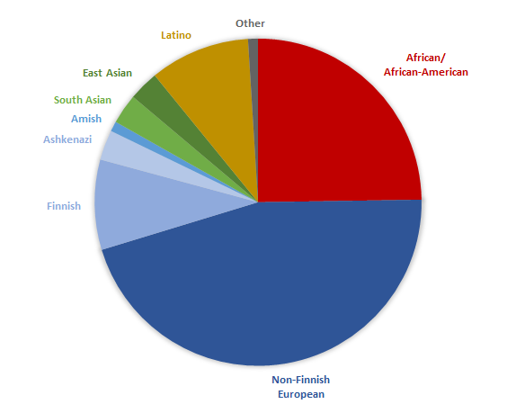
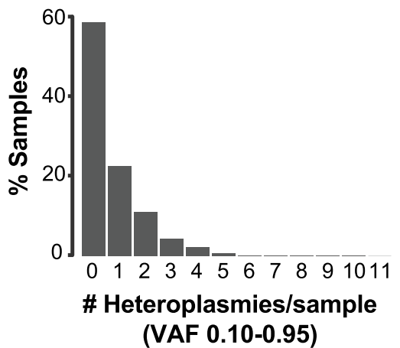
gnomAD now has mtDNA variants from 56K samples
Diverse cohort
98% variants homoplasmic
Most variants rare
~0-2 heteroplasmies
per person
25% African
60% European
Larrichia et al, Genome Research 2022

Slide 26
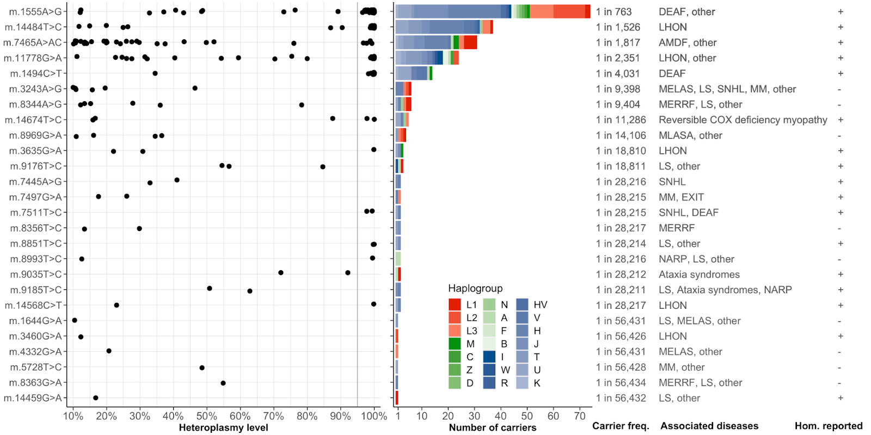
Population frequencies for known pathogenic variants
total carrier frequency is 1 in 282 (200 carriers in 56434 individuals)
Larrichia et al, Genome Research 2022

Slide 27
mtDNA sequences continually migrate to nucleus
2N
Nuclear sequences of mitochondrial origin (NUMTs)
can be in references genome, or
polymorphic across humans (not in reference genome)

Slide 28
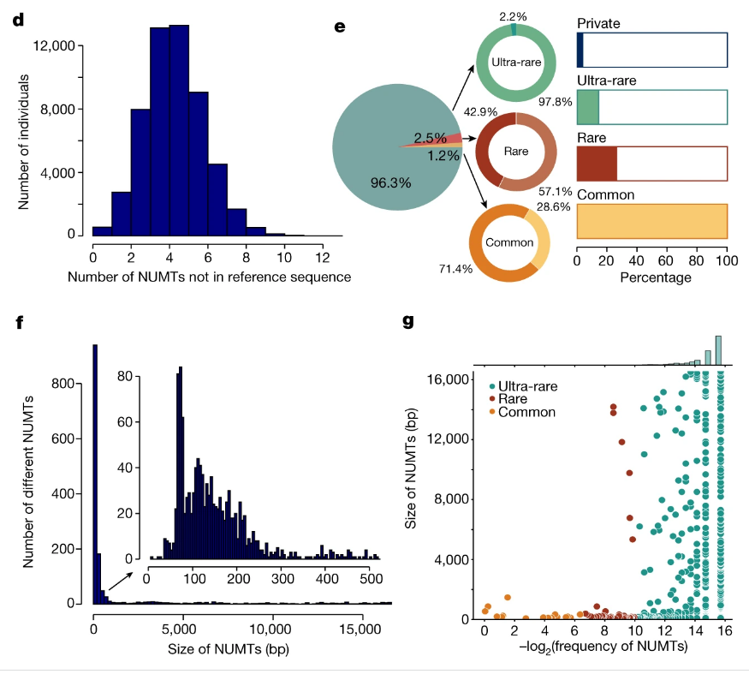
NUMT detection in 53,574 individuals
~4 polymorphic NUMTs/person
Most are ultra-rare
Most are short (50-200bp),
but some are entire 16Kb
Long NUMTs are very rare
Wei et al, Nature 2022

Slide 29
Mitochondrial genomics: outline
Background
Mitochondrial genome (mtDNA)
Human mtDNA variation
Human mtDNA variation in common disease
Oocyte transfer to prevent mt disease transmission
Somatic mtDNA alterations (tissues & cancer & aging)

Slide 30
mtDNA dysfunction is associated with many diseases
Mitochondrial function associated with aging and nearly all age-related diseases
# mtDNA copies decrease
# mtDNA mutations increase
ROS increases (and ROS-scavengers decrease)
functional ETC measurements decrease
?
Mito dysfunction
Age-related
diseases

Slide 31
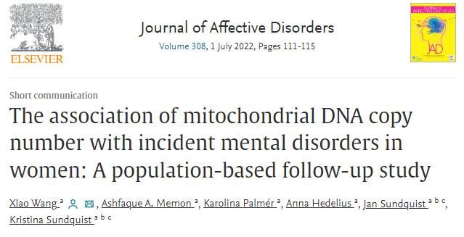
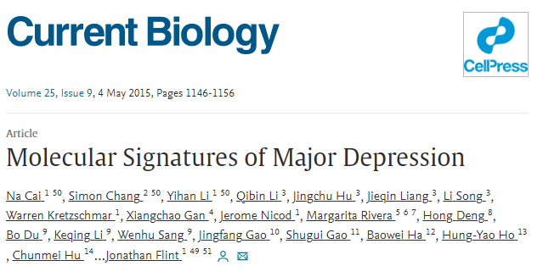
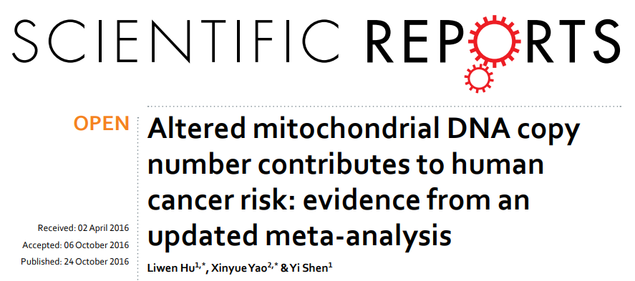
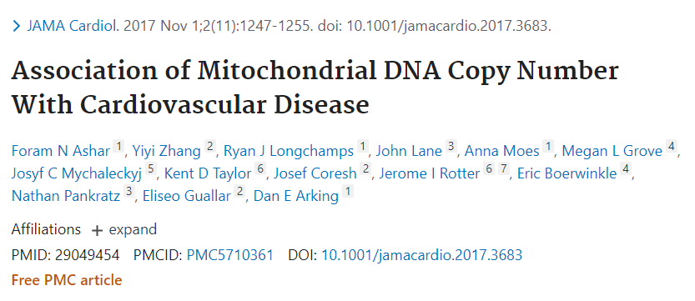
mtDNA dysfunction is associated with many diseases
Mitochondrial function associated with aging and nearly all age-related diseases
# mtDNA copies decrease
# mtDNA mutations increase
ROS increases (and ROS-scavengers decrease)
functional ETC measurements decrease
?
# mtDNA copies decrease
Age-related
diseases

Slide 32
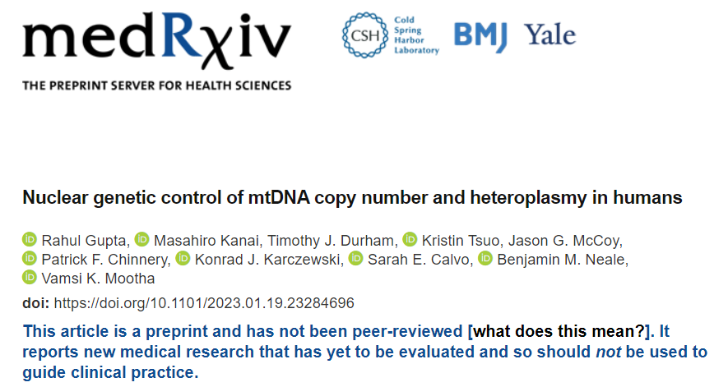
mtDNA variation in UK Biobank whole genomes can assess links to common disease

Slide 33
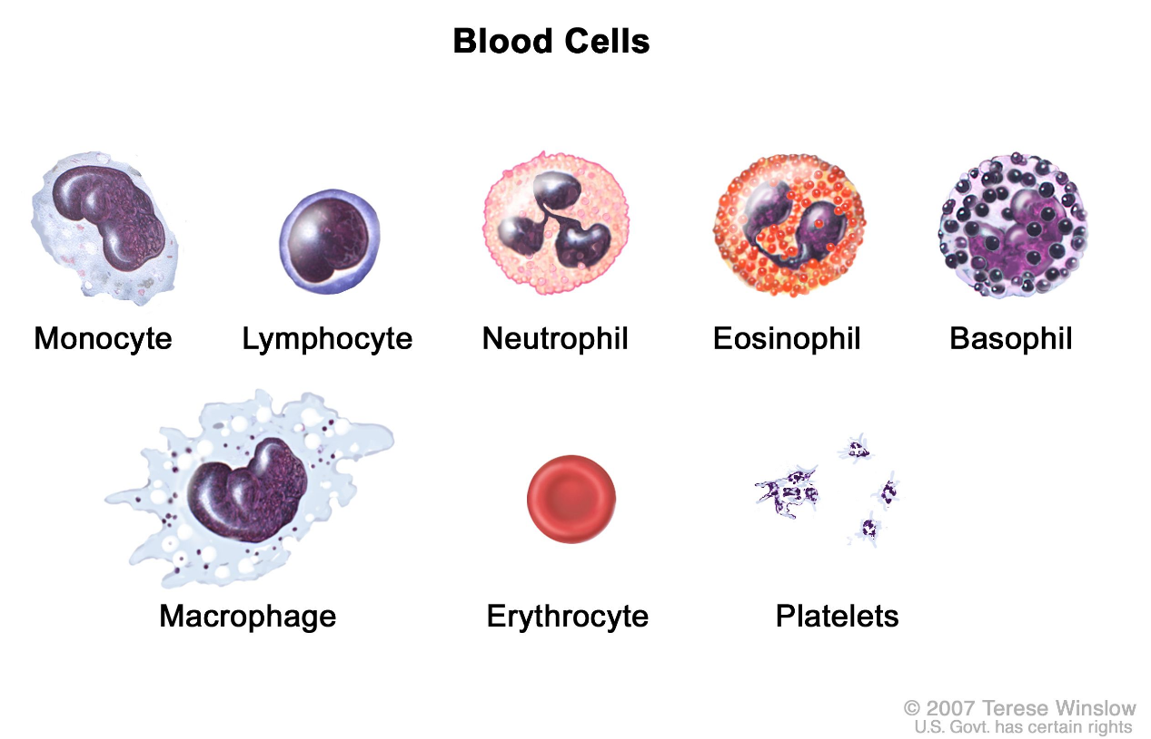
Need to correct for blood cell composition in assessing mtDNA copy number
Gupta et al, MedRxiv 2023

Slide 34
After correcting for blood cell composition, mtDNA copy number not linked to most common diseases
Gupta et al, MedRxiv 2023

Slide 35
Can use UK Biobank to discover intermediate phenotypes eg carriers of MELAS chrM.3243A>G show altered metabolites
Gupta et al, MedRxiv 2023

Slide 36
Mitochondrial genomics: outline
Background
Mitochondrial genome (mtDNA)
mtDNA sequence analysis challenges
Human mtDNA variation in common disease
Oocyte transfer to prevent mtDNA disease transmission
Somatic mtDNA alterations (tissues & cancer & aging)

Slide 37
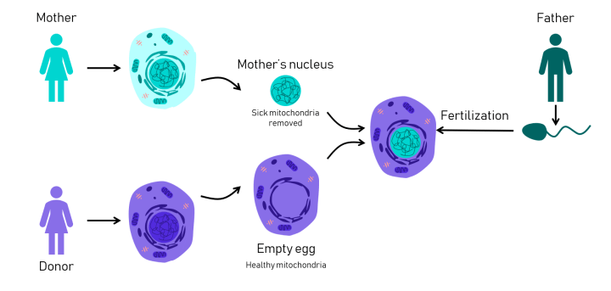
Oocyte transfer to prevent transmission of mtDNA disease

Slide 38
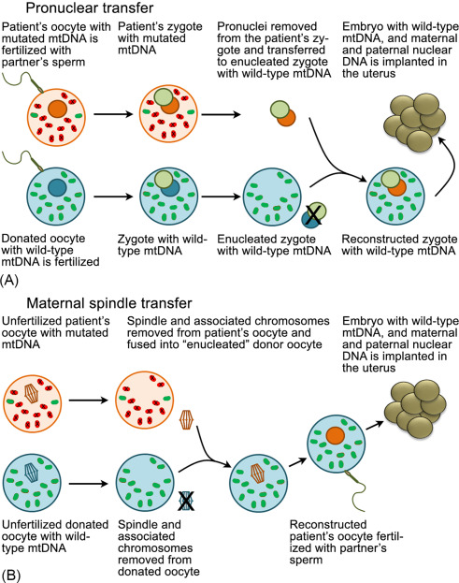
Methods of mitochondrial replacement therapy
ICSI: intracytoplasmic sperm injection
Pronuclear transfer:
ICSI into both oocytes (mother & donor)
Then remove pronuclei from both
Transfer pronucleus from mom into donor
Technically easier, but destroys a “zygote”
Maternal spindle transfer:
Remove spindle/chromosomes from both oocytes (mother & donor)
Transfer spindle from mother to donor
Then ICSI
Technically more difficult as spindle + chrs
Harder to isolate, and
More fragile
Taanman & Kroon, Mitochondria in Obesity and Type 2 Diabetes, 2019

Slide 39
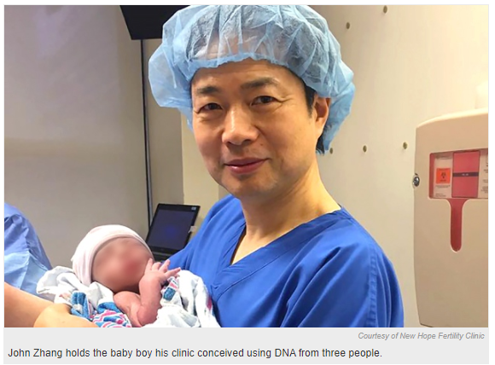
Ethics of “three-parent baby” to treat mitochondrial disease
Mother carries Leigh syndrome mtDNA variant
lost previous children to disease
Nuclear transfer
egg from healthy donor
nucleus from mother
sperm from father
Baby born April 2016 in Mexico
2-9% mitochondria from mother (not donor)
Ethical concerns:
Scientific: potential mito-nuclear genome incompatibility (has been shown in mice)
Child cannot provide consent
Parents/child unable to withdraw from study
Zhang, Reproductive Biomedicine Online 2017

Slide 40
Legality of “three-parent baby” to treat mtDNA disease
UK 2015: approved for carriers of mitochondrial disease
Australia 2022: approved for carriers of mitochondrial disease
US 2016
Budget rider forbids FDA from considering clinical trial applications “in which a human embryo is intentionally created or modified to include a heritable genetic modification.”
National Academies of Science, Engineering and Medicine report: ethically permissible to use mitochondrial replacement therapy in women at high risk of transmitting a severe mitochondrial genetic disease
Mitalipov (OHSU) proposes US clinical trial for mito replacement therapy : “We don’t think this is modification. It’s not something that’s synthetic. It’s just taking a donor genome from somebody and replacing it with one that already exists. It’s natural”
US current:
FDA states technique not legal as it involves a heritable genetic modification (could decide to allow male embryos only, so changes would not be heritable)
Zhang, Reproductive Biomedicine Online 2017

Slide 41
Mitochondrial replacement therapy to treat infertility
Practice banned in US
April 2019 in Europe
Mother with multiple IVF failures, poor egg quality
Spindle nuclear transfer
egg from healthy donor
nucleus from mother
sperm from father
Practice now banned in EU

Slide 42
Mitochondrial genomics: outline
Background
Mitochondrial genome (mtDNA)
mtDNA sequence analysis challenges
Human mtDNA variation in common disease
Oocyte transfer to prevent mtDNA disease transmission
Somatic mtDNA alterations (tissues & cancer & aging)

Slide 43
Somatic mtDNA mutations
March 2019

Slide 44
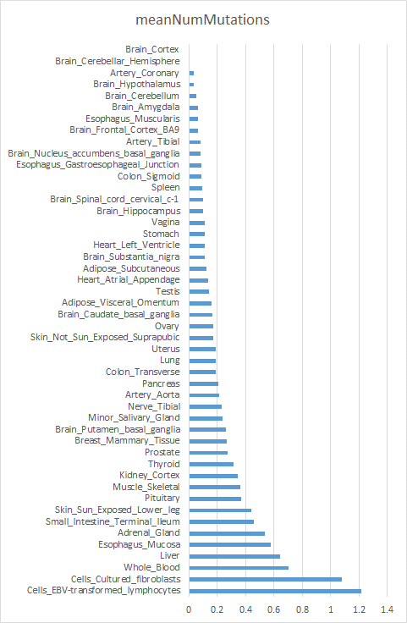
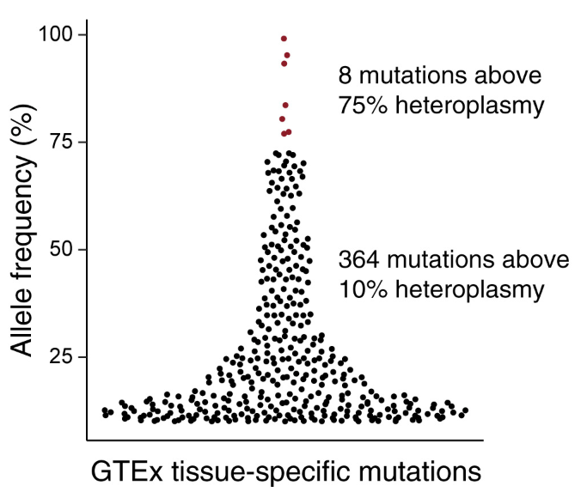
Somatic mtDNA mutations in human tissues
Typically 0-1 somatic mutation per tissue;
Highest in blood; lowest in brain/heart
Most are low-heteroplasmy
Mean # GTEX tissue-specific mutations
unpublished
Ludwig et al, Cell 2019

Slide 45
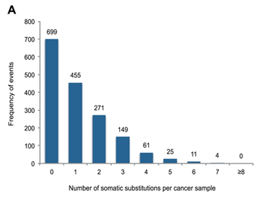
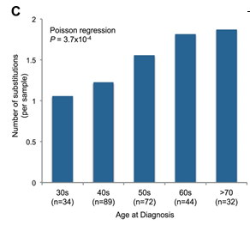
Somatic mtDNA mutations in cancer
Typically 0-1 somatic mutation per tumor
Increase with aging
Likely passengers (selection against deleterious)
Ju, Campbell et al, eLIFE 2014
Typically 0-1 somatic mutation per tumor
Mutations increase with age

Slide 46
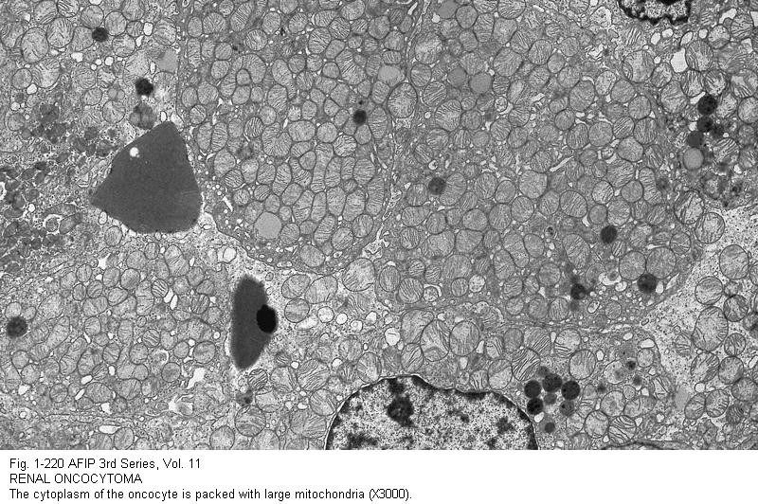
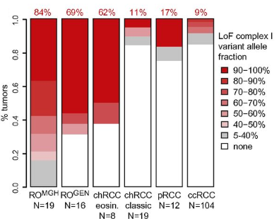
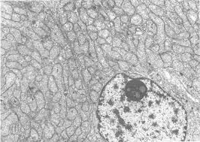
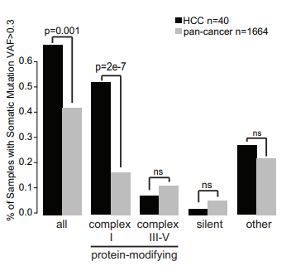
Somatic mtDNA mutations in cancer: Evidence causal in 3 rare cancers
Adrenocortical carcinoma
Renal oncocytoma: 70-85% have mtDNA loss-of-function mutations in complex I genes
Thyroid Hurthle Cell Carcinoma: 50% have mtDNA mutations in complex I genes
Gopal et al, PNAS 2018
Gopal et al, Cancer Cell 2018

Slide 47
mtDNA somatic mutations in aging and age-related disease
?
Somatic mtDNA mutations
Age-related
diseases

Slide 48
mtDNA somatic mutations in aging and age-related disease
Somatic mtDNA mutations
?
Age-related
diseases
Somatic mtDNA mutations
?
eg fibrosis
Blood cell composition changes
Age-related
diseases
Something
eg inflammation
Somatic mtDNA mutations
Age-related
diseases

Slide 49
Mitochondrial dysfunction in aging and age-related disease
How to distinguish association from causality?
Genetics
Rare monogenic disease: do these affect mitochondrial genes/function?
Common disease: are GWAS hits enriched in mitochondrial genes? Does association still stand after correcting for correlates (eg blood cell composition)
Pharmocology
Do drugs known to help disease directly target mitochondrial function?
Experiments in model systems
Do perturbations to mitochondria (eg mtDNA mutations, mito gene KO) cause similar phenotype in model organisms?
So far,
Parkinson’s Disease has strong support of mitochondria playing a causal role (based on familial PD genes, pharmocology)
Diabetes and cancer: evidence does not look causal (with a few exceptions)
Others (e.g. Alzheimer’s Disease, Aging): Jury is still out

Slide 50
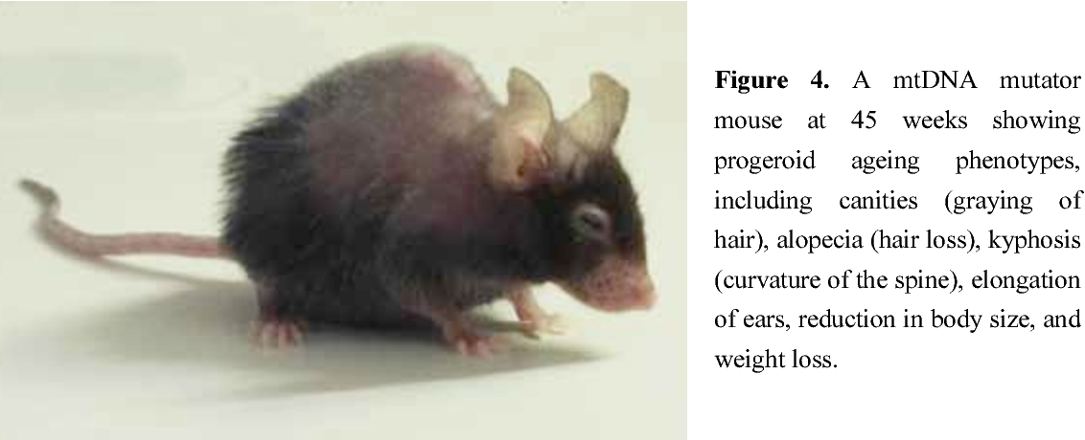
mtDNA somatic mutations and aging
Experiment in model systems: mtDNA mutator mouse
Ross, Thesis 2012

Slide 51
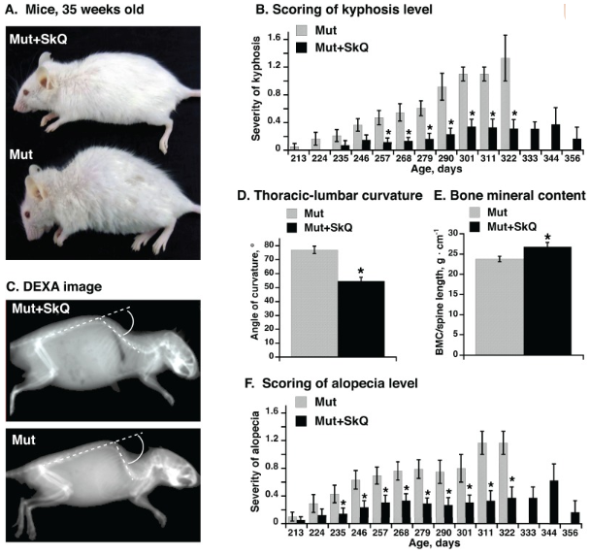
mtDNA somatic mutations and aging
Shabalina, Aging 2017

Slide 52
mtDNA somatic mutations in aging and age-related disease
Somatic mtDNA mutations
Age-related
diseases
Can be causal
Unclear if typical aging caused by mtDNA mutations

Slide 53
Mitochondrial genomics
Background
Mitochondrial genome (mtDNA)
mtDNA sequence analysis challenges
Human mtDNA variation in common disease
Oocyte transfer to prevent mtDNA disease transmission
Somatic mtDNA alterations (tissues & cancer & aging)

