Slide 1
EX1: Region JAJGAP010000001:344,430-353,835 IsoQuant misses reverse-strand gene that StringTie calls correctly
IGV “squished” view
Gene on reverse strand (blue) missed by IsoQuant while positive strand (pink) gene correctly called
IGV “expanded” view
Red indicates AAAAA tail mismatch

Slide 2
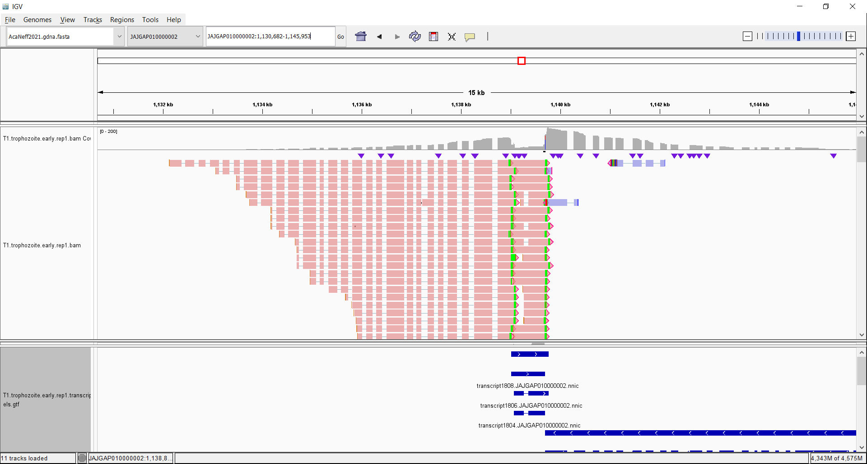
EX2: Region JAJGAP010000002:1130682-1145953 IsoQuant misses gene that StringTie calls correctly
Transcripts called by IsoQuant

Slide 3
Files for you
T1.r1.missed_gene.bam: contains all reads from 2 regions shown, each with 1 missed genes
AcaNeff2021.gdna.fasta: reference genome
AcaNeff2021.gdna.fasta.fai : reference genome index
Command run
isoquant.py \
--reference AcaNeff2021. gdna.fa \
--bam T1.r1.missed_gene.bam \
--threads 32 \
--data_type "pacbio_ccs" \
--labels "all" \
-o isoquant

