Slide 1
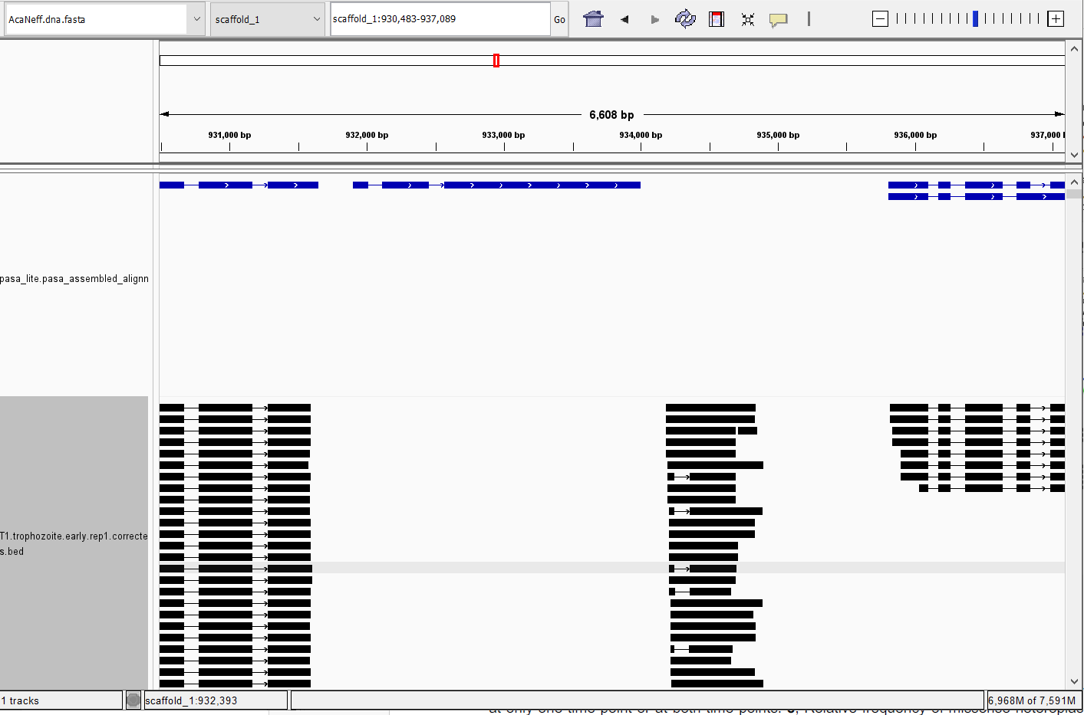
Ex 6: missing gene: scaffold_1:930,483-937,089 (absent stringtie also)
T9
T1

Slide 2
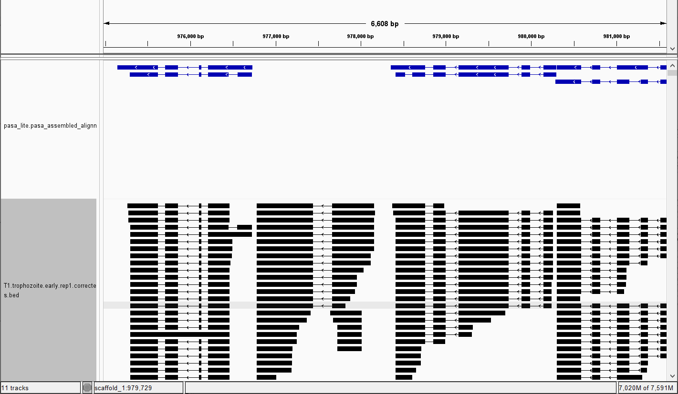
Ex 7: missing gene scaffold_1:974,977-981,583 (absent stringtie also)

Slide 3
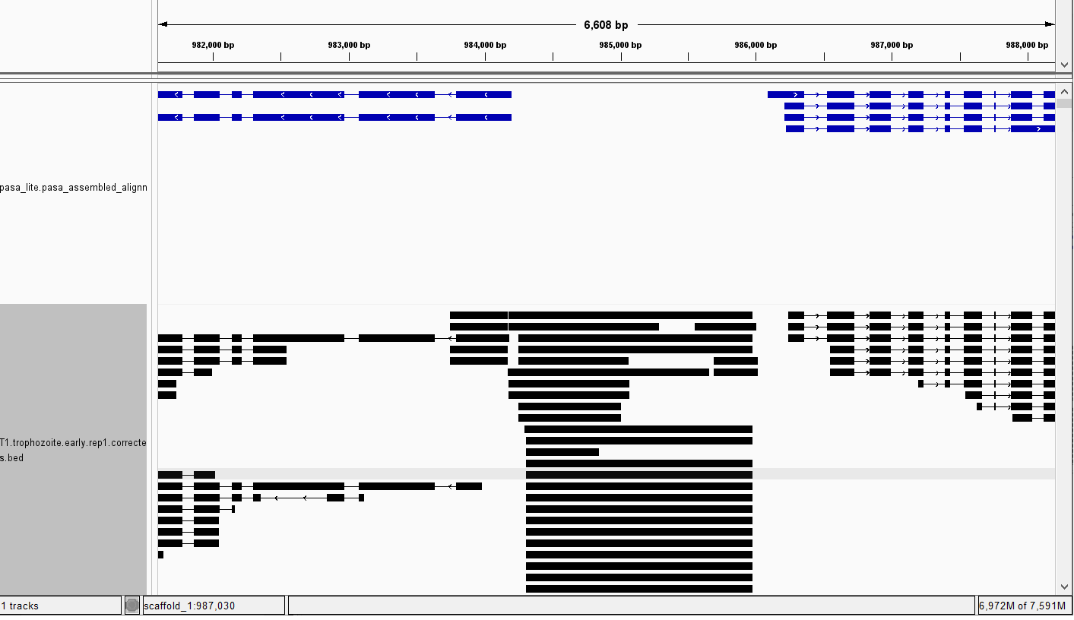
Ex 8: missing single-exon gene: scaffold_1:981,592-988,198 (absent stringtie also)

Slide 4
Separate problem : only 2 reads supporting missed gene

Slide 5
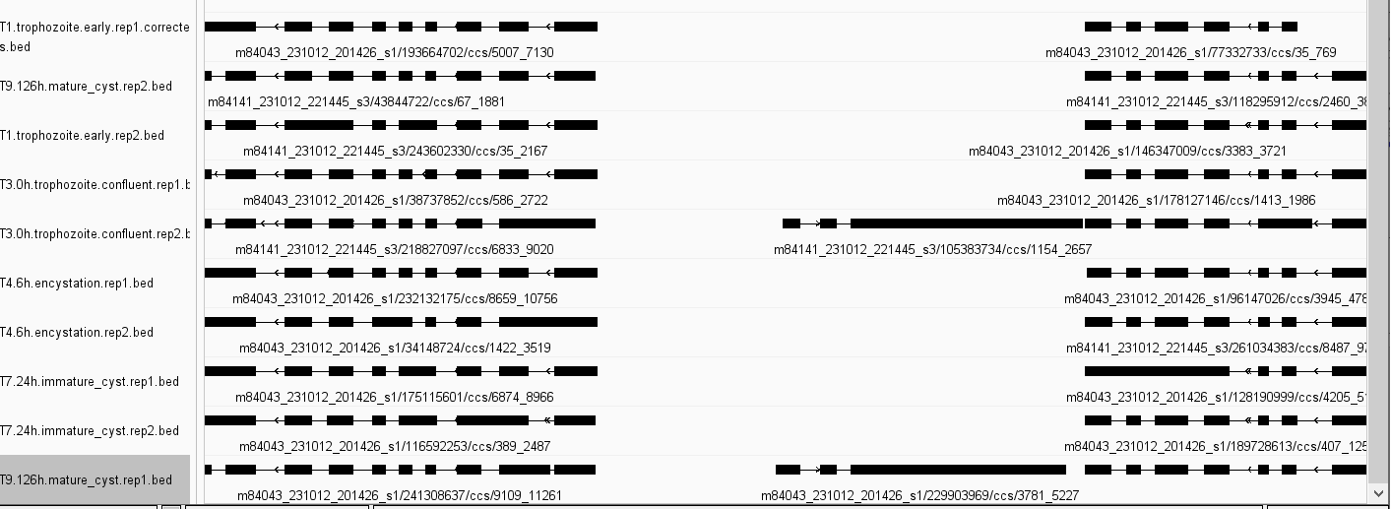
Ex 9: missing very low expressed gene scaffold_1:966,647-973,253 (1 read in each of 2 samples) (absent stringtie also)

