Slide 1
Mitochondrial Genomics
Sarah Calvo, Ph.D.
Senior Computational Biologist
Laboratory of Vamsi Mootha
Broad Institute (Cambridge, MA)
Massachusetts General Hospital (Boston, MA)
HST160 11/24/2020

Slide 2
Even at rest, a human body requires
as much power as a 100-watt lightbulb
Peter Rich The cost of living. Nature 2003

Slide 3
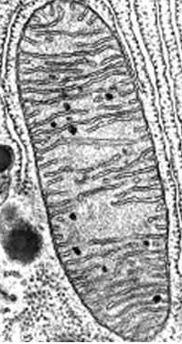
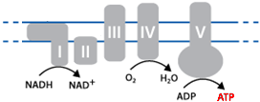
Mitochondrial oxidative phosphorylation (OXPHOS)
100 kilocalories/hr
20% brain (only 2% body mass)
Mitochondria generate 90% cellular ATP
380 liters oxygen/day (90% used in OXPHOS)
65kg (140lbs) ATP/day
mito inner membrane 14,000m²
H+
H+
H+
H+
OXPHOS
Rich Nature 2003

Slide 4
Mitochondrial genomics: outline
Background
Mitochondrial genome (mtDNA)
mtDNA sequence analysis challenges
Mitochondrial disease & diagnosis
Oocyte transfer to prevent mt disease transmission
Somatic mtDNA alterations (tissues & cancer & aging)

Slide 5
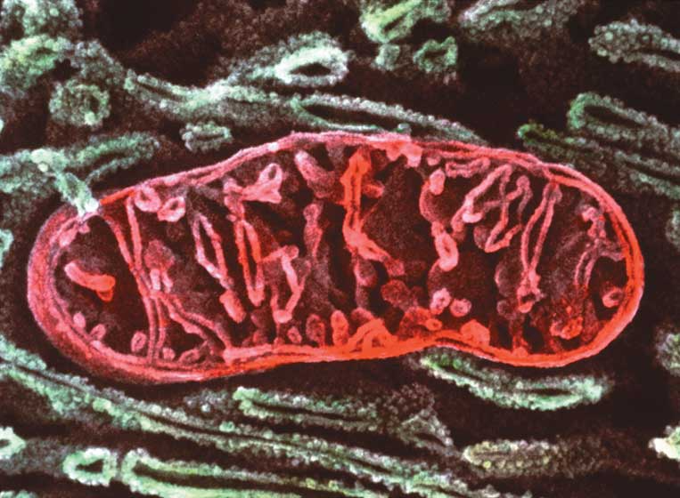
Mitochondria
μιτος or mitos, thread
κουδριον or khondrion, granule
Discovery
1840s by Richard Altmann (German pathologist/ histologist) – called BioBlasts
1898 named by Carl Benda (German physician)

Slide 6
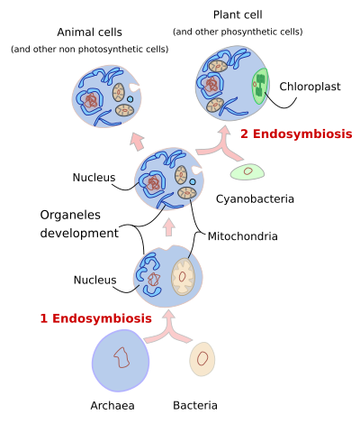
Evolutionary origin of mitochondria & eukayrotes
850 million years ago: endosymbiosis 2
>2 billion years ago: endosymbiosis 1
mmegias.webs.uvigo.es/02-english/5-celulas/1-endosimbiosis.php

Slide 7
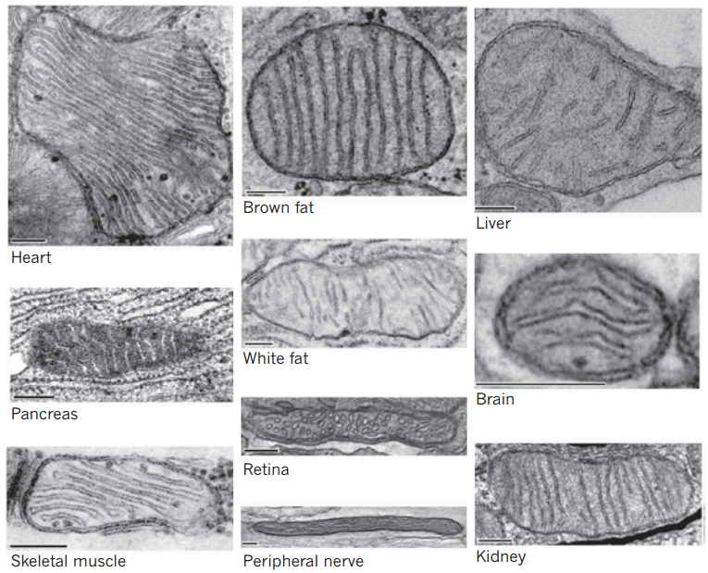
Diverse structures & functions across tissues
Vafai and Mootha, Nature 2012

Slide 8
Can form tight junctions (“synapses”)
Picard, Trends in Neurosciences 2015

Slide 9
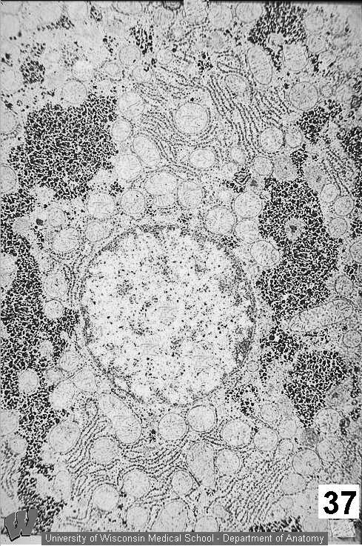
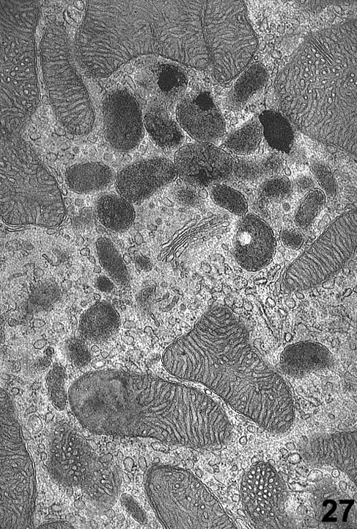
Highly interactive with other structures
University of Wisconsin Medical School – department of anatomy

Slide 10
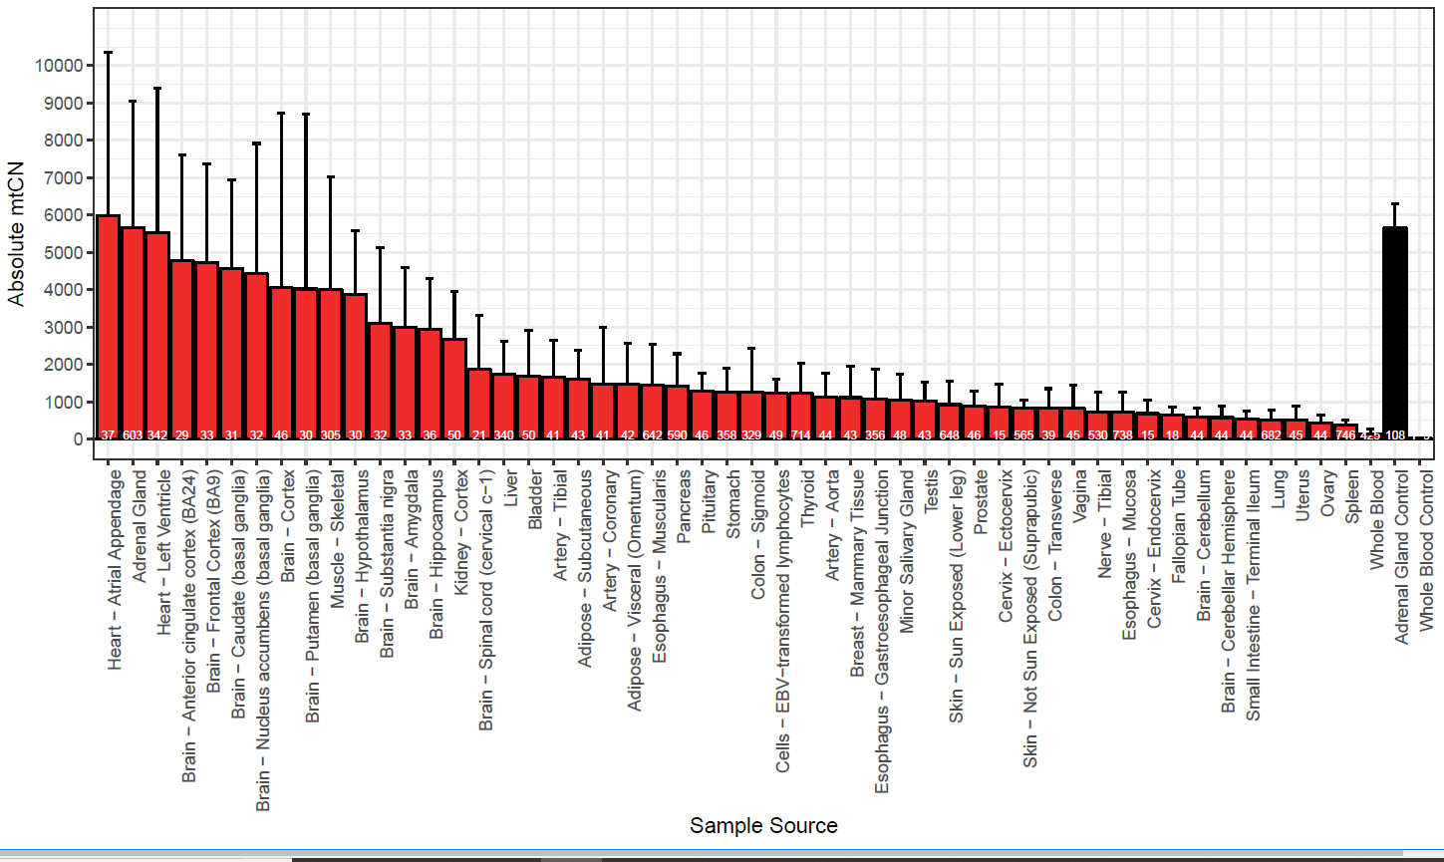
Variable number of mitochondria per cell
~6000 in heart, adrenal
~5000 in brain
~4000 in muscle
~2000 in liver
~200 in whole blood
Generally: more variation between individuals than between tissues (except blood)
mtDNA copy number from 100s of human GTEx samples (qPCR)
Rahul Gupta, unpublished

Slide 11
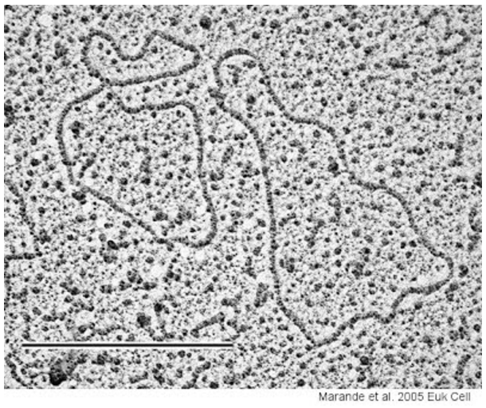
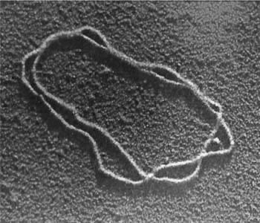
Mitochondrial genome (mtDNA)
Circular genome
Discovery 1960s
EM by Margit & Sylvan Nass
Biochemistry: Haslbrunner, Tuppy, Schatz
www.fidelitysystems.com/unlinked_dna_em_1.JPG

Slide 12
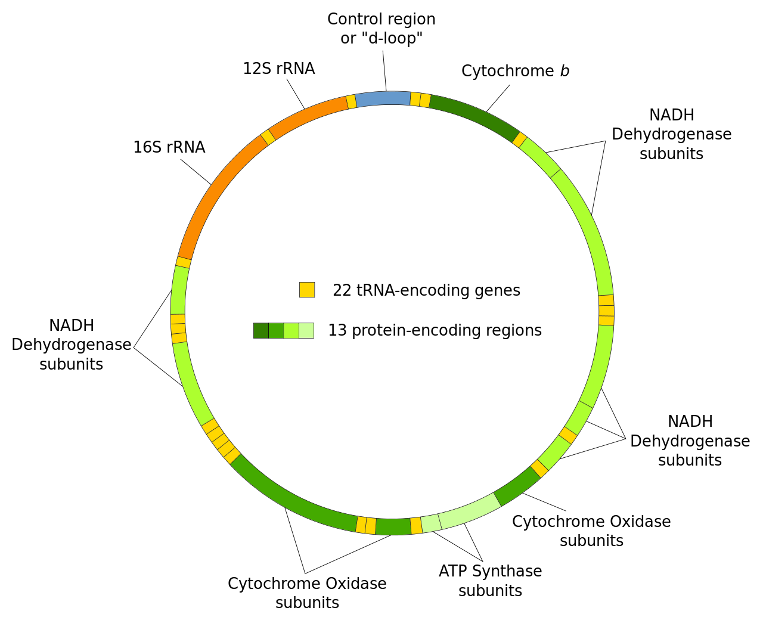
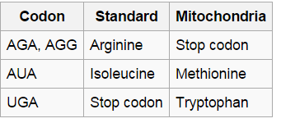
Human mitochondrial genome
Circular 16,569bp molecule
37 genes:
13 protein-coding*
22 tRNA
2 rRNA
Slightly different genetic code
Mutation rate 10x higher than nDNA
en.wikipedia.org/wiki/Mitochondrial_DNA

Slide 13
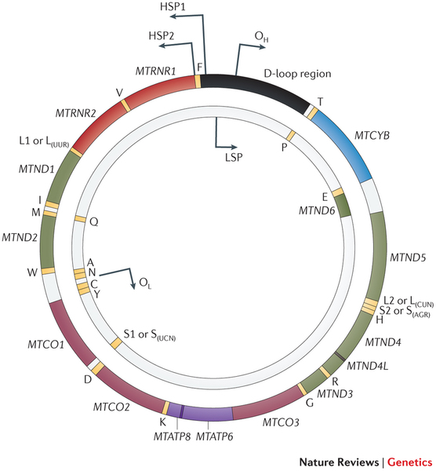
Human mitochondrial transcription
Polycistronic (like bacteria)
No introns
“Heavy” strand
More “G”s (fewer “C”s)
28 genes
“Light” strand
Fewer “Gs” (more “Cs”)
9 genes
Note rCRS sequence is the light strand, containing 12/13 “sense” transcripts
Overlapping genes (different frames)
ATP8 / ATP6
ND4 / ND4L
Stewart & Chinnery, Nature Reviews Genetics 2015

Slide 14
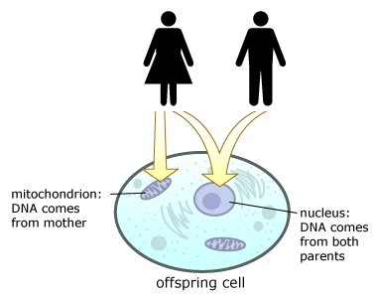
Maternal mtDNA transmission
Textbook:
exclusively maternal
paternal mtDNA
diluted (50-100 sperm vs 100,000 egg)
specifically degraded
imprinted & ubiquitinated
if lysosome blocked →paternal transmission
Confirmed through:
Many large pedigree studies
Deep sequencing & PCR search for paternal alleles
Rare exceptions to the rule:
Mouse backcrosses: show 0.1–0.01% paternal mtDNA “leakage” Gyllensten et al, Nature 1991
Single human case: paternally-derived mtDNA at 90% in muscle Schwartz & Vissing, NEJM 2002
Instance within 50-generation chicken pedigree Alexander et al, Biol Lett 2015
Invalidated “Biparental Inheritance of mtDNA in Humans”: 3 families with dominant pattern of paternal mtDNA inheritance Luo et al, PNAS 2018 ; Actually due to nuclear sequences (2020)!
nazaroo.blogspot.com

Slide 15
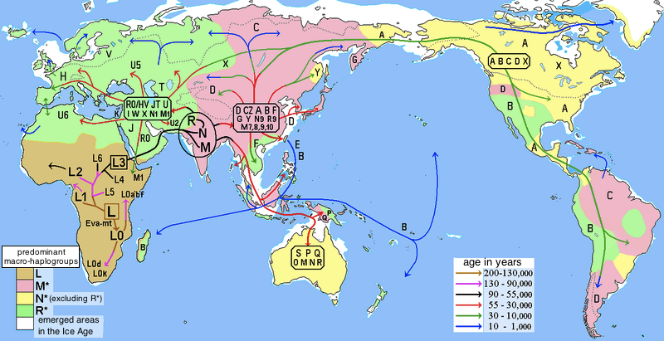
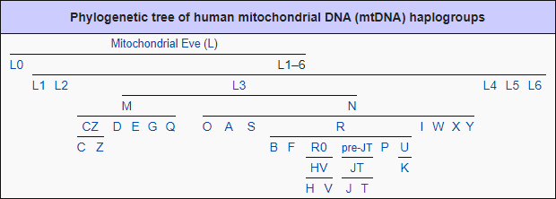
Mitochondrial haplogroups
mtDNA sequences grouped into “haplogroups”, transmitted maternally
Different haplogroups have ~50 differences from ancestral reconstruction
Human reference genome is haplogroup H (common in Europeans)
en.wikipedia.org/wiki/Human_mitochondrial_DNA_haplogroup

Slide 16
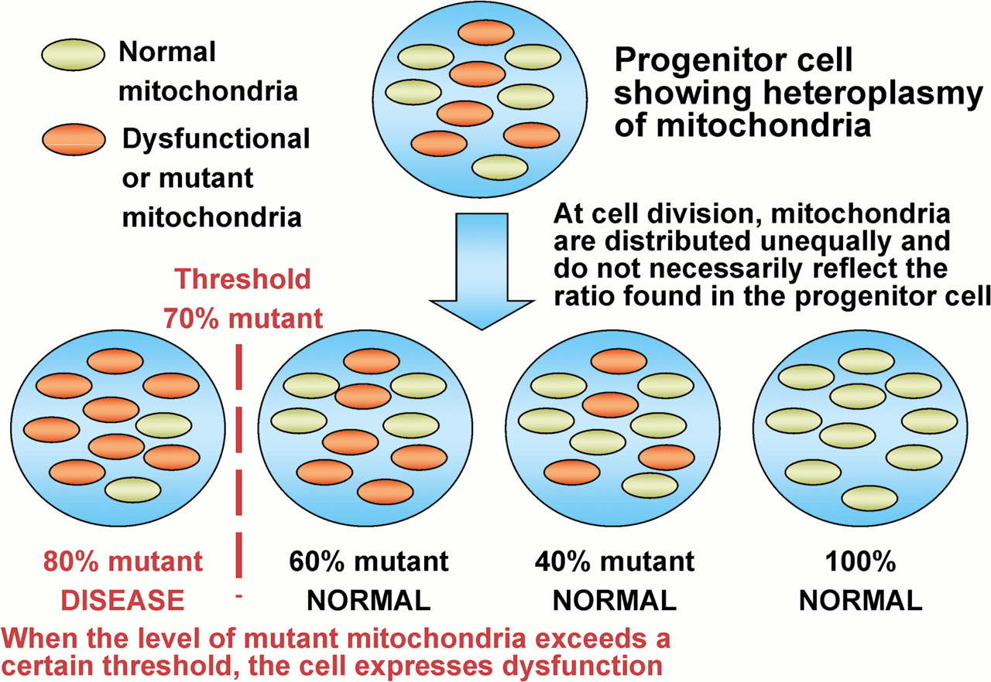
Heteroplasmy
sti.bmj.com/content/77/3/158/F3.large.jpg

Slide 17
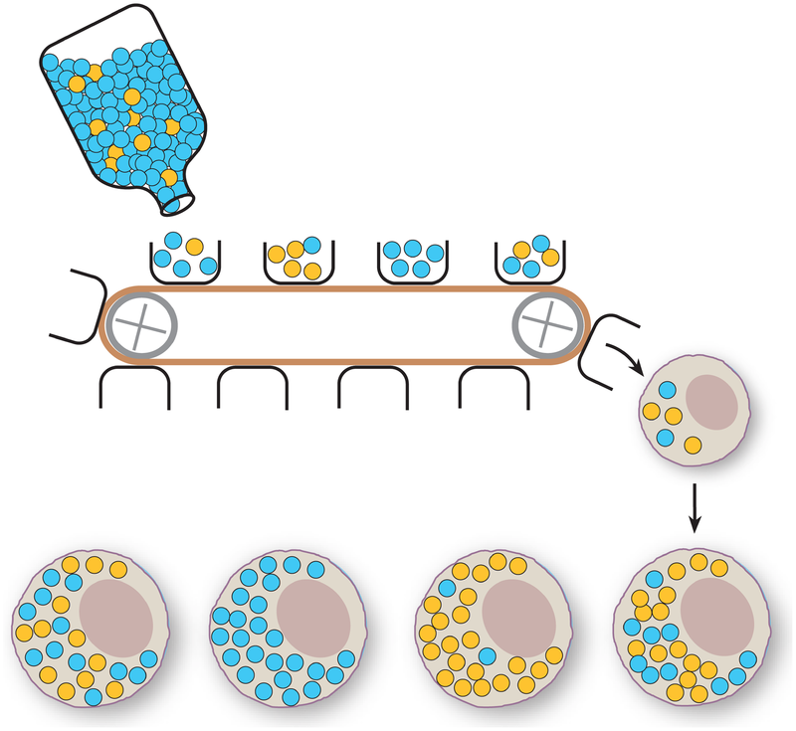
Heteroplasmy and maternal inheritance
Wikipedia Heteroplasmy

Slide 18
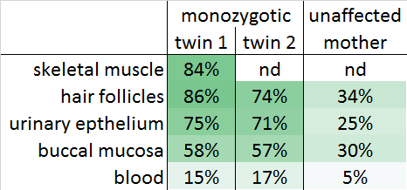
Heteroplasmy: different across tissues
m.14487T>C; ND6:p.M63V
_
_
Near-Identical Segregation of mtDNA Heteroplasmy …
in Twins With Optic Atrophy, Ptosis, and Intractable Epilepsy.
Spyropoulos et al, JAMA Neurology 2013
Detecting mtDNA mutations in blood may be problematic (preferred urine sediment/buccal)
High mtDNA coverage needed to detect low-heteroplasmy events

Slide 19
Mitochondrial genomics: outline
Background
Mitochondrial genome (mtDNA)
Genes, genetic code
Transcription
Transmission (maternal)
Haplogroups
Heteroplasmy
NUMTs
mtDNA sequence analysis challenges
Mitochondrial disease & diagnosis
Oocyte transfer to prevent mt disease transmission
Somatic mtDNA alterations (tissues & cancer & aging)

Slide 20
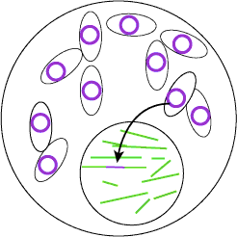
NUMTs: Nuclear sequences of mtDNA origin
755 NUMTs in hg19 Calabrese et al, BMC Bioinformatics 2012
Most short & moderately diverged
Some long & highly similar (eg 98.6% identity chr1:564464-570304)
Additional NUMTs not in reference genome
People typically contain ~3 NUMTs not in reference assembly
141 polymorphic NUMTs (1000 individuals 1KG project) Dayama et al, NAR 2014
Some recent, some copies of other NUMTs
Enriched insertions near repetitive sequences (but not A+T oligomers)
scienceblogs.com/digitalbio/wp-content/blogs.dir/460/files/2012/04/i-1ebf120494a28b0ae8bc5204bac865b7-cell.gif

Slide 21
Mitochondrial genomics: outline
Background
Mitochondrial genome (mtDNA)
mtDNA sequence analysis challenges
Mitochondrial disease & diagnosis
Oocyte transfer to prevent mt disease transmission
Somatic mtDNA alterations (tissues & cancer & aging)

Slide 22
mtDNA analysis issues
mtDNA Feature | Analysis issues
Circular molecule | Poor mapping at each “chromosome” end This “D-loop” region is hypervariable Used to define “haplogroups” for tracing ancestry
~100-10,000 copies per cell highly tissue dependent heteroplasmic variants | Variant caller needs to call heteroplasmic variants Need high coverage to call heteroplasmic variants Sample contamination becomes big challenge to distinguish true ~1% heteroplasmy from contamination
NuMTs Nuclear seq of mito origin highly seq similar likely polymorphic in popn | Many areas of poor mapping quality SNPs -> thousands reads incorrectly mapping ~20% of low-heteroplasmy calls accounted for by 4 common NUMTs
Genes 13 proteins (not in all dbs) rRNA and tRNA | Some annotation pipelines properly annotate VEP works okay (not great tRNA annotation) Haven’t tried ANNOVAR, SNPeff etc
High mutation/deletion rate (somatic & germline) | Need to be added to large databases (eg gnomAD)

Slide 23
mtDNA variants in 56K individuals: now in gnomAD v3.1!

Slide 24
Mitochondrial genomics: outline
Background
Mitochondrial genome (mtDNA)
mtDNA sequence analysis challenges
Mitochondrial disease & diagnosis
Oocyte transfer to prevent mt disease transmission
Somatic mtDNA alterations (tissues & cancer & aging)

Slide 25
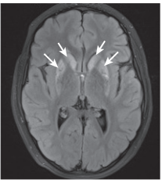
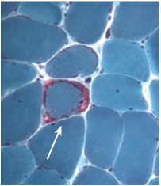
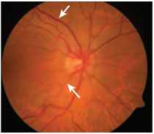
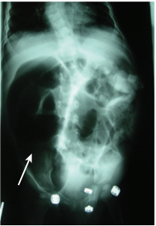
Mitochondrial OXPHOS disease
Prevalence ~1/4300
Inheritance: maternal, recessive, dominant, X-linked
Involvement of multiple organ systems
Diagnosis is extremely challenging
highly-variable, non-specific symptoms, pleiotropy
No proven therapies
Leigh lesions
ragged-red fibre
hypertrophic cardiomyopathy
swollen optic nerve
pseudo-obstruction

Slide 26
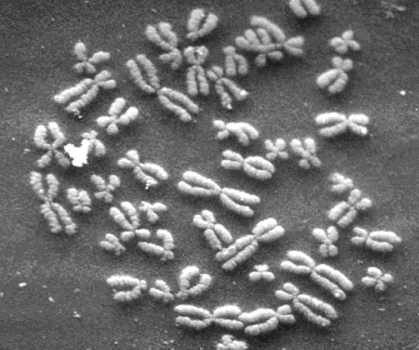
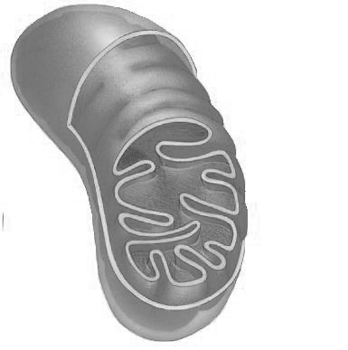
Genetic heterogeneity: over 145 genes
>145 genes, >900 monogenic alleles (no gene accounts for >8% cases)
mtDNA
Nuclear DNA
13 proteins
~15-20% pediatric patients
maternal inheritance
~1200 proteins ”MitoCarta”
85% of pediatric patients
>130 disease genes to date
recessive/ dominant/ X-linked
Kirby, Thorburn Twin Res Hum Genet 2008

Slide 27
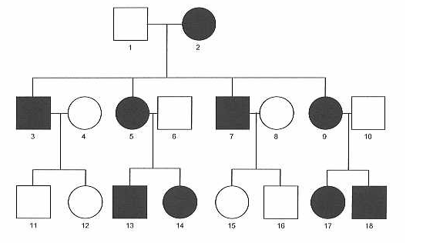
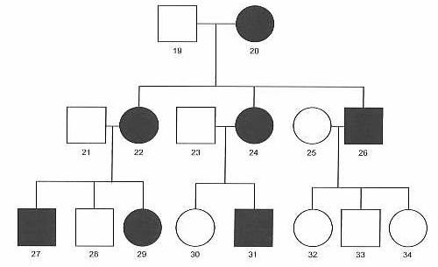
If mutation in mtDNA, then maternal inheritance
Both males & females affected
Mother → all offspring
No Father → offspring transmission
https://migrc.org/teaching-tools/genetic-inheritance-patterns/mitochondrial/

Slide 28
What about this pedigree?
Both males & females affected
Mother → SOME offspring
No Father → offspring transmission
Possibilities:
Heteroplasmic variant only sometimes transmitted to offspring, OR
Variant penetrance
https://migrc.org/teaching-tools/genetic-inheritance-patterns/mitochondrial/

Slide 29
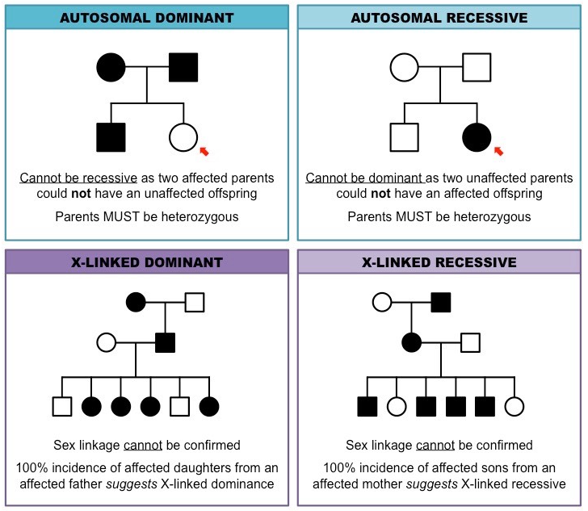
Mito disease: maternal, recessive, dominant, X-linked
mtDNA
Nuclear DNA
MATERNAL INHERITANCE
https://migrc.org/teaching-tools/genetic-inheritance-patterns/mitochondrial/
https://ib.bioninja.com.au/standard-level/topic-3-genetics/34-inheritance/pedigree-charts.html

Slide 30
Mitochondrial OXPHOS disease
Prevalence ~1/4300
Inheritance: maternal, recessive, dominant, X-linked
Involvement of multiple organ systems
Diagnosis is extremely challenging
highly-variable, non-specific symptoms, pleiotropy
No proven therapies
Leigh lesions
ragged-red fibre
hypertrophic cardiomyopathy
swollen optic nerve
pseudo-obstruction

Slide 31
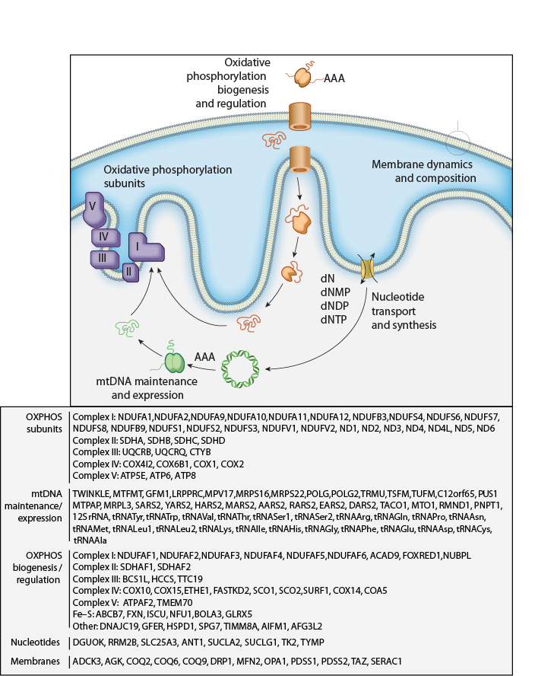
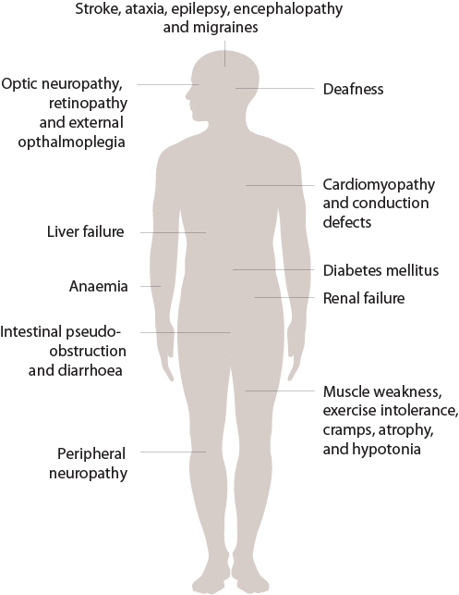
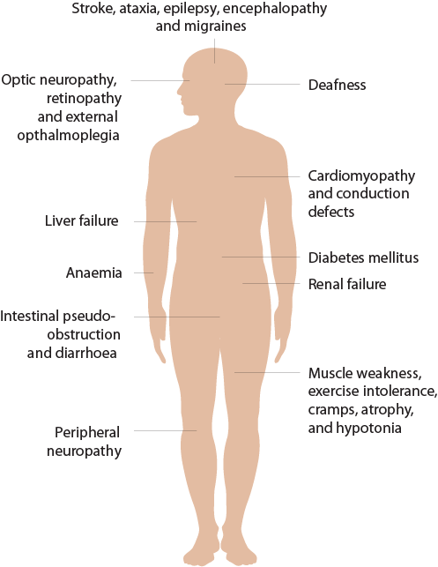
Phenotypic heterogeneity
Diverse symptoms
Over 140 genes
In most cases, cannot predict exact genetic defect from symptoms
Vafai and Mootha, Nature, in press

Slide 32
Mitochondrial OXPHOS disease: e.g. Leigh Disease
Severe neurological disorder
onset 0-12 months
progressive loss of mental and movement abilities (psychomotor regression)
typically death by age 2-3 years
Diagnosis
symmetrical necrotic lesions in the basal ganglia and/or brainstem (T2 MRI)
Genetics
75 monogenic causes (~20% mtDNA, 80% nuclear OXPHOS genes)
Leigh lesions
ragged-red fibre
hypertrophic cardiomyopathy
swollen optic nerve
pseudo-obstruction

Slide 33
Mitochondrial OXPHOS disease: e.g. MELAS
Mitochondrial Encephalomyopathy, Lactic Acidosis, Stroke-like episodes
onset childhood – adulthood
stroke-like episodes typically before age 40
encephalopathy
mitochondrial myopathy, ragged-red fibers
headache
vomiting
Genetics
maternally inherited or de novo , usually heteroplasmic
80% cases tRNA mt-Leu1 (m.3243), 29 other tRNA mutations
Leigh lesions
ragged-red fibre
hypertrophic cardiomyopathy
swollen optic nerve
pseudo-obstruction

Slide 34
Mitochondrial OXPHOS disease: e.g. LHON
Leber’s hereditary optic neuropathy
onset late adolescence
bilateral vision loss
4:1 males: female
Genetics
Maternal inheritance
mostly m.11778G>A, m.3460G>A, 14484T>C
coding changes in complex I OXPHOS subunits
some “causal” variants only on certain haplogroups, but common in other popns
Low penetrance
Leigh lesions
ragged-red fibre
hypertrophic cardiomyopathy
swollen optic nerve
pseudo-obstruction

Slide 35
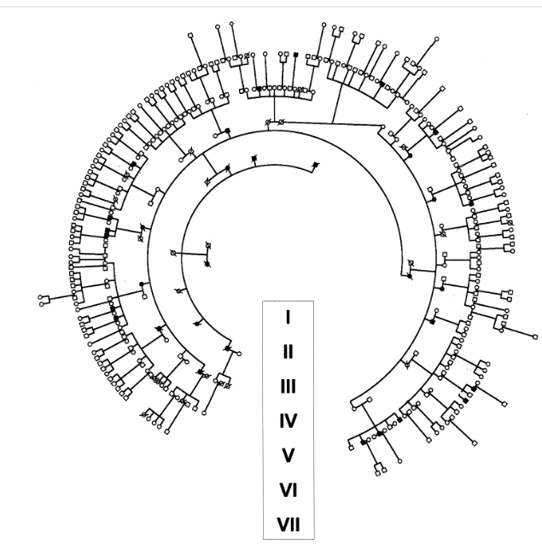
LHON pedigree with homoplasmic m.11778
7 generations
Founder 1870s
328 living members
33 affected
decreasing penetrance
Sadun et al, Am Jour Opthamology 2003

Slide 36
Mitochondrial OXPHOS disease
Prevalence ~1/4300
Involvement of multiple organ systems
Diagnosis is extremely challenging
highly-variable, non-specific symptoms, pleiotropy
No proven therapies
Leigh lesions
ragged-red fibre
hypertrophic cardiomyopathy
swollen optic nerve
pseudo-obstruction

Slide 37
Mitochondrial OXPHOS disease: clinical criteria in children
Morava, Mitochondrial disease criteria in children Neurology 2006

Slide 38
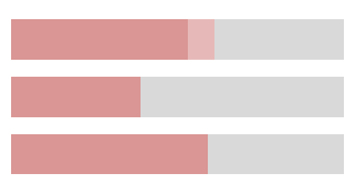
Mitochondrial disease diagnosis with exome seq
Respiratory chain disease [N=53]
Taylor, Chinnery et al JAMA 2014
53%
Suspected mitochondrial disease [N=109]
Wortmann, Rodenburg et al J Inherit Metab Dis 2015
39%
Pediatric suspected mitochondrial disease [N=113]
Pronicka, Ploski et al J Transl Med 2016
59%
answers for patients
new genes in OXPHOS pathways
new phenotypes for established genes
not primary OXPHOS disease?
non-coding?
structural variants?
multigenic?
gene-environment?
Main challenge ahead: interpreting pathogenic coding and non-coding variants

Slide 39
Mitochondrial genomics: outline
Background
Mitochondrial genome (mtDNA)
mtDNA sequence analysis challenges
Mitochondrial disease & diagnosis
Oocyte transfer to prevent mtDNA disease transmission
Somatic mtDNA alterations (tissues & cancer & aging)

Slide 40
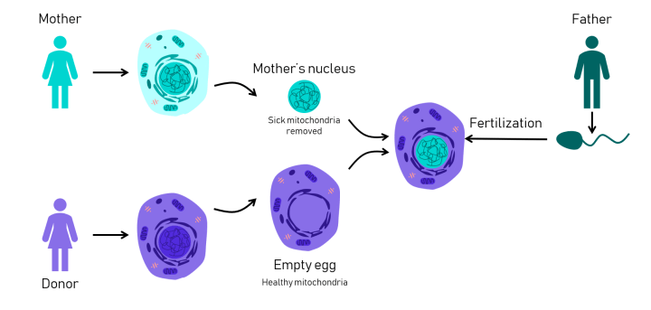
Oocyte transfer to prevent transmission of mtDNA disease

Slide 41
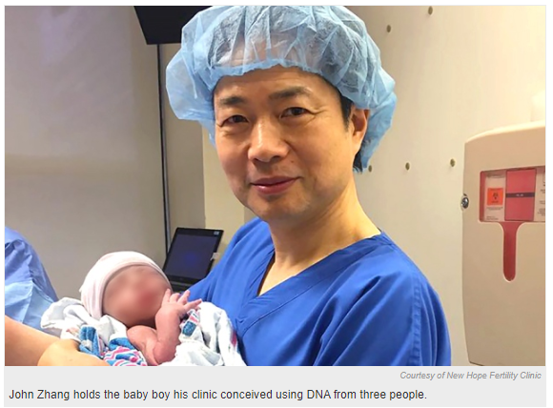
Ethics of “three-parent baby” to treat mitochondrial disease
Mother carries Leigh syndrome mtDNA variant
lost previous children to disease
Nuclear transfer
egg from healthy donor
nucleus from mother
sperm from father
Baby born April 2016 in Mexico
2-9% mitochondria from mother (not donor)
Ethical concerns:
Scientific: potential mito-nuclear genome incompatibility (has been shown in mice)
Child cannot provide consent
Parents/child unable to withdraw from study
Zhang, Reproductive Biomedicine Online 2017

Slide 42
Legality of “three-parent baby” to treat mtDNA disease
UK 2015 approved for carriers of mitochondrial disease
US 2016
Budget rider forbids FDA from considering clinical trial applications “in which a human embryo is intentionally created or modified to include a heritable genetic modification.”
National Academies of Science, Engineering and Medicine report: ethically permissible to use mitochondrial replacement therapy in women at high risk of transmitting a severe mitochondrial genetic disease
Mitalipov (OHSU) proposes US clinical trial for mito replacement therapy : “We don’t think this is modification. It’s not something that’s synthetic. It’s just taking a donor genome from somebody and replacing it with one that already exists. It’s natural”
US current:
FDA states technique not legal as it involves a heritable genetic modification (could decide to allow male embryos only, so changes would not be heritable)
Zhang, Reproductive Biomedicine Online 2017

Slide 43
Mitochondrial replacement therapy to treat infertility
Practice banned in US
April 2019 in Europe
Mother with multiple IVF failures, poor egg quality
Spindle nuclear transfer
egg from healthy donor
nucleus from mother
sperm from father
Practice now banned in EU

Slide 44
Mitochondrial genomics: outline
Background
Mitochondrial genome (mtDNA)
mtDNA sequence analysis challenges
Mitochondrial disease & diagnosis
Oocyte transfer to prevent mtDNA disease transmission
Somatic mtDNA alterations (tissues & cancer & aging)

Slide 45
Somatic mtDNA mutations
March 2019

Slide 46
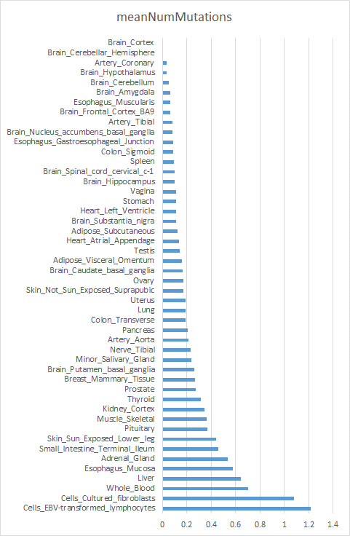
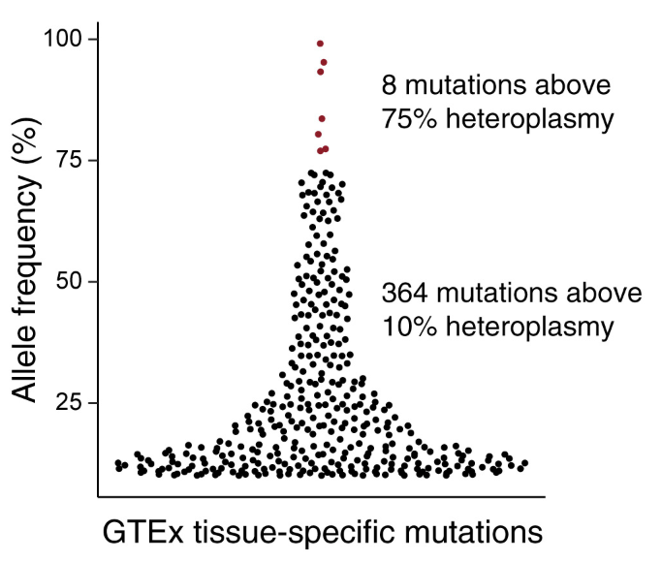
Somatic mtDNA mutations in human tissues
Typically 0-1 somatic mutation per tissue;
Highest in blood; lowest in brain/heart
Most are low-heteroplasmy
Mean # GTEX tissue-specific mutations
unpublished
Ludwig et al, Cell 2019

Slide 47
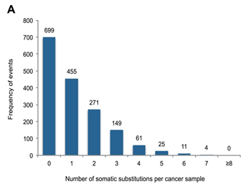
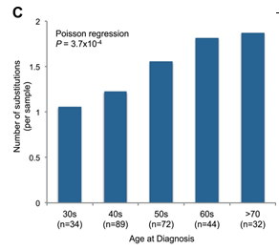
Somatic mtDNA mutations in cancer
Typically 0-1 somatic mutation per tumor
Increase with aging
Likely passengers (selection against deleterious)
Ju, Campbell et al, eLIFE 2014
Typically 0-1 somatic mutation per tumor
Mutations increase with age

Slide 48
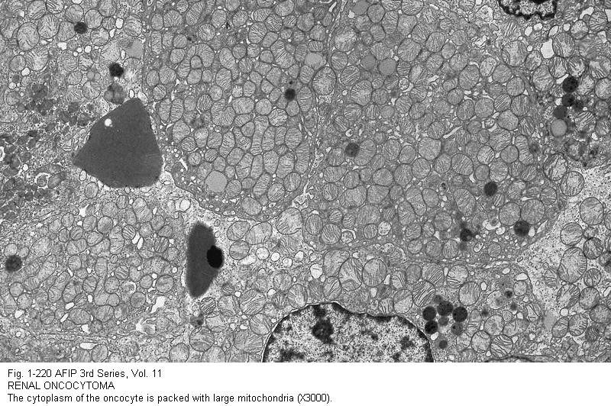
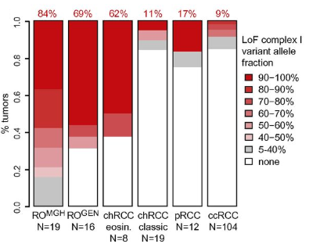
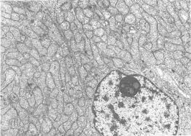
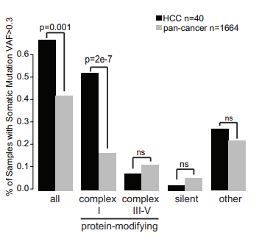
Somatic mtDNA mutations in cancer: Evidence causal in 3 rare cancers
Adrenocortical carcinoma
Renal oncocytoma: 70-85% have mtDNA loss-of-function mutations in complex I genes
Thyroid Hurthle Cell Carcinoma: 50% have mtDNA mutations in complex I genes
Gopal et al, PNAS 2018
Gopal et al, Cancer Cell 2018

Slide 49
mtDNA somatic mutations in aging and age-related disease
Mitochondrial function declines with age
# mtDNA mutations increase
mtDNA copy number decreases
ROS increases (and ROS-scavengers decrease)
functional ETC measurements decrease
Mitochondrial dysfunction associated with nearly all age-related diseases
E.G. neurodegeneration, cancer, diabetes
?
Mito dysfunction
Age-related
diseases

Slide 50
Mitochondrial dysfunction in aging and age-related disease
Mito dysfunction
?
Age-related
diseases
Mito dysfunction
?
eg fibrosis
Age-related
diseases
Something
eg inflammation
Mito dysfunction
Age-related
diseases

Slide 51
Mitochondrial dysfunction in aging and age-related disease
How to distinguish association from causality?
Genetics
Rare monogenic disease: do these affect mitochondrial genes/function?
Common disease: are GWAS hits enriched in mitochondrial genes?
Pharmocology
Do drugs known to help disease directly target mitochondrial function?
Experiments in model systems
Do perturbations to mitochondria (eg mtDNA mutations, mito gene KO) cause similar phenotype in model organisms?
So far,
Parkinson’s Disease has strong support of mitochondria playing a causal role (based on familial PD genes)
Diabetes and cancer: evidence does not look causal (with a few exceptions)
Others (e.g. Alzheimer’s Disease): Jury is still out

Slide 52
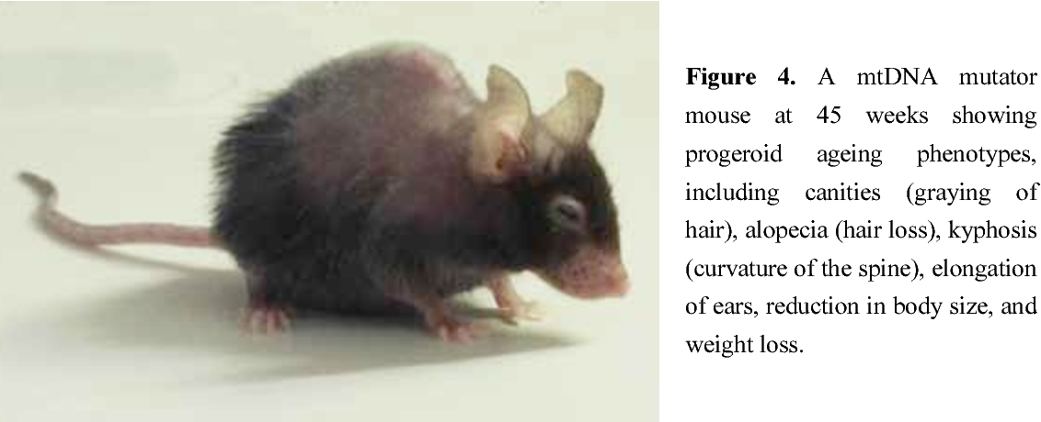
mtDNA somatic mutations and aging
Experiment in model systems: mtDNA mutator mouse
Ross, Thesis 2012

Slide 53
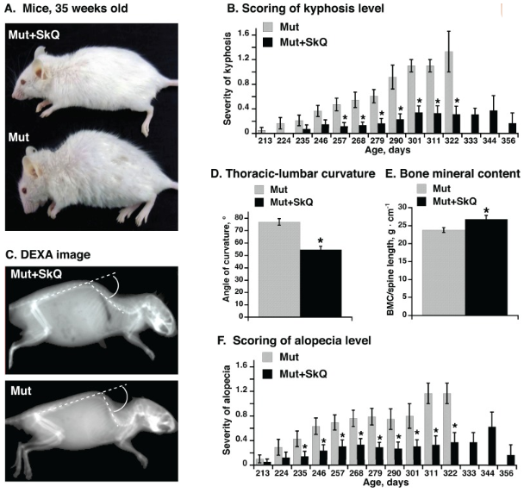
mtDNA somatic mutations and aging
Shabalina, Aging 2017

Slide 54
mtDNA somatic mutations in aging and age-related disease
Mitochondrial function declines with age
# mtDNA mutations increase
mtDNA copy number decreases
ROS increases (and ROS-scavengers decrease)
functional ETC measurements decrease
Mitochondrial dysfunction associated with nearly all age-related diseases
E.G. neurodegeneration, cancer, diabetes
Mito dysfunction
Aging
Can be causal
Is typical aging caused by mtDNA mutations?

Slide 55
Mitochondrial genomics: summary
Mitochondrial genome (mtDNA)
Circular, 16kb
100s-1000s per cell
Mitochondrial disease:
Clinically and genetically heterogeneous (maternal, recessive, dominant, X)
Genetics
mtDNA mutations (maternal)
Nuclear mutations (usually recessive, can be dominant, X-linked)
Variable penetrance
Pleiotropy
Somatic mtDNA mutations
Occur across all tissues
Increase with age
Can contribute to several rare cancers (but no evidence for most cancers)
Associated nearly all age-related conditions
evidence of causal link for PD and aging

