Slide 1
Explaining MitoCarta and Excel tutorial: calculate Naïve Bayes log-odds scores and ROC curves
Sarah Calvo, tutorial 2/22/2023

Slide 2
Motivation example: which experimental technique to isolate mitos is best?
Many Arabidopsis studies isolate mitochondria and perform proteomics. Which method is best?

Slide 3
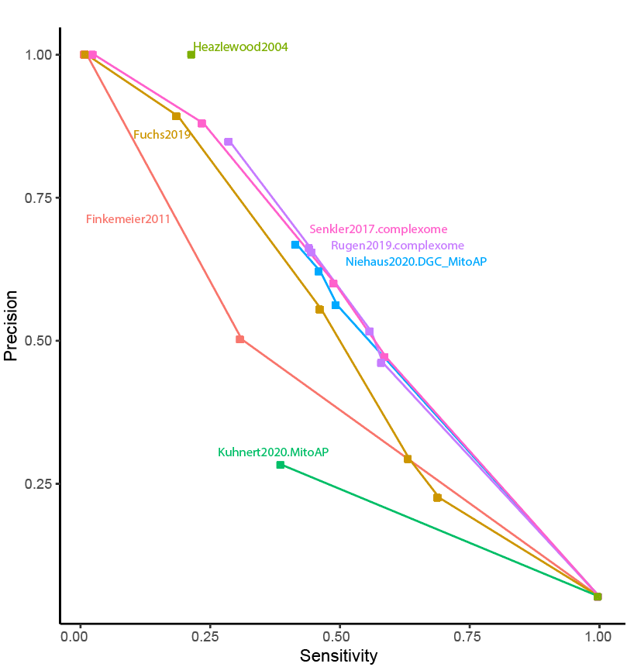
Motivation example: which experimental technique to isolate mitos is best?
Many Arabidopsis studies isolate mitochondria and perform proteomics. Which method is best?
Method:
“training data” of gold+ (known mito proteins) and gold- (non-mito proteins)
apply Naïve Bayes log-odds scores
generate ROC curve
Conclusions:
3 papers with very similar results: ~ 50% sensitivity with ~40% FDR
Differential centrifugation +/- affinity purification similar results
Affinity purification alone (Kuhnert) is worse

Slide 4
Outline
Steps to build human MitoCarta
Tutorial in Excel, example 1
Tutorial In Excel, you do on your own

Slide 5
Building Human MitoCarta: catalog of proteins that reside in the mitochondrion
Naïve Bayes Integration: principled method to combine datasets
by scoring each by its accuracy on training data
Pagliarini, Calvo et al, Cell 2008

Slide 6
Naïve Bayes integration
Step 1: define training data of known mito proteins (gold+) and non-mito proteins (gold-)
Step 2: compile “features” that are datasets that might provide clues into mito localization
Step 3: score each feature by its accuracy on gold+ and gold-
Step 4: combine scores across features

Slide 7
Naïve Bayes integration
Step 1: define training data of known mito proteins (gold+) and non-mito proteins (gold-)
Step 2: compile “features” that are datasets that might provide clues into mito localization
Step 3: score each feature by its accuracy on gold+ and gold-
Step 4: combine scores across features
591 gold+ from literature (excluding proteins determined solely by proteomics)
2519 gold- from literature
Pagliarini, Calvo et al, Cell 2008

Slide 8
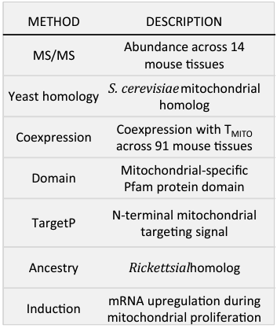
Naïve Bayes integration
Step 1: define training data of known mito proteins (gold+) and non-mito proteins (gold-)
Step 2: compile “features” that are datasets that might provide clues into mito localization
Step 3: score each feature by its accuracy on gold+ and gold-
Step 4: combine scores across features
Calvo et al, NAR 2015

Slide 9
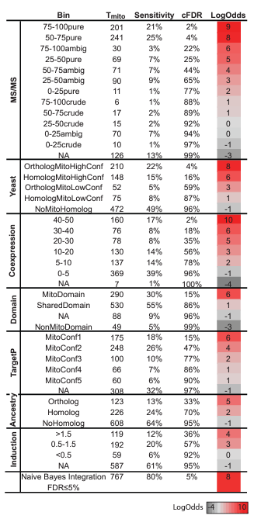
Naïve Bayes integration
Gold+
Step 1: define training data of known mito proteins (gold+) and non-mito proteins (gold-)
Step 2: compile “features” that are datasets that might provide clues into mito localization
Step 3: score each feature by its accuracy on gold+ and gold-
Step 4: combine scores across features
$$=\sum{log2\left({P\left(score \right| gold+ \atop P\left(score \right| gold−}\right)}$$
LogOdds
score
=
Calvo et al, NAR 2015

Slide 10
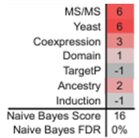
Naïve Bayes integration
Gold+
Step 1: define training data of known mito proteins (gold+) and non-mito proteins (gold-)
Step 2: compile “features” that are datasets that might provide clues into mito localization
Step 3: score each feature by its accuracy on gold+ and gold-
Step 4: combine scores across features
$$=\sum_{k=1}^{7}{log2\left({P\left(scorek \right| gold+ \atop P\left(scorek\right| gold−}\right)}$$
Naïve Bayes
score
Assumes conditional independence across features
EG Given protein is mito, detection by MS/MS is independent of having yeast homolog,
independent of having an MTS,
etc
Example: ECHDC1
(ethylmalonyl-CoA decarboxylase 1)
Calvo et al, NAR 2015

Slide 11
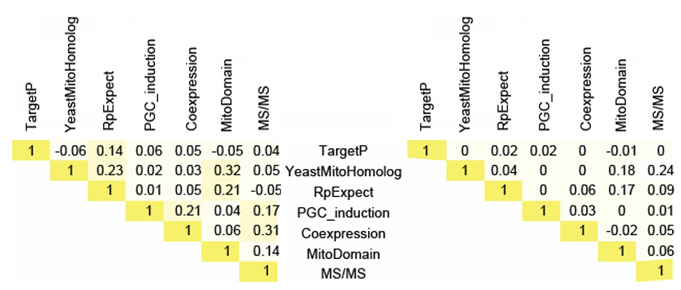
Conditional independence of features
gold+ correlations
gold- correlations
Pagliarini, Calvo et al, Cell 2008

Slide 12
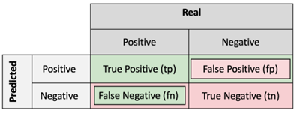
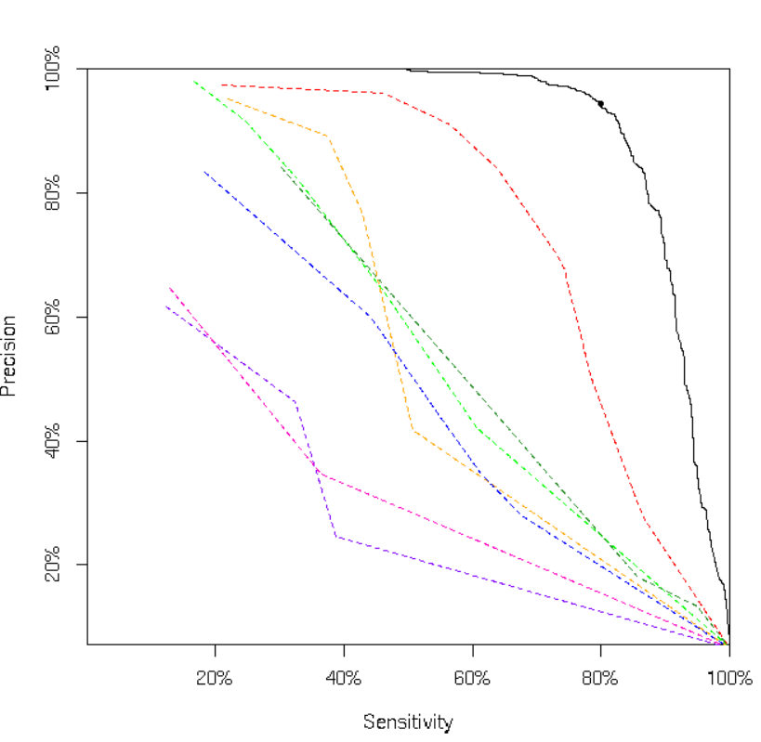
Naïve Bayes integration: metrics to assess accuracy
Sensitivity vs Precision
FDR = fp / (tp+fp)
Precision = tp / (tp+fp)
MSMS
Naïve Bayes
Coexpression
Domain
TargetP
Sensitivity
tp / (tp+fn)
Specificity
tn / (tn+fp)
Ancestry
Induction
Yeast
Calvo et al, NAR 2015

Slide 13
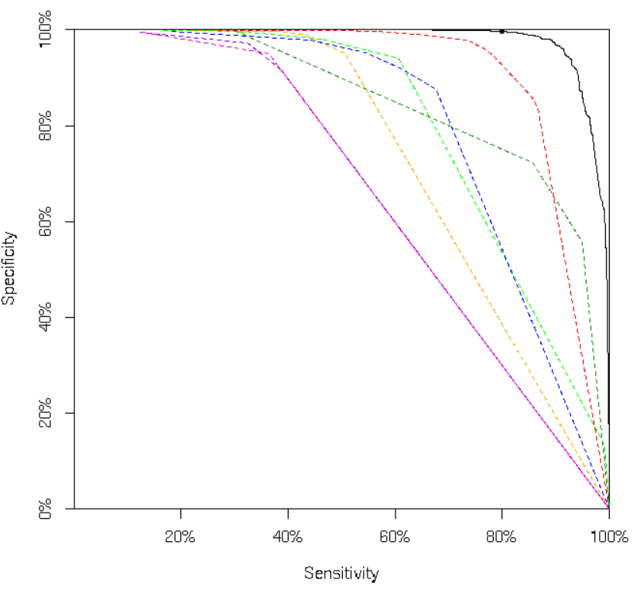
Naïve Bayes integration: metrics to assess accuracy
Sensitivity vs Specificity
Sensitivity vs Precision
Naïve Bayes
Naïve Bayes
MSMS
MSMS
Domain
Domain
Coexpression
Coexpression
TargetP
TargetP
Yeast
Yeast
Ancestry
Ancestry
Induction
Induction
MS/MS alone: >50% FDR at 80% Sn
Calvo et al, NAR 2015

Slide 14
What is accuracy of APEX data? Matrix data is highly specific but not sensitive
APEX-matrix
 | Sensitivity | FDR | Notes
APEX-matrix | 49% | 0% | 6 “FP” were mito upon manual inspection
APEX-IMS | 12% | 16% | 4 “FPs” were contaminant
APEX-MOM | 9% | 34% | 8 “FPs” were not inside mito
APEX-IMS
APEX-MOM
Naïve Bayes
MSMS
Domain
Coexpression
TargetP
Yeast
Ancestry
Induction
Assess human APEX data via MitoCarta1.0 training sets (577 gold+, 2412 gold-)

Slide 15
Human MitoCarta versions 1, 2, 3…
MitoCarta Version | Method | Training | Data sources | # genes
1.0 (Cell 2008) | MS/MS of 14 tissues + Bayesian integration + GFP validation | 591 gold+ 2519 gold- | MS/MS, domain, Induction, Co-expr, Yeast, Ancestry, TargetP | 1098
2.0 (NAR 2015) | APEX-matrix + Bayesian integration | 960 gold+ 17468 gold- | MS/MS, domain, Induction, Co-expr, Yeast, Ancestry, TargetP | 1158
3.0 (NAR 2021) | Manual annotation of MitoCarta2.0 including pathways + sub-mito loc | NA | Literature | 1136
>3500 total citations; >10,000 page views per year

Slide 16
Building this ROC curve… tutorial

Slide 17
Appendix

Slide 18
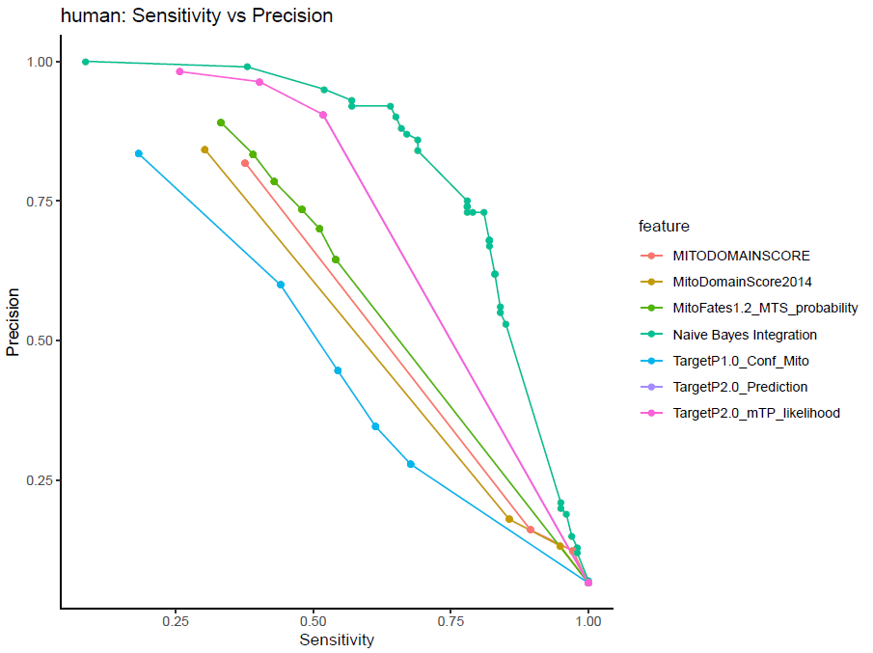
Updated features more accurate on human: targetP2.0 and MitoDomain2022
Human MitoCarta2.0
Rerun with updated versions of:
targetP2.0, MitoFates1.2, MitoDomain2022
MSMS
Naïve Bayes
Coexpression
Domain
Domain2022
TargetP
Domain2014
Ancestry
targetP2.0
Induction
MitoFates
Yeast
targetP1.0

Slide 19
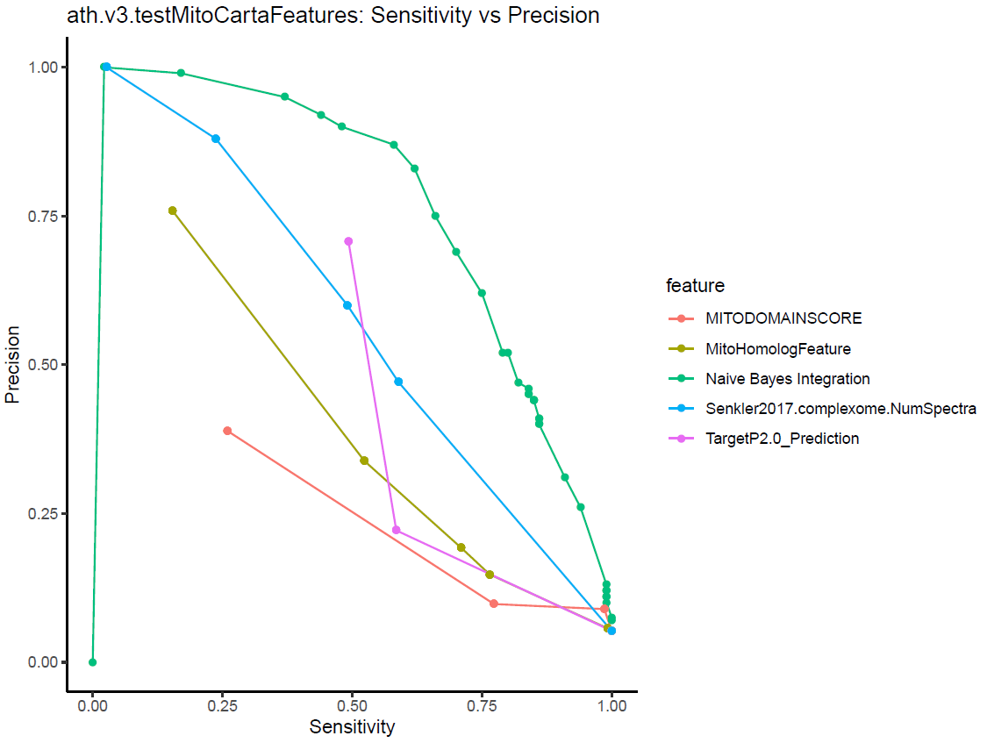
Use Arabidopsis gold+ and gold- : best conditionally independent features
Naïve bayes
Conclusions:
TargetP2.0 alone is better than bucket biochem MS/MS
By combining features, now ~60% sensitivity at 20% FDR
Lots of room for improvement!

Slide 20
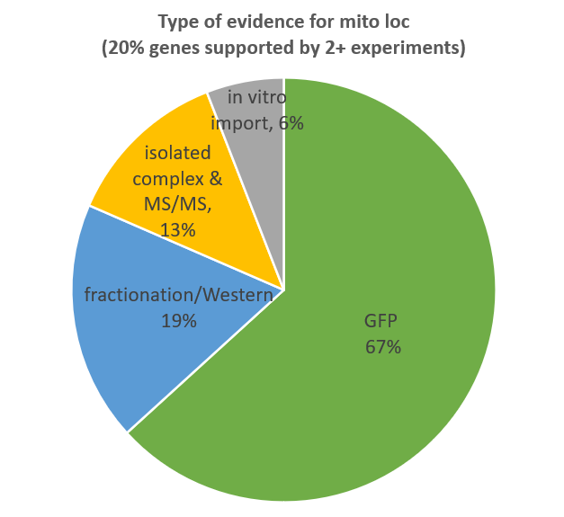
Protocol for gold+ via manual review in Arabidopsis thaliana
Use TAIR & SUBA databases to compile potential mito proteins and associated PubMed IDs
Assign “possible_mito” label if any mito annotation TAIR or SUBA N=4395 possible_mito
Identify subset with PMID of experimental evidence for manual review N=746 genes for manual review
Link each gene to all PMIDs associated with GO mito annotation N=361 unique PMIDs
Assign gold+ if an associated PMID shows mito loc by any of these methods:
GFP-tagging/microscopy that co-localizes with mito marker (MitoTracker, AOX-RFP, etc); either full-length or N-terminal region
Fractionation & Western (with proper controls)
Presence in Co-IP pulldown of mito complex (especially in crystal structure)
In vitro import assay
Not counted as gold+ evidence:
MS/MS
functional studies of KO (eg lower complex I upon KO)
Yeast complementation
Note lower bar if protein is BBH to human/yeast mito gene (eg lack of proper control)

Slide 21
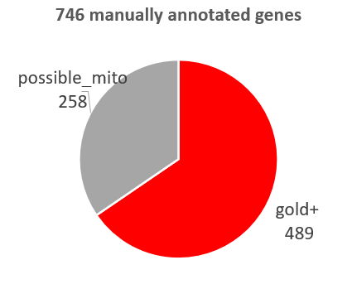
Arabidopsis thaliana gold+ manual annotation results

Slide 22
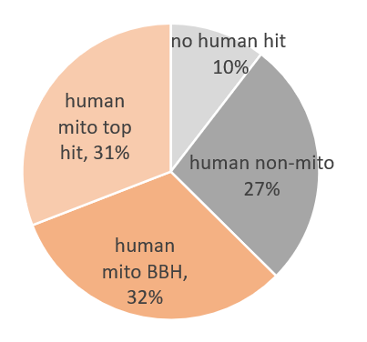
Arabidopsis thaliana gold+: two-thirds have human mito homolog

Slide 23
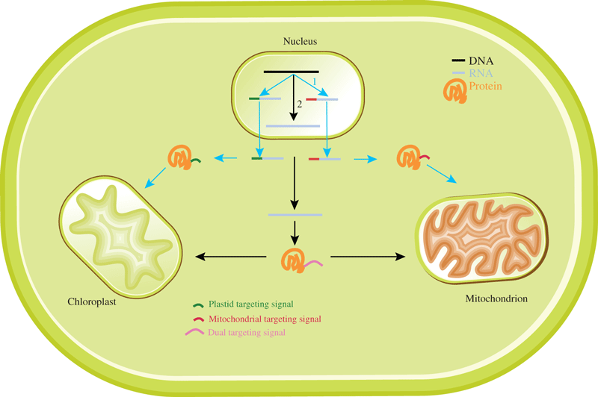
Extensive dual targeting between chloroplast and mito
Note > 54/489 gold+ have good evidence for dual targeting (catalogs of >100 dual targeted proteins, but not all great evidence)
Note 13/489 targeted to mito and another location (eg peroxisome, cytosol, etc)
The FEBS Journal, Volume: 276, Issue: 5, Pages: 1187-1195, First published: 16 February 2009, DOI: (10.1111/j.1742-4658.2009.06876.x)

Slide 24
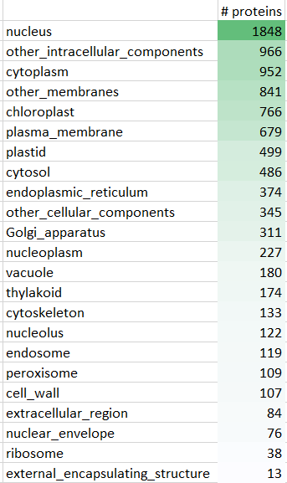
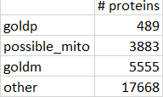
Protocol for gold-
Assign gold- if evidence of non-mito loc from GO with strong evidence code (excluding gold+ or possible_mito):
EXP= Direct experimental evidence
IDA= Inferred by direct assay
TAS= traceable author statement
IC= Inferred by curator
Gold- compartment annotations

Slide 25
Use Arabidopsis gold+ and gold- : best conditionally independent features
Naïve bayes
Conclusions:
TargetP2.0 alone is better than bucket biochem MS/MS
By combining features, now ~60% sensitivity at 20% FDR
Lots of room for improvement!

Slide 26
Gold+ status for all MITO-EPI species
Species | Gold+ mito | Status | # Gold+
Human | MitoCarta3.0 | n/a | 1136
Yeast | Vogtle, Nat Comm 2017 | n/a | 986
Species | Gold+ mito method | Status | # Gold+
Trypanosoma | Literature curation | done | 397
Leishmania | BBH from Tryp | done | 352
Acanthamoeba | BBH human & yeast mito | done | 270
Giardia | Literature curation | need to redo | 31
Arabidopsis | Literature curation | done | 489
Plasmodium | Literature curation | not started
Babesia | BBH from Plasmodium | not started

Slide 27
Gold+ and gold- per MITO-EPI species
Gold+: strong evidence mitochondria from literature manual curation
Possible_mito: any evidence mito in GO (including high throughput papers)
Gold-: strong evidence non-mito in GO (excluding gold+ or possible_mito)
Other: all remaining proteins
Species | Gold+ | Gold+ Status | Gold- | Gold+ | possible | Gold- | other | Total
Trypanosoma | Literature curation | done | GO non-mito (EXP, IDA, TAS, IC) | 397 | 1390 | 4930 | 3088 | 9805
Leishmania | BBH from Tryp | done | BBH to Tryp gold- | 352 | 1104 | 3359 | 3903 | 8721
Acanthamoeba | BBH human & yeast mito | done | BBH human & yeast non-mito | 270 | 2131 | 1193 | 11427 | 15021
Giardia | Literature curation | need to redo | GO non-mito (EXP, IDA, TAS, IC) | 31 | 14 | 324 | 9300 | 9669
Arabidopsis | Literature curation | done | GO non-mito (EXP, IDA, TAS, IC) | 489 | 3883 | 5555 | 17668 | 27595
Plasmodium | Literature curation | not started | GO non-mito (EXP, IDA, TAS, IC)* | ? | 593 | 757 | 3923 | 5273
Babesia | BBH from Plasmodium | not started | BBH to Plasmodium gold- |  |  |  |  | 4132
* For Plasmodium: we will assign possible_mito to homologs of toxo mito, so these are not included in gold-. Then we can use orthologs to toxo mito as a separate feature

Slide 28
Appendix

Slide 29
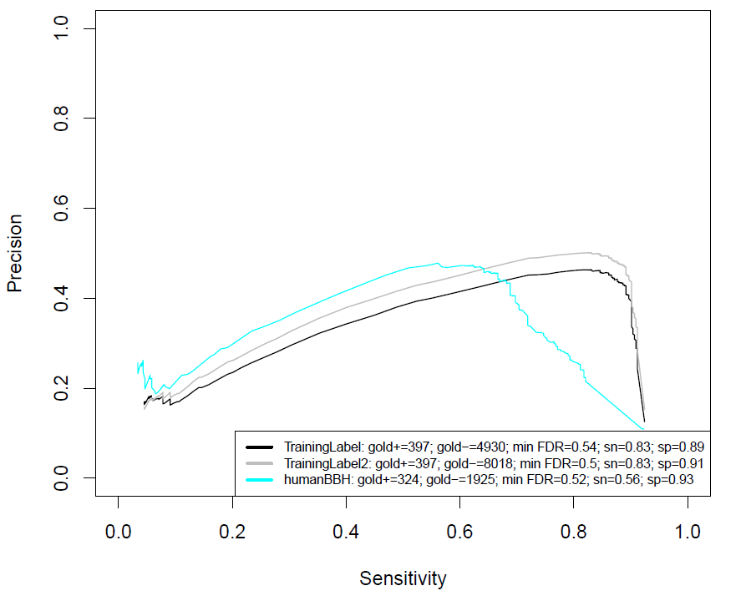
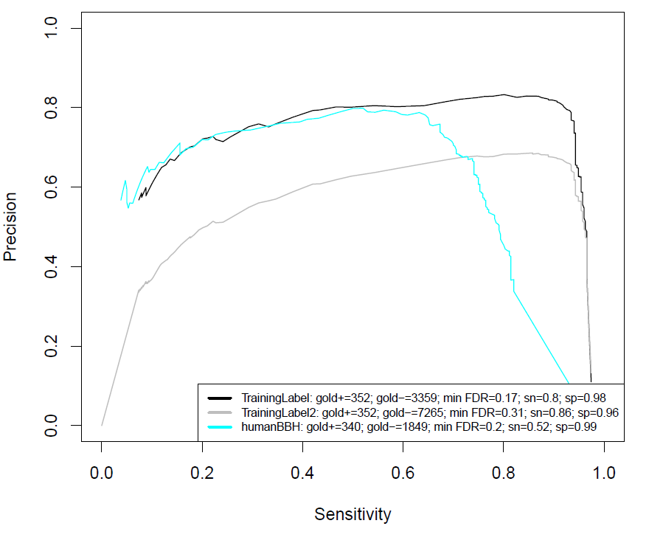
Sensitivity vs Precision in MS/MS from mito vs whole cell lysate
Trypanosoma
Leishmania
Gold+ literature,
Gold- from GO nonmito
humanBBH
Gold+ literature,
Gold- everything but gold+/possible_mito

Slide 30
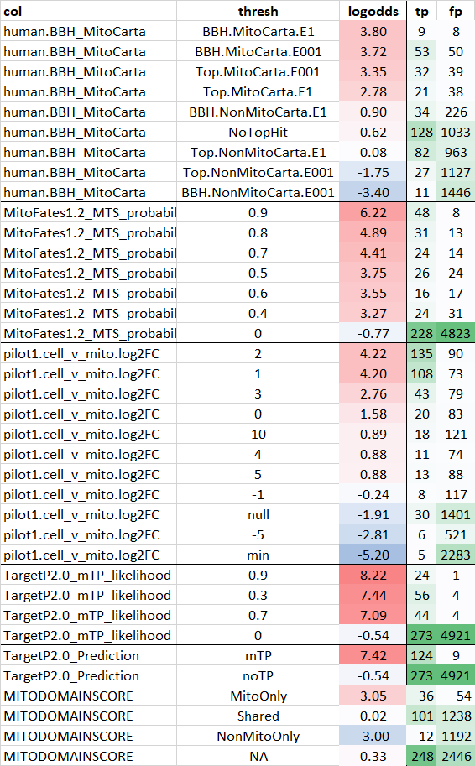
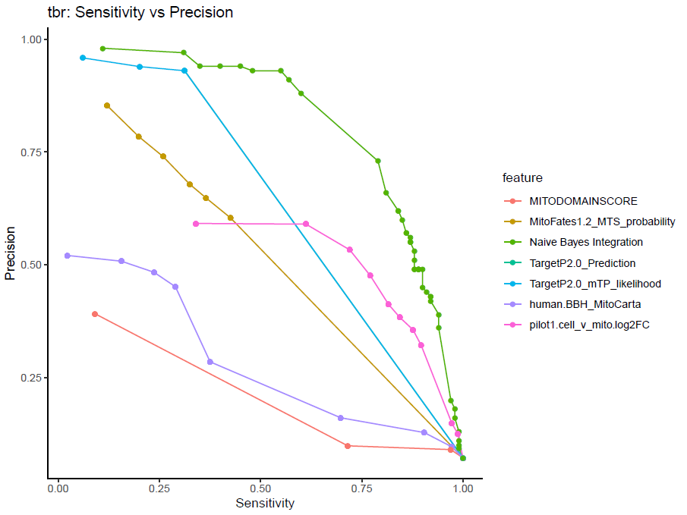
Naïve Bayes integration & logodds scores for Tbr
TargetP2.0
Naïve Bayes
Naïve Bayes
MitoFates
Pilot1 MS
Pilot1 MS
HumanMitoCarta
Domain2022
MitoFates
Domain2022
TargetP2.0
BBH_MitoCarta
TargetP2.0: not much difference between categorical mTP vs noTP vs likelihood score

Slide 31
Note human’s yeastMito feature much better than tbr’s humanMito feature
Human Naïve Bayes
AUC ~ 50%
Trypanosoma Naïve Bayes
AUC ~ 25%
HumanMitoCarta
YeastMito

