Slide 1
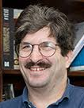
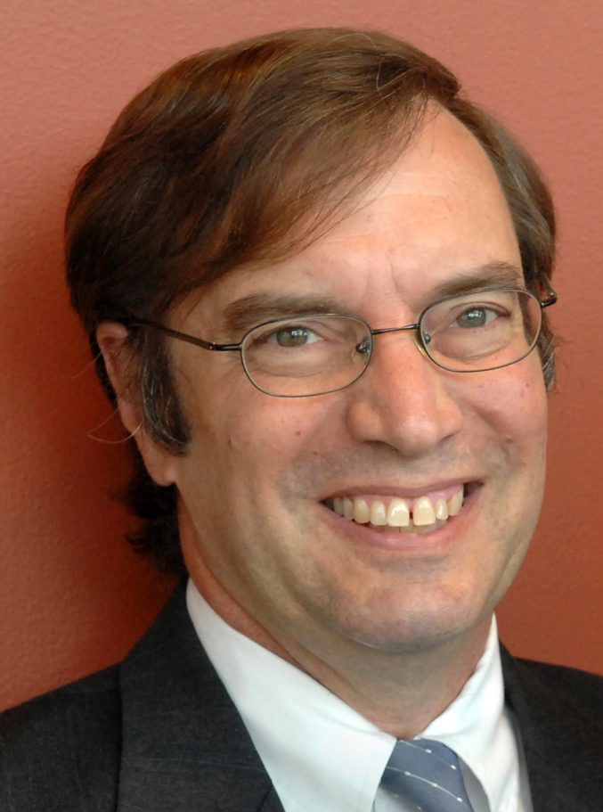
FAA 2.0: towards definitive medicines for FA
Genes → Genetic Modifiers → Environmental Modifiers → Pathogenesis → Biomarkers
Liu Lab
DNA editing
Ruvkun Lab
worm genetics
Mootha Lab
hypoxia
Seidman Lab
Cardiomyopathy
Gupta Lab
Digital biomarkers

Slide 2
FAA 2.0: towards definitive medicines for FA
Genes → Genetic Modifiers → Environmental Modifiers → Pathogenesis → Biomarkers
Liu Lab
DNA editing
Ruvkun Lab
worm genetics
Mootha Lab
hypoxia
Seidman Lab
Cardiomyopathy
Gupta Lab
Digital biomarkers

Slide 3
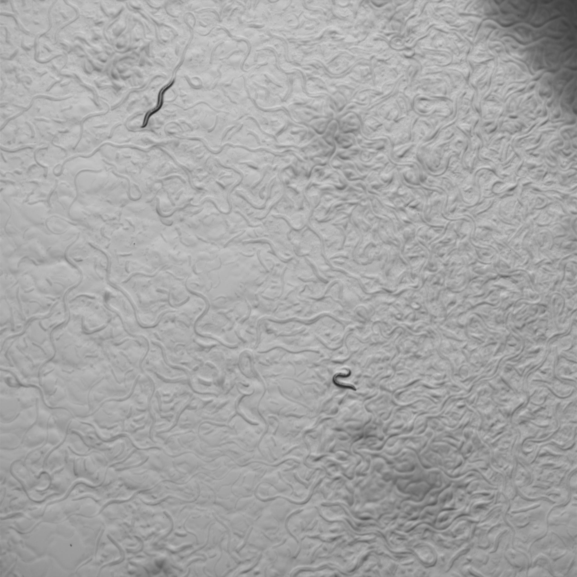
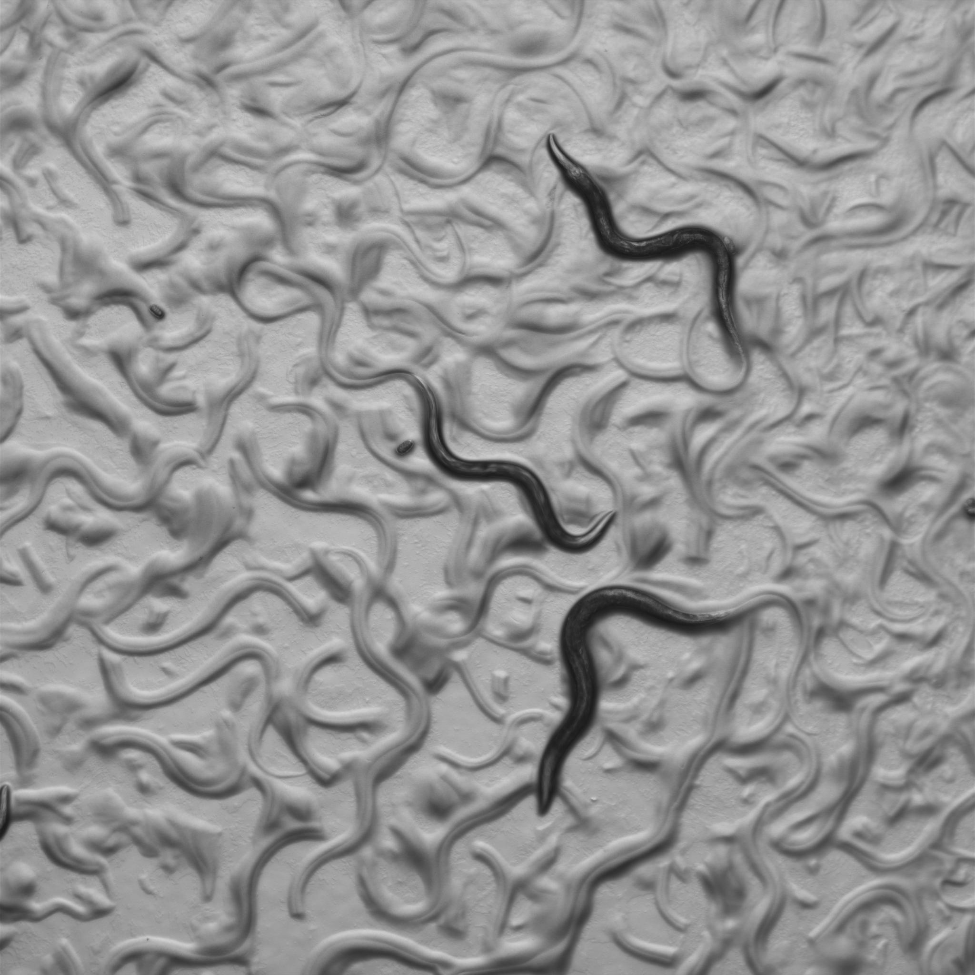
Forward genetics can reveal mutations that suppress the loss of Frataxin, and we don’t have to guess what genes they might be
EMS
P0
8% O2
1% O2
frh-1
F1
1% O2
frh-1; sup/+
F2
8% O2
frh-1
frh-1; suppressor
frh-1; suppressor
Genetic suppressors can identify new therapeutic pathways
Genetic suppressors may shed light on hypoxia rescue
Notes:
comment on oxygen tensions? c. elegans natural habitat, and brain o2 levels comparable
Virtue of EMS screens, techniques to “clone” genes

Slide 4
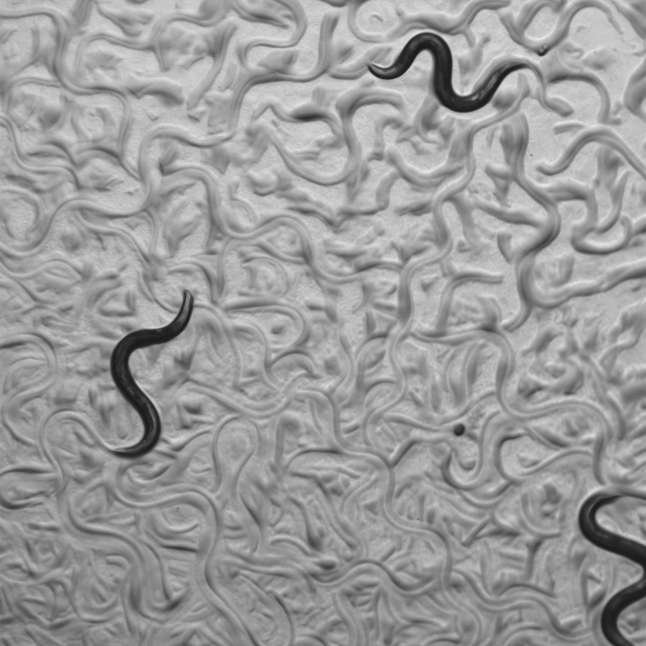
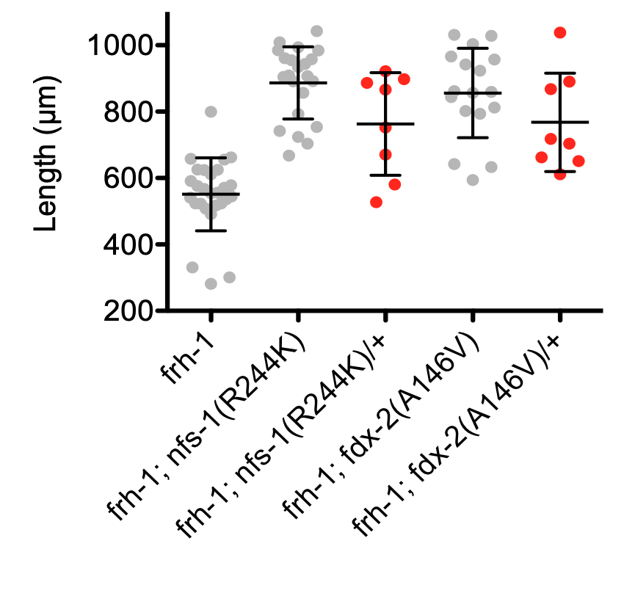
Dominant missense mutations in NFS-1 and FDX-2 suppress the oxygen lethality of Frataxin loss
frh-1(tm5913)
frh-1(tm5913);
nfs-1(R244K)
frh-1(tm5913);
fdx-2(A126V)

Slide 5
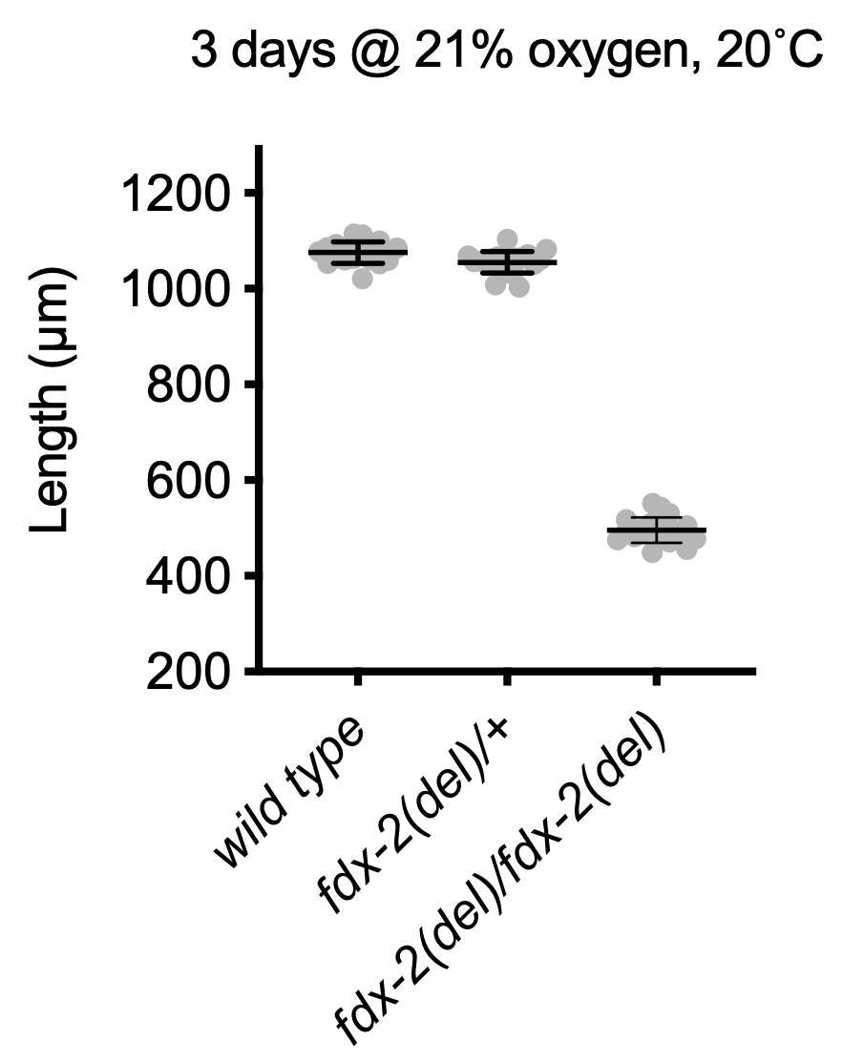
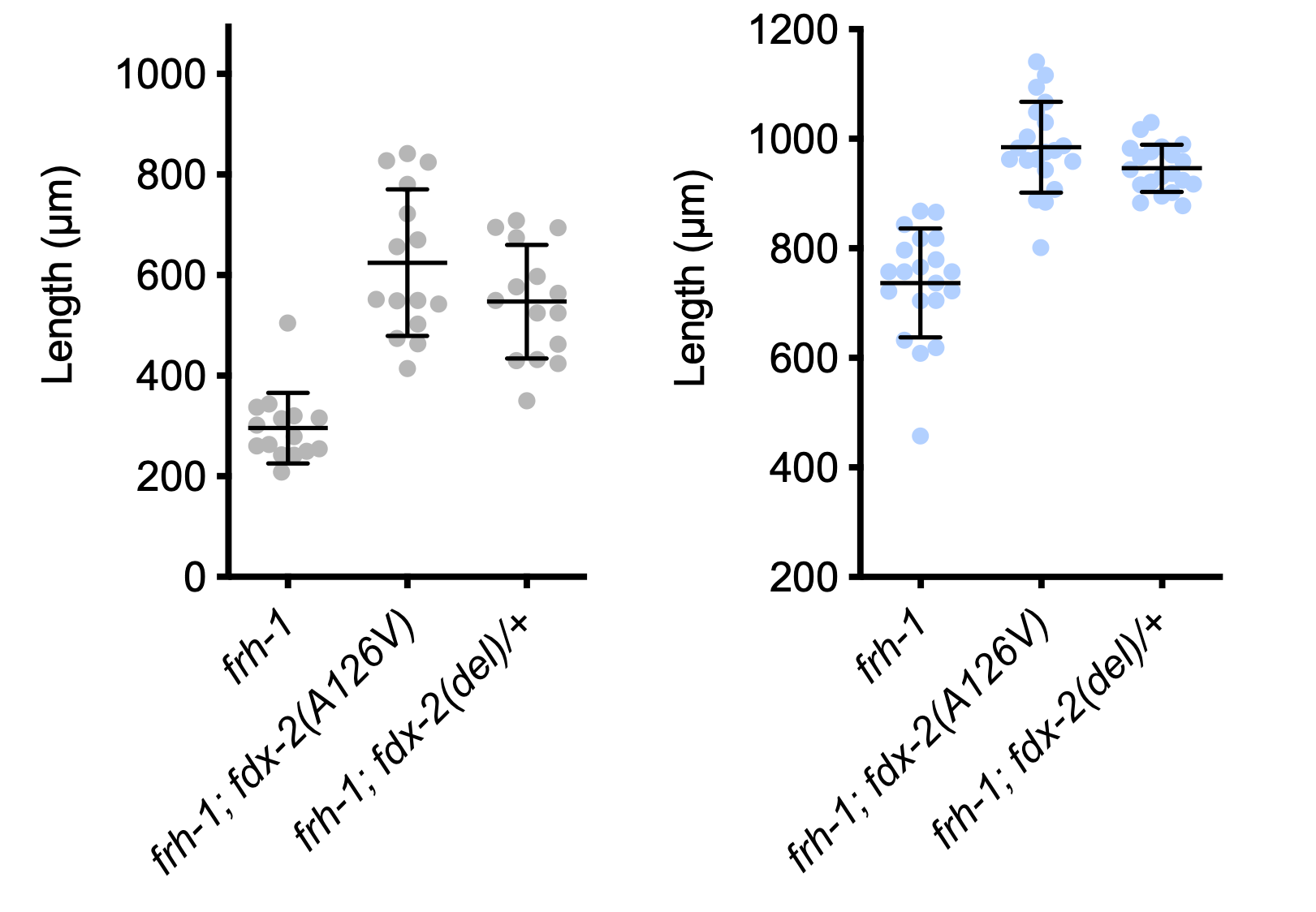
An FDX2 null mutant heterozygote, fdx-2(0)/fdx-2(+), rescues a Frataxin null mutant for oxygen lethality and slow growth in 1% oxygen
21% O2
10% O2
1% O2
]
Losing one copy of FDX2 has no effect in wild type, but improves Frataxin mutants
Lowering the amount of wild type FDX2 may Frataxin loss
fdx-2
8 bp deletion
100 bp

Slide 6
The FDX-2 suppressor residues lie at NFS-1-FDX-2 interaction surface
Frataxin
NDUFAB1/ ACP
LYRM4
FDX2
NFS1
ISCU
FDX2
RED = residues necessary for binding
P127S
YELLOW = residues mutated in suppressor screen

Slide 7
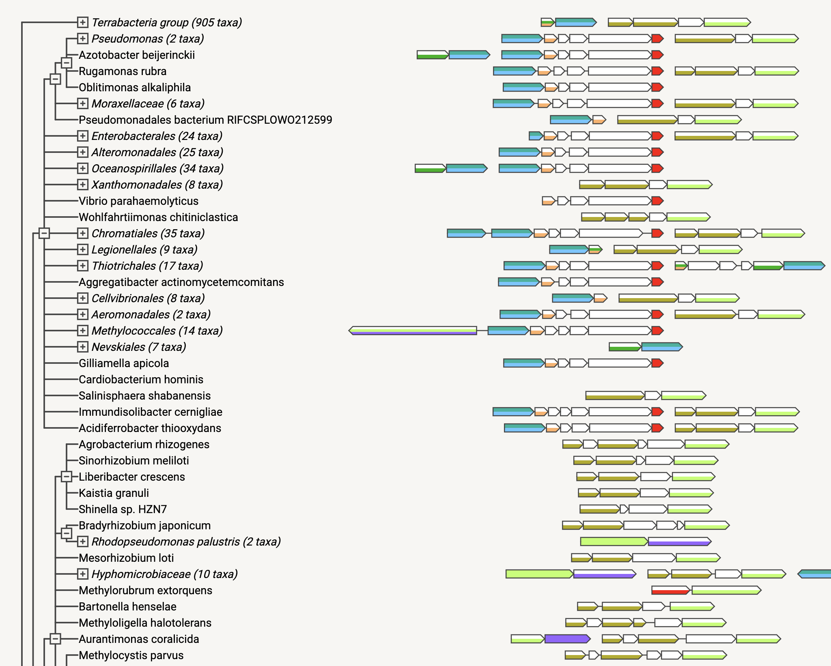

Slide 8
FAA 2.0: towards definitive medicines for FA
Genes → Genetic Modifiers → Environmental Modifiers → Pathogenesis → Biomarkers
Liu Lab
DNA editing
Ruvkun Lab
worm genetics
Mootha Lab
hypoxia
Seidman Lab
Cardiomyopathy
Gupta Lab
Digital biomarkers

Slide 9
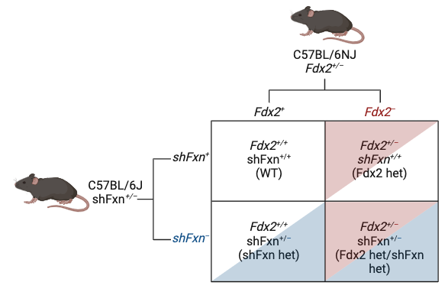
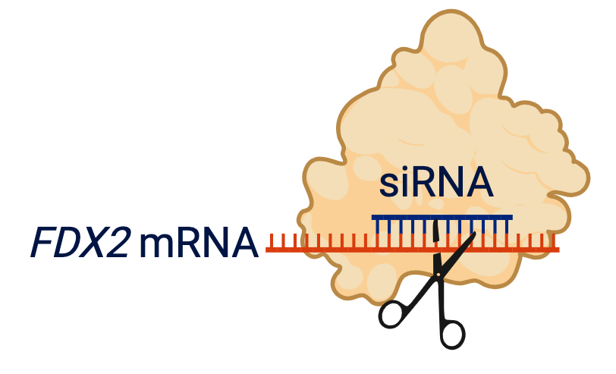
Further validation of mammalian FDX2 as a therapeutic target
Mouse models
Obtained Fdx2^{em1Murr/Murr} mice from Jackson labs (Summer 2023)
Fdx2–/– mouse show embryonic lethal by E9.5
Fdx2^{+/–} mouse sometimes show ocular defects
Crossed Fdx2 ^{+/–} to shFxn^{+/–} (Fall 2023)
Ongoing, 10 male mice per group
Started dox at 3 months of age (February 2024)
Checking body weight each week, lifespan
Rotarod and grip testing at 12 & 15 weeks (Summer 2024)
Human cellular model
Testing pooled and individual siRNA against FDX2
Will combine with FXN KO, shRNA if needed

Slide 10
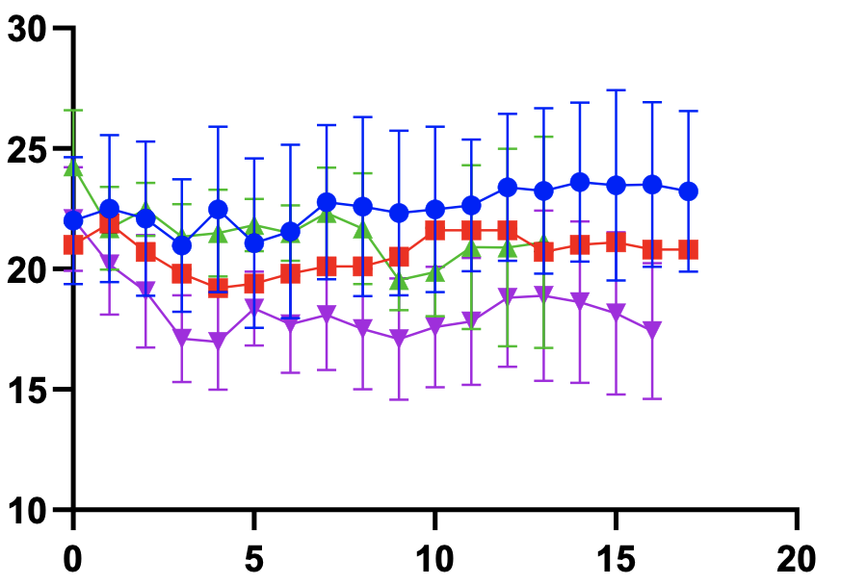
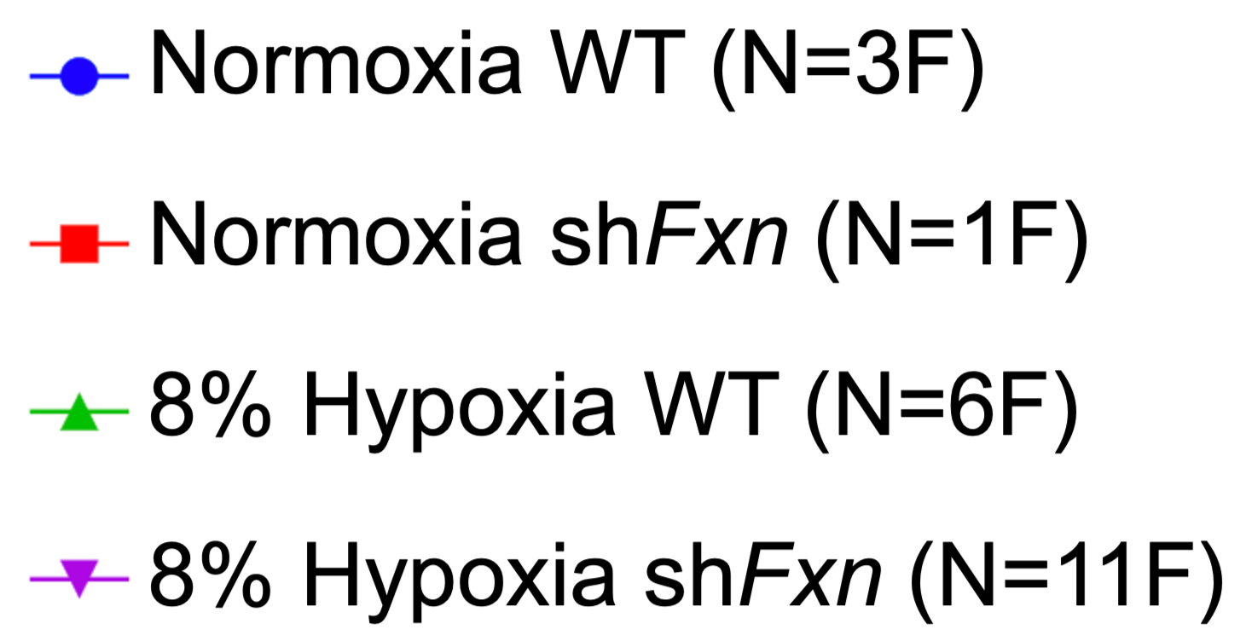
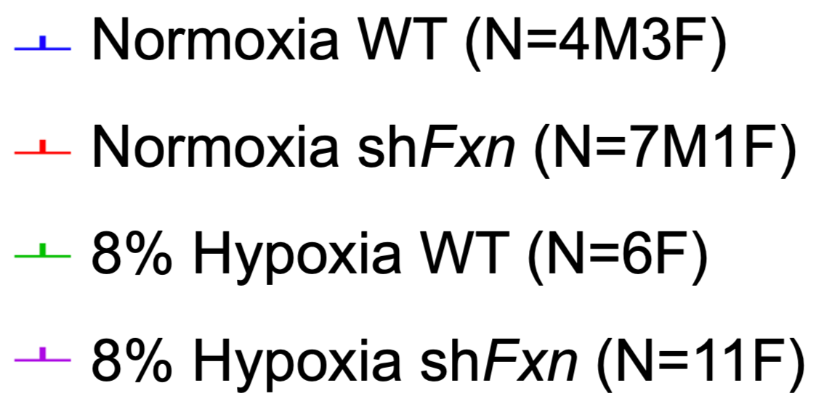
Will 8% hypoxia prevent early death in shFxn mice?
8% hypoxia shFxn mice body weight change
8% hypoxia shFxn survival curve
Weight (g)
Survival (%)
Weeks of doxycycline
Weeks of doxycycline
Normoxia WT (N=3F)
Normoxia shFxn (N=1F)
8% Hypoxia WT (N=6F)
8% Hypoxia shFxn (N=11F)

Slide 11
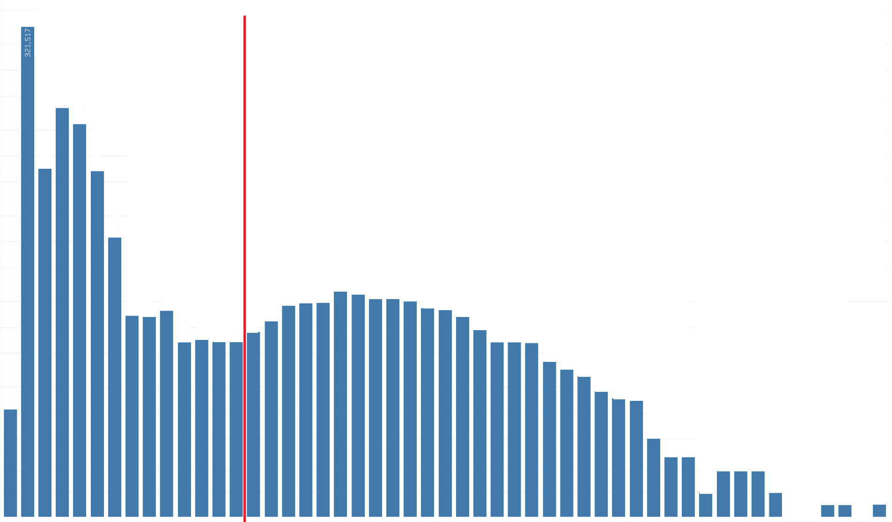
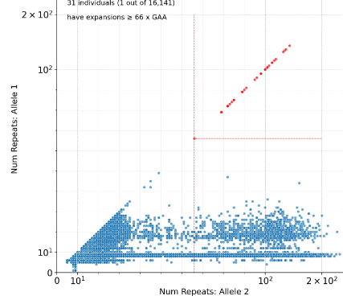
UK biobank analyses of GAA repeat length in 500k individuals
9 copies
31 homozygous (1 in 16k)
20 with GAG interruptions
none with ataxia
11 pure GAA (1 in 45k)
4 with ataxia diagnosis
7,031 carriers
(1 in 72)
with 66-250 copies
# UK Biobank individuals
(axis in log scale)
# GAA copies : allele 1
Similar results also obtained in All of Us cohort.
0
# GAA repeats
250
# GAA repeats : allele 2

Slide 12
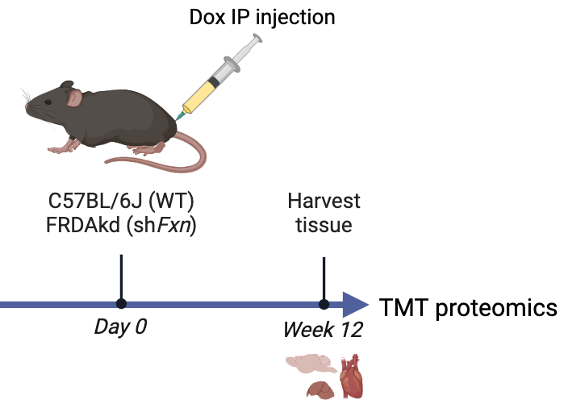
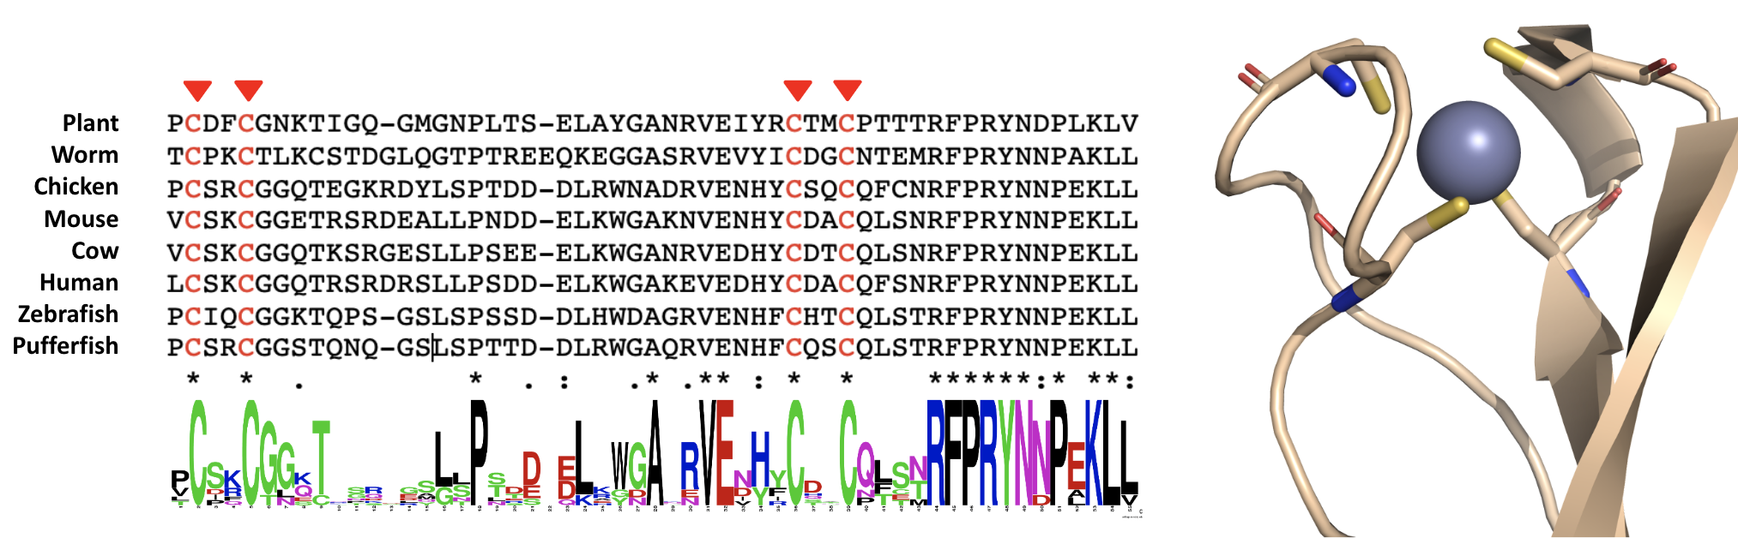
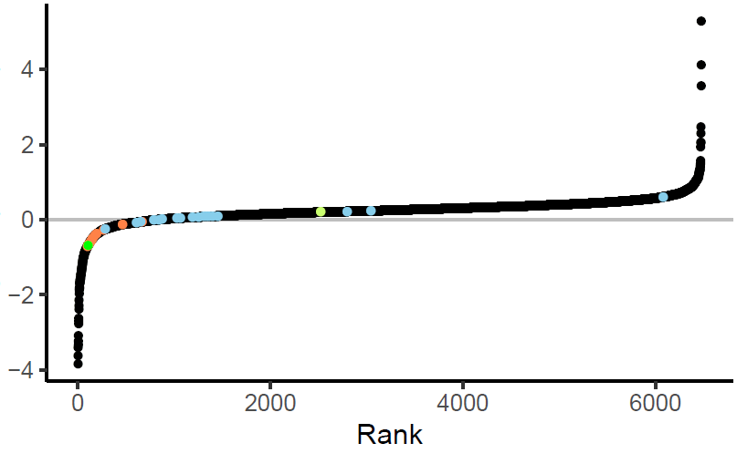
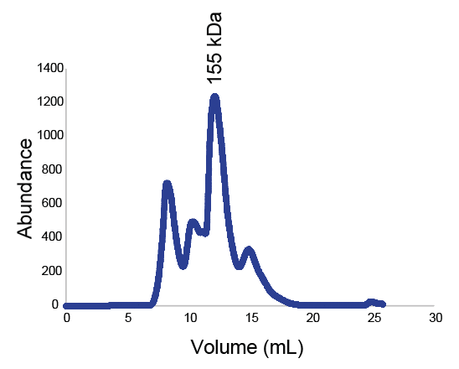
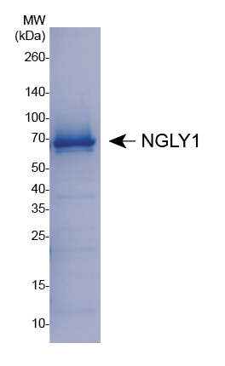
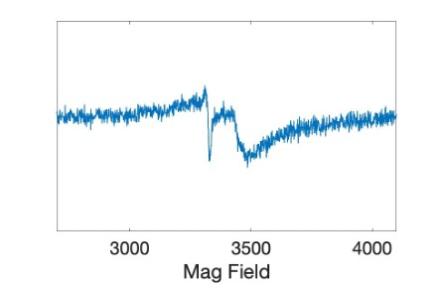
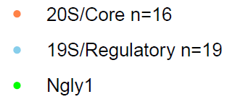
NGLY1 as a candidate, novel mediator of pathogenesis
Model
Heart
NGLY1 MSA
PDB ID: 2F4M
Proteasome
subunits
Log2 Fold Change
(shFxn / WT)
4Fe-4S
NGLY1
Purification
EPR
NGLY1 and most proteasome subunits are decreased in shFxn mouse tissue.
Preliminary studies indicate a 4Fe-4S cluster.
Rousseau, Bertolotti Nat Rev Mol Cell Biol 2018
Lehrbach, Breen, Ruvkun, Cell 2019
Lehrbach, Ruvkun, eLife 2016

Slide 13
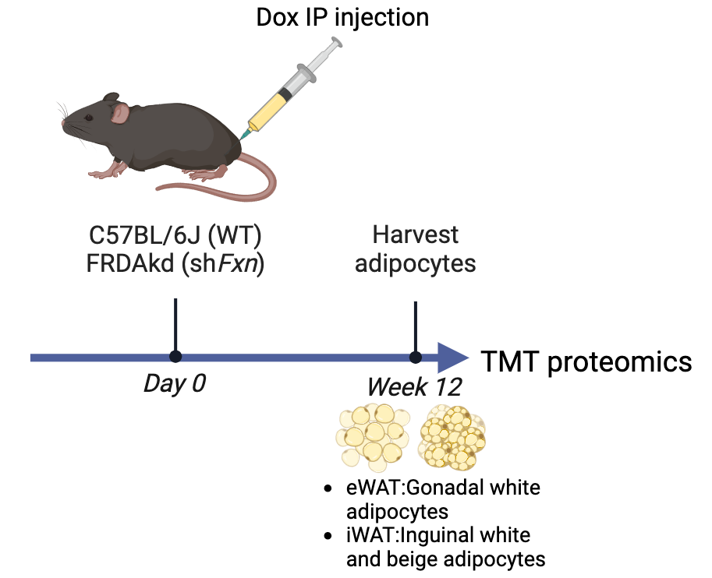
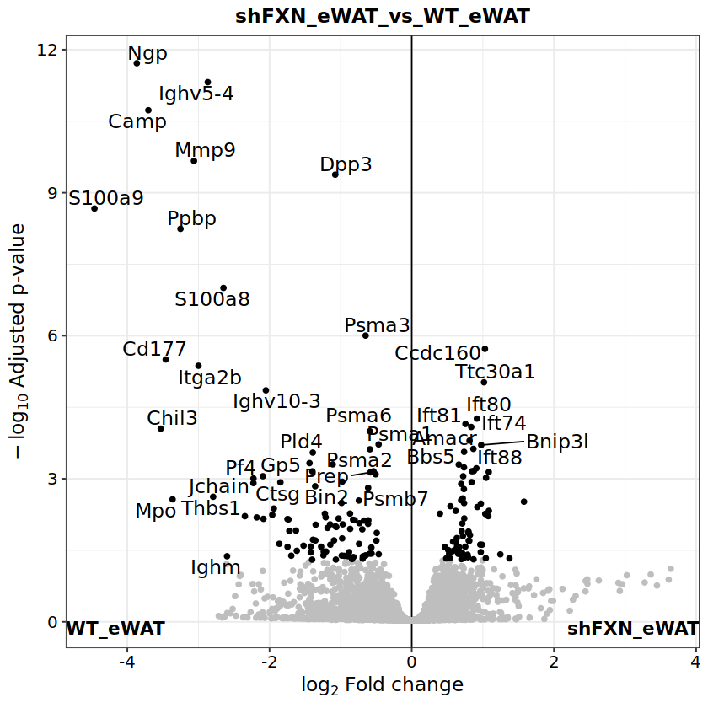
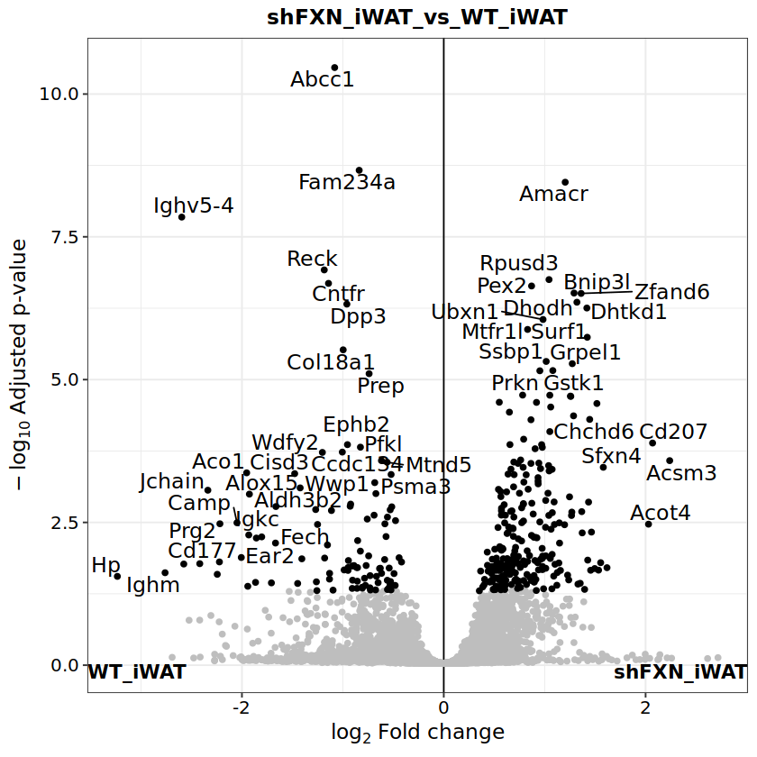
Understanding adipose tissue pathogenesis in shFxn mice
shFxn vs WT comparisons:
eWAT
iWAT

Slide 14
FAA 2.0: towards definitive medicines for FA
Genes → Genetic Modifiers → Environmental Modifiers → Pathogenesis → Biomarkers
Liu Lab
DNA editing
Ruvkun Lab
worm genetics
Mootha Lab
hypoxia
Seidman Lab
Cardiomyopathy
Gupta Lab
Digital biomarkers

Slide 15
FAA 2.0: towards definitive medicines for FA
Genes → Genetic Modifiers → Environmental Modifiers → Pathogenesis → Biomarkers
Liu Lab
DNA editing
Ruvkun Lab
worm genetics
Mootha Lab
hypoxia
Seidman Lab
Cardiomyopathy
Gupta Lab
Digital biomarkers

Slide 16
Development of Sensitive Motor Outcomes for FA
Goals:
Create objective measures that are sensitive to disease change, reliable, and reflect function
Create measures that are applicable across all ages and stages of disease
Study:
Record natural behavior at home for a week
Repeat every 6 months
Hypothesis: Movement building blocks called
submovements become progressively slower
and smaller in FA
Faye Yang

Slide 17
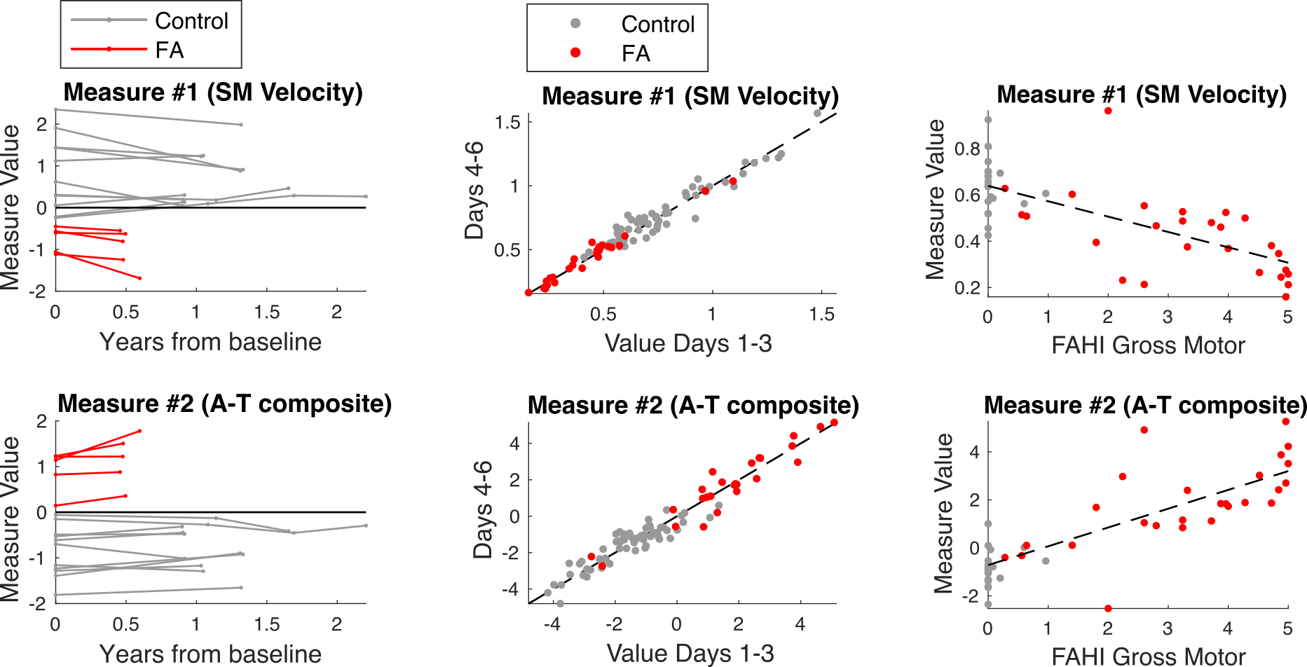
Ankle Sensor Motor Measures
28 Individuals with FA; Six-month follow-up data in 5
ICC = 0.98
r = -0.57
ICC = 0.97
r = 0.67

Slide 18
Next Steps
Train FA-specific machine learning models
Analyze submovement sequences using transformer and other sequence models
Characterize individual variability in movement patterns over a day
Incorporate sensors more broadly in FA natural history studies
Collect data in young children and presymptomatic individuals

