Slide 1
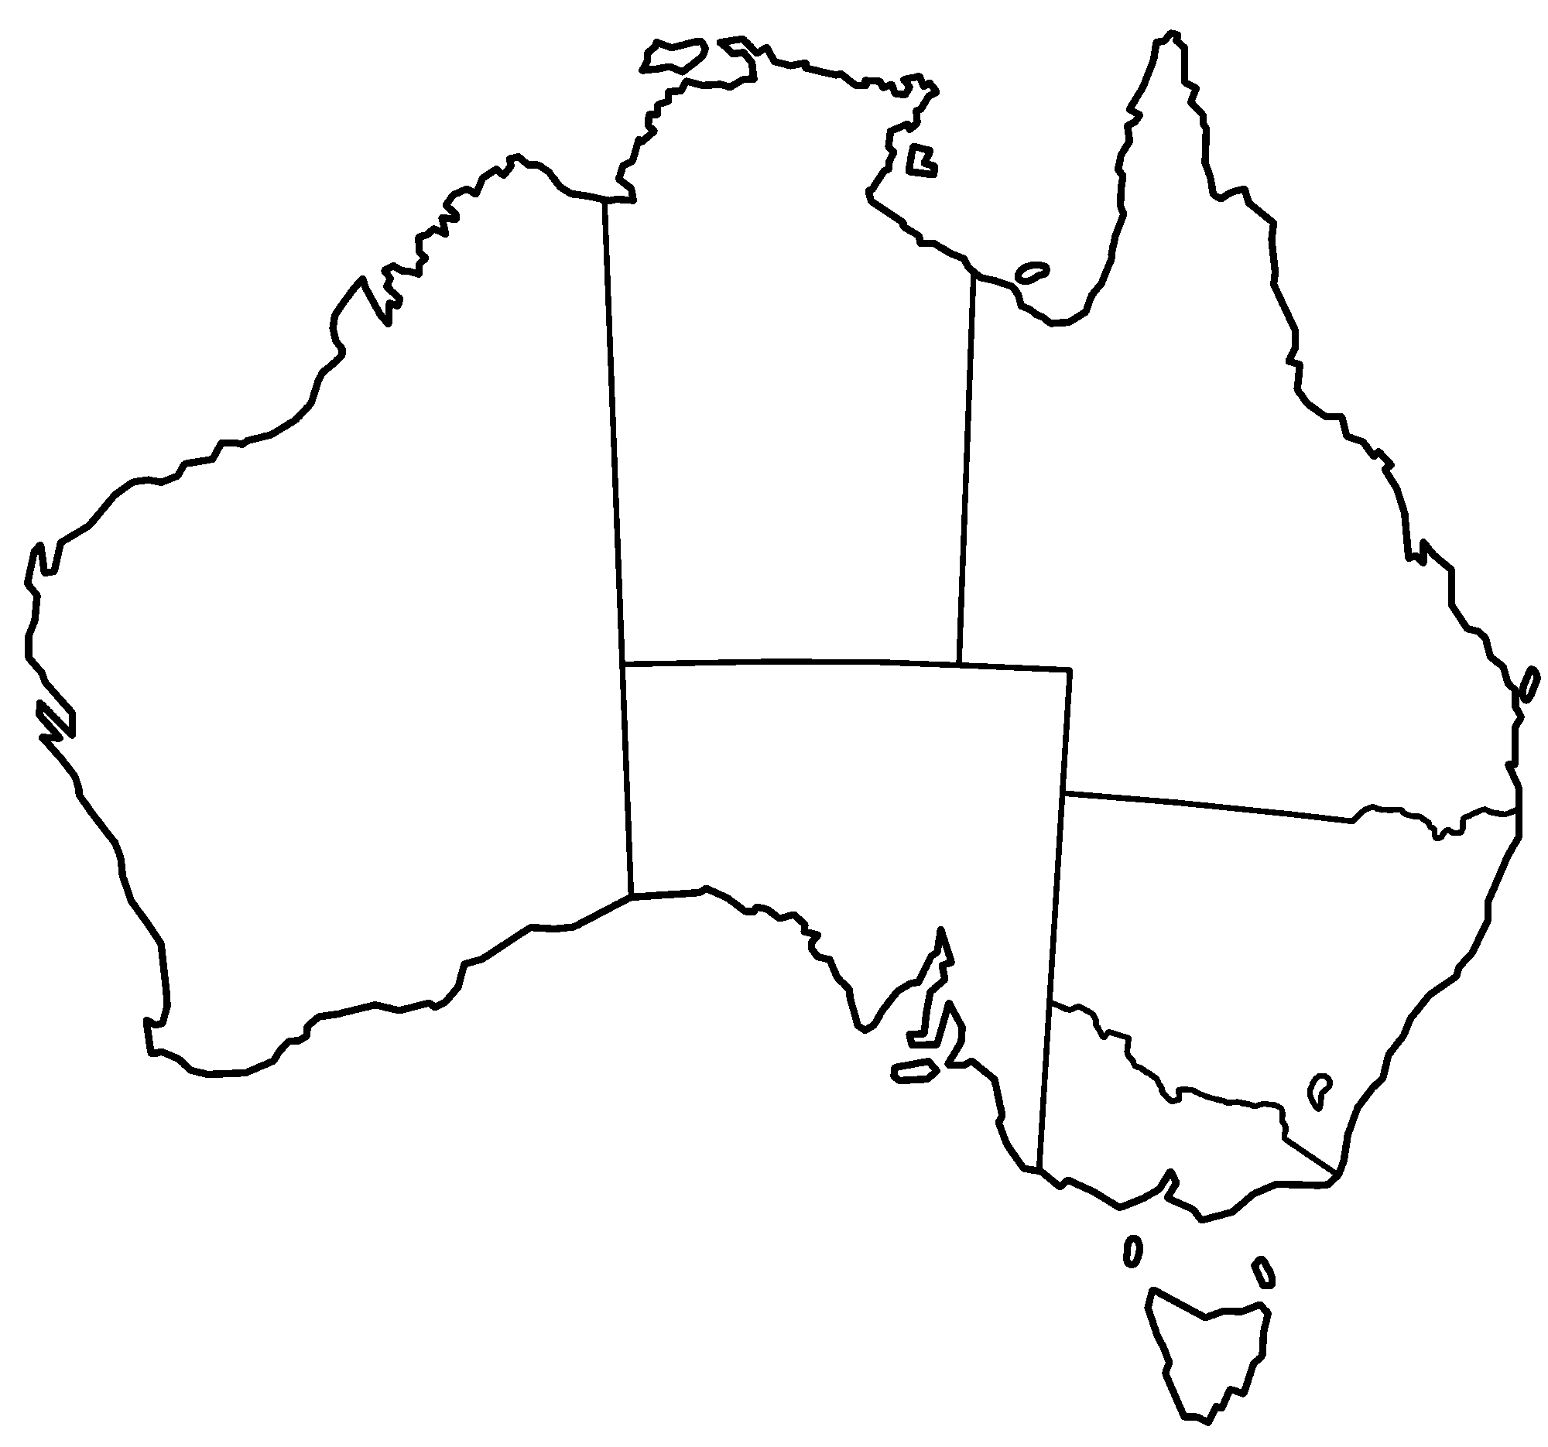
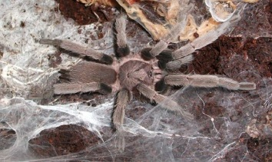
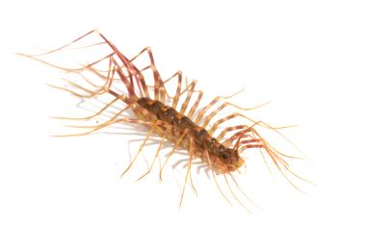
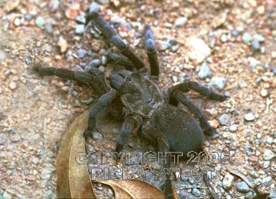
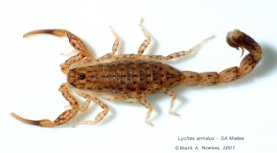
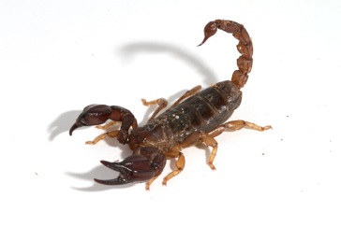
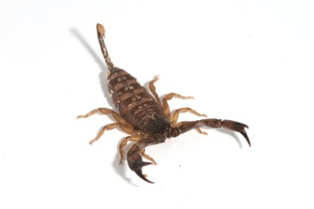
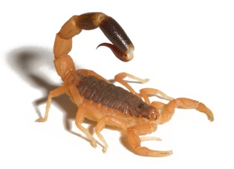
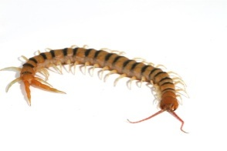
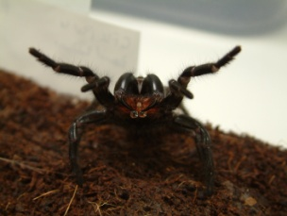
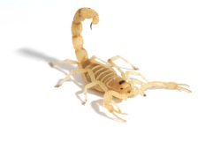
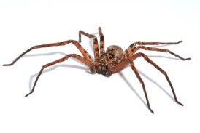
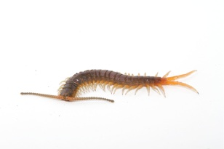
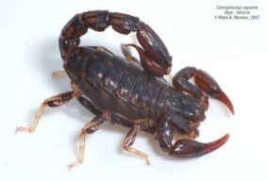
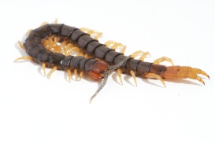
7 scorpions
4 centipedes
1 spider
C. Tropix
Thereuopoda sp.
L. variatus
S. foelschei
U. manicatus
I. vescus
L. weigensis
S. Morsitans
H. infensa
A. xerolimniorum
L. buchari
H. jugulans
E. rubripes
Centipedes
Spiders
Scorpions
C. squama
C. westwoodi

Slide 2
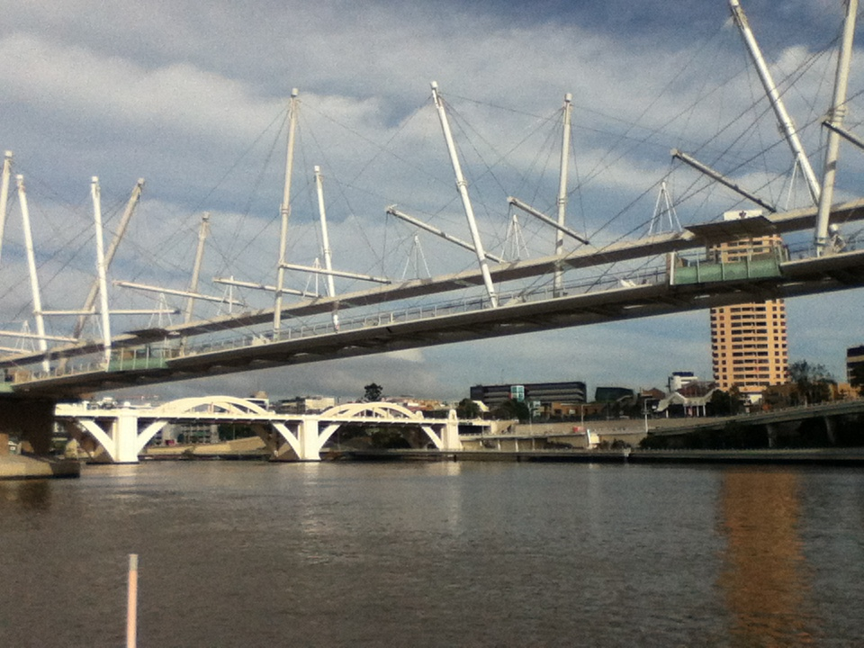
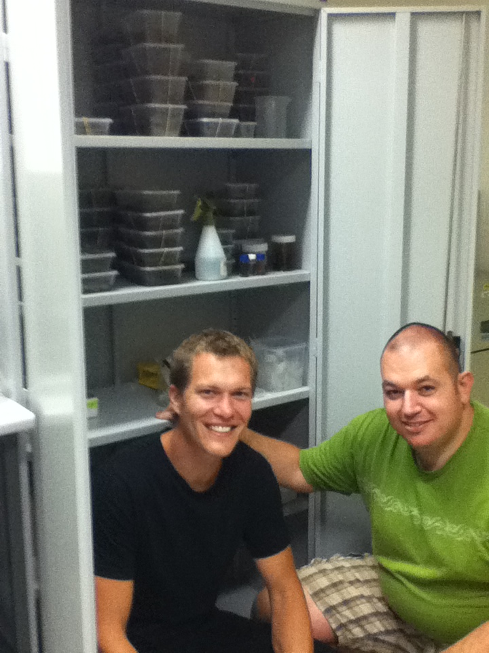
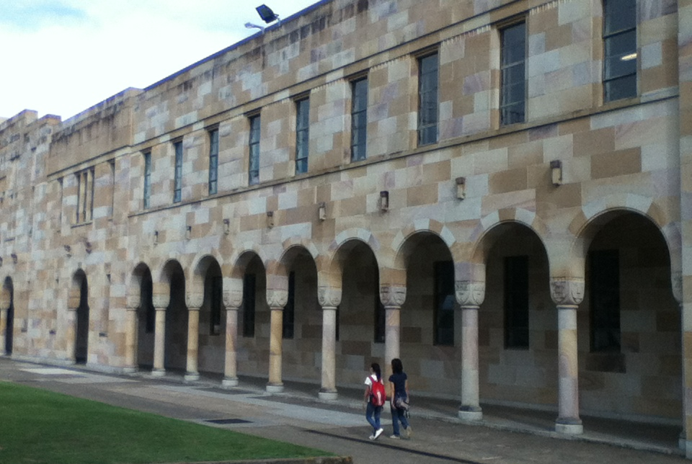
University of Queensland
Brisbane
Eivind Undheim
David Morgenstern

Slide 3
Sample Experiment Summary
Centipede
1 ug venom
Reduce/alkylate
Cys-ethanolyl-gp
Digest
500ng & 500 ng
Trypsin Glu-C
De-salt
LC-MS/MS 150 ng
300A Microsorb 3um C18
C18 120A Reprosil 3um
Orbitrap Elite CID/HCD/ETD
Spectrum Mill
Scorpion
1 ug venom
Reduce/alkylate
De-salt
LC-MS/MS 300,600 ng
C18 300A Microsorb 3um
Orbitrap Elite CID/HCD/ETD
Spectrum Mill
Spider
1 ug venom
Reduce/alkylate
De-salt
LC-MS/MS 300ng
C18 300A Microsorb 3um
Orbitrap Elite CID/HCD/ETD
Spectrum Mill
Cys-ethanolyl-sol
Cys-iodoacetamide
C18 200A Magic 3um
Cys-MeAziridine
Digest
Lys-C
Cys
iodoacetamide
Cys
MeAziridine
Digest
Lys-C
Database
Venom gland mRNA library
454 sequencing
  300-400 bp reads
Transcriptome assembly (MIRA)
Translation (extractORFS.pl)
Database
Venom gland mRNA library
454 sequencing
  300-400 bp reads
Transcriptome assembly (Trinity)
Translation (extractORFS.pl)
Database
Venom gland mRNA library
Ion Torrent sequencing
  75-150 bp reads
Transcriptome assembly (Trinity)
Translation (extractORFS.pl)

Slide 4
Undigested Scorpion Venoms?
P83405 BUTJU Neurotoxin Tx-1
V/G|C|E E|C/P/A H/C K 0 11 17 CID K120215_HjRA_ff4f4f4_pccc_01.2400.2400.3.pkl.spo
V G\C/E/E/C/P/A H/C K 0 11 17 HCD K120215_HjRA_ff4f4f4_pccc_01.2401.2401.3.pkl.spo
V/G|C|E|E|C/P A/H/C K G 0 12 16 CID K120215_HjRA_ff4f4f4_pccc_01.2422.2422.3.pkl.spo
V/G/C|E/E|C P|A|H|C|K G 0 12 16 ETD K120215_HjRA_ff4f4f4_pccc_01.2424.2424.3.pkl.spo
V G\C/E/E/C/P/A/H/C K G 0 12 16 HCD K120215_HjRA_ff4f4f4_pccc_01.2423.2423.3.pkl.spo
V|G\C|E|E\C P|A|H\C|K\G\K 0 13 15 ETD K120215_HjRA_ff4f4f4_pccc_01.2210.2210.4.pkl.spo
V G\C E E C/P/A/H/C/K/G K 0 13 15 HCD K120215_HjRA_ff4f4f4_pccc_01.2209.2209.4.pkl.spo
V/G|C|E|E|C/P A H C K G K 0 13 15 CID K120215_HjRA_ff4f4f4_pccc_01.2205.2205.3.pkl.spo
V/G/C|E|E C/P A H/C K G K\N 0 14 14 CID K120215_HjRA_ff4f4f4_pccc_01.2211.2211.3.pkl.spo
V/G C/E/E C P\A|H\C|K G|K\N 0 14 14 ETD K120215_HjRA_ff4f4f4_pccc_01.2213.2213.3.pkl.spo
V/G/C/E/E/C/P A H C K G K N A K\P 0 17 11 CID K120215_HjRA_ff4f4f4_pccc_01.2286.2286.4.pkl.spo
V/G\C\E|E\C P|A|H\C|K|G|K|N|A|K P 0 17 11 ETD K120215_HjRA_ff4f4f4_pccc_01.2288.2288.4.pkl.spo
V/G/C|E/E C/P A/H C K G K/N/A K P T C D 0 20 8 CID K120215_HjRA_ff4f4f4_pccc_01.2351.2351.4.pkl.spo
V/G\C\E|E\C P\A|H\C|K|G|K/N|A|K P T C\D 0 20 8 ETD K120215_HjRA_ff4f4f4_pccc_01.2353.2353.4.pkl.spo
V/G C E E|C|P A H C K G K N A K P T C\D\D 0 21 7 CID K120215_HjRA_ff4f4f4_pccc_01.2380.2380.5.pkl.spo
V/G\C|E|E C P|A|H\C|K G K|N\A|K P T C|D\D 0 21 7 ETD K120215_HjRA_ff4f4f4_pccc_01.2382.2382.5.pkl.spo
V G\C\E\E\C P\A|H C|K G K N\A|K P T/C D\D G V C/N C/N V 0 28 0 ETD K120215_HjRA_ff4f4f4_pccc_01.3159.3159.5.pkl.spo
V G C E/E/C/P A H C K\G K N A\K|P T C D|D|G V|C\N\C\N\V 0 28 0 CID K120215_HjRA_ff4f4f4_pccc_01.3193.3193.3.pkl.spo
G C|E|E|C|P A/H\C 1 9 18 CID K120215_HjRA_ff4f4f4_pccc_01.2390.2390.2.pkl.spo
G C|E|E|C P A|H|C\K 1 10 17 CID K120215_HjRA_ff4f4f4_pccc_01.2114.2114.2.pkl.spo
G C|E|E/C P/A/H/C K 1 10 17 HCD K120215_HjRA_ff4f4f4_pccc_01.2115.2115.2.pkl.spo
G/C|E|E|C/P A H C K G 1 11 16 CID K120215_HjRA_ff4f4f4_pccc_01.2159.2159.3.pkl.spo
G C|E|E\C P|A|H|C|K G 1 11 16 ETD K120215_HjRA_ff4f4f4_pccc_01.2161.2161.3.pkl.spo
G C|E|E/C/P A/H/C/K G 1 11 16 HCD K120215_HjRA_ff4f4f4_pccc_01.2167.2167.2.pkl.spo
G C/E/E C P\A|H|C|K|G\K 1 12 15 ETD K120215_HjRA_ff4f4f4_pccc_01.1872.1872.3.pkl.spo
G C\E E/C/P/A/H/C/K/G K 1 12 15 HCD K120215_HjRA_ff4f4f4_pccc_01.1871.1871.3.pkl.spo
G C/E|E|C|P A/H|C\K\G K 1 12 15 CID K120215_HjRA_ff4f4f4_pccc_01.1899.1899.2.pkl.spo
G C\E\E\C P|A|H\C|K G K|N|A|K P 1 16 11 ETD K120215_HjRA_ff4f4f4_pccc_01.2122.2122.4.pkl.spo
G/C E\E\C P A|H\C|K G K\N/A\K P T C D/D G V C N C N V 1 27 0 ETD K120215_HjRA_ff4f4f4_pccc_01.3087.3087.5.pkl.spo
C\E\E/C/P/A/H/C K 2 9 17 HCD K120215_HjRA_ff4f4f4_pccc_01.1972.1972.2.pkl.spo
C|E|E\C P/A|H|C|K G 2 10 16 ETD K120215_HjRA_ff4f4f4_pccc_01.2077.2077.3.pkl.spo
C E|E|C|P A/H|C\K\G 2 10 16 CID K120215_HjRA_ff4f4f4_pccc_01.2062.2062.2.pkl.spo
E E|C/P A/H/C K 3 8 17 HCD K120215_HjRA_ff4f4f4_pccc_01.0449.0449.2.pkl.spo
E/E|C/P/A/H|C K G 3 9 16 CID K120215_HjRA_ff4f4f4_pccc_01.1186.1186.2.pkl.spo
E E|C/P/A/H/C/K G 3 9 16 HCD K120215_HjRA_ff4f4f4_pccc_01.1060.1060.2.pkl.spo
P/A|H/C/K/G/K 6 7 15 HCD K120215_HjRA_ff4f4f4_pccc_01.2238.2238.2.pkl.spo
N A/K/P T/C|D|D|G V|C\N|C\N\V 13 15 0 CID K120215_HjRA_ff4f4f4_pccc_01.3514.3514.2.pkl.spo
A K/P T/C D|D\G V|C|N|C\N\V 14 14 0 CID K120215_HjRA_ff4f4f4_pccc_01.3492.3492.2.pkl.spo
P T C D|D|G V|C|N|C\N\V 16 12 0 CID K120215_HjRA_ff4f4f4_pccc_01.3765.3765.2.pkl.spo
C D D G V|C|N|C|N\V 18 10 0 CID K120215_HjRA_ff4f4f4_pccc_01.3628.3628.2.pkl.spo
D D G\V|C|N|C|N\V 19 9 0 CID K120215_HjRA_ff4f4f4_pccc_01.3472.3472.2.pkl.spo
D G V|C|N|C|N\V 20 8 0 CID K120215_HjRA_ff4f4f4_pccc_01.3388.3388.2.pkl.spo
David Morgenstern, University of Queensland

Slide 5
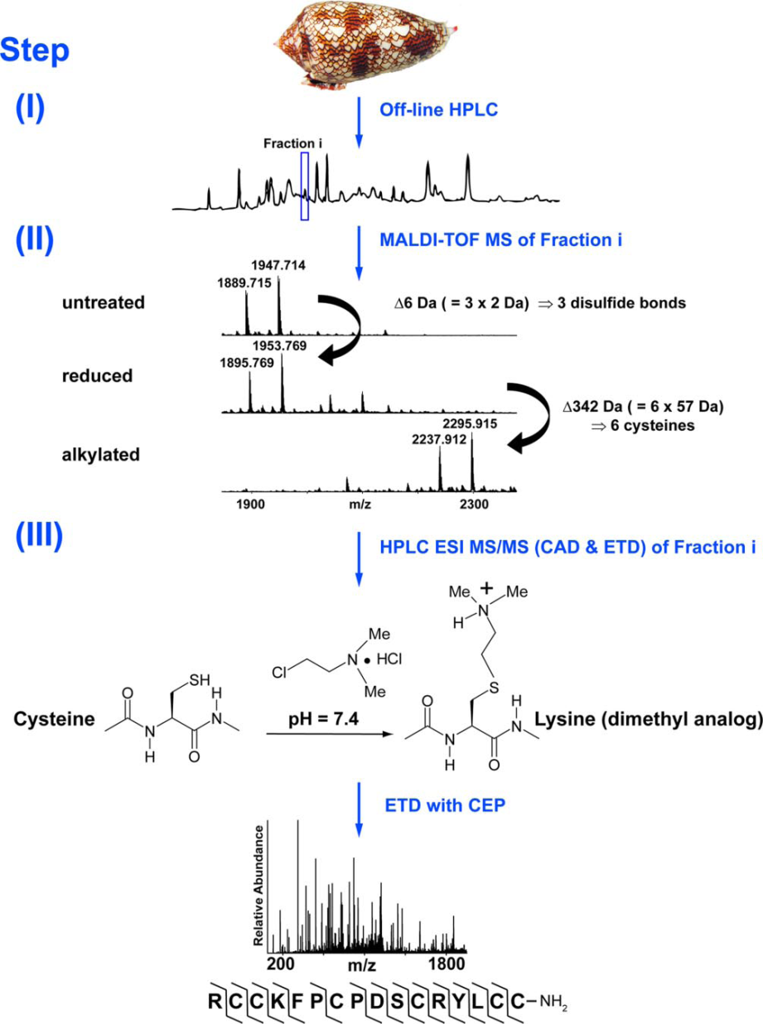
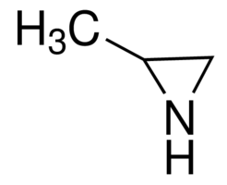
Adding Charge to Cys for better ETD
2-Methylaziridine
Fig. 1. Overview of the de novo sequencing strategy. (I) UV trace of HPLC
separation of crude venom extract from C. textile. (II) MALDI TOF MS of
fraction i after no treatment, reduction, and alkylation. (III) On-line LC ESIMS/MS using CAD and ETD on reduced and alkylated aliquots of fraction i. The final step shows the conversion of Cys residues to dimethylated Lys analogs followed by ETD fragmentation; MS/MS is shown for the (M5H)5 ion of the 1,889.715 Da species in II. c ions are indicated by and z ions by . Shell image Copyright 2005, Richard Ling.
Ueberheide BM, Fenyo¨ D, Alewood PF, and Chait BT. PNAS 2009 106 , 6910–6915 .

Slide 6
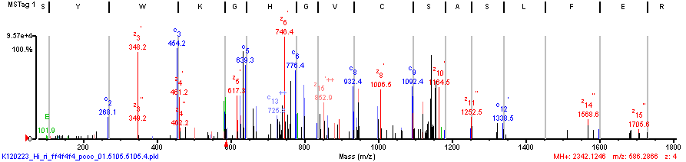
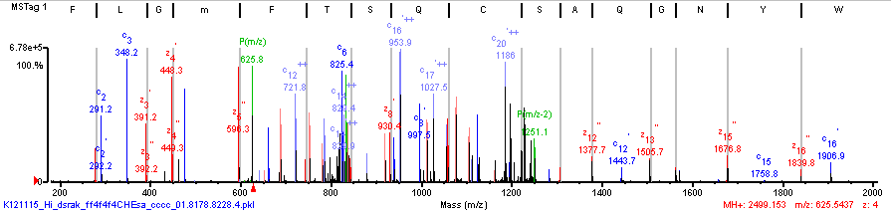
MeAziridine Cys mod Yields Great ETD Spectra
(K)S/Y\W|K/G|H/G\V\C\S A\S|L|F|E|R|L|K\G\C(-)
(K)C/I|G|Q|W|Y/N|G|Q|A S C|Q|S/T\F|m|G|L\F\K(S)

Slide 7
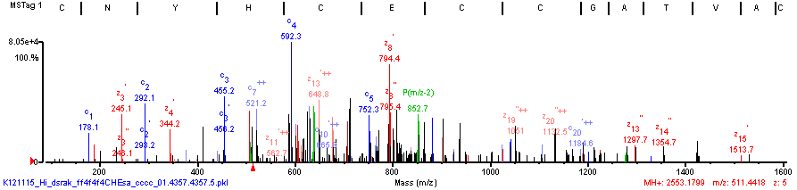
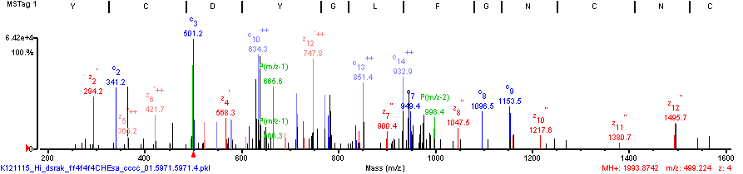
MeAziridine Cys mod Yields Great ETD Spectra
(K)C/N|Y|H\C|E\C\C|G/A T V\A\C|S/T|V\Y/V|G G\K(E)
(K)C Y\C/D|Y|G|L|F|G|N\C|N\C|Y\K(R)

Slide 8
Lys-C Cleaves at MeAziridine Cys mod
Cys cleavages observed only in most abundant proteins
Kinetics: K >> C

Slide 9
Spider Protein List

Slide 10
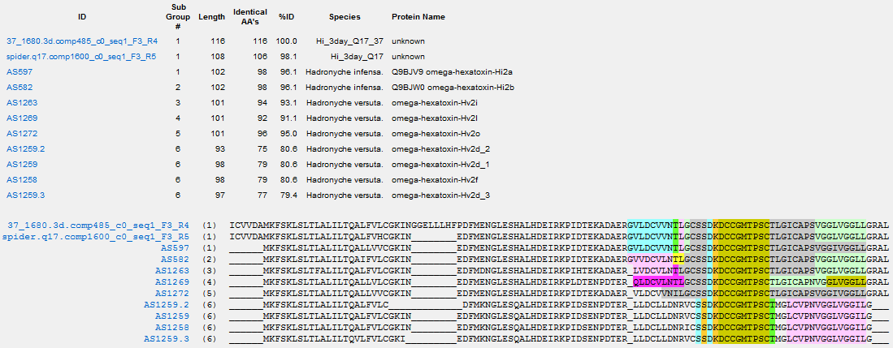
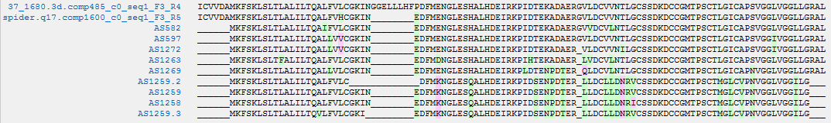
Group 2 omega-hexatoxin Hi2
6 Cys
Sub
Group
1
1
2
1
5
3
4
6
6
6
6
MTPSCTLGICAPSVGGLVGGLLG reads: 4382
MTPSCTLGICAPSVGGIVGGLLG reads: 0251
MTPSCTLGICAPNVGGLVGGLLG reads: 0201
MTPSCTMGLCVPNVGGLVGGILG reads: 0000
MTPSCTMGICVPNVGGLVGGILG reads: 0000
MTPSCTMGICVPNVGGLVGGLLG reads: 0000
CAPNVGG reads: 0442
CVPNVGG reads: 0000

Slide 11
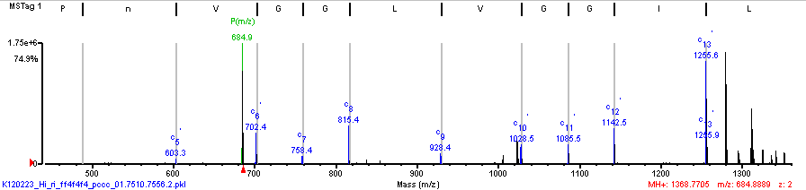
Only 1 spectrum supports LCVPN
(G)L C V P n\V\G\G\L\V\G\G\I\L(G)
MTPSCTLGICAPSVGGLVGGLLG reads: 4382
MTPSCTLGICAPSVGGIVGGLLG reads: 0251
MTPSCTLGICAPNVGGLVGGLLG reads: 0201
MTPSCTMGLCVPNVGGLVGGILG reads: 0000
MTPSCTMGICVPNVGGLVGGILG reads: 0000
MTPSCTMGICVPNVGGLVGGLLG reads: 0000
CAPNVGG reads: 0442
CVPNVGG reads: 0000

Slide 12
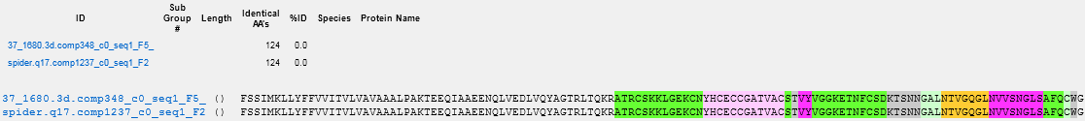
Group 1
8 Cys
topBLAST hit not in Arachnoserver
gi|294653183|gb|ADF28499.1|putative mature sequence toxin-like ACSKQ [Pelinobius muticus]
<Hsp_qseq>EQIAAEENQLVEDLVQYAGTRLTQKRATRCSKKLGEKCNYHCECCGATVACSTVYVGGKETNFCSDKTSNNGALNTVGQGLNVVSNGLSAFQCWG
<Hsp_midline>+ A+E ++L+E L + + Q+ A CSK++GEKC + C+CCGATV C T+YVGG C KTSNN LNT+G G+N V N ++ CWG
<Hsp_hseq>RKTASETSKLLEKL-GVSREAIPQEMARACSKQIGEKCEHDCQCCGATVVCGTIYVGGNAVEQCMSKTSNNAVLNTMGHGMNAVQNAFTSVMCWG
CSKKLGEKCNYHC reads: 769
CSKKLGEKCDYHC reads: 111
CSKKLGEKCNYHCECCGATVAC reads: 380
CSKKLGEKCDYHCECCGATVAC reads: 50
CSTVYVGGKETNFC reads: 5251
GGKETNFCSDKTSNN reads: 3771
GGRETNFCSDKTSNN reads: 10
CSDKTSNNGALNTVGQGLNVVSNGLSAFQC reads: 1023
CSDKTSNNGALNTVGQGLN reads: 1887
TVGQGLNVVSNGLSAFQC reads: 4449

Slide 13
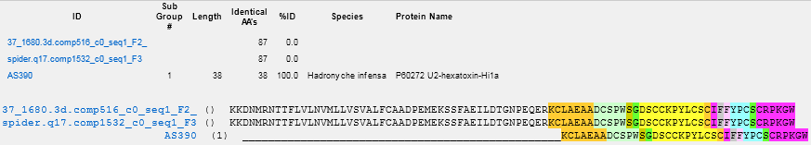
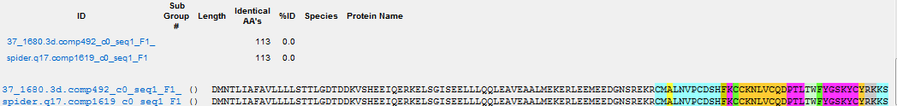
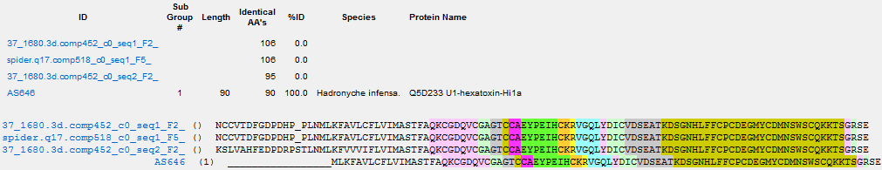
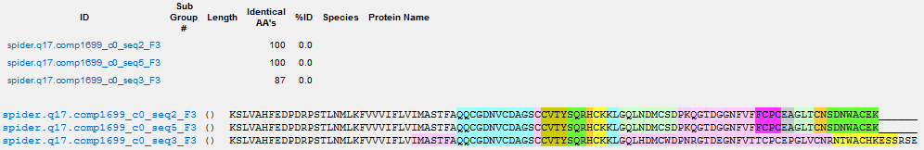
Group 3, 4,5, 6
8 Cys
6 Cys
10 Cys
10 Cys

Slide 14
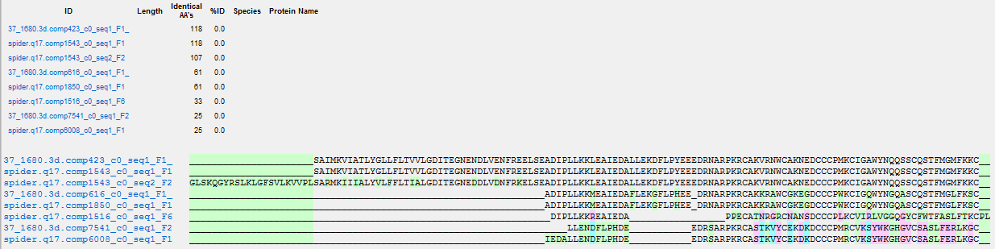
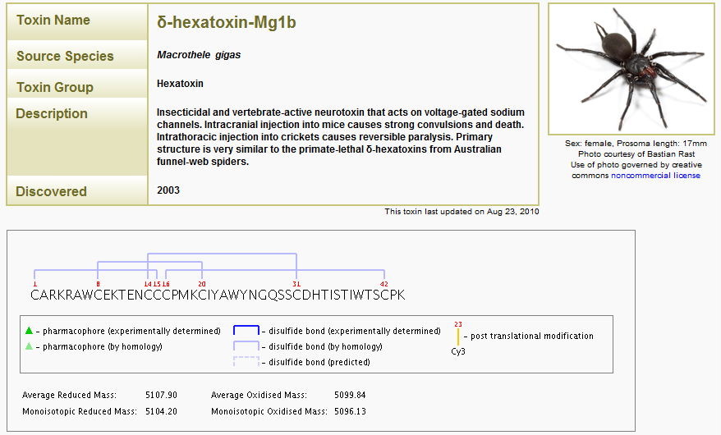
Alignment of protein groups containing CCC and 8 Cys
Protein
Group
16.1
16.1
16.1
8.1
8.1
22.1
12.1
12.1

Slide 15
PSM Overlap for Group 10.1

Slide 16
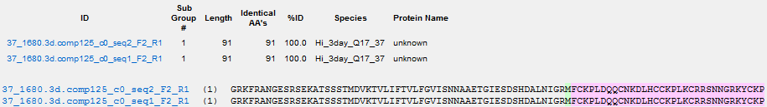
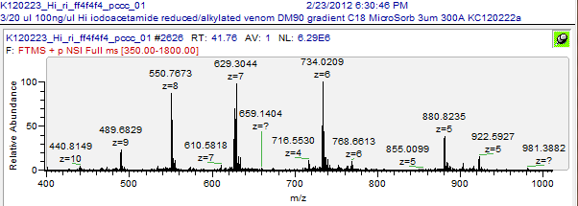
Group 18 - 6Cys - only intact MS/MS z5-10
56
spectra
2
peptides
Cys
Iodoacetamide
(R)M F C K P L D\Q|Q\C\N K|D L H\C C|K P L/K C/R|R/S/N/N/G/R/K Y C/K P(-)
z9
z8
z7
z6
z5
(R)M F\C\K P L D\Q|Q\C N K\D L H\C\C|K P/L/K C/R/R/S/N/N/G R/K Y C/K P(-)
(R)M F\C\K P L D\Q|Q\C N K\D L H\C C K P L K C|R/R/S/N/N/G/R/K/Y C/K P(-)
ETD
CID
HCD
(R)M F C\K P L D\Q\Q\C N K\D/L H\C\C|K P L K\C/R/R S/N/N/G/R/K/Y C K P(-)
(R)M/F C/K P L\D\Q|Q\C N K D L H C C K P L K\C\R\R/S/N/N/G/R/K Y C K P(-)
(R)M/F/C\K/P L D\Q Q C N K D|L H/C C K P L K C R R S N N G R K\Y C K\P(-)
z6
z5
(R)M/F/C|K/P L D\Q Q/C N/K/D|L H C C K P L K C R R S N N G R K\Y C K\P(-)
(R)M F C|K/P/L/D/Q/Q/C/N/K/D/L H/C C K P L K C R R S N N G R K\Y C K P(-)
z5

Slide 17
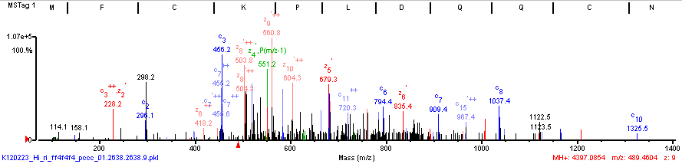
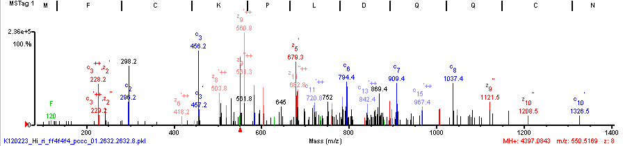
Group 18 - 6Cys - only intact MS/MS z8-9 ETD
(R)M F C K P L D\Q|Q\C\N K|D L H\C C|K P L/K C/R|R/S/N/N/G/R/K Y C/K P(-)
(R)M F\C\K P L D\Q|Q\C N K\D L H\C\C|K P/L/K C/R/R/S/N/N/G R/K Y C/K P(-)

Slide 18
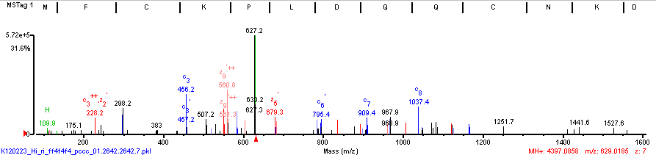
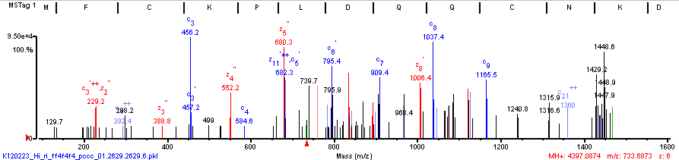
Group 18 - 6Cys - only intact MS/MS z6-7, ETD
(R)M F\C\K P L D\Q|Q\C N K\D L H\C C K P L K C|R/R/S/N/N/G/R/K/Y C/K P(-)
(R)M F C\K P L D\Q\Q\C N K\D/L H\C\C|K P L K\C/R/R S/N/N/G/R/K/Y C K P(-)

Slide 19
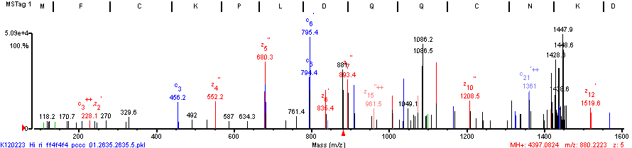
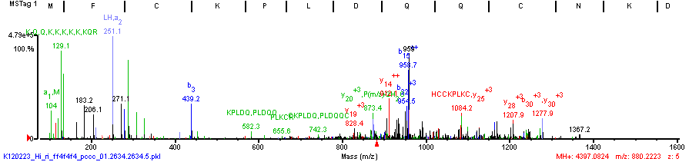
Group 18 - 6Cys - only intact MS/MS z5
(R)M/F C/K P L\D\Q|Q\C N K D L H C C K P L K\C\R\R/S/N/N/G/R/K Y C K P(-)
ETD
HCD
(R)M F C|K/P/L/D/Q/Q/C/N/K/D/L H/C C K P L K C R R S N N G R K\Y C K P(-)

Slide 20
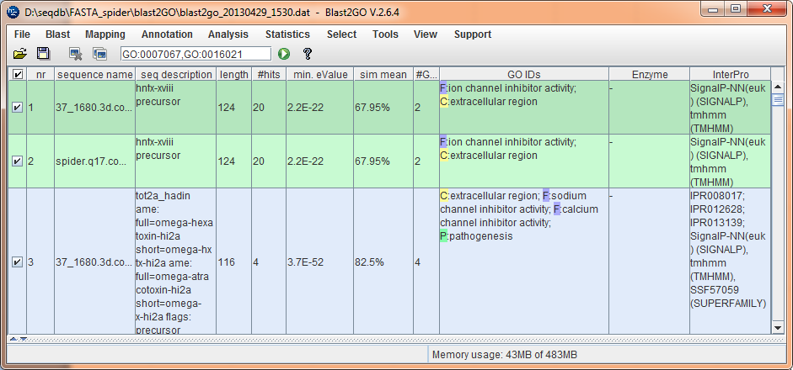
BLAST2GO – Functional Annotation
Export FASTA of Valid Hits from SM
Run BLAST step
Run GO mapping step
Run annotation step
Run InterProScan, SIGNALP
Run GO-Slim
Export results to SM categories file

Slide 21
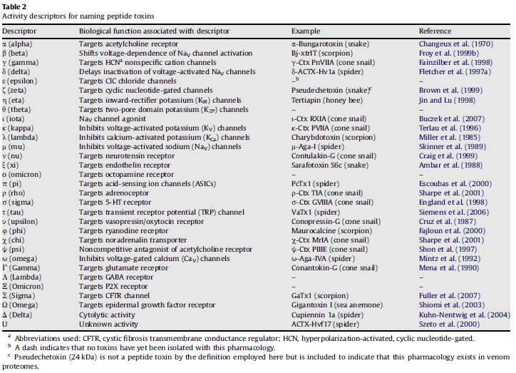
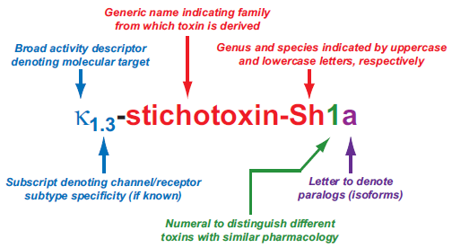
Venom Toxin Nomenclature
King GF, Gentz MC, Escoubas P, Nicholson GM A rational nomenclature for naming peptide toxins from spiders and other venomous animals.
Toxicon 52 (2008) 264–276.

Slide 22
Next Steps
Improve paralog inclusion in RNA-Seq Transcript Assembly.
Run SM homology searches
Improve SM monoisotopic m/z assignment for z>4.
Obtain ETD MS/MS of intact toxins after MeAziridine Cys mod.
Assemble spectra de novo.
Name novel toxins.
Call full length gene, predict signal peptide.

Slide 23
Acknowledgements
University of Queensland
  David Morgenstern
  Eivind Undheim
  Glenn King
Broad Institute of MIT and Harvard
  Brian Haas
  Namrata Udeshi
  Steve Carr
University of California San Diego
  Adrian Guthals
  Nuno Bandeira
NYU
  David Morgenstern
  Trixi Ueberheide
Thermo
  John Syka
  Lani Cardasis

Slide 24
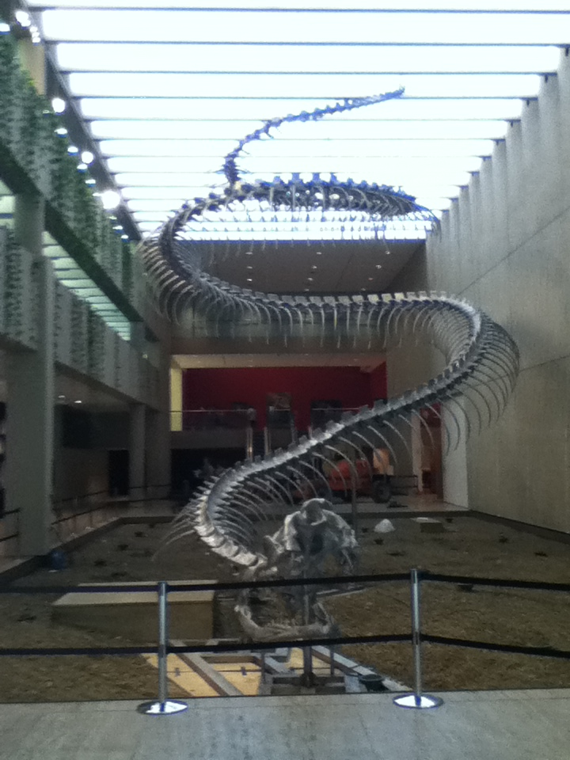
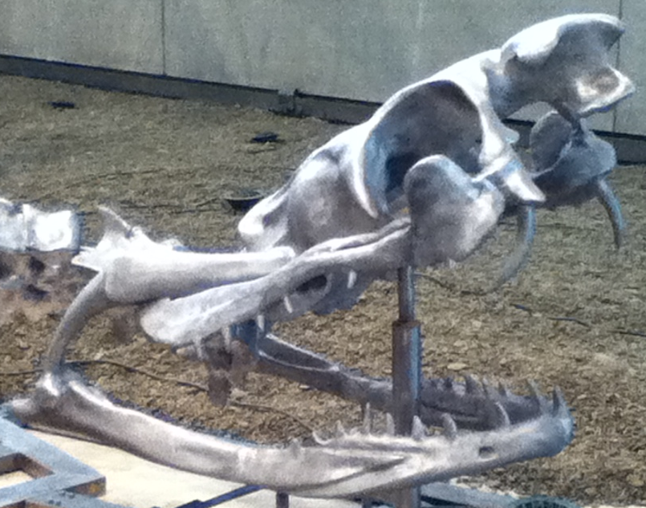
Queensland Art Gallery - Brisbane

Slide 25
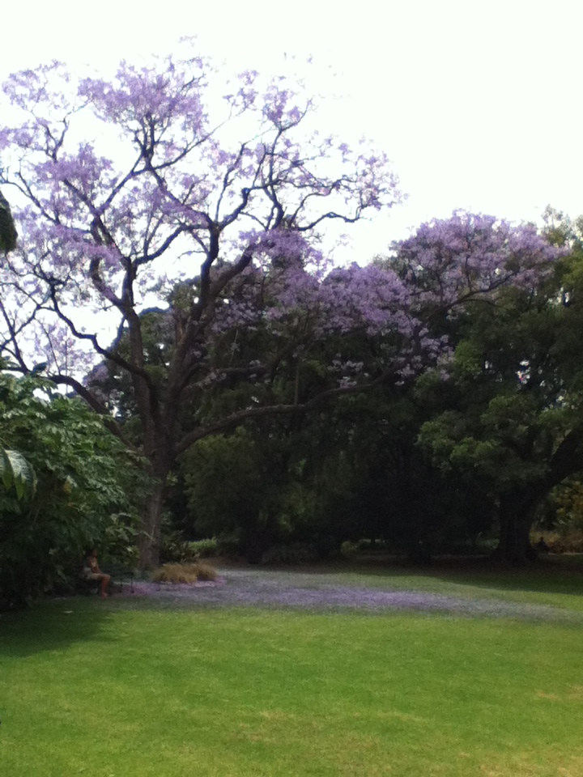
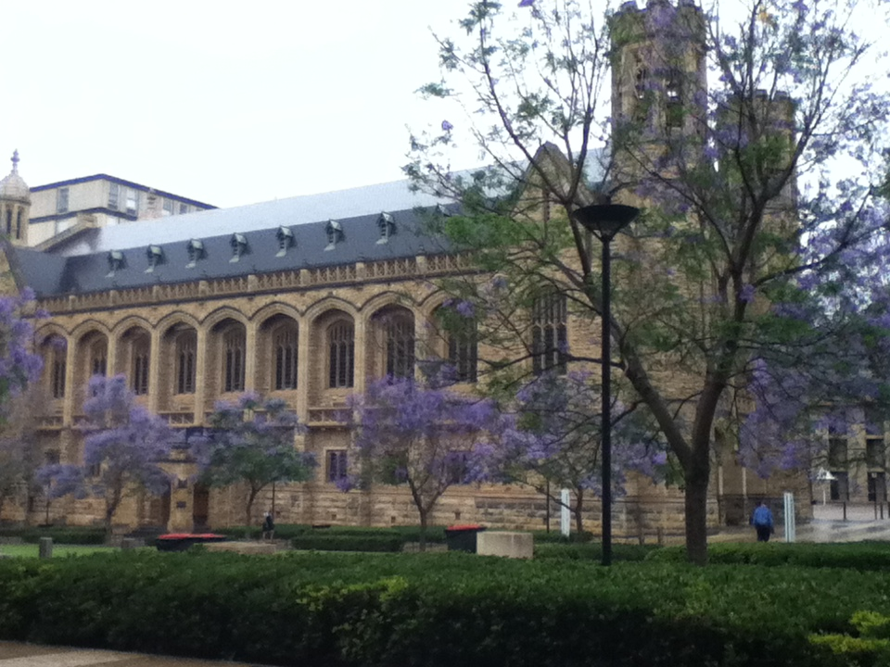
Adelaide

Slide 26


Slide 27



Slide 28


Slide 29
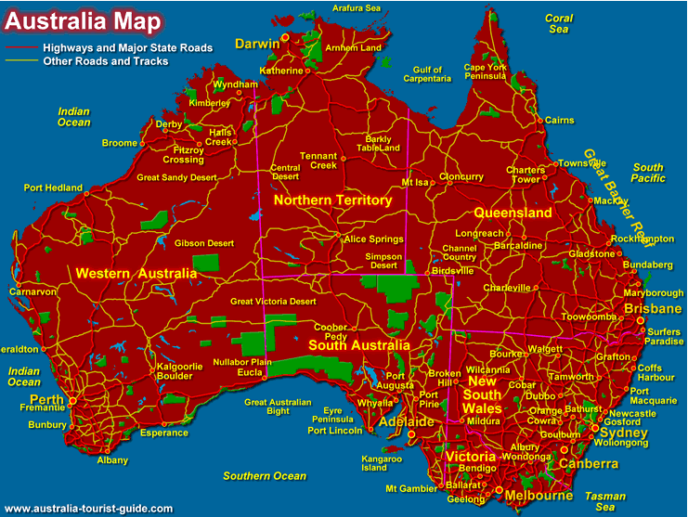

Slide 30

RNA-Seq Data Generation and Analysis
Figure 1
a | Data generation. To generate an RNA sequencing (RNA-seq) data set, RNA (light blue) is first extracted (stage 1), DNA contamination is removed using DNase (stage 2), and the remaining RNA is broken up into short fragments (stage 3). The RNA fragments are then reverse transcribed into cDNA (yellow, stage 4), sequencing adaptors (blue) are ligated (stage 5), and fragment size selection is undertaken (stage 6). Finally, the ends of the cDNAs are sequenced using next-generation sequencing technologies to produce many short reads (red, stage 7). If both ends of the cDNAs are sequenced, then paired-end reads are generated, as shown here by dashed lines between the pairs.
b | Data analysis. After sequencing, reads are pre-processed by removing low-quality reads and artefacts, such as adaptor sequences (blue), contaminant DNA (green) and PCR duplicates (stages 1 and 2). Next, the sequence errors (red crosses) are optionally removed (stage 3) to improve the read quality (see main text for details). The pre-processed reads are then assembled into transcripts (orange, stage 4) and polished by post-assembly processes to remove assembly errors (blue crosses). The transcripts are then post-processed (stage 5), and the expression level of each transcript is then estimated by counting the number of reads that align to each transcript (stage 6). rRNA, ribosomal RNA.
Martin JA, Wang Z. Next-generation transcriptome assembly. Nat Rev Genet. 2011, 12, 671-82.

Slide 31

Transcriptome Assembly from RNA-Seq Reads
Bowtie short read aligner
TopHat splice-aware
Trinity
Cufflinks
?
Haas BJ, Zody MC. Advancing RNA-Seq analysis.
Nat Biotechnol. 2010, 28, 421-3.
Notes:
Figure 1 Strategies for reconstructing transcripts from RNA-Seq reads. The ‘align-then-assemble’
approach (left) taken by Trapnell et al.4 and Guttman et al.5 first aligns short RNA-Seq reads to
the genome, accounting for possible splicing events, and then reconstructs transcripts from the
spliced alignments. The ‘assemble-then-align’ approach (right) first assembles transcript sequences
de novo—that is, directly from the RNA-Seq reads. These transcripts are then splice-aligned to the
genome to delineate intron and exon structures and variations between alternatively spliced transcripts.
As de novo assembly is likely to work only for the most abundant transcripts, the align-then-assemble
method should be more sensitive, although this warrants further investigation. RNA-Seq reads are
colored according to the transcript isoform from which they were derived. Protein-coding regions of
reconstructed transcript isoforms are depicted in dark colors.

Slide 32


Transcriptome Assembly from RNA-Seq Reads
Reference-based
De novo
Martin JA, Wang Z. Next-generation transcriptome assembly. Nat Rev Genet. 2011, 12, 671-82.
Notes:
Figure 2 | Overview of the reference-based transcriptome assembly strategy. The steps of the reference-based transcriptome strategy are shown using an example of a maize gene (GRMZM2G060216). a | Reads (grey) are first splice-aligned to a reference genome. b | A connectivity or splice graph is then constructed to represent all possible isoforms at a locus. c,d | Finally, alternative paths through the graph (blue, red, yellow and green) are followed to join compatible reads together into isoforms.
Figure 3 | Overview of the de novo transcriptome assembly strategy. a | All substrings of length k (k-mers) are generated from each read. b | Each unique k‑mer is used to represent a node (or vertex) in the De Bruijn graph, and pairs of nodes are connected if shifting a k‑mer by one character creates an exact k–1 overlap between the two k‑mers. Note that for non-strand-specific RNA sequencing data sets, the reverse complement of each k‑mer will also be represented in the graph. Here, a simple example using 5‑mers is shown. The example illustrates a SNP or sequencing error (for example, A/T) and an example of an intron or a deletion. Single-nucleotide differences cause ‘bubbles’ of length k in the De Brujin graph, whereas introns or deletions introduce a shorter path in the graph. c,d | Chains of adjacent nodes in the graph are collapsed into a single node when the first node has an out degree of one and the second node has an in degree of one. Last, as in the reference-based approach, four alternative paths (blue, red, yellow and green) through the graph are chosen. e | The isoforms are then assembled.

Slide 33

Dual Transcriptome Assembly
Combine referenced-based and de novo
RNA-seq reads are shown in red, and assembled transcripts are shown in orange.
Martin JA, Wang Z. Next-generation transcriptome assembly. Nat Rev Genet. 2011, 12, 671-82.
Notes:
Figure 4 | Alternative approaches for combined transcriptome assembly. The left choice depicts the align-then-assemble strategy, in which reference-based assembly is followed by de novo assembly of reads that failed to align to the genome. The right choice depicts the assemble-then-align strategy, in which the reads are first de novo assembled and then scaffolded and extended using a reference genome. RNA sequencing (RNA-seq) reads are shown in red, and assembled transcripts are shown in orange.

Slide 34

Trinity de novo Transcriptome Assembly for RNA-Seq
Figure 1. Overview of Trinity
(a) Inchworm assembles the read data set (short black line, top) by greedily searching for paths in a k-mer graph (middle), resulting in a collection of linear contigs (color lines, bottom), with each k-mer present only once in the contigs. (b) Chrysalis pools contigs if they share at least one k-1-mer and reads span the join, and builds individual de Bruijn graphs from each pool (colored lines). (c) Butterfly takes each de Bruijn graph from Chrysalis (top), and trims spurious edges and compacts linear paths (middle). It then reconciles the graph with reads (dashed colored arrows, bottom) and pairs (not shown), and outputs one linear sequence for each splice form and/or paralogous transcript reflected in the graph (bottom, colored sequences).
Grabherr MG, Haas BJ, Yassour M, et al. Trinity: reconstructing a full-length transcriptome without a genome from RNA-Seq data. Nat Biotechnol. 2011, 29, 644–652.

Slide 35


MeAziridine Cys mod Yields Great ETD Spectra
(N)W C|A|K/N\E|D\C\C\C P M\K(C)
(Q)T C/G|G P|D D\C G|E|G/S C\C V|G|S|F|S|R\K(C)

Slide 36


Group 7 omega-hexatoxin Hi1
7 Cys
Sub
Group
4
2
3
1
1
3
3
6
5
5
5
6
5
5

Slide 37

Alignment of 10 Cys containing protein groups
Protein
Group
5.1
24.1
5.1
5.1
5.1
6.1
6.1
6.2
10.1
10.1

Slide 38
PSM Overlap for Group 8.1
37_1680.3d.comp616_c0_seq1_F1_R1

Slide 39
PSM Overlap for Group 10.1
37_1680.3d.comp799_c0_seq1_F2_R4

Slide 40
PSM Overlap for Group 12.1
spider.q17.comp6008_c0_seq1_F1_R1

Slide 41
Centipede Scolopendra morsitans Glenmorgan
Queensland Australia
Sample
Venom of single critter 1ug
Cys –ethanolyl
Trypsin (500ng), Glu-C (500 ng)
CID/HCD/ETD (150ng)
Spectrum Mill searches
Database
Venom gland
mRNA library
454 sequencing (300-400 bp reads)
Aligned assembled (MIRA)
Orf Finder > 20 AA’s (CLC Main Workbench)
Results
77 protein groups
104 distinct proteins (27 isoforms/family members)
3154 MS/MS spectra
713 distinct peptides
Eivind Undheim, University of Queensland

Slide 42

Centipede Scolopendra morsitans Glenmorgan
Queensland Australia
77 protein groups
104 distinct proteins (27 isoforms/family members)
3154 MS/MS spectra
713 distinct peptides
Group 2 Unannotated name
2 subgroups
28kDa, 79% coverage
37 distinct peptides

Slide 43

Centipede Scolopendra morsitans Glenmorgan
Queensland Australia
77 protein groups
104 distinct proteins (27 isoforms/family members)
3154 MS/MS spectra
713 distinct peptides
Group 12 LDL class A repeat domain
2 subgroups
28kDa, 52% coverage
12 distinct peptides

Slide 44
Conclusions
Extensive and accurate protein sequencing can be achieved without the use of a database
  More can be gained from experimental MS/MS data before mapping to a reference database
CID/HCD/ETD triplets provide the longest and most accurate de novo sequences without requiring any sequence homology steps
  De novo sequences which extend beyond 190 amino acids can be assembled with 99% accuracy
Life is much easier when working with genome sequence

Slide 45
MALDI-mapping

