Slide 1
Peptide Sequencing by LC-MS/MS for Organisms with Unsequenced Genomes
Karl Clauser
Broad Institute of MIT and Harvard
University of Queensland
November 27, 2012

Slide 2
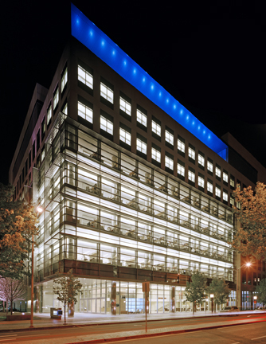
Broad Institute of MIT and Harvard
2004 Eli and Edythe Broad $100 million
2004 MIT $100 million
2004 Harvard $100 million
2005 Eli and Edythe Broad $100 million
2008 Eli and Edythe Broad $400 million

Slide 3
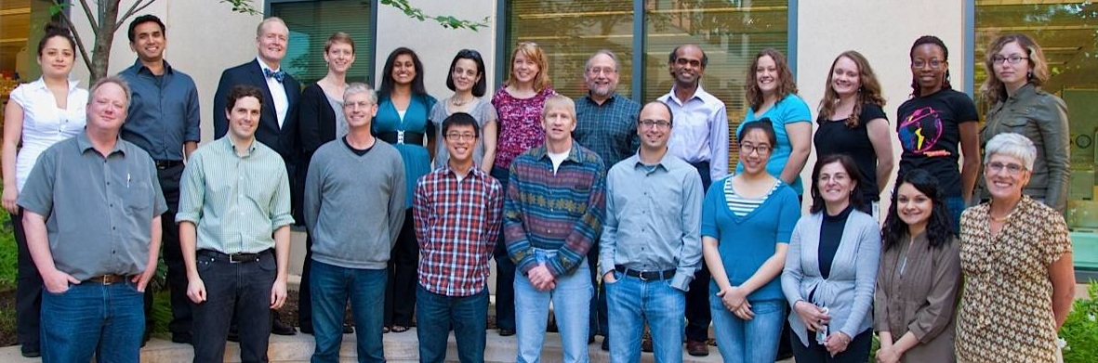
Broad Institute of MIT and Harvard – Proteomics Group
Research Focus Areas
  Biomarkers
  Interactions
  Signaling
  Epigenetics
MS Instrumentation
4 Thermo Q-Exactives
1 Thermo Orbitrap Elite
2 LTQ-Orbitraps
2 LTQs
2 AB-Sciex Qtrap 4000’s
1 AB-Sciex Qtrap 5500
1 AB-Sciex 5600 QTof
1 Waters Xevo TQ-S
1 Agilent 6490 triple Quad

Slide 4
Outline
Images of papers
Key features
Orbitrap Elite figure
Protein w/ overlap
Spectral triplet example
Assembly process
Bandeira 2007 figures 1,2,3, 4?
Guthals 2012 figures 1, 3b, 4a, S7
Guthals 2013 figures 1, 2ab, 4 table 1
Remaining troubles – Guthals 2012 discussion

Slide 5
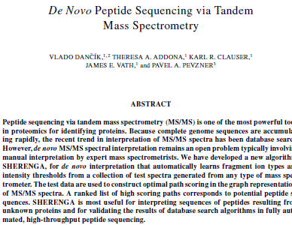
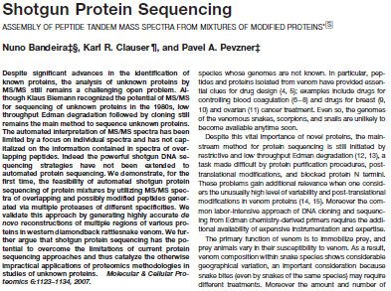
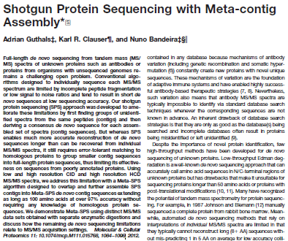
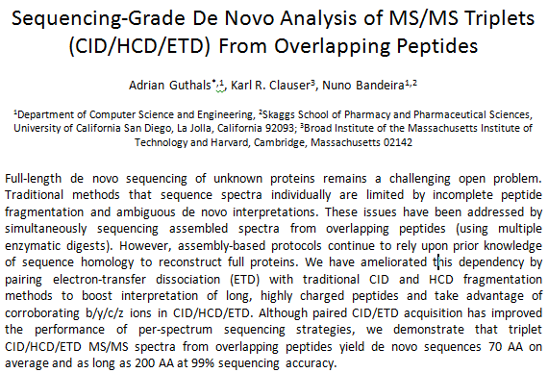
Toward Complete Sequencing of Proteins by MS/MS
Dancik, V.; Clauser, K. R.; Addona, T.A.; Vath, J. E.; Pevzner, P.A. "De novo Peptide Sequencing via Tandem Mass Spectrometry", J. Comp. Biol. 1999, 6, 327-342.
Bandeira N, Clauser KR, Pevzner PA, "Shotgun protein sequencing: Assembly of MS/MS spectra from mixtures of modified proteins", Mol Cell Proteomics, 2007, 6, 1123-1134.
Guthals A, Clauser KR, Bandeira N, “Shotgun Protein Sequencing With Meta Contig Assembly” Mol Cell Proteomics 2012 11: 1084-1096, doi:10.1074/mcp.M111.015768.
Guthals A, Clauser KR, Bandeira N, “Sequencing-Grade De Novo Analysis of MS/MS Triplets (CID/HCD/ETD) From Overlapping Peptides”, J Proteome Res, 2013, in preparation.
LCQ
low res CID
LTQ-FT
low res CID
LTQ-Orbitrap
hi res
CID, HCD
LTQ Velos Orbitrap
hi res
CID, HCD, ETD

Slide 6
Key Features for de novo MS/MS Sequencing of Proteins
Overlapping peptides
  multiple enzymes, with different specificity
Complementary and corroborating MS/MS dissociation methods
  CID, HCD, ETD (b, y, c, z ions)
  High resolution spectra
Innovative software for
  de novo spectral interpretation and assembly

Slide 7
Generating Overlapping Peptides
2,500 μg dried venom
Reduction/alkylation, NH₄HCO₃/DTT/iodoacetamide
Precipitation 60% EtOH, 4’C
Wash 95% EtOH, 4’C
Resuspend in 0.04% Rapigest
Trypsin 1:100
200 μg venom
100mM NH₄HCO₃
0.085% Rapigest
3hr
Acidify 0.1% TFA
Lys-C 1:250
200 μg venom
100mM NH₄HCO₃
0.085% Rapigest
3hr
Acidify 0.1% TFA
Glu-C 1:100
200 μg venom
100mM NH₄HCO₃
0.085% Rapigest
3hr
Acidify 0.1% TFA
Asp-N 1:500
200 μg venom
100mM NH₄HCO₃
0.01% Rapigest
3hr
Acidify 0.1% TFA
Chymotrypsin 1:100
200 μg venom
100mM NH₄HCO₃
0.01% Rapigest
3hr
Acidify 0.1% TFA
Arg-C 1:200
100 μg venom
100mM NH₄HCO₃
0.01% Rapigest
4hr
Acidify 0.1% TFA
Acidify
Precipitation
60% EtOH, 4’C
Wash 95% EtOH, 4’C
Dry pellet
CNBr
100 μg venom
70% TFA
36 hr
Dry
Resuspend
in 0.1% TFA
Rapigest: SDS-like, acid labile detergent

Slide 8
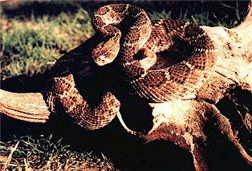
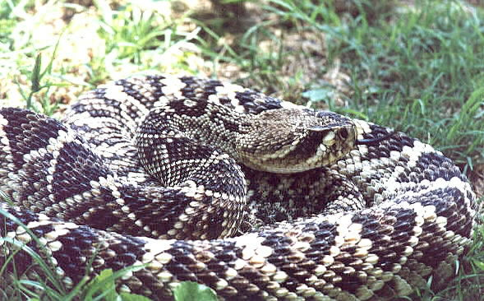
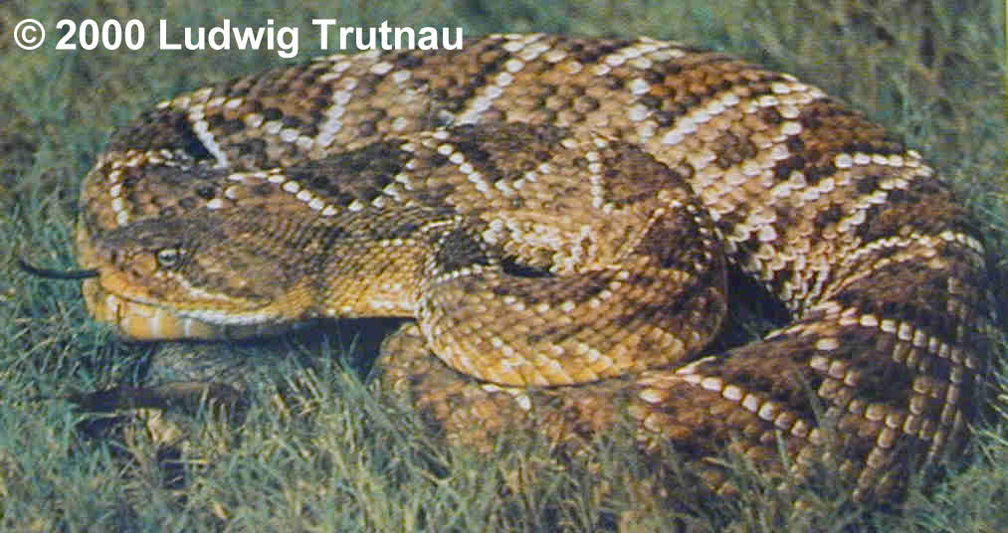
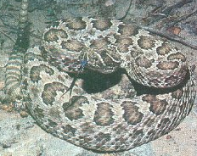
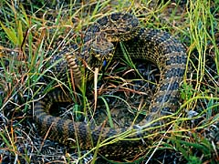
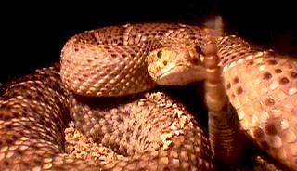
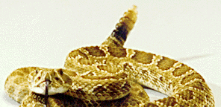
Rattlesnake Venoms from Sigma
Western Diamondback Rattlesnake
Crotalus atrox - CROAT
Eastern Diamondback rattlesnake
Crotalus adamanteus - CROAD
Mexican West Coast Rattlesnake
Crotalus basiliscus - CROBA
Prairie rattlesnake
Crotalus viridis viridis - CROVI

Slide 9
Charge-directed Fragmentation Scheme
O
O
O
O
zH^{z+}
+
H₂N CH C NH CH C NH CH C NH CH C OH
R₁
R₂
R₃
H
R₄
b ion formation
and/or
y ion formation
O
O
O
O
+
y₁
b₃
+
H₂N CH C NH CH C NH CH C
H
NH CH C OH
R₁
R₂
R₃
H
R₄
+
Neutral pumped away by vacuum system
+
Neutral pumped away by vacuum system
Proton Mobility
Mobile: z_{pre} > #Arg + #Lys + #His
Partially mobile: z_{pre} < #Arg + #Lys + #His and > #Arg
Non-mobile: z_{pre} < #Arg
For peptides with non-mobile protons, fragmentation tends to proceed via charge-remote mechanisms. MS/MS spectra will be dominated by a few ions, typically:
C-term side of D, E
N-term side of P

Slide 10
Sequence Specific Fragment Ion Types
a₃
b₃
c₃
O
O
O
O
nH^{n+}
H₂N CH C NH CH C NH CH C NH CH C OH
R₁
R₂
R₃
R₄
x₁
y₁
z₁
Ion type restrictions residues delta
a-NH₃ contains NH₃ residue RK NQ -17
b-NH₃, y-NH₃ contains NH₃ residue RK NQ -17
b-H₂O, y-H₂O contains H₂O residue ST DE -18
b-H₃PO₄, y-H₃PO₄ contains H₃PO₄ residue st -98
y++, b++ contains charged residues RHK

Slide 11
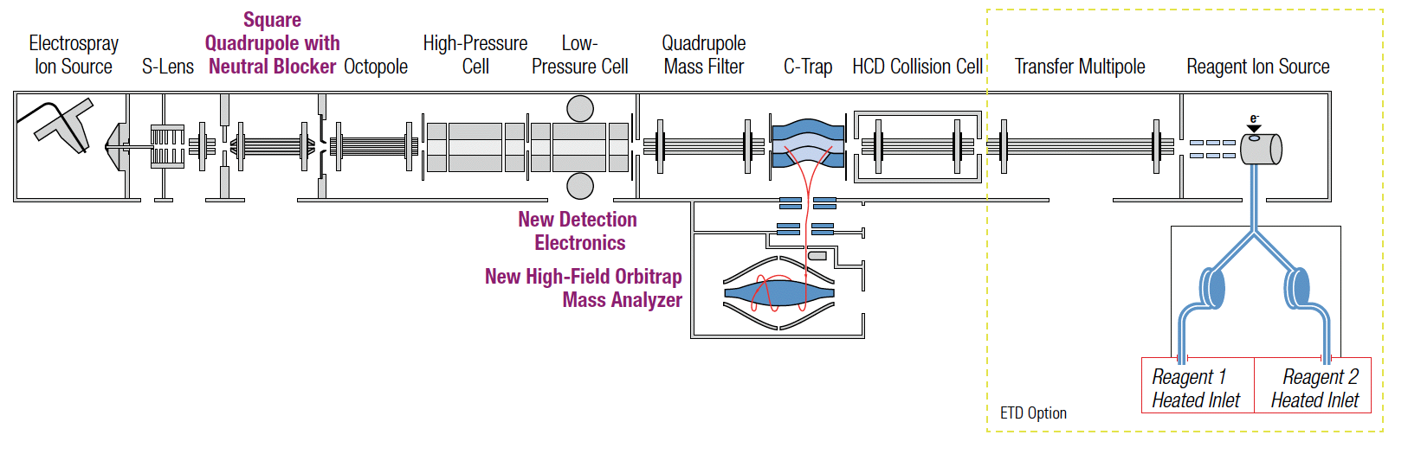
Orbitrap Elite, High Resolution MS/MS by CID, HCD, or ETD
Precursor Isolation
for each
Dissociation
by CID or ETD
Dissociation
by HCD
Fluoranthene
for ETD
Mass Analyzer
for each
CID by resonant excitation <2eV
HCD beam-type collisions with N₂ ~100eV
ETD electron transfer dissociation
CID 1/3 precursor m/z cut-off
HCD, no cutoff for Separation in space of precursor isolation and fragmentation
http://planetorbitrap.com/orbitrap-elite

Slide 12
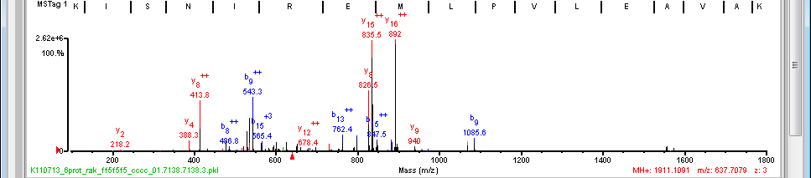
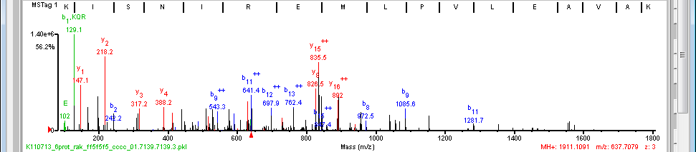
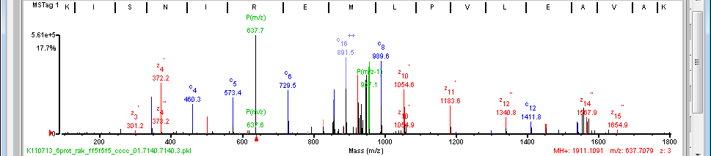
3 spectra on same precursor z=3
(K)K/I/S/N I R E M L|P/V L\E|A\V\A\K(A)
(K)K|I/S N I R E M L|P|V|L\E|A V/A/K(A)
(K)K/I/S/N|I|R|E|M\L P V L|E|A V\A\K(A)

Slide 13
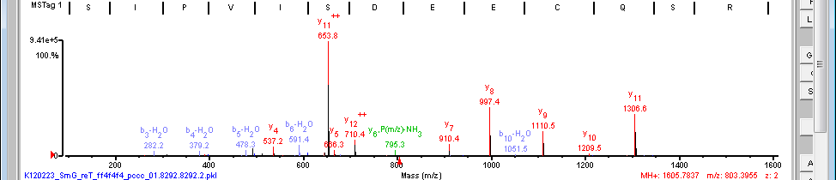
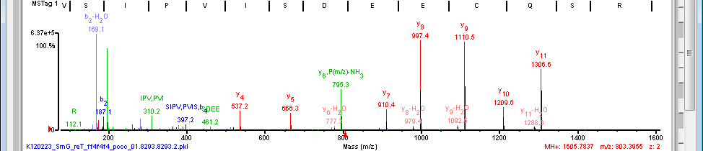
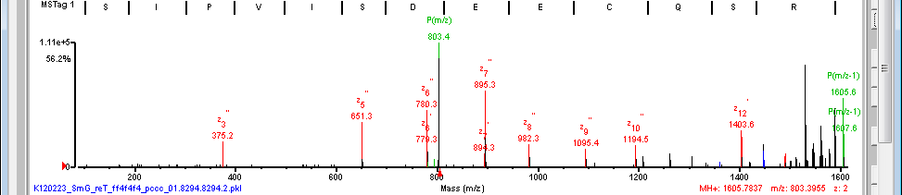
3 spectra on same precursor z=2
(K)V S/I/P/V|I|S/D E/E|C/Q S R(F)
(K)V S\I/P|V/I/S/D E/E/C Q/S/R(F)
(K)V/S/I P/V/I/S/D E/E C/Q S\R(F)

Slide 14
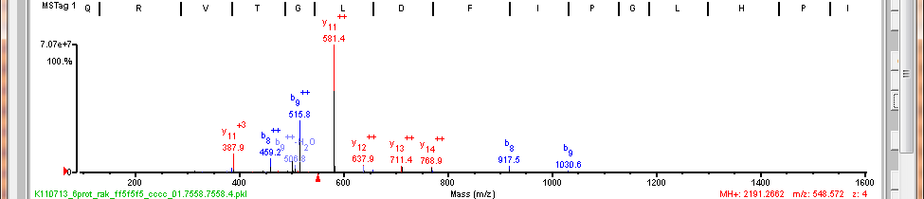
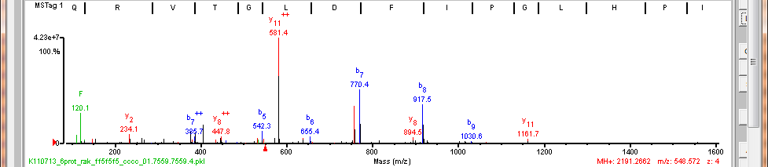
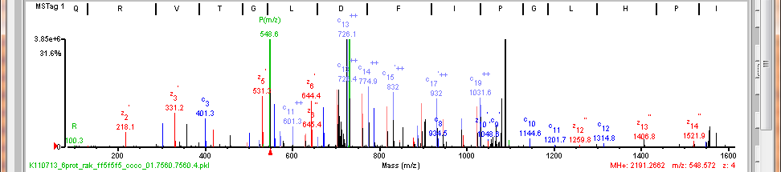
3 spectra on same precursor z=4
(K)Q R V T G L|D|F|I|P/G L H P I L S L S K(M)
(K)Q R V T G\L\D\F|I/P/G L/H/P I L/S L/S K(M)
(K)Q/R|V|T|G|L|D|F/I P\G|L\H P|I\L|S|L|S\K(M)

Slide 15
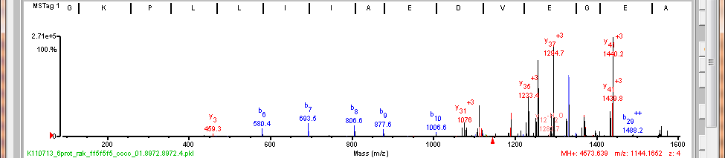
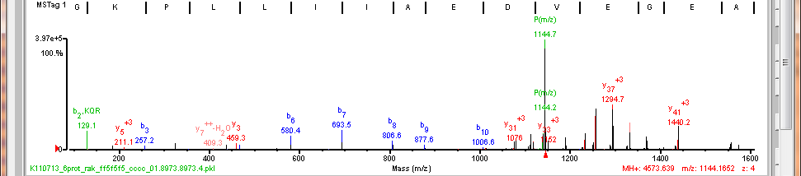
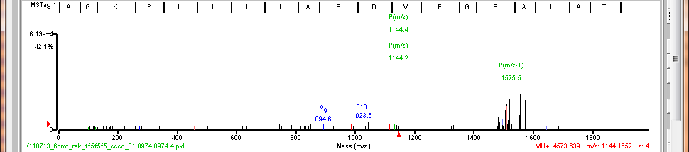
ETD doesn’t work well at high m/z
(K)A G/K/P L/L|I|I|A/E/D V E G E A L A T L V V N T M R G I V K V A A V K A P G F G D/R R K(A)
(K)A G/K/P L L/I|I|A/E/D V E/G E A L A T L V V N T M R G I V K V A A V K A P G F G D R R K(A)

Slide 16
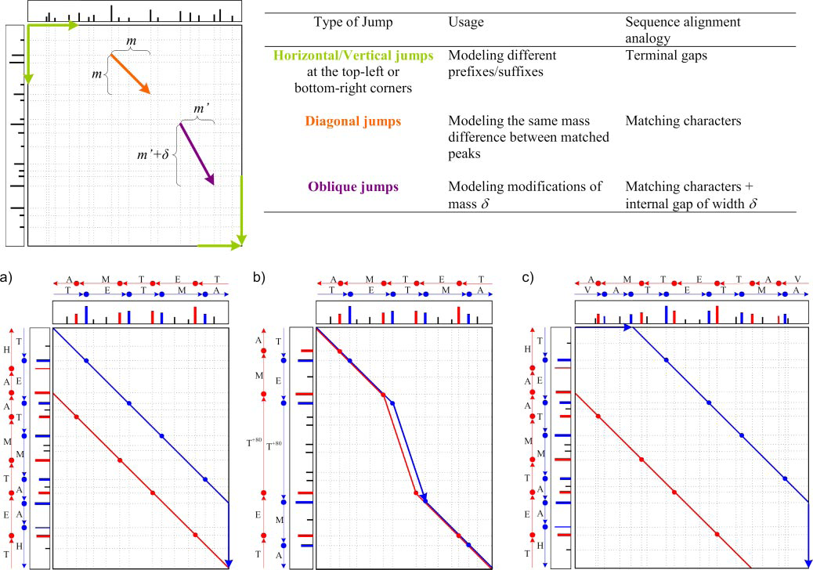
Pairwise Spectral Alignment of Overlapping Peptides
b ions
y ions
terminal
extension
modified AA
unmodified
partial overlap
both ends
Bandeira N, Clauser KR, Pevzner PA, Mol Cell Proteomics, 2007, 6, 1123-1134.
Notes:
FIG. 2. Pairwise spectral alignments (33, 34, 54) are computed with a dynamic programming algorithm similar to the Smith-Waterman sequence alignment algorithm (43); the corresponding intuitive interpretations are given in the table. The alignment of two spectra is defined on the set of all matching peaks; each pair of matching peaks is represented as an intersection of vertical and horizontal dotted lines on the spectral matrix (top left). 18 peaks in the first spectrum and 17 peaks in the second spectrum result in 17 18 matching peaks in the spectral matrix. Matching peaks may be connected by three types of jumps: horizontal/vertical (because MS/MS spectra commonly lack peaks in the low/high mass regions, we also accept horizontal/vertical jumps to locations where no peaks are matched), diagonal, and oblique jumps. A spectral alignment is defined as a sequence of jumps from the top left corner to the bottom right corner. We consider spectral alignments with any number of diagonal jumps but a limited number of other jumps and distinguish between three types of spectral alignments: a, prefix/suffix alignments use a single horizontal/vertical jump (either at the top left or bottom right); b, modified/unmodified alignments use a
single oblique jump; and c, partial overlap alignments use one horizontal/vertical jump at the top left corner and another at the bottom right corner. The optimal alignment of two spectra is an alignment with the longest sequence of valid jumps on the spectral matrix (the implemented scoring function is described in the main text). The alignment of b ions is shown in blue, and that of y ions is shown in red.

Slide 17
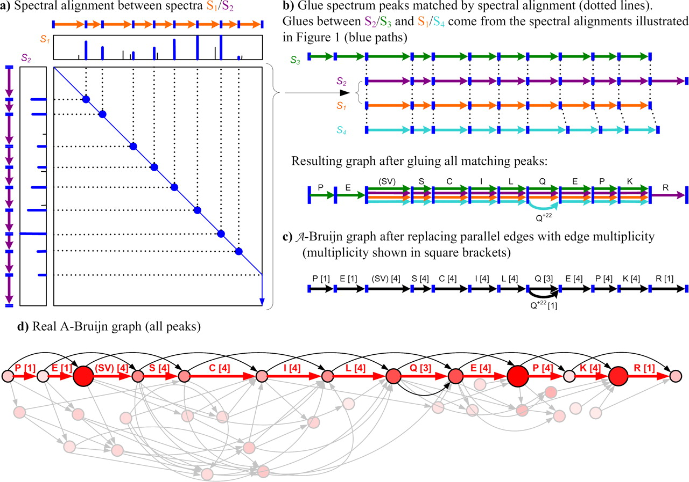
Construction of an A-Bruijn graph from MS/MS data
Bandeira N, Clauser KR, Pevzner PA, Mol Cell Proteomics, 2007, 6, 1123-1134.
Notes:
FIG. 3. Construction of an A-Bruijn graph from MS/MS data. Star spectra of peptides SVSCILQEPK (S1), SVSCILQEPKR (S2), PESVSCILQEPK (S3), and SVSCILQ22EPK (S4) are “glued” together into an A-Bruijn graph using gluing instructions provided by pairwise spectral alignments shown in Fig. 2. a, the spectral alignment of spectra S1 and S2 shown in Fig. 2a reveals matching peaks in these spectra (only the blue path is shown). The peaks corresponding to b ions are shown in blue; other peaks are shown in black. Simplified spectrum graphs are shown next to each spectrum as paths through b ions. b, matching peaks in spectral alignments shown in Fig. 2, a, b, and c, generate pairwise gluing instructions between every pair of aligned spectra. Thus, dotted lines are used to represent both matching peaks in a and gluing instructions in b. c, parallel edges are replaced by a single edge with weight proportional to its multiplicity. In reality, edge weights are determined from peak intensities. d, real A-Bruijn graph using all peaks in the aligned spectra. Vertex scores are represented as vertex size and color intensity; edges to noise peaks are shown in gray. The path found by shotgun protein sequencing is shown in red with edge labels for the identified amino acids (numbers in square brackets indicate edge multiplicity).

Slide 18
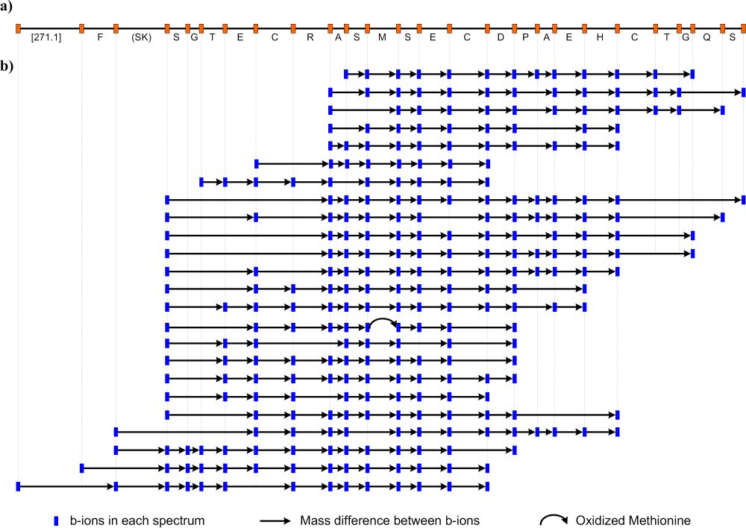
Contig assembling 24 spectra covering a 25-amino acid portion of C. atrox catrocollastatin
Bandeira N, Clauser KR, Pevzner PA, Mol Cell Proteomics, 2007, 6, 1123-1134.
Notes:
FIG. 1. Contig assembling 24 spectra covering a 25-amino acid portion of C. atrox catrocollastatin. Note that no single spectrum contains all the b ions for the recovered sequence even after we recovered missing b ions from correlated ion types (e.g. y ions). a, de novo contig sequence reconstructed from the assembled spectra. b, MS/MS spectra assembled in the contig. Each line corresponds to a different spectrum where matched b ions are shown as blue rectangles connected by arrows.

Slide 19
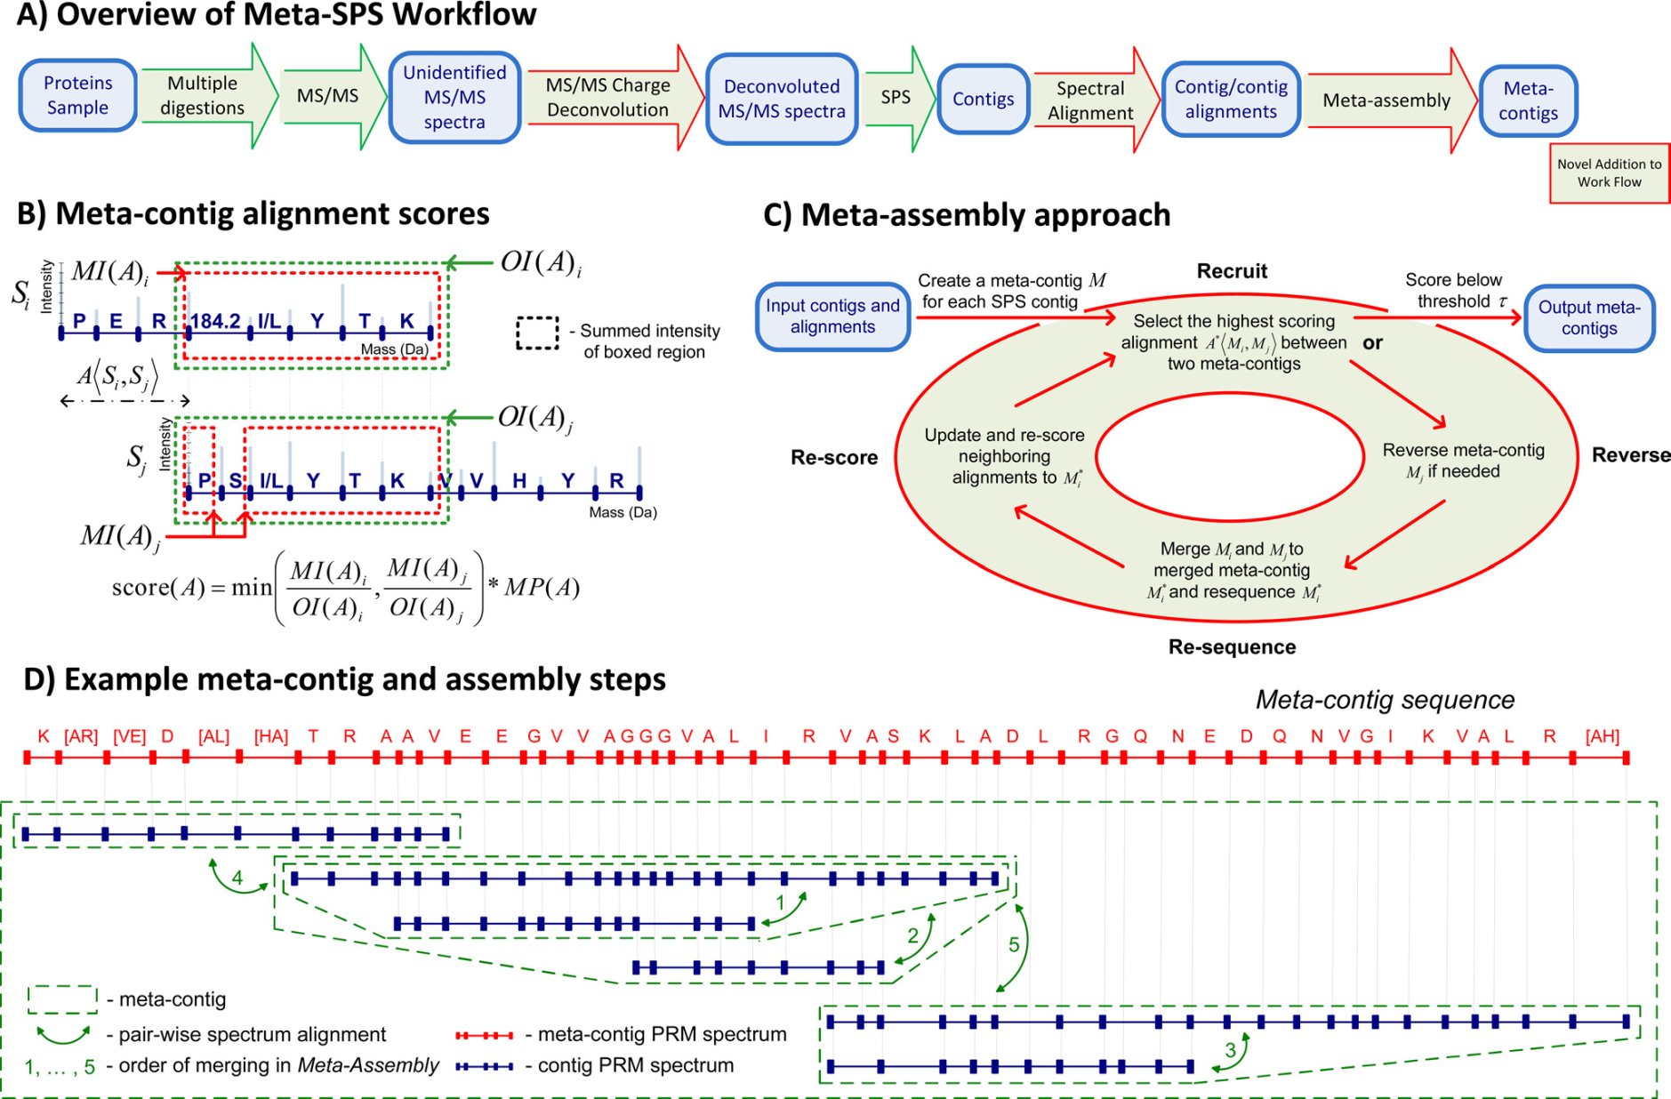
Meta-SPS Procedures
Guthals A, Clauser KR, Bandeira N, Mol Cell Proteomics 2012 11: 1084-1096, doi:10.1074/mcp.M111.015768.
Notes:
FIG. 1. Meta-SPS Procedures. A, Green arrows denote procedures previously described in (1) and red arrows denote procedures described here. The SPS step involves spectral clustering by MSCluster (34), PepNovo PRM scoring (35), and assembly of mass spectra into contigs (1). B, An alignment between two PRM spectra is represented as the shift of the second spectrum wrt the first that yields the highest possible score. The displayed scoring function takes the minimum matched/overlapping intensity ratio and multiplies by the number of matching peaks (denoted by MP(A) for alignment ASi,Sj between contig PRM spectra Si and Sj). Matched and overlapping intensities for each spectrum are displayed as red and blue boxed regions, respectively. Sequences are not known in advance; shown only for illustration purposes. C, Here aligned SPS contigs are assembled into meta-contigs by iteratively merging the highest scoring alignment until remaining alignments have a low score. By merging the highest scoring alignment at every iteration, it is guaranteed that all inconsistent alignments that were removed have a lower score. D, Green arrows denote merged alignments and numbers correspond to the order in which they alignments are merged. Initially, every contig was in its own meta-contig. The 6 meta-contigs were then merged by five alignments, yielding a single meta-contig PRM spectrum and its meta-contig sequence.

Slide 20
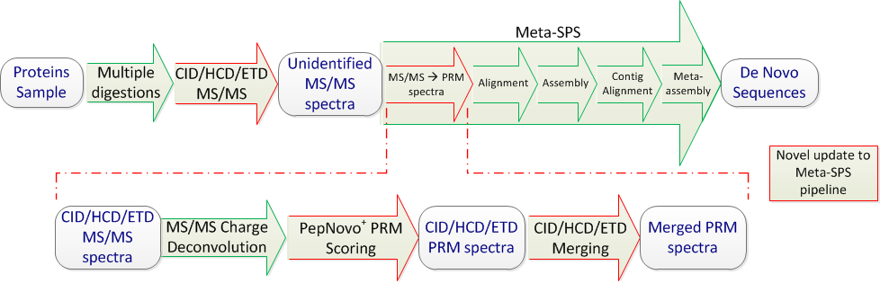
Overall Approach
Updated algorithmic steps of the Meta-SPS pipeline to process any combination of paired high-resolution CID, HCD, and ETD spectra
Guthals A, Clauser KR, Bandeira N, J Proteome Res, 2013, in preparation
Notes:
Figure 1. Overview of Updated Meta-SPS Procedures: Green arrows denote procedures previously described in (28) and (20) while red arrows denote updated procedures described here. Parts of this figure are reproduced from Figure 1a in (28).

Slide 21
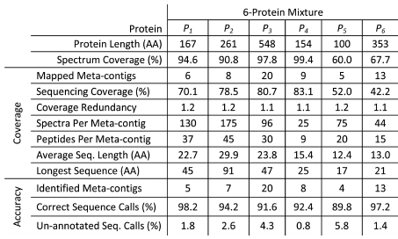
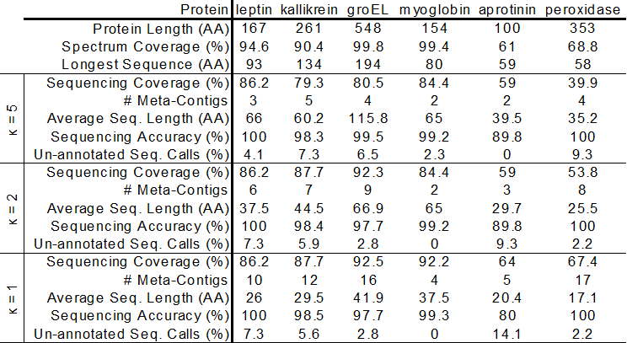
Coverage, Accuracy by Protein
Guthals A, Clauser KR, Bandeira N, Mol Cell Proteomics 2012 11: 1084-1096, doi:10.1074/mcp.M111.015768.
De novo sequencing length, coverage, and accuracy for CID/HCD/ETD triplets at minimum meta-contig size (κ) cutoffs.
Guthals A, Clauser KR, Bandeira N, J Proteome Res, 2013, in preparation
Notes:
FIG. 3. De novo sequencing length, coverage, and accuracy. B, Protein identifiers
are: P1 - leptin precursor, P2 - kallikrein-related peptidase, P3 - GroEL, P4 - myoglobin, P5 - aprotinin, P6 – peroxidase. Protein Length is the length of each reference protein in amino acid residues. Spectrum Coverage is the percent of each protein covered by peptides identified MS-GFDB with 1% FDR. Coverage is taken over all mapped contigs and Accuracy is taken over all identified meta-contigs. Mapped meta-contigs must be aligned to a reference protein as described in the text whereas identified meta-contigs must assemble at least one identified spectrum whose peptide sequence is a substring of a reference protein. Sequencing Coverage is the percent of amino acids in each protein covered by at least one mapped meta-contig sequence. Coverage Redundancy is the average number of mapped meta-contig sequences covering each amino acid residue that is covered by at least one meta-contig sequence. Spectra Per Meta-contig is the average number of spectra assembled by each mapped meta-contig whereas Peptides Per Meta-contig is the average number of peptides (spectra with distinct parent masses) assembled by each mapped meta-contig. Average Seq. Length is the average number of amino acid residues covered by each mapped meta-contig and Longest Sequence is the maximum number of amino acid residues covered by a mapped meta-contig. Correct Sequence Calls is the percentage of annotated sequence calls that were correct in identified meta-contigs. Un-annotated Seq. Calls is the percentage of sequence calls that were un-annotated in identified meta-contigs.

Slide 22
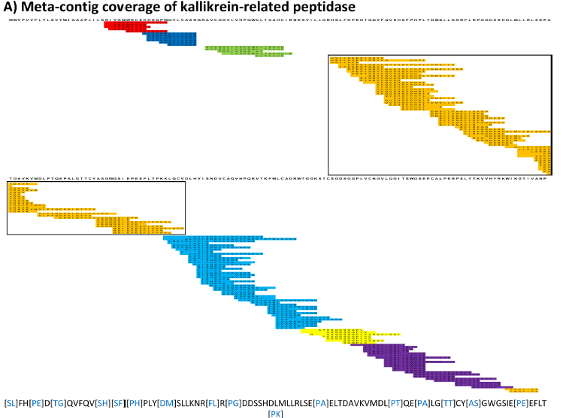
Guthals A, Clauser KR, Bandeira N, Mol Cell Proteomics 2012 11: 1084-1096, doi:10.1074/mcp.M111.015768.
Notes:
FIG. 4A. Mapped Meta-contigs. Meta-contig PRM spectra were aligned to reference proteins to evaluate de novo sequencing coverage.
Every colored row corresponds to a contig PRM spectrum as separately mapped to the target protein sequence (information not used by
Meta-SPS). Every set of overlapping contigs of the same color corresponds to a meta-contig; sets of contigs of the same color with no overlap
indicate separate meta-contigs. Below each coverage map is the longest meta-contig sequence of the boxed meta-contig for the corresponding
protein. Purple gaps correspond to mapped sequence calls with PTMs verified by MS-GFDB; blue gaps correspond to mapped gaps
that span 2 or more residues in the reference. Remaining un-colored residues represent sequence calls that map to reference amino acid
masses. A, Meta-contig coverage of kallikrein-related peptidase from the 6-prot sample is displayed here; 8 meta-contigs covered 78% of the
261 AA protein with the longest sequence spanning 94 AA.

Slide 23
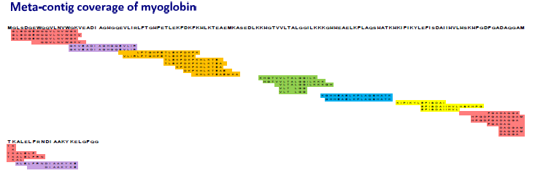
Guthals A, Clauser KR, Bandeira N, Mol Cell Proteomics 2012 11: 1084-1096, doi:10.1074/mcp.M111.015768.
Notes:
Figure S-7 – Meta-contig coverage of myoglobin from the 6-prot sample is displayed here (as in Figure
4). Contigs that overlap but were not merged are explained by circumstances illustrated in Figure 6.

Slide 24
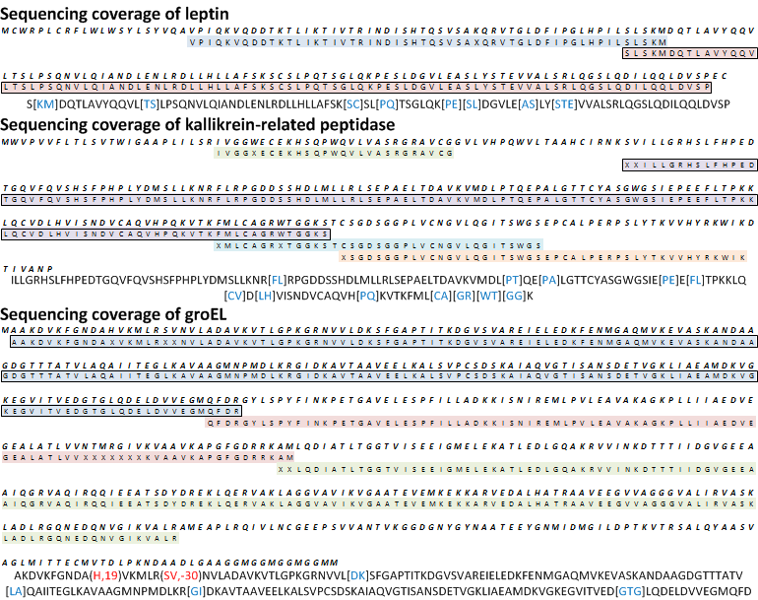
Sequencing Coverage
Guthals A, Clauser KR, Bandeira N, J Proteome Res, 2013, in preparation
Notes:
De novo sequencing coverage of six target proteins at $κ=5$: Every colored row corresponds to a de novo sequence as separately mapped to the target protein sequence (information not used by Meta-SPS). Every row in the coverage map spans at most 85 AA of the reference. Below each map is the longest de novo sequence covering that protein (also indicated in the coverage map). Blue letters correspond to gaps that span 2 or more residues in the reference. Red letters indicate incorrect sequence calls as they are aligned to the reference. Remaining un-colored residues represent sequence calls that match reference amino acid masses.

Slide 25
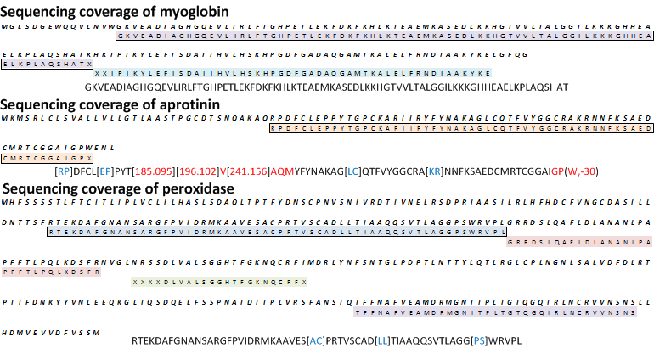
Sequencing Coverage
Guthals A, Clauser KR, Bandeira N, J Proteome Res, 2013, in preparation
Notes:
De novo sequencing coverage of six target proteins at $κ=5$: Every colored row corresponds to a de novo sequence as separately mapped to the target protein sequence (information not used by Meta-SPS). Every row in the coverage map spans at most 85 AA of the reference. Below each map is the longest de novo sequence covering that protein (also indicated in the coverage map). Blue letters correspond to gaps that span 2 or more residues in the reference. Red letters indicate incorrect sequence calls as they are aligned to the reference. Remaining un-colored residues represent sequence calls that match reference amino acid masses.

Slide 26
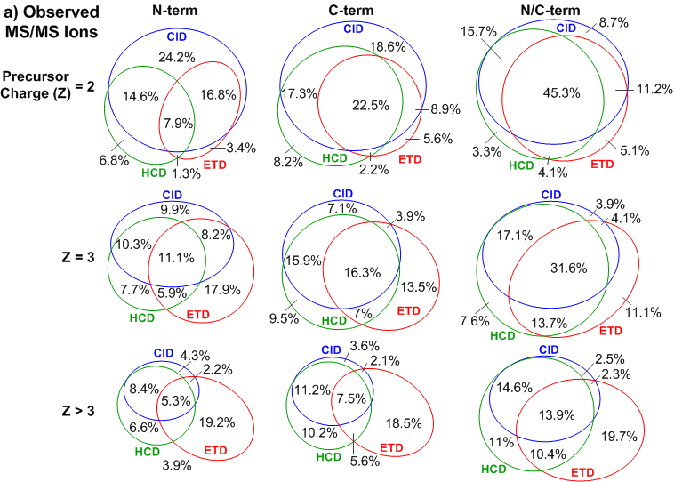
Overlap of Peptide Bond Dissociations Observed in MS/MS
Guthals A, Clauser KR, Bandeira N, J Proteome Res, 2013, in preparation
Notes:
Figure 2 (a) Observed MS/MS Ions: This shows the percentage of peptide breaks observed by N-terminal ions ($b$ ions in CID/HCD and $c$ ions in ETD) and/or C-terminal ions ($y$ ions in CID/HCD and $z$°/$z$°+H ions(36) in ETD) over all MS/MS CID/HCD/ETD triplets identified by MS-GFDB (considering a 20 ppm peak tolerance). To filter out low-intensity peaks, a peak was counted if and only if its intensity was ranked in the top seven over all neighboring peak intensities with in a ±56 Da radius. Rows separate baseline PSMs by precursor charge of identified triplets.

Slide 27
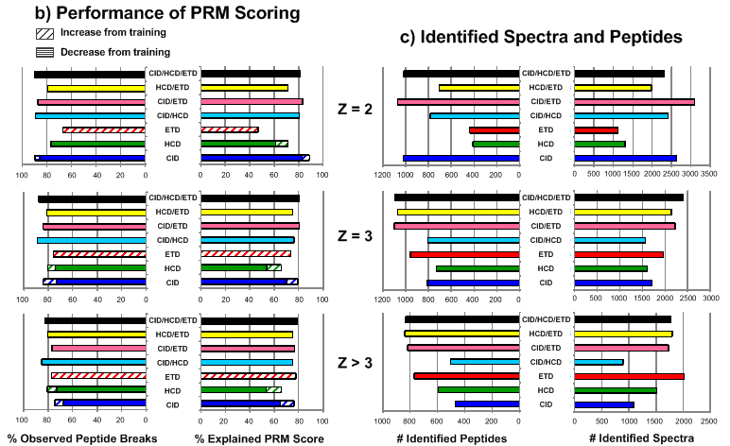
Merging Results
Guthals A, Clauser KR, Bandeira N, J Proteome Res, 2013, in preparation
Notes:
Figure 2 (b) Performance of PRM Scoring: The percentage of observed peptide breaks and percentage of explained PRM score (the summed score of all annotated PRMs over the sum of all PRM scores in the spectrum x 100) was counted over all combinations of merged/un-merged PRM spectra (without clustering) with identified MS/MS spectra. Peaks at mass PRM or SRM + mass(H₂O) indicated peptide breaks in all combinations except ETD alone, where peaks at mass PRM or SRM - mass(NH) were considered. Each combination of PRM spectra was benchmarked by MS-GFDB IDs of the same combination of MS/MS spectra (CID/HCD/ETD PRMs were benchmarked with CID/HCD/ETD MS/MS IDs, CID/ETD PRMs with CID/ETD IDs, HCD PRMs with HCD IDs, etc). Also indicated is the performance gained by re-training PepNovo⁺ to individually score high resolution CID, HCD, and ETD spectra.
(c) Identified Spectra and Peptides: The numbers of identified spectra and unique peptides are shown for each combination of MS/MS spectra used to benchmark PRM scores in (b). As expected, incorporation of HCD and ETD significantly boosts identification rates of spectra from highly charged precursors.

Slide 28
Obstacles to Obtaining Full-length Protein Sequence de novo
signal peptides and Pre-pro activation sequences already cleaved off
Certainty of having reached termini – label prior to digestion?
Missing regions containing N-linked glycans – PNGase-F before proteolysis
Peptide sampling bias
hydrophobicity
  ionizability
Location of basic residues (R,H, K)
Isobaric AA combinations
6 peaks, 5 AA overlap required
Use ppm rather than Da tolerance
Peptide triplets –concatenate 2 short tryptics to overlap a long Lys-C
Isobaricpeptide AA’s
  I = L (C6 H11 N1 O) = 113.08406
  K ~ Q (C6 H12 N2 O, C5 H8 N2 O2) 128.09496 ~ 128.05858 D =0.03638
  F~m (C9 H9 N O, C5 H9 N O S) 147.06841 ~ 147.0354 D =0.0330
Isobaric AA combinations
  GG=N (C4 H6 N2 O2 , C4 H6 N2 O2) 114.04293
  GA=Q~K (C5 H8 N2 O2, C5 H8 N2 O2, C6 H12 N2 O) 128.09496 ~ 128.05858 D =0.03638
  DA~W~VS (C7 H10 N2 O4, C11 H11 N2 O, C8 H14 N2 O3) 186.06405 ~ 186.07931 ~ 186.10044 D =0.01526 D =0.02113

Slide 29
Sequencing Results
To compute sequencing accuracy, assembled MS/MS spectra were identified and their annotations were propagated to meta-contig PRM spectra
To compute sequencing coverage, meta-contig PRM spectra were aligned to target protein sequences

Slide 30
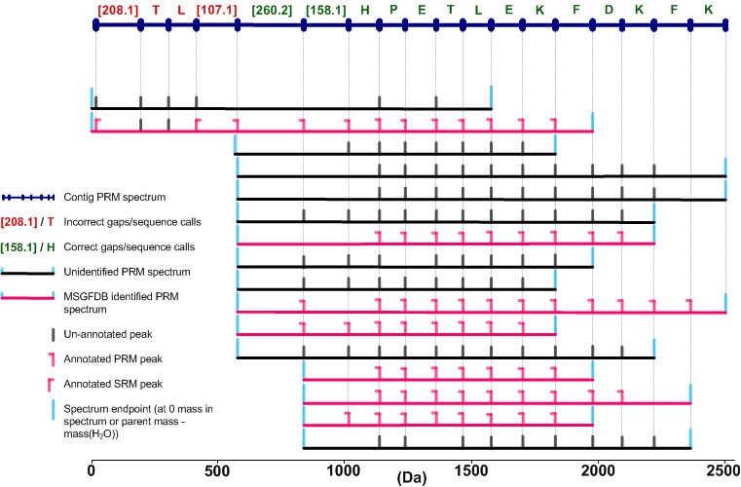
Sequencing Accuracy
MS/MS spectra were identified by MS-GFDB against the target proteins at 1% FDR
Spectrum-peptide matches were used to annotate SPS contigs and meta-contigs

Slide 31
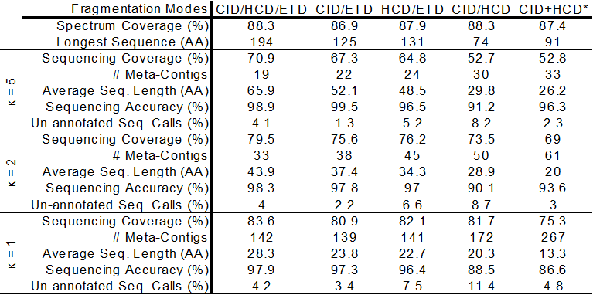
Coverage, Accuracy by Dissociation Method
Guthals 2012 MCP
De novo sequencing length, coverage, and accuracy for alternative fragmentation modes at minimum meta-contig size (κ) cutoffs. *The CID+HCD column indicates sequencing results we reported in Guthals 2012 MCP using unpaired high-resolution CID and HCD MS/MS spectra from a Thermo LTQ Orbitrap using the same sample material and enzymatic digestions.
Guthals A, Clauser KR, Bandeira N, J Proteome Res, 2013, in preparation
Notes:
Table 1 Spectrum Coverage is the percent of amino acids in all proteins covered by peptides identified by MS-GFDB at 1% FDR. Sequencing Coverage is the percent of amino acids in all proteins covered by at least one aligned de novo sequence. Average Seq. Length is the average number of amino acids covered by each aligned de novo sequence and Longest Sequence is the maximum number of amino acids covered by a single de novo sequence. Sequencing Accuracy is the percentage of all annotated sequence calls or gaps that were labeled correct. Un-annotated Seq. Calls is the percentage of sequence calls/gaps that were un-annotated. Each column indicates which combination of MS/MS spectra was used as input to Meta-SPS and database search (each column also defines a different set of PSMs for computing sequencing accuracy).

Slide 32
Pitfalls
Spectral Networks not optimized for high accuracy MS/MS spectra
Limitations inherent with proteomics mass spectrometry
  incomplete enzyme digestion
  peptide sampling bias
  ambiguous amino acid masses

Slide 33
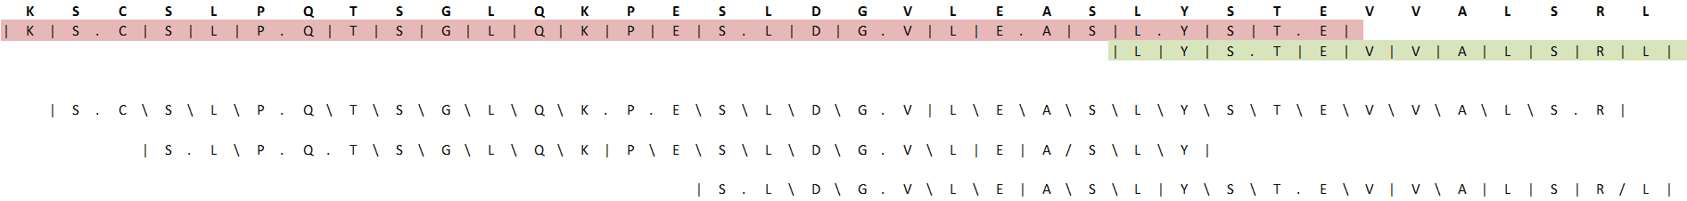
Pitfalls
[ST], 324.6
Gaps towards endpoints because of parallel paths in abruijn graph
S, 105.2
T, 55.0
18 matching peaks
17 matching peaks

Slide 34
Conclusion
Extensive and accurate protein sequencing can be achieved without the use of a database
  More can be gained from experimental MS/MS data before mapping to a reference database
Compared to other approaches, provides the longest and most accurate de novo sequences without requiring any sequence homology steps
  De novo sequences which extend beyond 190 amino acids can be assembled with 99% accuracy

Slide 35
Acknowledgements
Advisor - Nuno Bandeira^{1,2}
Data acquisition, sample prep, and contributor – Karl Clauser³
Assistance training PepNovo – Ari Frank
CCMS Computing support – Jeremy Carver¹, Ian Kaufman¹, To-ju Huang¹
¹Department of Computer Science and Engineering, ²Skaggs School of Pharmacy and Pharmaceutical Sciences, University of California San Diego, La Jolla, California 92093; ³Broad Institute of the Massachusetts Institute of Technology and Harvard, Cambridge, Massachusetts 02142

Slide 36
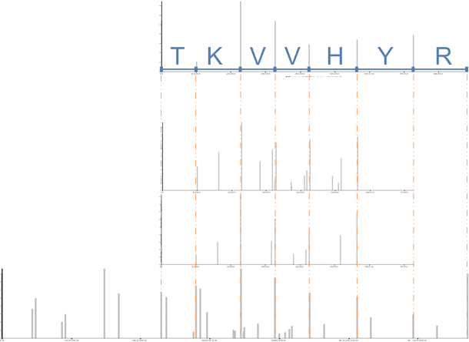
Shotgun Protein Sequencing
SPS contig spectra
Peak intensity = summed log-likelihood score
Corresponds to product of probabilities (spectra are independent observations)
Scored PRM spectra
Peak intensity = likelihood score
Score accounts for:
Ion types
b/y complementarities
intensities

Slide 37
Basic Meta-SPS Approach
Unknown Protein ( > 80 AA)
N
C
Meta contig spectra
Unknown Protein ( > 80 AA)
N
C
SPS contig spectra
Utilize overlapping regions of SPS contig PRM spectra to merge/extend sequences

Slide 38
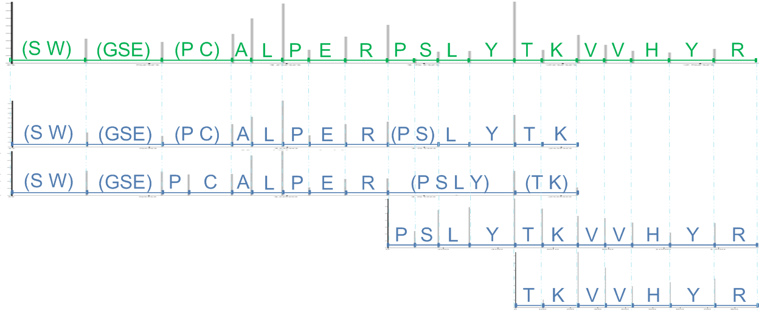
Overall Approach
23 amino acid region of Kallikrein 3, (prostate specific antigen)
Meta contig spectra
Contig Assembly
SPS Contig spectra
Spectral Networks
Scored PRM spectra

Slide 39
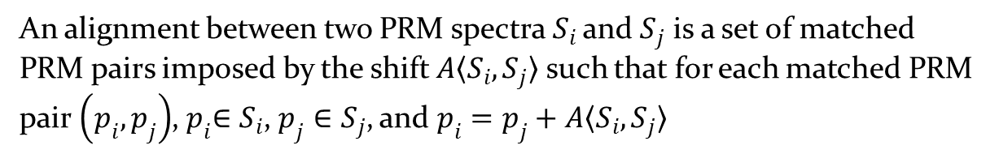
Meta-SPS Alignment
Given a set of contig spectra, find all correct pairs with significant overlap
An alignment between two PRM spectra$S_{i}$ and$S_{j}$ is a set of matched PRM pairs imposed by the shift $A〈S_{i},S_{j}〉$ such that for each matched PRM pair$\left(p_{i},p_{j}\right)$,${ p}_{i}∈S_{i}$,$p_{j}∈S_{j}$, and $p_{i}=p_{j}+A〈S_{i},S_{j}〉$

Slide 40
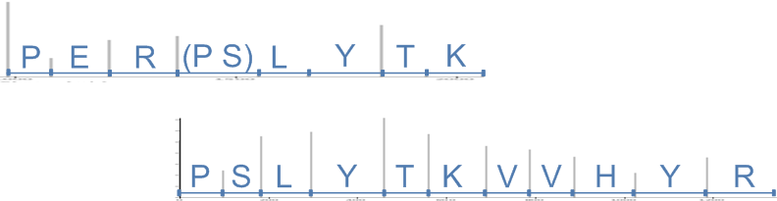


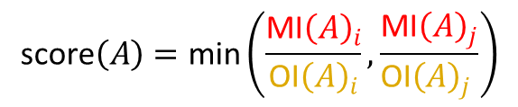





Meta-SPS Alignment
We score by the minimum ratio of matched intensity/overlapping intensity multiplied by the number of matching peaks
$$S_{i}$$
Denotes summed intensity of boxed region
$${\text{MI}\left(A\right)}_{i}$$
$${\text{O}\text{I}\left(A\right)}_{i}$$
$$S_{j}$$
$${\text{MI}\left(A\right)}_{j}$$
$${\text{O}\text{I}\left(A\right)}_{j}$$
$$A〈S_{i},S_{j}〉$$
${\text{O}\text{I}\left(A\right)}_{i}$ - Summed intensity of all peaks in the $m/z$ range of $S_{i}$ that overlaps with the aligned $m/z$ range of $S_{j}$
$$\text{score}\left(A\right)=\text{min}\left(\frac{{\text{MI}\left(A\right)}_{i}}{{\text{O}\text{I}\left(A\right)}_{i}},\frac{{\text{MI}\left(A\right)}_{j}}{{\text{O}\text{I}\left(A\right)}_{j} }\right)$$
* number of matching peaks

Slide 41
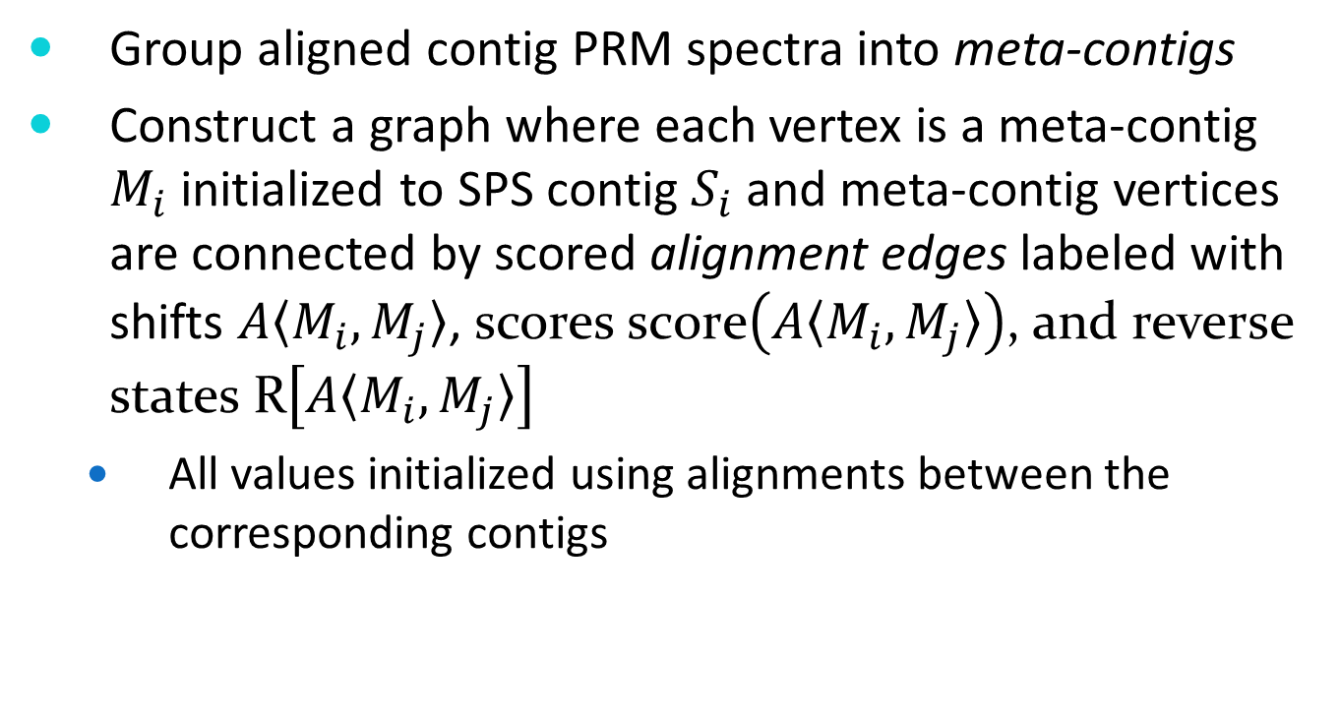
Meta-Assembly
Group aligned contig PRM spectra into meta-contigs
Construct a graph where each vertex is a meta-contig $M_{i}$ initialized to SPS contig $S_{i}$ and meta-contig vertices are connected by scored alignment edges labeled with shifts $A〈M_{i},M_{j}〉$, scores $\text{score}\left(A〈M_{i},M_{j}〉\right)$, and reverse states $\text{R}\left[A〈M_{i},M_{j}〉\right]$
  All values initialized using alignments between the corresponding contigs

Slide 42
Meta-Assembly
Problem is complicated in real overlap graph:
  PTMs
  Cycles
Contigs may not be in the same orientation wrt each other.
E
D
I
T
P
E
P
Incorrect
pair
reverse
P
E
P
T
I
D
E
Correct
pair
P
E
P
E
P
T

Slide 43
Assembly
Input: Overlap graph, threshold T
Problem: Merge the maximal scoring subset of edges such that:
  All alignments between contigs in the same meta-contig are consistent* and coherent*
  Every contig PRM spectrum can be aligned to its meta-contig PRM spectrum* with score at least T
*A set of alignment edges are consistent if and only if every path between any two contigs induce the same shift
*Similar to the relationship between a contig and a contig PRM spectrum, every meta-contig also has a meta-contig PRM spectrum
*A set of alignments are coherent if and only if they all agree on the orientation of all connected contigs (forward or reversed)

Slide 44
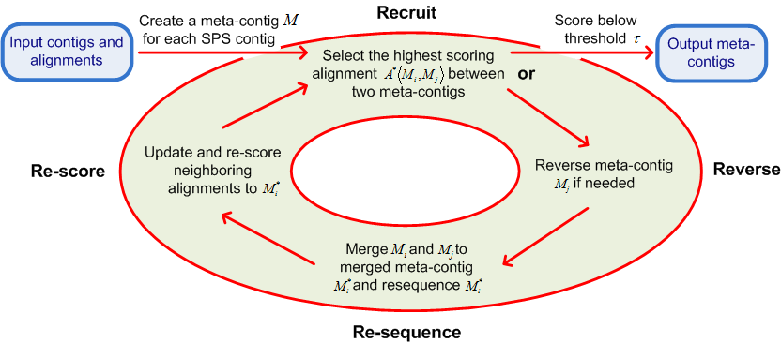
Assembly
Meta-assembly iterates over the following steps:
  Recruit → Reverse → Re-sequence → Re-score

Slide 45
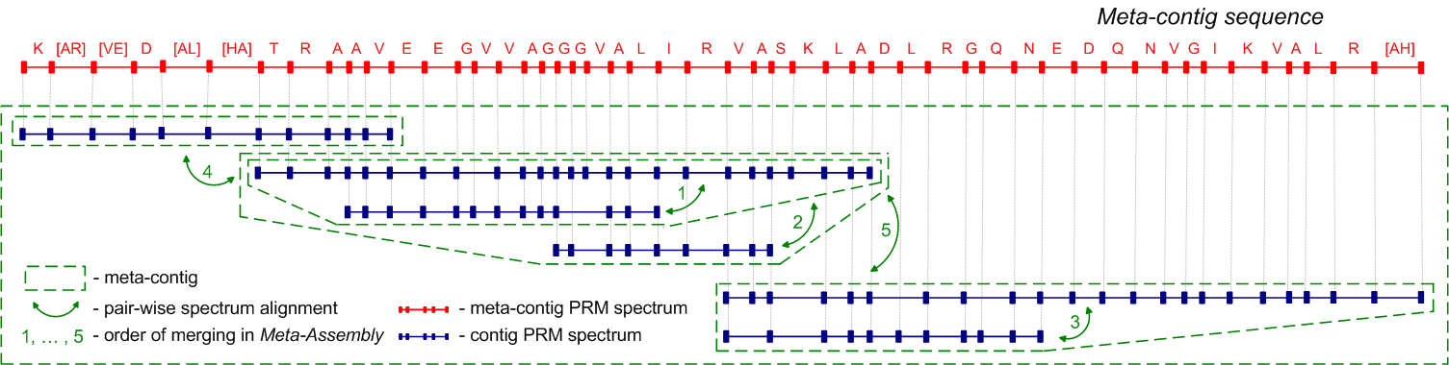
Assembly

Slide 46
Triplet Merging Procedure
Find peaks with same mass in CID/ETD or HCD/ETD, move them and their complementary SRMs to the merged spectrum*
Find peaks with mass difference 15+18 in CID/ETD or HCD/ETD, move them and their complementary PRMs to the merged spectrum*
Find PRM / SRM peak pairs in CID/ETD or HCD/ETD pairs, , move them and their complementary masses to the merged spectrum*
Add in leftover peaks
* Double the score of PRMs added in 1-3

Slide 47
Merging Results
For all precursors: | CID | HCD | ETD | Merged CID, HCD, and ETD
 |  |  |  | Naive Merge | Ranked Merge | Ranked Merge (filtered)
% Breaks Observed by PRMs | 63.3 | 63 | 55.3 | 88 | 87.1 | 83.8
% Score Explained by PRMs | 45.8 | 38.7 | 40.2 | 41.8 | 69.2 | 75.5
% Breaks Observed by SRMs+18 | 47.6 | 43.4 | 35.5 | 58.8 | 23.9 | 19.7
% Score Explained by SRMs+18 | 28.5 | 18.8 | 25.7 | 17.3 | 4.6 | 4.8
% Breaks Observed by PRMs/SRMs | 77.8 | 76.6 | 65.8 | 93.6 | 90.7 | 88.1
% Score Explained by PRMs/SRMs | 74.3 | 57.5 | 66 | 59.1 | 73.8 | 80.4
% Breaks Observed by SRMs-15 | 0.6 | 1 | 35.5 | 35.7 | 7.7 | 5.8
% Score Explained by SRMs-15 | 0.1 | 0.2 | 25.7 | 7 | 1.4 | 1.4
For charge > 3 precursors: | CID | HCD | ETD | Merged CID, HCD, and ETD
 |  |  |  | Naive Merge | Ranked Merge | Ranked Merge (filtered)
% Breaks Observed by PRMs | 50.4 | 66.7 | 60.2 | 86.4 | 85.3 | 81.8
% Score Explained by PRMs | 39.2 | 36.7 | 40.8 | 38.9 | 69 | 75.7
% Breaks Observed by SRMs+18 | 42.3 | 54 | 0.9 | 59.6 | 21.7 | 17.3
% Score Explained by SRMs+18 | 28 | 21.7 | 0.1 | 16.9 | 4.1 | 4.3
% Breaks Observed by PRMs/SRMs | 69.7 | 82.4 | 75.5 | 93.2 | 89.1 | 86.1
% Score Explained by PRMs/SRMs | 67.2 | 58.3 | 73.4 | 55.7 | 73.1 | 80.1
% Breaks Observed by SRMs-15 | 0.6 | 1.2 | 51.5 | 51.5 | 13.3 | 10.7
% Score Explained by SRMs-15 | 0.1 | 0.2 | 32.6 | 10.1 | 2.1 | 2.3
Merged numbers are over all triplets identified by MSGFDB at 1% FDR

Slide 48















C. Tropix
Thereuopoda sp.
L. variatus
S. foelschei
U. manicatus
I. vescus
L. weigensis
S. Morsitans
H. infensa
A. xerolimniorum
L. buchari
H. jugulans
E. rubripes
Centipedes
Spiders
Scorpions
C. squama
C. westwoodi

Slide 49


Slide 50







L. quinquestriatus h.
H. judaicus
A. bicolor
C. werneri
B. intumescens
N. hierichonticus
B. malhommei
A. australis
A. crassicauda
H. judaicus
L. quinquestriatus q.
P. liosoma
H. paucidens
G. grandidieri
O. madagascariensis
Centipedes
Spiders
Scorpions

Slide 51





Scolopendra sp.
Geophilomorph sp.
H. spinifer
Centipedes
Spiders
Scorpions
Liocheles sp.

Slide 52
Undigested Scorpion Venoms
P83405 BUTJU Neurotoxin Tx-1
V/G|C|E E|C/P/A H/C K 0 11 17 CID K120215_HjRA_ff4f4f4_pccc_01.2400.2400.3.pkl.spo
V G\C/E/E/C/P/A H/C K 0 11 17 HCD K120215_HjRA_ff4f4f4_pccc_01.2401.2401.3.pkl.spo
V/G|C|E|E|C/P A/H/C K G 0 12 16 CID K120215_HjRA_ff4f4f4_pccc_01.2422.2422.3.pkl.spo
V/G/C|E/E|C P|A|H|C|K G 0 12 16 ETD K120215_HjRA_ff4f4f4_pccc_01.2424.2424.3.pkl.spo
V G\C/E/E/C/P/A/H/C K G 0 12 16 HCD K120215_HjRA_ff4f4f4_pccc_01.2423.2423.3.pkl.spo
V|G\C|E|E\C P|A|H\C|K\G\K 0 13 15 ETD K120215_HjRA_ff4f4f4_pccc_01.2210.2210.4.pkl.spo
V G\C E E C/P/A/H/C/K/G K 0 13 15 HCD K120215_HjRA_ff4f4f4_pccc_01.2209.2209.4.pkl.spo
V/G|C|E|E|C/P A H C K G K 0 13 15 CID K120215_HjRA_ff4f4f4_pccc_01.2205.2205.3.pkl.spo
V/G/C|E|E C/P A H/C K G K\N 0 14 14 CID K120215_HjRA_ff4f4f4_pccc_01.2211.2211.3.pkl.spo
V/G C/E/E C P\A|H\C|K G|K\N 0 14 14 ETD K120215_HjRA_ff4f4f4_pccc_01.2213.2213.3.pkl.spo
V/G/C/E/E/C/P A H C K G K N A K\P 0 17 11 CID K120215_HjRA_ff4f4f4_pccc_01.2286.2286.4.pkl.spo
V/G\C\E|E\C P|A|H\C|K|G|K|N|A|K P 0 17 11 ETD K120215_HjRA_ff4f4f4_pccc_01.2288.2288.4.pkl.spo
V/G/C|E/E C/P A/H C K G K/N/A K P T C D 0 20 8 CID K120215_HjRA_ff4f4f4_pccc_01.2351.2351.4.pkl.spo
V/G\C\E|E\C P\A|H\C|K|G|K/N|A|K P T C\D 0 20 8 ETD K120215_HjRA_ff4f4f4_pccc_01.2353.2353.4.pkl.spo
V/G C E E|C|P A H C K G K N A K P T C\D\D 0 21 7 CID K120215_HjRA_ff4f4f4_pccc_01.2380.2380.5.pkl.spo
V/G\C|E|E C P|A|H\C|K G K|N\A|K P T C|D\D 0 21 7 ETD K120215_HjRA_ff4f4f4_pccc_01.2382.2382.5.pkl.spo
V G\C\E\E\C P\A|H C|K G K N\A|K P T/C D\D G V C/N C/N V 0 28 0 ETD K120215_HjRA_ff4f4f4_pccc_01.3159.3159.5.pkl.spo
V G C E/E/C/P A H C K\G K N A\K|P T C D|D|G V|C\N\C\N\V 0 28 0 CID K120215_HjRA_ff4f4f4_pccc_01.3193.3193.3.pkl.spo
G C|E|E|C|P A/H\C 1 9 18 CID K120215_HjRA_ff4f4f4_pccc_01.2390.2390.2.pkl.spo
G C|E|E|C P A|H|C\K 1 10 17 CID K120215_HjRA_ff4f4f4_pccc_01.2114.2114.2.pkl.spo
G C|E|E/C P/A/H/C K 1 10 17 HCD K120215_HjRA_ff4f4f4_pccc_01.2115.2115.2.pkl.spo
G/C|E|E|C/P A H C K G 1 11 16 CID K120215_HjRA_ff4f4f4_pccc_01.2159.2159.3.pkl.spo
G C|E|E\C P|A|H|C|K G 1 11 16 ETD K120215_HjRA_ff4f4f4_pccc_01.2161.2161.3.pkl.spo
G C|E|E/C/P A/H/C/K G 1 11 16 HCD K120215_HjRA_ff4f4f4_pccc_01.2167.2167.2.pkl.spo
G C/E/E C P\A|H|C|K|G\K 1 12 15 ETD K120215_HjRA_ff4f4f4_pccc_01.1872.1872.3.pkl.spo
G C\E E/C/P/A/H/C/K/G K 1 12 15 HCD K120215_HjRA_ff4f4f4_pccc_01.1871.1871.3.pkl.spo
G C/E|E|C|P A/H|C\K\G K 1 12 15 CID K120215_HjRA_ff4f4f4_pccc_01.1899.1899.2.pkl.spo
G C\E\E\C P|A|H\C|K G K|N|A|K P 1 16 11 ETD K120215_HjRA_ff4f4f4_pccc_01.2122.2122.4.pkl.spo
G/C E\E\C P A|H\C|K G K\N/A\K P T C D/D G V C N C N V 1 27 0 ETD K120215_HjRA_ff4f4f4_pccc_01.3087.3087.5.pkl.spo
C\E\E/C/P/A/H/C K 2 9 17 HCD K120215_HjRA_ff4f4f4_pccc_01.1972.1972.2.pkl.spo
C|E|E\C P/A|H|C|K G 2 10 16 ETD K120215_HjRA_ff4f4f4_pccc_01.2077.2077.3.pkl.spo
C E|E|C|P A/H|C\K\G 2 10 16 CID K120215_HjRA_ff4f4f4_pccc_01.2062.2062.2.pkl.spo
E E|C/P A/H/C K 3 8 17 HCD K120215_HjRA_ff4f4f4_pccc_01.0449.0449.2.pkl.spo
E/E|C/P/A/H|C K G 3 9 16 CID K120215_HjRA_ff4f4f4_pccc_01.1186.1186.2.pkl.spo
E E|C/P/A/H/C/K G 3 9 16 HCD K120215_HjRA_ff4f4f4_pccc_01.1060.1060.2.pkl.spo
P/A|H/C/K/G/K 6 7 15 HCD K120215_HjRA_ff4f4f4_pccc_01.2238.2238.2.pkl.spo
N A/K/P T/C|D|D|G V|C\N|C\N\V 13 15 0 CID K120215_HjRA_ff4f4f4_pccc_01.3514.3514.2.pkl.spo
A K/P T/C D|D\G V|C|N|C\N\V 14 14 0 CID K120215_HjRA_ff4f4f4_pccc_01.3492.3492.2.pkl.spo
P T C D|D|G V|C|N|C\N\V 16 12 0 CID K120215_HjRA_ff4f4f4_pccc_01.3765.3765.2.pkl.spo
C D D G V|C|N|C|N\V 18 10 0 CID K120215_HjRA_ff4f4f4_pccc_01.3628.3628.2.pkl.spo
D D G\V|C|N|C|N\V 19 9 0 CID K120215_HjRA_ff4f4f4_pccc_01.3472.3472.2.pkl.spo
D G V|C|N|C|N\V 20 8 0 CID K120215_HjRA_ff4f4f4_pccc_01.3388.3388.2.pkl.spo

Slide 53

Adding Charge to Cys for better ETD
Fig. 1. Overview of the de novo sequencing strategy. (I) UV trace of HPLC
separation of crude venom extract from C. textile. (II) MALDI TOF MS of
fraction i after no treatment, reduction, and alkylation. (III) On-line LC ESIMS/MS using CAD and ETD on reduced and alkylated aliquots of fraction i. The final step shows the conversion of Cys residues to dimethylated Lys analogs followed by ETD fragmentation; MS/MS is shown for the (M5H)5 ion of the 1,889.715 Da species in II. c ions are indicated by and z ions by . Shell image Copyright 2005, Richard Ling.
Ueberheide BM, Fenyo¨ D, Alewood PF, and Chait BT. PNAS 2009 106 , 6910–6915 .

Slide 54


scorpion Liocheles waigiensis Australia Q
Opisthacanthus cayaporum (South American scorpion)
(K)I/W|E\G|V|K\S(L)
(A)I/W|S/G I|K\S(L)

Slide 55
Spectrum Mill - Unassigned mass gap
Wide open precursor mass filter coupled with complementary ion principle
+
+
1 2 3 4 5 6
S A M P L E R
6 5 4 3 2 1
+
+
i
j
P_{e}
b_{i}
b_{i} *
y_{j}
y_{j}*
Relative Abundance
P_{db}
y_{j}* + P_{gap}
P_{gap}
b_{i} + P_{gap}
P_{gap}
b_{i} *
Mass (m/z)
0 sequence mismatches: b_{i} , b_{i}* , y_{j} , y_{j}* , P_{e}, P_{db} match
1 sequence mismatch at A: b_{i}* , y_{j} match
2 sequence mismatches at A and P: y_{j} matches
Notes:
Every ion in a spectrum can be thought of as a measurement of the mass of two complementary entities, both the ion and neutral (yj & yj*) resulting from fragmentation of a precursor. When comparing the experimental MS/MS spectrum of a peptide whose precursor mass is shifted from that of a candidate sequence in a database, because of a single modification, either the masses of the fragment ions or the neutrals will match (bi* & yj)while the masses of their complements (bi & yj*) will be shifted by the gap (Pdb-Pe) between the two precursor masses. The enitites containing the modification will have the shifted masses.

Slide 56


Single AA substitutions from a related species
(N)I/W|D|A V|K\G(H)
P0C298 Toxin Acra III-1
Androctonus crassicauda (Arabian fat-tailed scorpion)
N64G
(G)F/L|D\K|I|W(K)
Lychas mucronatus (Chinese swimming scorpion)
D9U2B7 Bradykinin-potentiating peptide NDBP12
K34D

Slide 57

(S)T I|W|S|G I|K\S(L)
C5J886 Non-disulfide-bridged peptide 5.7
Opisthacanthus cayaporum (South American scorpion)
A27T

Slide 58


Single AA substitutions from a related species
(Y)V/A|E|K|M|G\A|T|P T(-)
P83239 Pandinin-1
Pandinus imperator (Emperor scorpion)
I39M
(A)L/A/K/G/A|L\K\A|I|P\S(L)
P83240 Pandinin-2
Pandinus imperator (Emperor scorpion)
L12A

Slide 59
Centipede Scolopendra morsitans Glenmorgan - New Guinea
500 ng
77 protein groups
104 distinct proteins (27 isoforms/family members)
3154 MS/MS spectra
713 distinct peptides

Slide 60

Centipede Scolopendra morsitans Glenmorgan - New Guinea
77 protein groups
104 distinct proteins (27 isoforms/family members)
3154 MS/MS spectra
713 distinct peptides
Group 2 Unannotated name
2 subgroups
28kDa, 79% coverage
37 distinct peptides

Slide 61

Centipede Scolopendra morsitans Glenmorgan - New Guinea
77 protein groups
104 distinct proteins (27 isoforms/family members)
3154 MS/MS spectra
713 distinct peptides
Group 12 LDL class A repeat domain
2 subgroups
28kDa, 52% coverage
12 distinct peptides

Slide 62
V/G|C|E E|C/P/A H/C K 0 11 17 CID K120215_HjRA_ff4f4f4_pccc_01.2400.2400.3.pkl.spo
V G\C/E/E/C/P/A H/C K 0 11 17 HCD K120215_HjRA_ff4f4f4_pccc_01.2401.2401.3.pkl.spo
V/G|C|E|E|C/P A/H/C K G 0 12 16 CID K120215_HjRA_ff4f4f4_pccc_01.2422.2422.3.pkl.spo
V/G/C|E/E|C P|A|H|C|K G 0 12 16 ETD K120215_HjRA_ff4f4f4_pccc_01.2424.2424.3.pkl.spo
V G\C/E/E/C/P/A/H/C K G 0 12 16 HCD K120215_HjRA_ff4f4f4_pccc_01.2423.2423.3.pkl.spo
V|G\C|E|E\C P|A|H\C|K\G\K 0 13 15 ETD K120215_HjRA_ff4f4f4_pccc_01.2210.2210.4.pkl.spo
V G\C E E C/P/A/H/C/K/G K 0 13 15 HCD K120215_HjRA_ff4f4f4_pccc_01.2209.2209.4.pkl.spo
V/G|C|E|E|C/P A H C K G K 0 13 15 CID K120215_HjRA_ff4f4f4_pccc_01.2205.2205.3.pkl.spo
V/G/C|E|E C/P A H/C K G K\N 0 14 14 CID K120215_HjRA_ff4f4f4_pccc_01.2211.2211.3.pkl.spo
V/G C/E/E C P\A|H\C|K G|K\N 0 14 14 ETD K120215_HjRA_ff4f4f4_pccc_01.2213.2213.3.pkl.spo
V/G/C/E/E/C/P A H C K G K N A K\P 0 17 11 CID K120215_HjRA_ff4f4f4_pccc_01.2286.2286.4.pkl.spo
V/G\C\E|E\C P|A|H\C|K|G|K|N|A|K P 0 17 11 ETD K120215_HjRA_ff4f4f4_pccc_01.2288.2288.4.pkl.spo
V/G/C|E/E C/P A/H C K G K/N/A K P T C D 0 20 8 CID K120215_HjRA_ff4f4f4_pccc_01.2351.2351.4.pkl.spo
V/G\C\E|E\C P\A|H\C|K|G|K/N|A|K P T C\D 0 20 8 ETD K120215_HjRA_ff4f4f4_pccc_01.2353.2353.4.pkl.spo
V/G C E E|C|P A H C K G K N A K P T C\D\D 0 21 7 CID K120215_HjRA_ff4f4f4_pccc_01.2380.2380.5.pkl.spo
V/G\C|E|E C P|A|H\C|K G K|N\A|K P T C|D\D 0 21 7 ETD K120215_HjRA_ff4f4f4_pccc_01.2382.2382.5.pkl.spo
V G\C\E\E\C P\A|H C|K G K N\A|K P T/C D\D G V C/N C/N V 0 28 0 ETD K120215_HjRA_ff4f4f4_pccc_01.3159.3159.5.pkl.spo
V G C E/E/C/P A H C K\G K N A\K|P T C D|D|G V|C\N\C\N\V 0 28 0 CID K120215_HjRA_ff4f4f4_pccc_01.3193.3193.3.pkl.spo
G C|E|E|C|P A/H\C 1 9 18 CID K120215_HjRA_ff4f4f4_pccc_01.2390.2390.2.pkl.spo
G C|E|E|C P A|H|C\K 1 10 17 CID K120215_HjRA_ff4f4f4_pccc_01.2114.2114.2.pkl.spo
G C|E|E/C P/A/H/C K 1 10 17 HCD K120215_HjRA_ff4f4f4_pccc_01.2115.2115.2.pkl.spo
G/C|E|E|C/P A H C K G 1 11 16 CID K120215_HjRA_ff4f4f4_pccc_01.2159.2159.3.pkl.spo
G C|E|E\C P|A|H|C|K G 1 11 16 ETD K120215_HjRA_ff4f4f4_pccc_01.2161.2161.3.pkl.spo
G C|E|E/C/P A/H/C/K G 1 11 16 HCD K120215_HjRA_ff4f4f4_pccc_01.2167.2167.2.pkl.spo
G C/E/E C P\A|H|C|K|G\K 1 12 15 ETD K120215_HjRA_ff4f4f4_pccc_01.1872.1872.3.pkl.spo
G C\E E/C/P/A/H/C/K/G K 1 12 15 HCD K120215_HjRA_ff4f4f4_pccc_01.1871.1871.3.pkl.spo
G C/E|E|C|P A/H|C\K\G K 1 12 15 CID K120215_HjRA_ff4f4f4_pccc_01.1899.1899.2.pkl.spo
G C\E\E\C P|A|H\C|K G K|N|A|K P 1 16 11 ETD K120215_HjRA_ff4f4f4_pccc_01.2122.2122.4.pkl.spo
G/C E\E\C P A|H\C|K G K\N/A\K P T C D/D G V C N C N V 1 27 0 ETD K120215_HjRA_ff4f4f4_pccc_01.3087.3087.5.pkl.spo
C\E\E/C/P/A/H/C K 2 9 17 HCD K120215_HjRA_ff4f4f4_pccc_01.1972.1972.2.pkl.spo
C|E|E\C P/A|H|C|K G 2 10 16 ETD K120215_HjRA_ff4f4f4_pccc_01.2077.2077.3.pkl.spo
C E|E|C|P A/H|C\K\G 2 10 16 CID K120215_HjRA_ff4f4f4_pccc_01.2062.2062.2.pkl.spo
E E|C/P A/H/C K 3 8 17 HCD K120215_HjRA_ff4f4f4_pccc_01.0449.0449.2.pkl.spo
E/E|C/P/A/H|C K G 3 9 16 CID K120215_HjRA_ff4f4f4_pccc_01.1186.1186.2.pkl.spo
E E|C/P/A/H/C/K G 3 9 16 HCD K120215_HjRA_ff4f4f4_pccc_01.1060.1060.2.pkl.spo
P/A|H/C/K/G/K 6 7 15 HCD K120215_HjRA_ff4f4f4_pccc_01.2238.2238.2.pkl.spo
N A/K/P T/C|D|D|G V|C\N|C\N\V 13 15 0 CID K120215_HjRA_ff4f4f4_pccc_01.3514.3514.2.pkl.spo
A K/P T/C D|D\G V|C|N|C\N\V 14 14 0 CID K120215_HjRA_ff4f4f4_pccc_01.3492.3492.2.pkl.spo
P T C D|D|G V|C|N|C\N\V 16 12 0 CID K120215_HjRA_ff4f4f4_pccc_01.3765.3765.2.pkl.spo
C D D G V|C|N|C|N\V 18 10 0 CID K120215_HjRA_ff4f4f4_pccc_01.3628.3628.2.pkl.spo
D D G\V|C|N|C|N\V 19 9 0 CID K120215_HjRA_ff4f4f4_pccc_01.3472.3472.2.pkl.spo
D G V|C|N|C|N\V 20 8 0 CID K120215_HjRA_ff4f4f4_pccc_01.3388.3388.2.pkl.spo

