Slide 1
The Extracellular Matrix: Proteomics Signatures of Breast Cancer Progression and Metastasis
Alexandra Naba, Ph.D.
Hynes Lab
Koch Institute for Integrative Cancer Research @ MIT

Slide 2
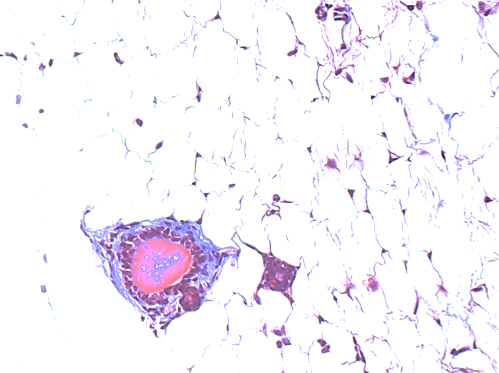
Why should one be interested in the ECM composition in cancer?
The ECM is a prominent part of the tissue/tumor microenvironment and frequently changes during tumor progression and metastasis
ECM proteins control cell proliferation, survival, adhesion, invasion, etc.
Direct signaling via the integrins
Modulation of growth factor signaling
ECM remodeling by enzymes is important during tumor progression:
Architectural changes
Breakdown of basement membrane is a key step of invasion
Cleavage: release of biologically active fragments
ECM is frequently invoked as a component of cancer stem cell and (pre-) metastatic niches
Murine Mammary Gland
Murine Mammary Tumor
(MMTV-PyMT)
Duct
Masson’s Trichrome Staining: Collagen fibers
Characterization of the tumor ECM =
Better understanding of tumor biology
+ Novel prognostic and diagnostic markers and therapeutic targets
Notes:
CD29 = Integrin β1, CD49a-f = Integrin α1-6

Slide 3
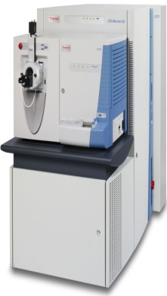

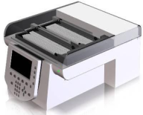

Proteomic Pipeline To Analyze The Composition Of The Extracellular Matrix
Lung
Colon
~150 mg
1. ECM protein enrichment
DTT
Iodoacetamide
Solubilize
(8M urea)
Reduction/
Alkylation
(2M urea)
Deglycosylation
(PNGaseF)
Digestion
(Lys-C, trypsin)
Peptide
Fractionation
(Off-Gel Electrophoresis)
LC-MS/MS
(LTQ Orbitrap XL)
2. Multidimensional Proteomic Analysis
What is the Matrisome?
Core Matrisome:
ECM Glycoproteins, Collagens, Proteoglycans
Matrisome-associated:
Secreted Factors, ECM-affiliated Proteins, ECM Regulators
List of ECM Proteins
List of
2000-3000 Proteins
3. Annotation:
in silico Matrisome
Software: SpectrumMill
DB: UniProt
Naba et al., 2012, Mol. Cell. Proteomics
http://web.mit.edu/hyneslab/matrisome/
Notes:
To analyze the composition of this ECM-rich fraction, I have developed in collaboration with Karl Clauser from the Proteomics platform of the Broad Institute, a proteomics pipeline based on a tandem mass spectrometry approach.
Briefly, after resolubilizing the proteins, we deglycosylate and then digest them. The peptides are separated first by off-gel electrophoresis according to their isoelectric point and then by liquid chromatography before being analyzed by tandem mass spectrometry.

Slide 4
The Extracellular Matrix Proteome
The ECM of any given tissue comprises over 150 proteins
Reproducible and characteristic differences between tissues: definition of an “ECM Signature” for each tissue.
Apply our proteomic approach to understand tumor biology
Naba et al., 2012, Mol. Cell. Proteomics

Slide 5
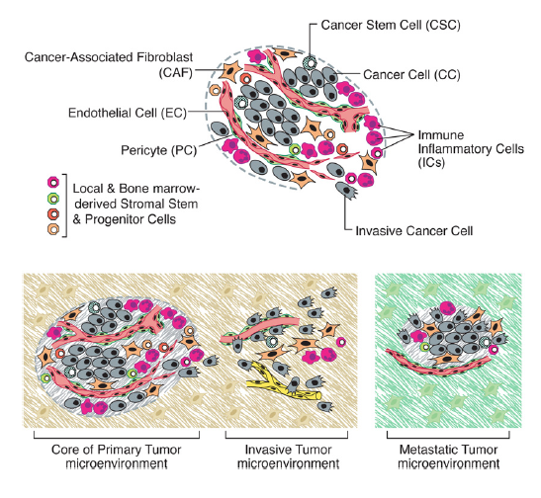
The tumor microenvironment is composed of many stromal cell types
Mural Cells
Cancer-associated Fibroblasts
Cancer Cells & Cancer Stem Cells
Immune/
Inflammatory Cells
Endothelial Cells
Core of Primary Tumor Microenvironment
Invasive Tumor Microenvironment
What is the contribution of stromal cells and tumor cells to the production of the tumor ECM?
Adapted from Hanahan D. and Weinberg R.A., 2011, Cell

Slide 6

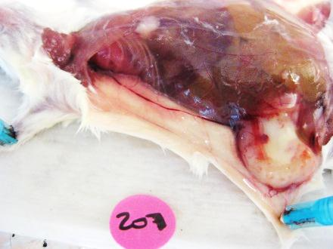
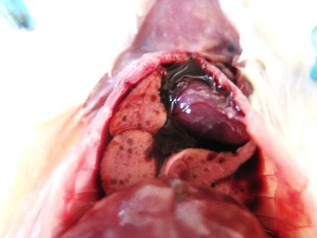
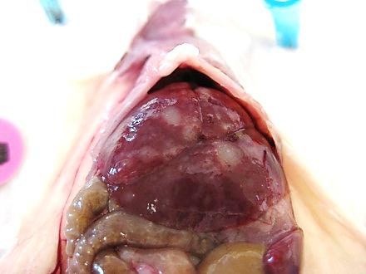
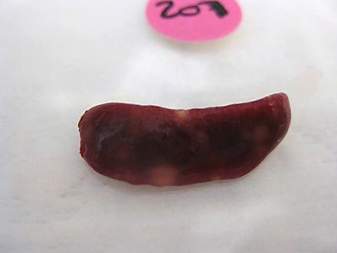
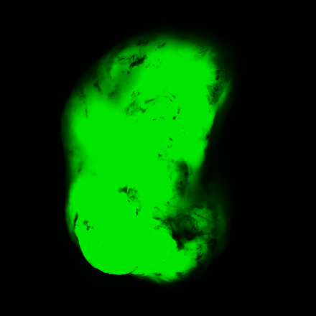
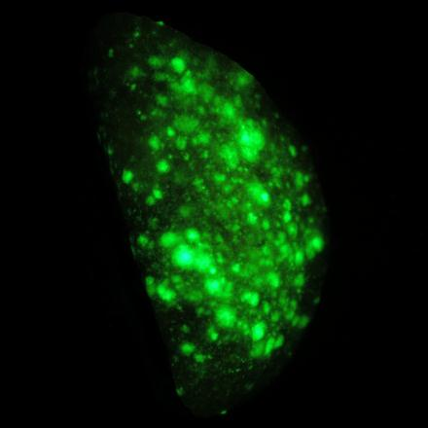
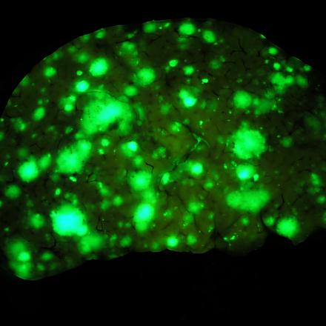
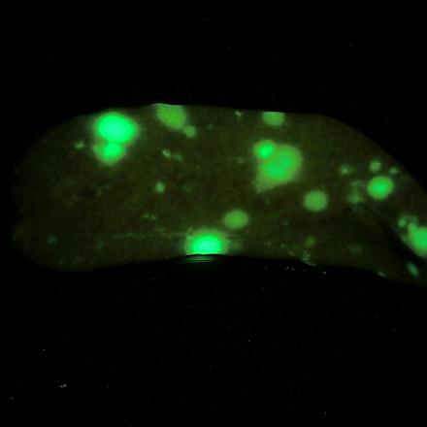
Experimental Strategy
Orthotopic xenograft:
MDA-MB-231 (poorly metastatic) or LM2 (highly metastatic to the lungs)
Human Mammary Carcinoma Cells
Primary
Tumor (LM2) Lung Liver Spleen
♀ mouse
NOD/SCID/IL2gR-/-
Primary Tumor Collection
---
Tumor ECM preparation
LM2 Zs-Green
Proteomic pipeline
Proteins secreted by the tumor cells (human sequence)
Proteins secreted by the stromal cells (murine sequence)
Notes:
LM2 Cells: gift from Joan Massagué

Slide 7
Of Mouse or Man?
Peptide Abundance
Peptide Abundance
If (ΣI_{Hs}/ΣI_{Mm}) >5: protein mostly secreted by the tumor cells
If (ΣI_{Mm}/ΣI_{Hs}) >5: protein mostly secreted by the stromal cells
Ex: Fibrillin-1 is secreted almost equally by the tumor and stromal cells
Tumor
Both
Stroma
Hs Hs>Mm Hs=Mm Mm>Hs Mm
?
Origin unknown: peptide detected are common to the human and mouse sequence

Slide 8
100 ECM proteins are expressed by the 2 tumor types and by the same compartment
Tumor only
 | MDA-MB-231 |  | LM2 |  |  |  | MDA-MB-231 |  | LM2 |  |  |  | MDA-MB-231 |  | LM2
Gene Symbol | Tumor | Stroma | Tumor | Stroma |  | Gene Symbol | Tumor | Stroma | Tumor | Stroma |  | Gene Symbol | Tumor | Stroma | Tumor | Stroma
ANXA3 |  |  |  |  |  | ANXA1 |  |  |  |  |  | Col15a1
ANXA7 |  |  |  |  |  | ANXA2 |  |  |  |  |  | Cspg4
CSTB |  |  |  |  |  | COL3A1 |  |  |  |  |  | Dpt
CYR61 |  |  |  |  |  | PXDN |  |  |  |  |  | Emilin1
GAS6 |  |  |  |  |  | TGM2 |  |  |  |  |  | F13a1
HCFC1 |  |  |  |  |  | THBS1 |  |  |  |  |  | F2
IGFBP3 |  |  |  |  |  | ANXA11 |  |  |  |  |  | Fbln2
LAMA3 |  |  |  |  |  | ANXA5 |  |  |  |  |  | Fga
LAMB3 |  |  |  |  |  | COL10A1 |  |  |  |  |  | Fgg
LAMC2 |  |  |  |  |  | COL6A3 |  |  |  |  |  | Hrg
LEPRE1 |  |  |  |  |  | FBN1 |  |  |  |  |  | Itih1
LGALS8 |  |  |  |  |  | IGFBP7 |  |  |  |  |  | Itih2
LMAN1 |  |  |  |  |  | LAMA5 |  |  |  |  |  | Kng1
LOX |  |  |  |  |  | LAMC1 |  |  |  |  |  | Lama4
MMP14 |  |  |  |  |  | PLOD3 |  |  |  |  |  | Lgals9
P4HA2 |  |  |  |  |  | COL1A1 |  |  |  |  |  | Loxl1
PLOD1 |  |  |  |  |  | COL1A2 |  |  |  |  |  | Mfap5
PLOD2 |  |  |  |  |  | COL5A2 |  |  |  |  |  | Nid1
S100A11 |  |  |  |  |  | COL5A3 |  |  |  |  |  | Nid2
S100A4 |  |  |  |  |  | HSPG2 |  |  |  |  |  | Plg
S100A6 |  |  |  |  |  | TNC |  |  |  |  |  | Pzp
SERPINB6 |  |  |  |  |  |  |  |  |  |  |  | Serpina3k
SERPINB9 |  |  |  |  |  |  |  |  |  |  |  | Serpinf2
WNT16 |  |  |  |  |  |  |  |  |  |  |  | Vtn
LGALS1 |  |  |  |  |  |  |  |  |  |  |  | Vwa5a
LTBP1 |  |  |  |  |  |  |  |  |  |  |  | COL14A1
CTSD |  |  |  |  |  |  |  |  |  |  |  | DCN
LTBP4 |  |  |  |  |  |  |  |  |  |  |  | EFEMP1
 |  |  |  |  |  |  |  |  |  |  |  | Fgb
 |  |  |  |  |  |  |  |  |  |  |  | SERPING1
 |  |  |  |  |  |  |  |  |  |  |  | Bmp1 | ? | ? | ? | ?
 |  |  |  |  |  |  |  |  |  |  |  | TLL1 | ? | ? | ? | ?
 |  |  |  |  |  |  |  |  |  |  |  | TLL2 | ? | ? | ? | ?
Stroma only
Tumor
Stroma
Both

Slide 9
ECM proteins expressed by the 2 tumor types but by a different compartment
Overexpressed by the stroma
in highly metastatic tumors
Overexpressed by the tumor cells in highly metastatic tumors
 | MDA-MB-231 |  | LM2
Gene Symbol | Tumor | Stroma | Tumor | Stroma
FN1
COL13A1
ANXA6
COL4A2
SERPIND1
COL16A1
COL4A3
S100A9
 | MDA-MB-231 |  | LM2
Gene Symbol | Tumor | Stroma | Tumor | Stroma
CRLF3
THSD4
P4HA1
PLAU
ECM1
COL11A2
COL2A1
COL4A4
LGALS3
POSTN
COL18A1
COL7A1
SERPINH1
TGFBI
ADAMTSL1
COL12A1
COL4A1
COL6A1
COL6A2
LAMB2
COL4A5
COL5A1
LAMB1
LTBP2 | ? | ?
ELN
Tumor
Stroma
Both
Notes:
If we had analyzed these tumors by array we wouldn’t detect any differences but with our proteomics approach we can actually detect that the compartment that secretes the proteins changes.

Slide 10
ECM proteins differentially expressed between poorly and highly metastatic tumors
Overexpressed by the poorly metastatic tumors
Overexpressed by highly metastatic tumors
Gene Symbol | Tumor | Stroma |  | Gene Symbol | Tumor | Stroma
COL17A1 |  |  |  | PRELP
Col28a1 |  |  |  | THBS2
FLG2 |  |  |  | Aspn
MMP1 |  |  |  | Emilin2
MMP19 |  |  |  | Gm7455
NGLY1 |  |  |  | Hmcn1
OGN |  |  |  | Itih3
PLAT |  |  |  | Lum
S100A16 |  |  |  | Vwa1
S100A8 |  |  |  | COL6A6 | ? | ?
COL19A1 |  |  |  | LAMA2 | ? | ?
EMID2 |  |  |  | FBLN5 | ? | ?
TNXB |  |  |  | Timp3 | ? | ?
Gene Symbol | Tumor | Stroma
ADAM10
ADAM9
AGRN
ANGPTL4
COL22A1
CST3
CTGF
CTSF
EGLN1
HCFC2
IGFBP4
LEPREL2
LOXL2
LTBP3
MFGE8
P4HTM
PRG4
S100A2
SNED1
SRPX
TIMP1
TINAGL1
Gene Symbol | Tumor | Stroma
CTSB
COL24A1
COL4A6
CTSC
C1qa
C1qc
F10
F13b
Habp2
Il16
Itih4
Papln
Plxnb2
SERPINC1
Serpinf1
Vwf
SERPINE2 | ? | ?
Serpina1b | ? | ?
EFEMP2 | ? | ?
HTRA1 | ? | ?
S100A10 | ? | ?
Tumor
Stroma
Both

Slide 11
Identification of proteins that are both tumor-type and compartment specific
The tumor cells and the stromal cells both contribute to the production of the tumor ECM.
A majority of matrisome proteins are expressed by the two compartments in the same proportion.
Subsets of matrisome proteins are either secreted by tumor cells or secreted by the stroma.
Tumors of differing metastatic potential differ in both
the tumor- and the stroma-derived ECM
Tumor/Stroma crosstalk during tumor progression
Notes:
Red frame Functionally important

Slide 12
Do ECM changes have functional consequences on tumor progression?
Overexpressed by the poorly metastatic tumors
Overexpressed by highly metastatic tumors
Gene Symbol | Tumor | Stroma |  | Gene Symbol | Tumor | Stroma
COL17A1 |  |  |  | PRELP
Col28a1 |  |  |  | THBS2
FLG2 |  |  |  | Aspn
MMP1 |  |  |  | Emilin2
MMP19 |  |  |  | Gm7455
NGLY1 |  |  |  | Hmcn1
OGN |  |  |  | Itih3
PLAT |  |  |  | Lum
S100A16 |  |  |  | Vwa1
S100A8 |  |  |  | COL6A6 | ? | ?
COL19A1 |  |  |  | LAMA2 | ? | ?
EMID2 |  |  |  | FBLN5 | ? | ?
TNXB |  |  |  | Timp3 | ? | ?
Gene Symbol | Tumor | Stroma
ADAM10
ADAM9
AGRN
ANGPTL4
COL22A1
CST3
CTGF
CTSF
EGLN1
HCFC2
IGFBP4
LEPREL2
LOXL2
LTBP3
MFGE8
P4HTM
PRG4
S100A2
SNED1
SRPX
TIMP1
TINAGL1
Gene Symbol | Tumor | Stroma
CTSB
COL24A1
COL4A6
CTSC
C1qa
C1qc
F10
F13b
Habp2
Il16
Itih4
Papln
Plxnb2
SERPINC1
Serpinf1
Vwf
SERPINE2 | ? | ?
Serpina1b | ? | ?
EFEMP2 | ? | ?
HTRA1 | ? | ?
S100A10 | ? | ?
*
*
*
Tumor
Stroma
* Fry JL, et al., 2010, Cancer Research
* Padua D. et al., 2008, Cell
* Barry-Hamilton V. et al., 2010, Nat. Medicine
Both

Slide 13
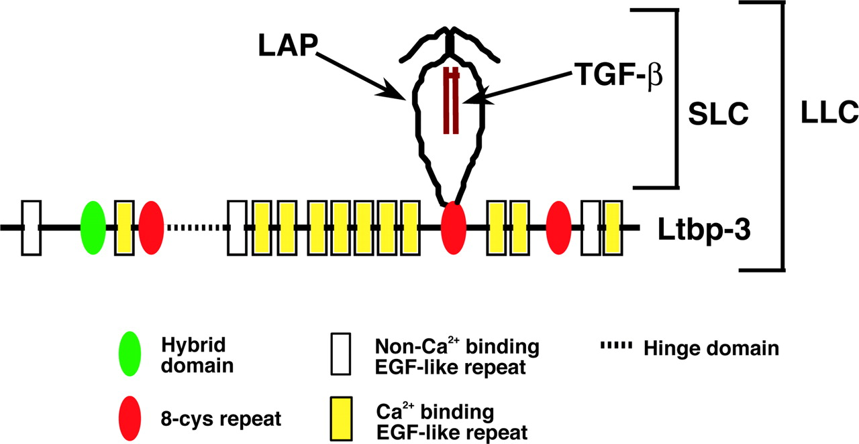
LTBP3: A regulator of TGFβ secretion and bioavailability
Latency- Associated Peptide (LAP)
Large Latent Complex (LLC)
Small Latent Complex (SLC)
Adapted from Rifkin D., 2005, J Biol. Chem.
Knock-out mouse phenotype: bone and lung septation defects
No data on the role of LTBP3 in cancers
Dual role of TGFβ in cancers:
At an early stage: tumor suppressor
At later stages: tumor promoter / enhancer of metastasis
Notes:
Septation: creation of terminal gas exchange units
if defect: enlarged alveoli and less numerous = bronchopulmonary dysplasia and developmental emphysema
Mechanism: hyperproliferation of alveolar type II cells in mutant alveoli compared to controls (due to decreased TGFb signaling)

Slide 14
LTBP3 is expressed in LM2 and not MDA-MB-231 tumors
LTBP3
DAPI
Merge
MDA-MB-231
LM2

Slide 15
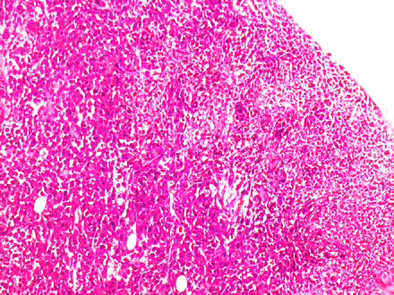
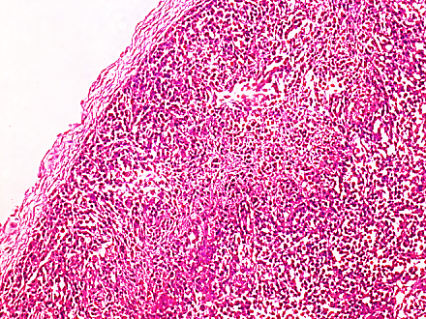
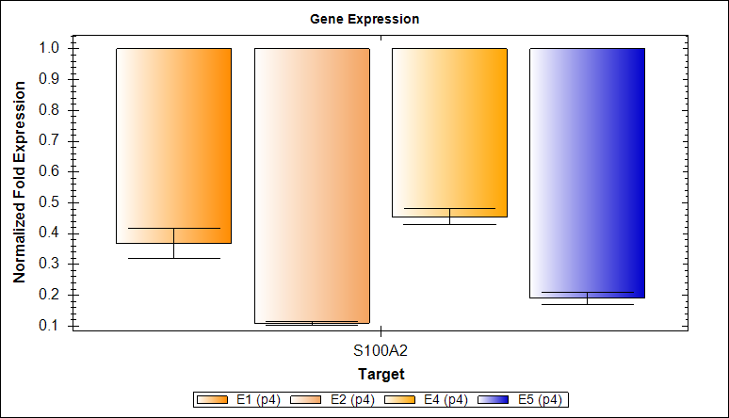
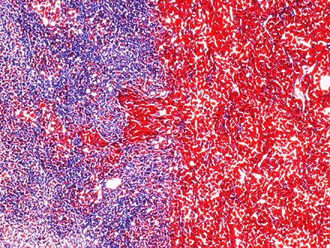
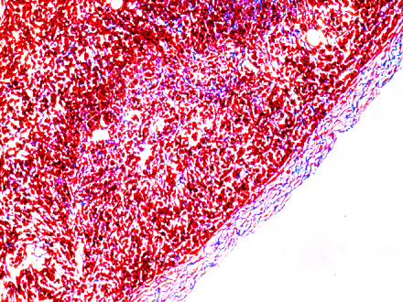
LTBP3 and SNED1 knock-down in LM2 cells increases primary tumor growth
LTBP3 knock-down
Effects of LTBP3 knock-down on the primary tumors
miR30-based shRNA retrovirally introduced in tumor cells
LTBP3 knock down has no major effect on primary tumor growth
LTBP3 knocked-down tumors are less invasive
5’ LTR
ZsGreen
2A
Puro ®
miR30
Barcode
3’ LTR
Control
shLTBP3#2
shLTBP3#1
shLTBP3#2
H&E
Tumor Mass (mg)
Normalized Fold Expression
Masson’s Trichrome
Vector design: Patrick Stern, John Lamar, Hynes Lab

Slide 16
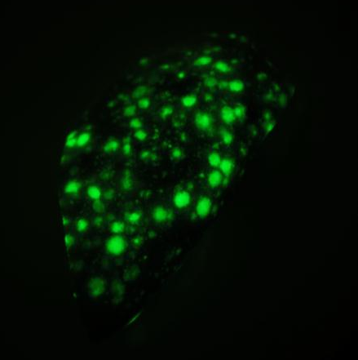
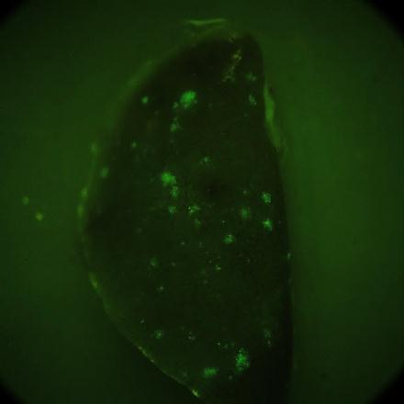
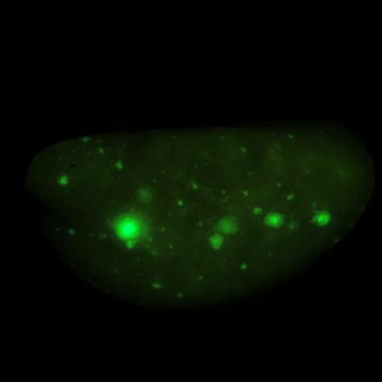
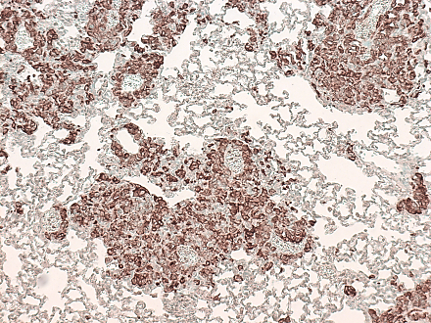
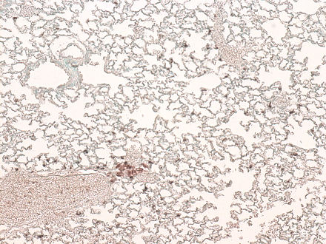
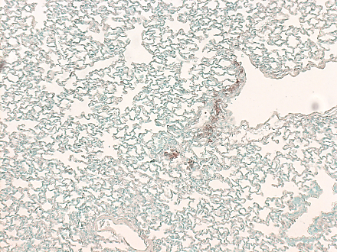
LTBP3 knock down strongly reduces metastatic burden
LM2 - shControl
LM2 – shLTBP3#1
LM2 – shLTBP3#2
*
*
Lung
# Metastases (Left lobe)
Anti-Human Vimentin
x10
* p<0.05
LTBP3 knock-down also prevents metastasis formation in other organs (liver, spleen)
Notes:
Sh#1 = D4 (mouse 1842), Sh#2 = D1 (AN219)

Slide 17
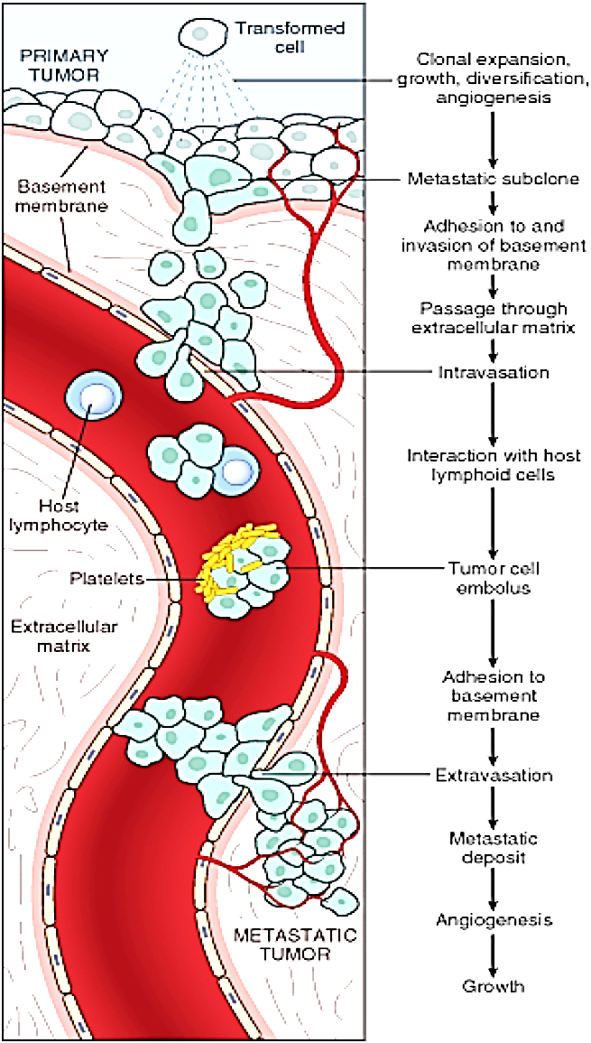
The metastatic cascade: a multi-step process
Tumor cell dissociation
Invasion
Intravasation
Survival in circulation
Arrest
Extravasation
Seeding, survival, exit from dormancy
Metastatic tumor growth

Slide 18
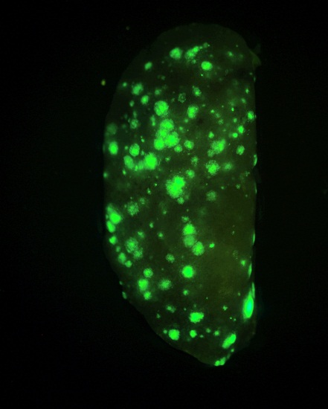
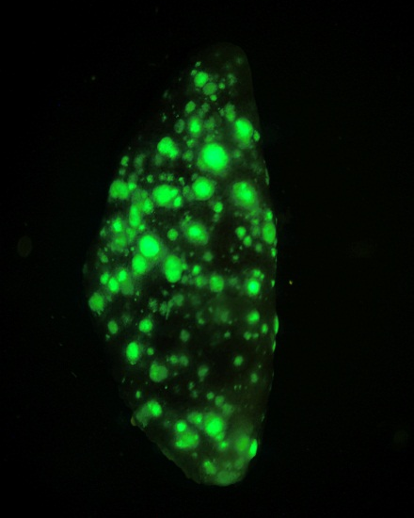
LTBP3 knock down doesn’t affect extravasation or seeding and growth in the lungs
Experimental Lung Metastasis Assay: Injection of the tumor cells in the tail vein
LTBP3 likely promotes metastasis formation by promoting
local invasion
shControl
shLTBP3#1
# Metastases (Left lobe)
shControl
shLTBP3#1

Slide 19
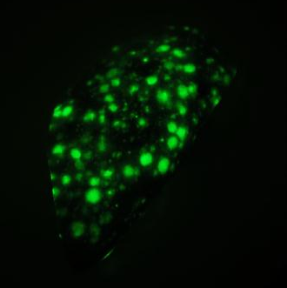

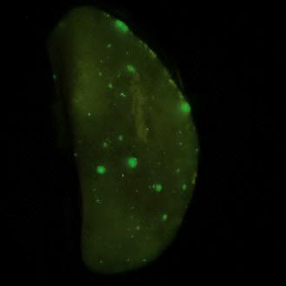
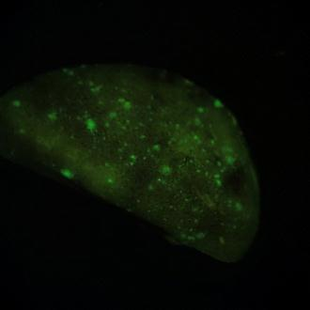
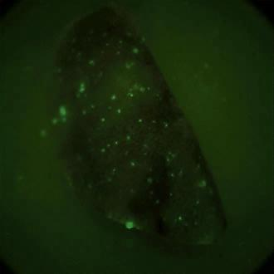
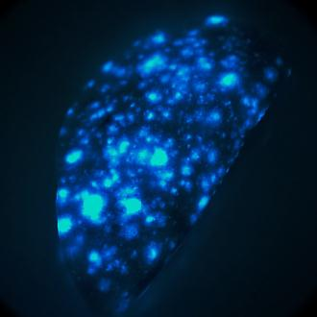
Conclusions
ECM differences discovered by proteomics do have functional effects on tumor progression and metastasis formation
Knock down of 4/5 hits resulted in a decrease of metastatic burden.
The proteins identified play roles at different steps of the metastatic cascade.
Apply our pipeline to clinical samples
Define set of extracellular matrix proteins as prognostic and diagnostic markers.
sh Control
sh LTBP3
sh SNED1
sh S100A2
sh EGLN1
sh CTSF
Future work

Slide 20




THE MATRIX DECODED
Karl Clauser
Steve
Carr
Richard
Hynes

Slide 21



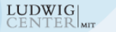


Acknowledgements
Hynes Lab
Richard Hynes
John Lamar
Viva Coles
Laurie Tang
Denise Crowley
& all the members of the Hynes Lab
Swanson Biotechnology Center
Bioinformatic Facility:
Sebastian Hoersch, Charlie Whittaker
Microscopy Facility: Eliza Vasile
Pathology: Roderick Bronson
http://web.mit.edu/hyneslab/matrisome/
Proteomics Platform
Karl Clauser
Steve Carr
Cancer Center, Tissue Bank
Kenneth Tanabe
Mohammad Miri

Slide 23
Extracellular Matrices in Tumors
Hanahan & Weinberg, Cell, 2001
Hanahan & Weinberg, Cell, 2011

Slide 24
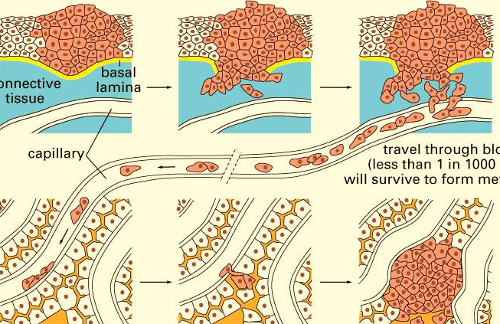
Extracellular Matrix and Cancer Progression
Primary Tumor Growth
Breaching of the basement membrane
Invasion and Intravasation
Tumor Angiogenesis
ECM Signaling
ECM Remodeling
Stroma
Primary Site
Basement Membrane
Blood Vessels
Survival in circulation
ECM Signaling
Stroma Secondary Site
Seeding and Proliferation in secondary site
Arrest
Extravasation
Adapted from Alberts, B. et al., Molecular Biology of the Cell

Slide 25
Challenges
Insolubility and large size of the ECM proteins have made biochemical analyses challenging.
Turn this to advantage and enrich for ECM proteins and use proteomics to define what is there.
This presents problems of definition – what to include in the definition of ECM.
Want to include all ECM proteins as well as associated proteins such as growth factors, crosslinking enzymes and proteases.

Slide 26








Enrichment of ECM proteins from tissues
- ECM proteins are largely insoluble
- Enrichment of ECM proteins by sequential extraction of soluble intracellular proteins
Whole lung extract
ECM-rich
Fraction
Tissue: Mechanical Lysis
Extraction Steps
1 2 3 4
ç Collagen VI (ECM)
Chemical Lysis
(High salt Buffer)
180kDa
ç Laminin (ECM)
180kDa
ç Integrin β1
120kDa
Membrane protein solubilization (DOC, NP-40)
ç Tf Receptor
83kDa
55kDa
ç Tubulin
49kDa
ç Actin
Cytoskeletal protein solubilization (SDS)
38kDa
ç GAPDH
16kDa
Insoluble fraction
= ECM-enriched fraction
ç Histones
→ ECM proteins:
8-fold enrichment

Slide 27
Peptide Separation by Off Gel Electrophoresis
IPG gel strip
pH gradient
pI (A)
pI (B)
50-100ug total peptide
12 fractions, pI 3-10
Each fraction analyzed by LC-MS/MS

Slide 28
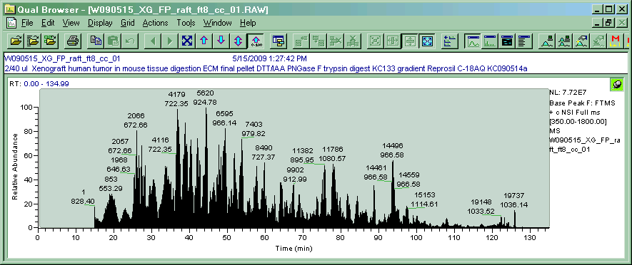
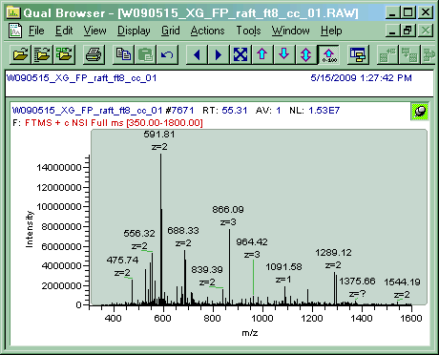
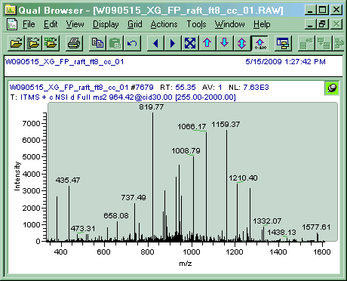
LC-MS/MS
LC
Relative Abundance
Retention time (min)
MS1
MS2
Spectrum Mill
Identification of peptides and proteins
Intensity
On average: 1000-2000 proteins
How many ECM proteins?
m/z
m/z
Quantitation
Identification
1 cycle: 3sec.
MS1 scan→ 8 most abundant peptides
MS2 → 8 MS/MS: peptide sequence

Slide 29
Limitations of the current protein annotation tools
Several cytosolic or cytoskeletal proteins involved in cell-matrix adhesion are mis-annotated as being a part of the extracellular matrix
Some known ECM proteins (thrombospondin 1, vWF, agrin, etc.) are defined by vague GO terms such as “external side of the plasma membrane” or “cell surface”
Many UniProt identifiers are not associated with any cellular compartments in the Gene Ontology database.
Conflicting annotations between human and mouse proteins.
More than 20 different Gene Ontology categories correspond to the extracellular matrix (extracellular matrix, basal lamina, basement membrane, etc.)
How to define an extracellular matrix protein?
Notes:
Limitations of the current protein annotation tools (GO)
In silico definition of the matrisome: Motivations

Slide 30
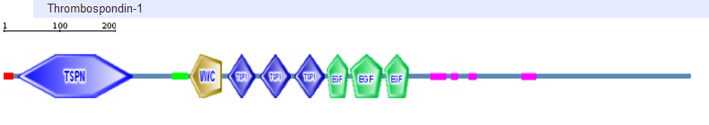
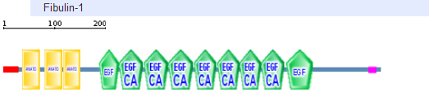
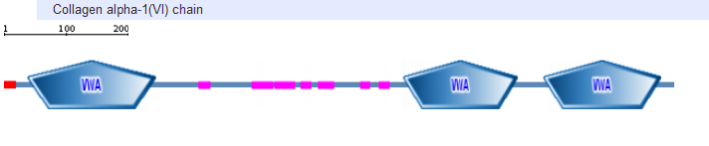
The domain-based organization of ECM proteins
SP
SP
SP
List of 55 domains commonly found in ECM proteins
Presence of an amino-terminal signal peptide
Notes:
Remove exons!!!

Slide 31
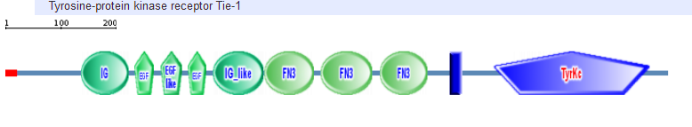
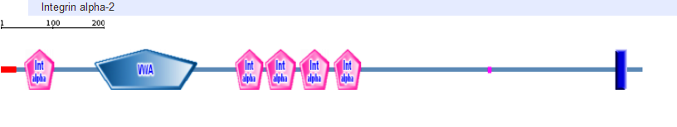
The domain-based organization of ECM proteins
TM
TM
List of 20 domains that shouldn’t be displayed by an ECM proteins (kinase domains, phosphatase domains, etc.)
No transmembrane domain

Slide 32
In silico definition of the matrisome: Workflow
55 domains
Core Matrisome
6 domains
ECM-affiliated
27 domains
ECM regulators
39 domains
Secreted factors
Positive screen: search UniProt database entries for presence of defining domains
Make gene-centric, using EntrezGene, GenPept, and Ensembl databases and manual sequence analysis
For all candidate genes, derive all the UniProt, RefSeq and Ensembl-specific information
20 excluding domains
12 excluding domains
17 excluding domains
Domain-based negative screen: eliminate candidate genes with excluding domains in >1 member UniProt entry.
Transmembrane domain-based negative screen: (TMHMM, Phobius).
http://mit.edu/hyneslab/matrisome/
Signal peptide-based positive screen (Phobius).
Orthology comparison
Manual curation: Division and category assignment
ECM Glycoproteins
Category
Collagens
ECM-affiliated
ECM regulators
Secreted Factors
Proteoglycans
Division
Core Matrisome
Matrisome-associated

Slide 33
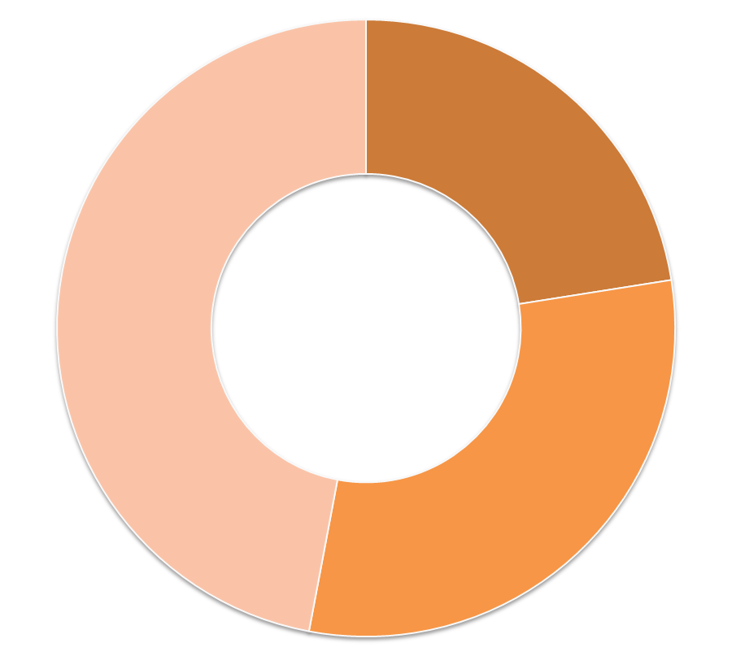
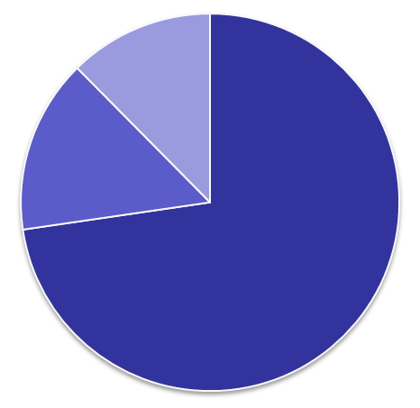
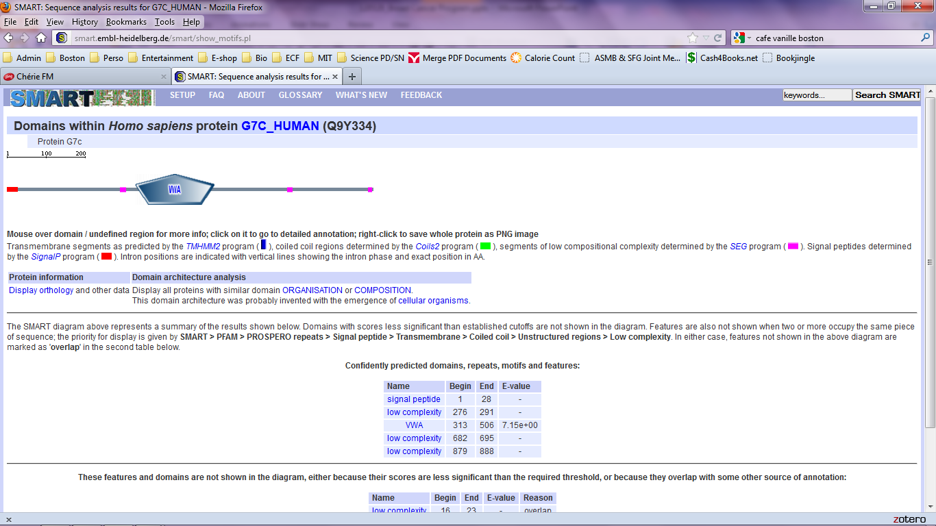
In silico definition of the matrisome
ECM-affiliated Proteins
Secreted
Factors
Proteoglycans
Galectins, mucins, semaphorins, plexins, etc.
176
Collagens
35
352
Core Matrisome
278
(>1 % of the genome)
ECM Glycoproteins
43
Laminins,
Fibrillins,
Fibronectin, Thrombospondins,
+ few novel proteins
200
ECM
Regulators
MMPs, ADAMs, TIMPs, LOXs, TGs, etc.
250
(VWA7)
The human genome encodes 1056 matrisome genes:
278 genes encoding sensu stricto ECM proteins
+ 778 genes encoding matrisome-associated proteins
Naba et al., 2012, Mol. Cell. Proteomics

Slide 34
Workflow to analyze the composition of tissue and tumor extracellular matrices
In silico definition of the “matrisome”
ECM-rich samples from tissues/tumors
Analysis by LC-MS/MS
Mass Spec Output Annotation:
in vivo composition of the extracellular matrix

Slide 35
Proof of Concept: The Lung Extracellular Matrix
Peptide abundance
Number of Peptides
Number of Proteins
Pre-OGE:
x7 x2; x7
x8 x2; x12
Post-OGE:
Core Matrisome
Matrisome-associated
Other
Naba et al., 2012, Mol. Cell. Proteomics

Slide 36
A reproducible approach
Lung Sample 1
Lung Sample 2
Number of proteins
46
120
16
ECM-
affiliated
ECM
Regulators
Secreted
Factors
ECM
Glycoproteins
Collagens
Proteoglycans
Definition of the lung extracellular matrix
Naba et al., 2012, Mol. Cell. Proteomics

Slide 37
Identification of tissue-characteristic ECM proteins
Colon vs Lung ECM

Slide 38
Experimental coverage of the in silico matrisome
% of in silico matrisome
Lung Specific
% of in silico matrisome
Colon Specific
Both
ECM
Glycoproteins
ECM-
affiliated
Secreted
Factors
Collagens
ECM
Regulators
Proteoglycans
Naba et al., 2012, Mol. Cell. Proteomics

Slide 39
Conclusions
We defined bioinformatically the “matrisome” as the ensemble of ECM proteins and associated factors.
We developed a proteomic pipeline to characterize the composition of in vivo extracellular matrices.
We identified in any given tissue 100+ ECM proteins and found reproducible and characteristic differences between tissues.
Naba et al., 2012, Mol. Cell. Proteomics

Slide 40
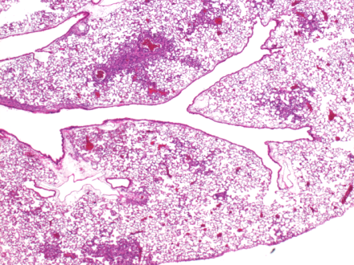
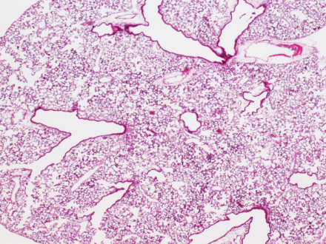
LTBP3 knock down strongly reduces metastatic burden
LM2 - shControl
LM2 – shLTBP3#1
LM2 – shLTBP3#2
*
*
Lung
# Metastases (Left lobe)
H&E
x2.5
* p<0.05
Notes:
Sh#1 = D4 (mouse 1842), Sh#2 = D1 (AN219)

Slide 41
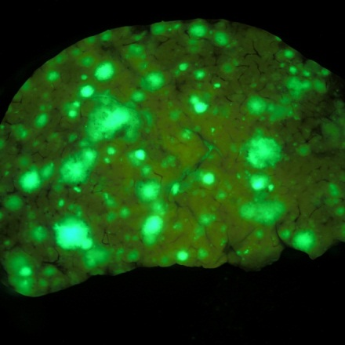
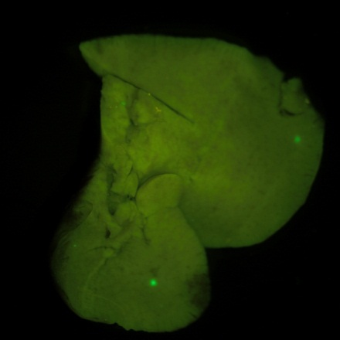
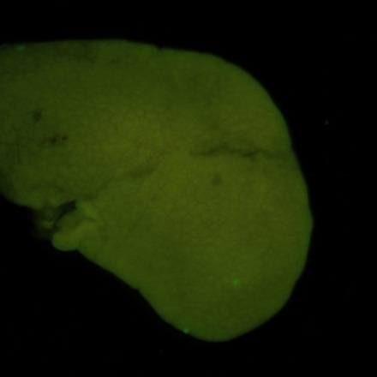
LTBP3 knock down strongly reduces metastatic burden
LM2 - shControl
LM2 – shLTBP3#1
LM2 – shLTBP3#2
Liver

Slide 42


LTBP3 knock down strongly attenuates metastatic burden
LM2 – shControl
LM2 – shLTBP3
Lung
anti-human Vimentin / Methyl green counterstain
No metastasis detected in other organs (spleen, LN, contra-lateral mammary gland)

