Slide 1
Bioinformatics of Phosphopeptide Identification, Phosphosite Localization, and iTRAQ Quantitation in Phosphoproteomics using LC-MS/MS
Karl R Clauser; Philipp Mertins; Jana W Qiao; DR Mani; Michael A. Gillette; Steven A Carr
Broad Institute of MIT and Harvard
Cambridge, MA

Slide 2
Topics Covered
CPTAC breast cancer tumor phosphoproteomics project
goals, samples, methods
Summary of initial results
Condensing PSM’s to the site level
Site ambiguity, missed cleavages, Different parent z, bRP frxn, median iTRAQ ratio
Basics of phospho site localization scoring in MS/MS spectra
Recent modification site localization algorithm development
Precursor-H₃PO₄ absence coupled with presence of b-H₃PO_{4 ,} y-H₃PO₄
PNL histograms, iTRAQ QE-HCD vs unlabeled LTQ-CID
example w & w/o PNL different precursor charges
Alternate localizations and ion type uncertainty
b-H₃PO₄ or b-H₂O when b missing
Effect of revisions
Opportunity for localization algorithm comparison

Slide 3
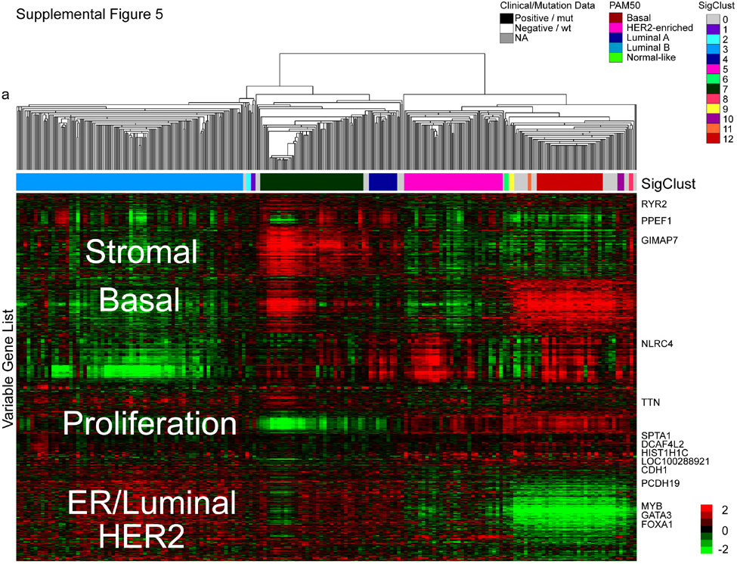
Clustering of mRNA Expression and Breast Cancer Subtypes
TCGA Nature 2012
A CPTAC goal is
to produce a
Proteomic
Equivalent
Rows -ID
PO₄ site
Protein
Color - Quant
iTRAQ Ratio
Column - patient
Notes:
Supplemental Figure 5. mRNA expression analyses. 522 primary breast tumors, 3 metastatic tumors and 22 normal samples were used for two different hierarchical clustering analyses. a) a unsupervised hierarchical clustering analysis using the ~3600 most variably expressed genes was performed with the resulting data tested by SigClust to identify twelve possible groups. b) The unsupervised mRNA expression subtypes showed a high correlation to the previously defined PAM50 subtypes, as well as high correlation to ER, PR, and HER2 status, and to TP53, GATA3, MAP3K1 and MAP2K4 mutation status
ALSO USED A PREVIOUSLY PUBLISHED INTRINSIC GENE LIST (13 CLASSES) AND A PAM50 CLASSIFICATION; HIGH AND SIGNIFICANT CONCORDANCE WAS OBSERVED SO PAM50 WAS USED AS A COMMON CLASSIFICATION METRIC

Slide 4
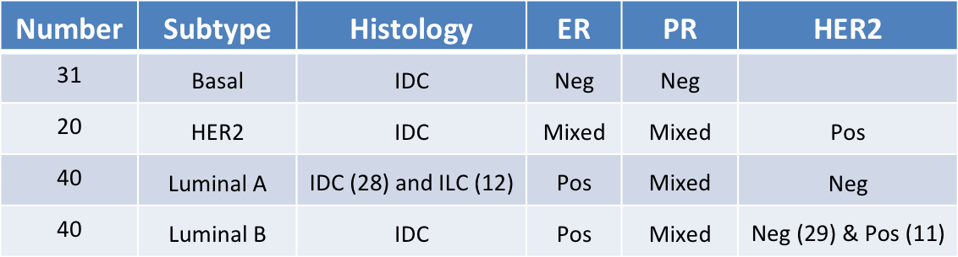
Initial 100 (of 150-200) samples selected from published TCGA breast cancer subset
348 Primary breast cancers “comprehensively” analyzed
Genomic DNA copy number arrays (Affy; n=547)
DNA methylation (Illumina Infinium; n= 802)
Exome sequencing (n=507)
Whole Genome sequencing (?n << 348)
mRNA arrays (Affy; n=547)
microRNA sequencing (n=697)
RNASeq (?n > 348)
Reverse phase protein arrays (Gordon Mills RPPA; n=403)

Slide 5
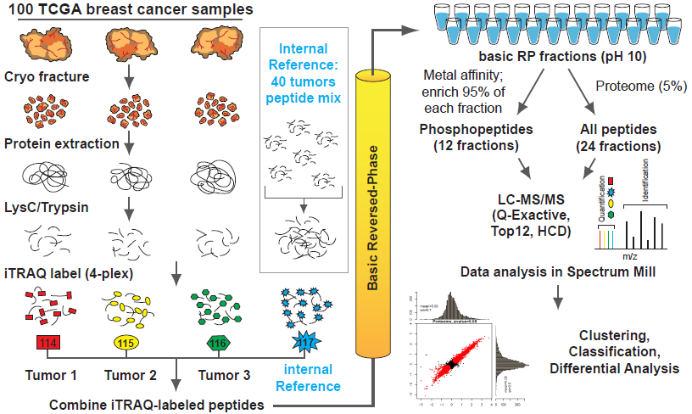
Quantitative Proteome and Phosphoproteome Analysis
1 mg peptide per iTRAQ channel
1,440 LC-MS/MS runs = 40 patient triplets x (12 phospho frxns + 24 proteome frxns)

Slide 6
Known Markers for BC subtypes detected (Exp1-whole)
Experimental design:
Subtype | Subtype | Subtype | Experiment# | iTRAQ | iTRAQ | iTRAQ
114 | 115 | 116 |  | 114 | 115 | 116
Her2 | Basal | LumB | 1 | AO-A12D | C8-A131 | AO-A12B
Marker proteins:
marker | GI number | unique peptides | Log2 Her2/ref | ratio count | Log2 Basal/ref | ratio count | Log2 LumB/ref | ratio count
KRT5 | 119395754 | 26 | -1.1 | 41 | -0.1 | 41 | -2.3 | 27
KRT6A | 5031839 | 5 | -0.1 | 6 | 1.6 | 6 | -2.9 | 4
HER2 | 54792096 | 45 | 2.3 | 106 | -1.3 | 84 | -1.2 | 105
EGFR | 29725609 | 21 | -0.5 | 23 | 0.2 | 23 | -1.9 | 20
PR | 110611914 | 31 | -0.6 | 53 | -0.6 | 49 | 1.2 | 55
ER | 170295800 | 16 | -0.8 | 25 | -0.9 | 24 | 1.3 | 25
Histopathology and PAM50 status:
TCGA # | ER Status | PR Status | HER2 Final Status (HH) | PAM50 | Est OCT %
TCGA-AO-A12B-01A-41 | Positive | Positive | Negative | LumB | 57
TCGA-AO-A12D-01A-41 | Negative | Negative | Positive | Her2 | 43
TCGA-C8-A131-01A-41 | Negative | Negative | Negative | Basal | 60

Slide 7
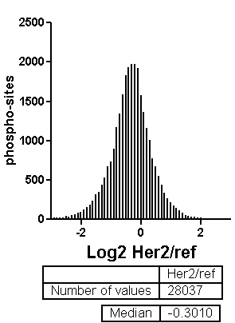
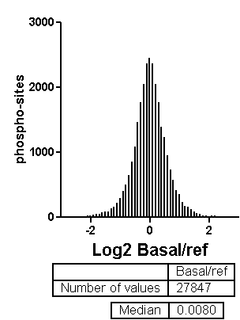
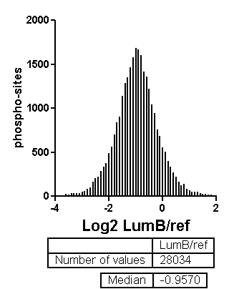
Id, Site Localization, Quantitation (Phospho-Exp 1)
PSM's | 62,537 |  | PO4 sites | 28,044 |  | Single PSM sites | 14,660
Fully localized sites (%) | 53.4 |  | Fully localized sites (%) | 63.1 |  | Fully localized sites (%) | 58.4
>99% sites quantifiable (iTRAQ reporter ion signal) in each tumor
Almost no missing values indicates precursor co-isolation interference?

Slide 8
Condensing PSM’s to the Phosphosite Level
Combine
Overlapping phosphosite ambiguity
Missed cleavages
Different precursor charge states
Different basic Reversed Phase Fractions
Separate
Same peptide, different # sites (1 vs 2 vs 3)
Same peptide, different loc (S273 vs T276)
Discard/Beware
Site ambiguity w/ conflicting overlaps
Peptide repeats in same protein

Slide 9
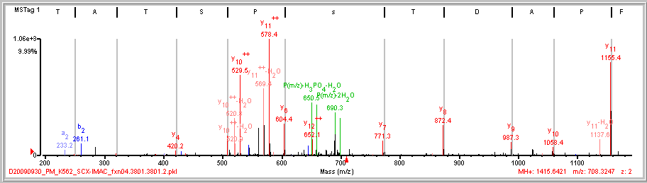
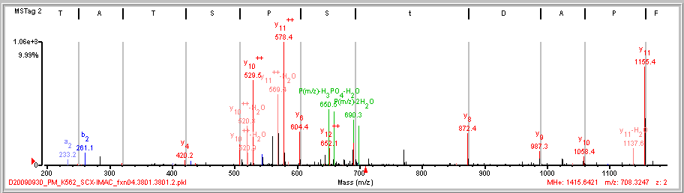
Localizing a Phosphorylation Site
L/F|P/A/D|T/s/P/S T A\T K
L/F|P/A/D|t S/P/S T A\T K

Slide 10
PTM Site Localization Test all Locations, Examine Score Gaps
Locations Tested Conclusion
No possible
ambiguity
AVsEEQQPALK
AVS(1.0)EEQQPALK
# PO₄ sites = # S,T, or Y
Single
Site
APsLTDLVK *
APSLtDLVK -
APS(0.99)LT(0.0)DLVK
sSSAGPEGPQLDVPR *
SsSAGPEGPQLDVPR *
SSsAGPEGPQLDVPR -
S(0.50)S(0.50)S(0.0)AGPEGPQLDVPR
Multiple
Sites
VTNDIsPEsSPGVGR *
VTNDIsPESsPGVGR *
VTNDISPEssPGVGR -
VtNDIsPESSPGVGR -
VtNDISPEsSPGVGR -
VtNDISPESsPGVGR -
VT(0.0)NDIS(0.99)PES(0.50)S(0.50)PGVGR

Slide 11
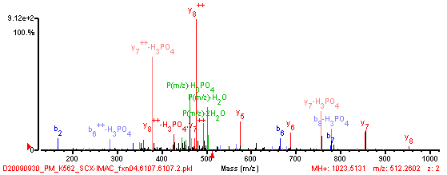
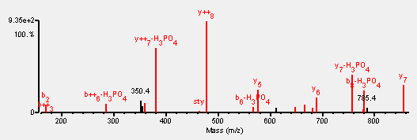
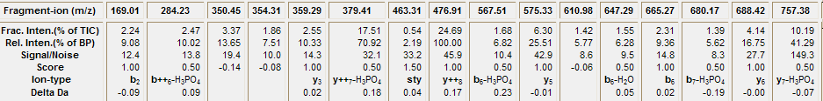
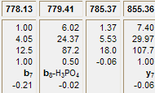
Spectrum Mill Scoring of MS/MS Interpretations
Score
=
Assignment Bonus
(Ion Type Weighted)
+
Marker Ion Bonus
(Ion Type Weighted)
-
Non-assignment Penalty
(Intensity Weighted)
Peak Selection: De-Isotoping, S/N thresholding,
Parent - neutral removal, Charge assignment
Match to Database Candidate Sequences
SPI (%)
Scored Peak Intensity
12.68
92%

Slide 12
Spectrum Mill Variable Modification Localization Score
VML score = Difference in Score of same identified sequences with different
variable modification localizations
VML score > 1.1 indicates confident localization
Why a threshold value of 1.1?
1 implies that there is a distinguishing ion of b or y ion type
0.1 means that when unassigned, a peak is 10% as intense as the base peak
1.0 b,y
0.5 b-H₃PO₄, y-H₃PO_{4,} b-H₂O, y-H₂O, internal b
0.25 b-NH₃, y-NH₃
Distorted phosphate loss:water loss
0.81 b-H₃PO₄, y-H₃PO₄
0.25 b-H₂O, y-H₂O
Δ1.12 2 H₃PO₄ loss vs 2 H₂O loss

Slide 13
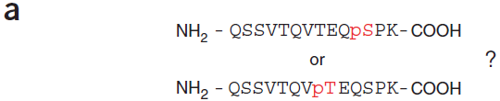
Phosphosite Localization Scoring - Ascore
7
0.07
0.07
http://ascore.med.harvard.edu/
Supports Sequest results only, Linux only
Beausoleil SA, Villen J, Gerber SA, Rush J, Gygi SP (2006) Nat Biotechnol 24:1285–1292.
Notes:
Figure 3 Resolving ambiguity in phosphorylation site localization. (a) Peptides containing multiple serine, threonine and/or tyrosine residues should be evaluated for precise site assignment. This phosphopeptide is from Zinc finger protein 638. (b) General scheme for calculating a probability-based ion matching score (Peptide Score) for each potential phosphorylation site. The tandem mass (MS/MS) spectrum for the phosphopeptide from panel a is shown. The spectrum was separated into 100 m/z windows where the top N most-intense peaks per window were matched to predicted b- and y-type ions for each possibility. This was repeated using from 1 to 10 ions in each window (6 is shown). The cumulative binomial probability P was calculated using the number of trials (all b- and y-type ions) and the number of successes (matched ions) for each possibility and plotted as -10 log (P) vs peak depth (peaks per 100 m/z). The peptide corresponding to the red line matched more ions at every peak depth than any other possibility. The actual ambiguity score (Ascore) for this peptide is calculated using only site-determining ions as shown in Figure 3c using information from this plot. (c) The Ascore is a probability-based metric that measures the likelihood that a difference in site-determining ions between two site positions was matched by random chance. In this example, only six b- or y-type ions could potentially differentiate the two phosphorylation sites. A peak depth of six was determined from Figure 3b as the earliest maximal difference in the number of matched ions. The cumulative binomial probability was applied as in Figure 3b but using only the site-determining subset of ions. An Ascore of 53.57 would represent a probability of less than 1 in 200,000 of matching a difference of at least 5 ions in 6 trials by random chance. Any of these 5 ions, if not due to chance, can differentiate between the two potential sites.

Slide 14
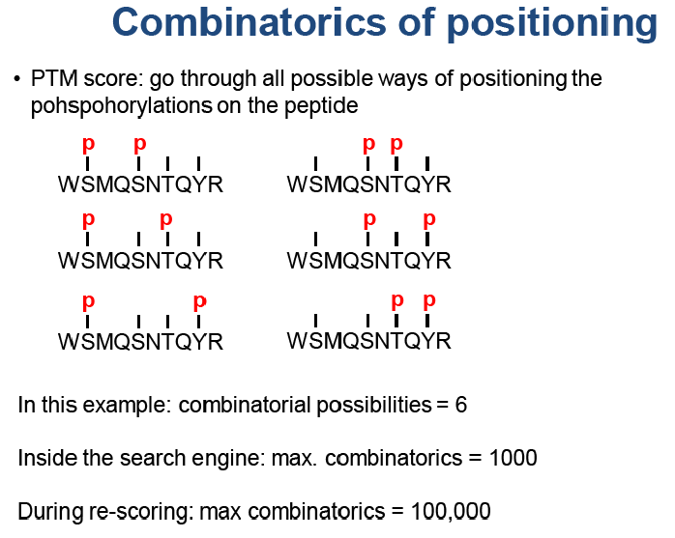
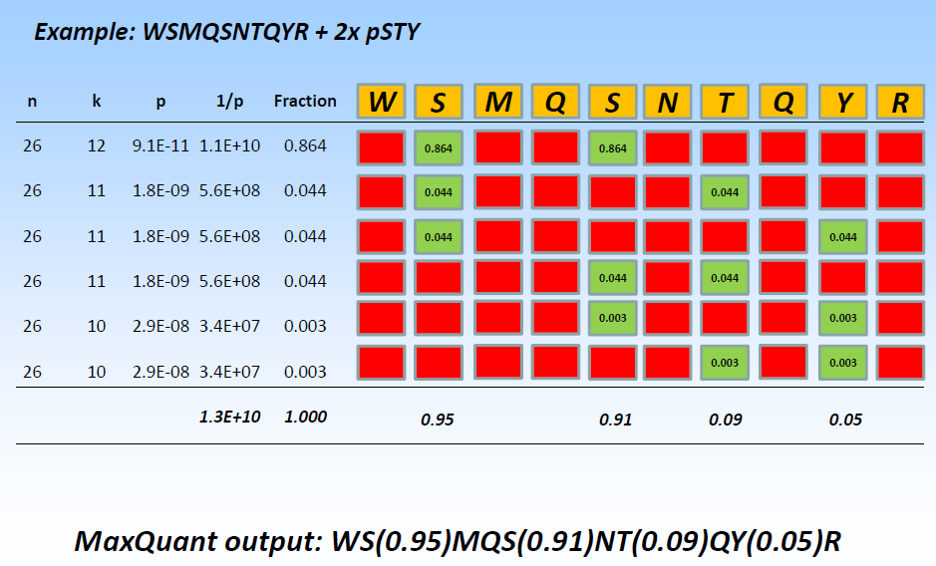
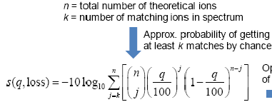
Phosphosite Localization in MaxQuant
Probability based scoring
Matching mass tolerance in ppm
but scoring uses +/-0.5Da
Cox J, Neuhauser N, Michalski A, Scheltema RA, Olsen JV, Mann M. J Proteome Res (2011) 10, 1794–1805.
Cox J, Mann M. Nature Biotechnology (2008) 26, 1367-1372.
Olsen JV, Blagoev B, Gnad F, Macek B, Kumar C, Mortensen P, Mann M. Cell (2006) 127, 635–48.
Olsen JV, Mann, M. Proc Natl Acad Sci USA. (2004) 101, 13417–13422.

Slide 15
True Probability or Just Effective Scores?
Peak selection assumptions
All regions of spectrum equally likely
multiply charged fragments below precursor
some 100-300 m/z values not possible, dipeptide AA combinations
tolerance in Da, not ppm
Tall and short peak intensities equally diagnostic
Fragment ion type assumptions
All ion types equally probable
Neutral losses ignored, y-H₃P0₄, y-H₂O

Slide 16
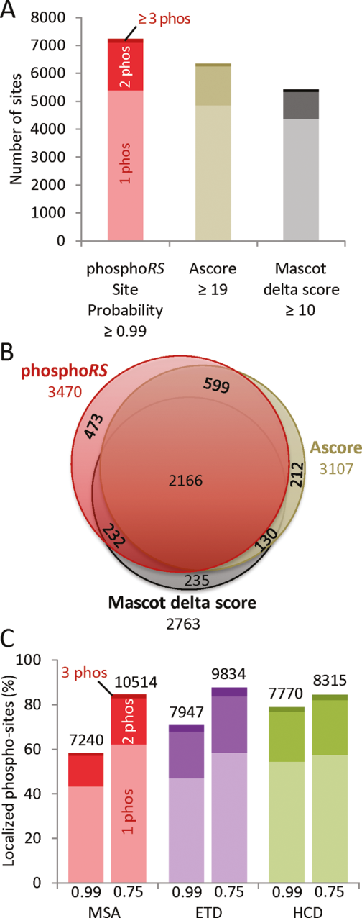
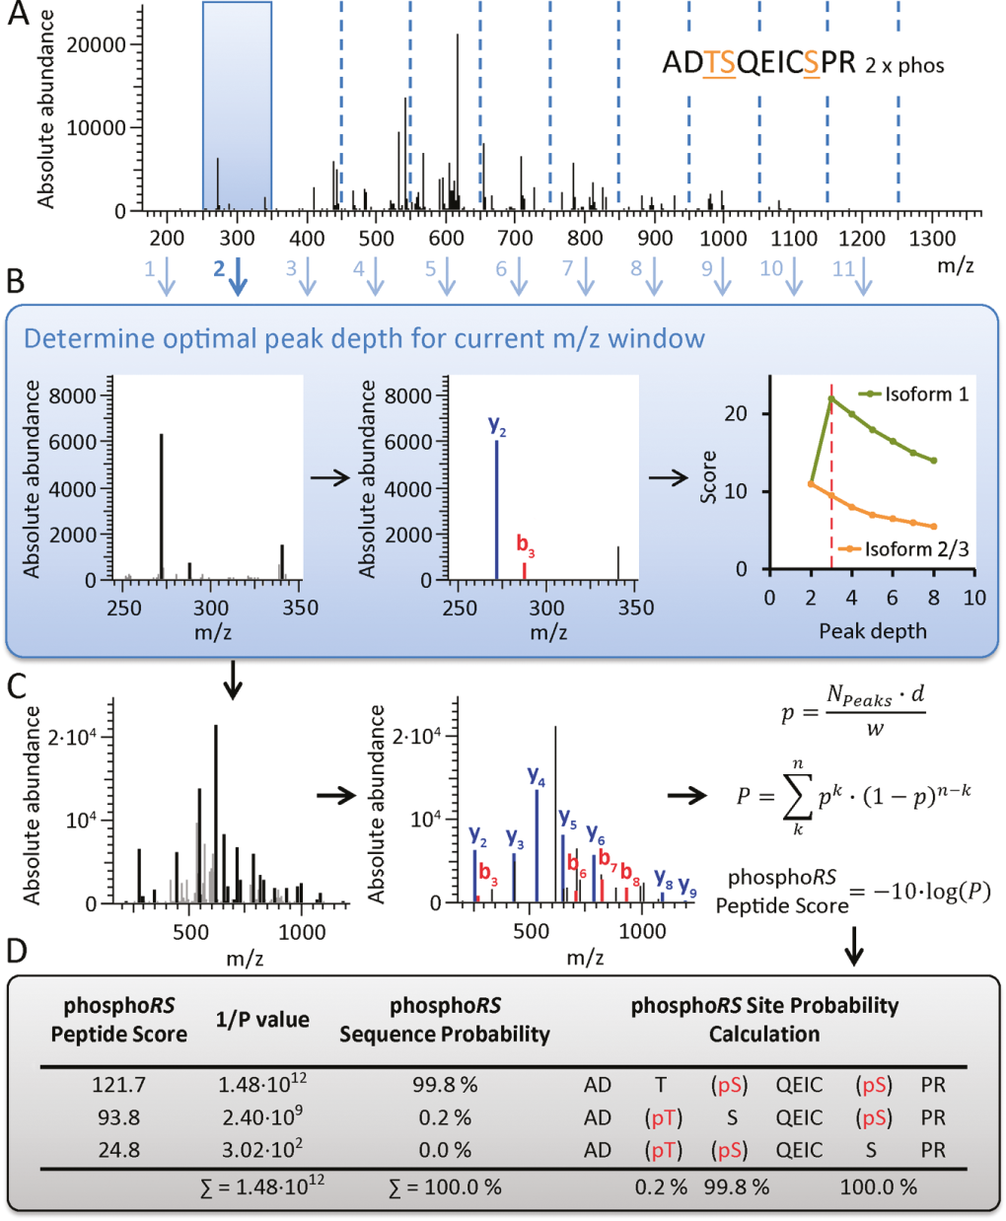
Phosphosite Localization Scoring - PhosphoRS
Ion types
b/y
HCD-add
b-H₃PO₄
y-H₃PO₄
N: total # of extracted peaks
d: fragment ion mass tolerance
w: full mass range of spectrum
Score ions at all AA positions, not just site determining one.
Taus, T., Kocher, T., Pichler, P., Paschke, C., Schmidt, A., Henrich, C., and Mechtler, K. (2011) J Proteome Res. 10(12): 5354-62.
Notes:
Figure 1. Overview of the processing steps performed by phosphoRS. (A) The MS/MS spectrum is divided in windows of 100 m/z. (B) Dynamic peak
extraction. For each m/z window the optimal peak depth is determined by calculating cumulative binomial probabilities for each isoform. (C)
Cumulative binomial probabilities and peptide scores are calculated for each isoform, considering the optimal number of most intense peaks for each m/z
window. (D) phosphoRS sequence and site probabilities are calculated, using the inverse probabilities for a random match obtained for each isoform.
Figure 6. Analysis of a titania-enriched peptide mixture from a HeLa
cell lysate. (A) The absolute numbers of phosphorylation sites at the
PSM level localized with phosphoRS (red), Ascore (gold), and MDscore
(black) from a MSA-generated data set are shown. (B) The
numbers of nonredundant phosphorylation sites localized using the
respective cutoff values for the different software tools are depicted. The
overlap and the uniquely localized sites are visualized. (C) The
percentage and absolute numbers of localized phosphorylation sites at
the PSM level are shown for MSA (red), ETD (violet), and HCD
(green) generated data sets applying phosphoRS site probability cutoffs
of 0.99 and 0.75.

Slide 17
Key Aspects of Scoring Localizations
Select peaks in spectrum to be used for identification/localization
Test all sequence/location possibilities
Assign fragment ion types to peaks
Allow for peaks to have different ion type assignments for conflicting localization possibilities
Use score differences to make decision on localization certainty/ambiguity
Decide upon conservative/aggressive thresholds.
Provide a clear representation of the certainty/ambiguity in localization of each site
Allow for multiple sites with mix of certainty and ambiguity in localization
Distinguish between:
Ambiguity – no distinguishing evidence, i.e. either possibility
Ambiguity – conflicting evidence, multiple co-eluting isoforms present
How can we calculate a false localization rate as a standard measure of certainty for phosphosite assignment across a dataset?

Slide 18
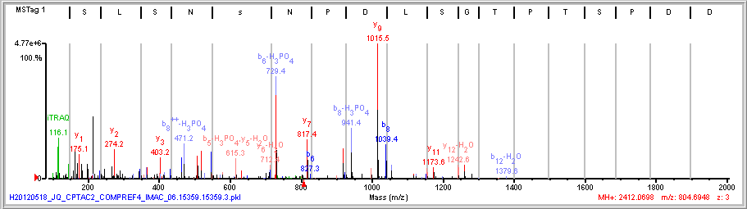
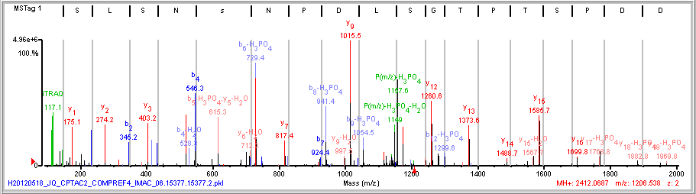
b-H₃PO₄ Ions Without Precursor-H₃PO₄ Ion
(R)S L S\N\s N P D\I/S/G T/P/T/S P D/D/E/V/R(S)
(R)S\L\S\N\s/N/P D/I/S/G/T/P T/S P D/D/E/V/R(S)
+3
precursor
+2
precursor

Slide 19
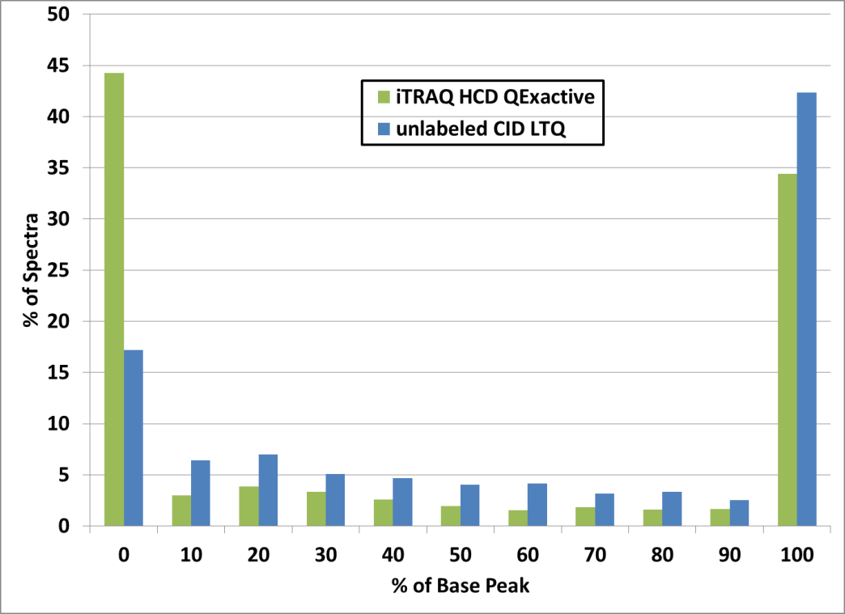
Precursor-H₃PO₄ Ion in Phosphopeptide MS/MS Spectra
In LTQ ion trap MS/MS spectra
if the spectra lack
Precursor-H₃PO₄ (-98/z)
Precursor-H₃PO₄-H₂O (-116/z)
then
b-H₃PO₄
y-H₃PO₄
are not present.
Presence of the ions historically used in Spectrum Mill to enable fragment ion types:
b-H₃PO₄
y-H₃PO₄
Not
observed
base
peak
Precursor-H₃PO₄ (-98/z)
or
Precursor-H₃PO₄-H₂O (-116/z)

Slide 20
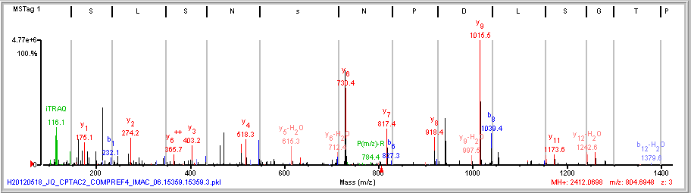
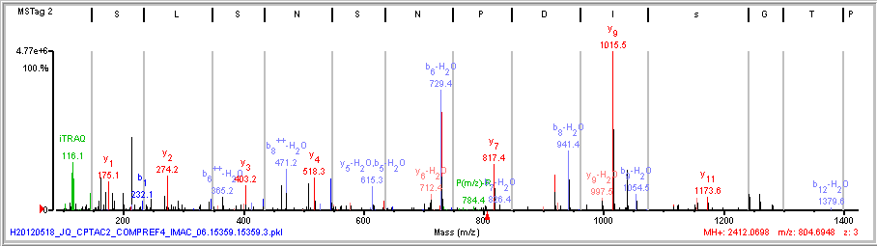
Different Site Localization with b-H₃PO₄, y-H₃PO₄ Ions Off
(R)S L S\N\s N P D\I/S/G T/P/T/S P D/D/E/V/R(S)
higher score
(R)S L S\N\S N P D I s/G T/P/T/S P D/D/E/V/R(S)
Score 11.1
Score 13.1

Slide 21
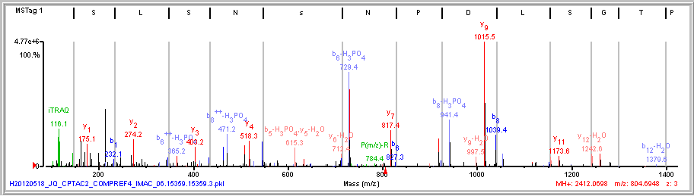
Correct Site Localization with b-H₃PO₄, y-H₃PO₄ Ions On
higher score
(R)S L S\N\s N P D\I/S/G T/P/T/S P D/D/E/V/R(S)
(R)S L S\N\S N P D I s/G T/P/T/S P D/D/E/V/R(S)
Score 16.1
Score 13.1

Slide 22
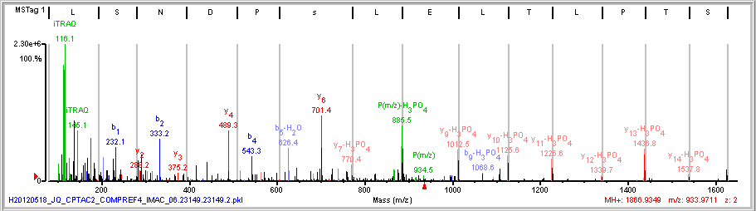
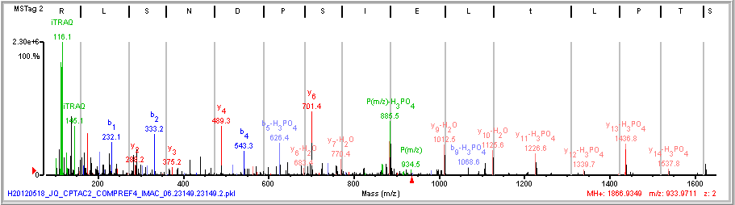
y-H₃PO₄ or y-H₂O Ions?
H₃PO₄
(R)S\T\P L\T L E I s/P D/N S L/R(R)
H₂O
(R)S\T\P L\t L E I S/P D/N S L/R(R)

Slide 23
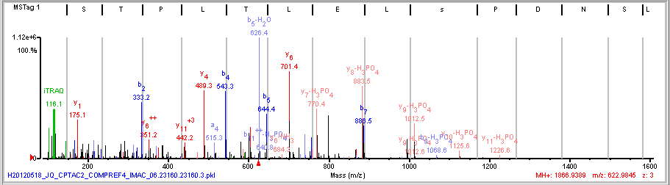
y-H₃PO₄ not y-H₂O Ions
H₃PO₄
(R)S\T\P L\T L E I s/P D/N S L/R(R)
+2
+3
(R)S T\P L\T\L\E I s/P/D/N S L/R(R)
+2
precursor
+3
precursor
b₆
757.5

Slide 24
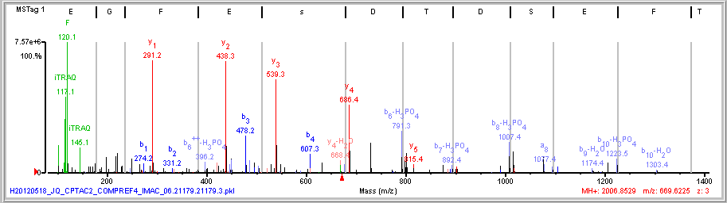
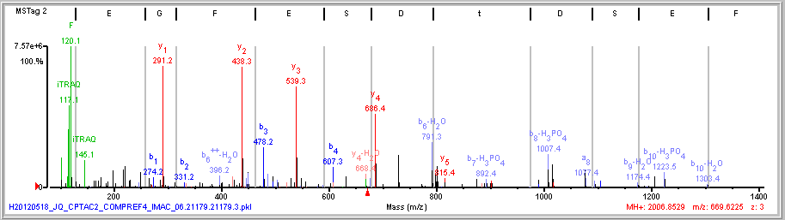
b-H₃PO₄ or b-H₂O Ions?
H₃PO₄
(R)E G F\E\s D T D/S/E/F/T/F/K(M)
H₂O
(R)E G F\E\S D t D/S/E/F/T/F/K(M)

Slide 25
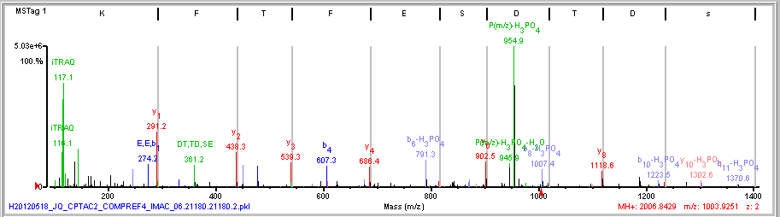
b-H₃PO₄ not b-H₂O Ions
H₃PO₄
(R)E G F\E\s D T D/S/E/F/T/F/K(M)
+3
+2
(R)E\G F\E\s D/T D/S E/F/T/F/K(M)
+3
precursor
+2
precursor

Slide 26
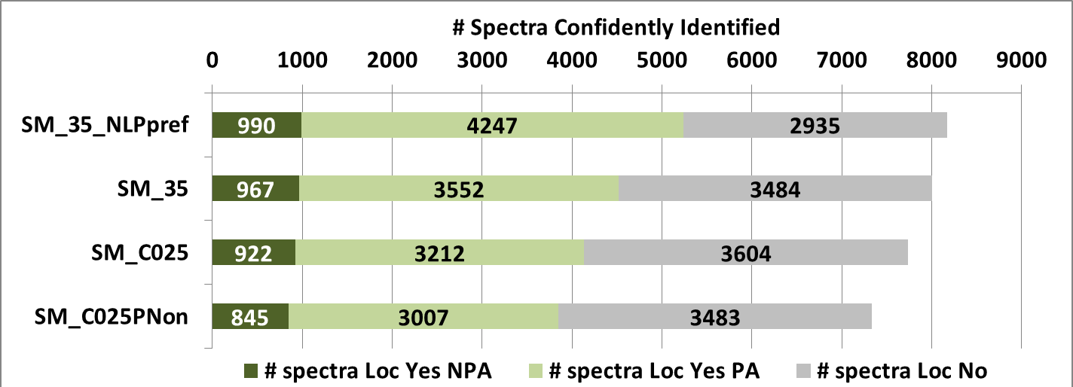
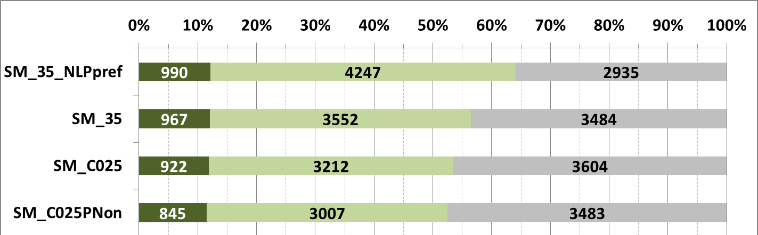
Performance of Spectrum Mill ID/Localization Algorithm Revisions
For alternate localizations
should H₃PO₄ loss ions be
preferred to H₂O loss?
Recover accompanying
b/y ions by decreasing CE?
Is this more an iTRAQ issue or an HCD feature?
Comparing different parent charge MS/MS of same
peptide very helpful.
Allow b-H₃PO_{4,} y-H₃PO₄ when
Parent - H₃PO₄ loss missing
2% alter loc 78/3852
Increase
max peak depth
from 25 to 35
Distort ion type scores
2 H₃PO₄ loss beats
2 H₂O loss

Slide 27
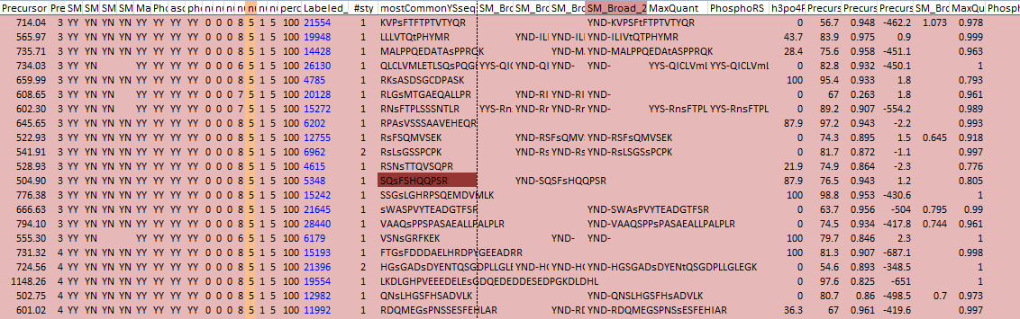
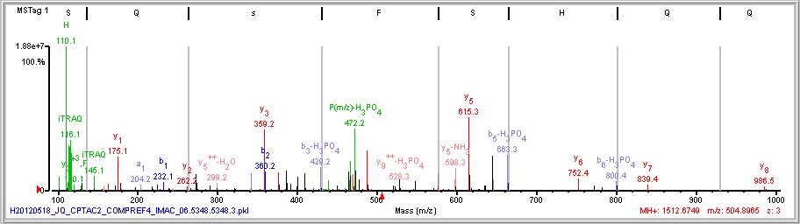
Opportunity to Participate in Localization Algorithm Comparison
Spec Features
Localization
Scores
Id/Loc Status
Link
Consensus
Disagreeements
Obtain raw data/database
Identify peptides
Localize phosphosites
Return result spreadsheet
Recieve spectrum comparison spreadsheet with links to labeled spectra
Comparison re-uses infrastructure developed for
2010-2012 ABRF-iPRG studies
clauser@broad.mit.edu

Slide 28
Acknowledgements
Broad Institute
Steve Carr
Mike Gillette
DR Mani
Philipp Mertins
Jana Qiao
Washington University
Sherri Davies
Robert Kitchens
Petra Gilmore
Matthew Ellis
Reid Townsend
NIST
Paul Rudnick
NYU
David Fenyo

Slide 29
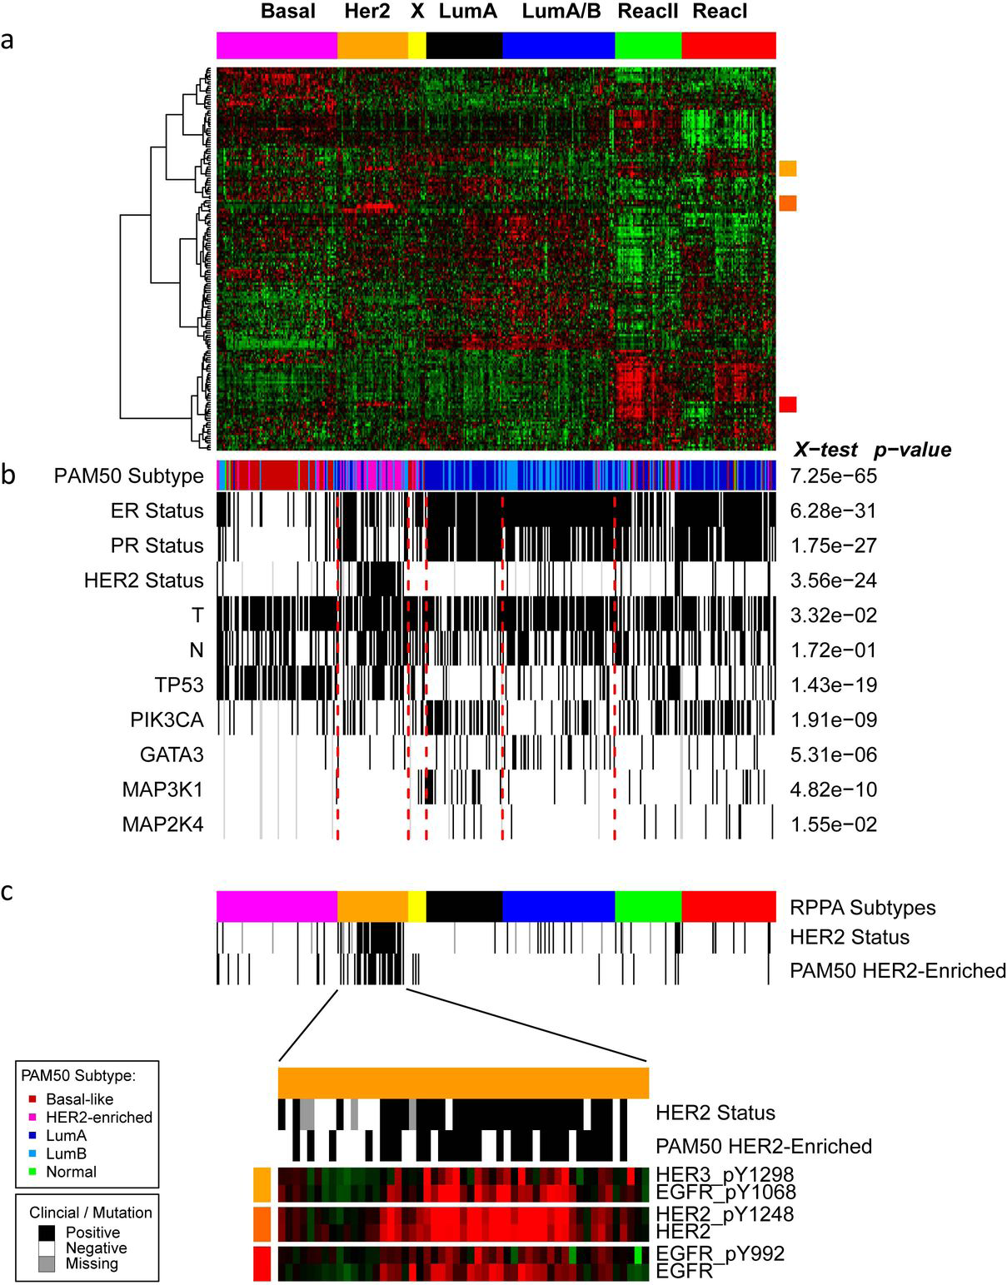
Clustering of RPPA data hints at complementarity of proteomics
TCGA Nature 2012
Sup fig 12
171 cancer related proteins and phosphoproteins (403 samples)
HIGHLY concordant with mRNA subtypes
Two potentially novel groups identified
Suspected stromal derivation
No difference in % tumor cell content
Not recapitulated by miR, DNA methylation, mutation or copy number
Supervised analysis shows many differential mRNA transcripts
Difference appears a QUALITATIVE biological difference
Notes:
Supplemental Figure 12. Disease subtypes defined using the expression patterns proteins and phosphoproteins.
a) Samples (n=403) were ordered by unsupervised clustering using non-negative matrix factorization (NMF) with 7 clusters. Proteins were ordered using hierarchical clustering.
Colored squares on right of heatmap represent regions expanded in C. b) Sample annotation ordered as in a. ER, PR, HER2, T (tumor size), and N (node) status: white, negative or T1; black, positive or T2-4; gray, unknown. Mutation status of TP53, PIK3CA, GATA3, MAP3K1 and MAP3K4: white, wild type; black, mutated; gray, unknown. c) Expanded view of the HER2
group with expression shown for EGFR, HER2, and HER3 antibodies.

Slide 30
Abstract
Abstract: 201 words
We are engaged in a large-scale phosphoproteomic project using human breast cancer tumor tissue obtained from ~100 patients that include luminal A, luminal B, Her-2 enriched and basal-like subtypes. The project is being done under the auspices of the Clinical Proteomic Tumor Analysis Consortium (CPTAC) of the National Cancer Institute (NCI), and the tumor samples were genomically characterized in The Cancer Genome Atlas (TCGA) initiative of the NCI. After cryofracturing frozen tumor tissue, protein was extracted and digested into peptides with trypsin. Groups of 3 patient samples and a common control were prepared for multiplexed quantitation, after iTRAQ labeling of peptides. High pH reversed phase peptide fractionation and IMAC enrichment of phosphopeptides were followed by LC-MS/MS on a high resolution Thermo QExactive mass spectrometer. This presentation will focus on bioinformatic methods for mass spectral data analysis to address issues in phosphopeptide identification and phosphosite localization when combining multiple observations of peptides containing the same phosphosite(s) to produce quantitative results at the phosphosite level. Particular attention will be devoted to the consequences of possible ambiguity in phosphosite localization. This inherent feature of phosphoproteomic datasets emerges when MS/MS fragmentation of a peptide is incomplete for individual peptides that have more phosphorylatable Ser, Thr, or Tyr residues than phosphates present.

Slide 31
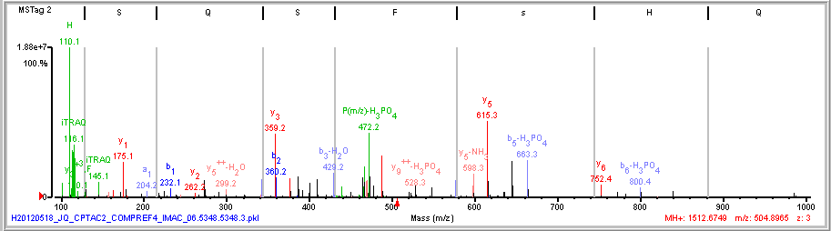
b-H₃PO₄ or b-H₂O Ions?
H₃PO₄
(R)S\Q s F S/H/Q/Q/P S/R(S)
H₂O
(R)S\Q S F s/H/Q/Q/P S/R(S)
b₄-H₃PO₄
576.3
b₄-H₂O
576.3

Slide 32
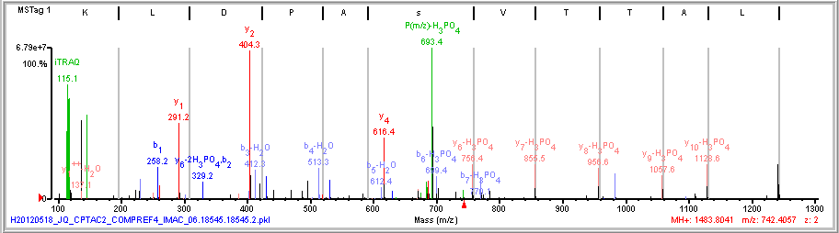
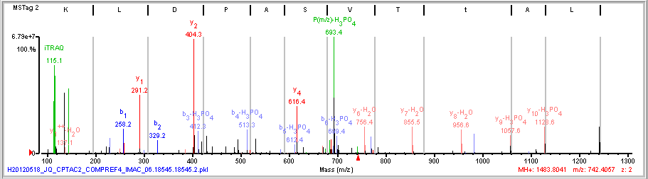
PhosphoRS Lone Disagreer
better
(R)L\A\T\T\V s/A/P D/L/K(S)
(R)L\A\T\t V S/A/P D/L/K(S)
b₄
531.3
b₅
630.4
PhosphoRS

