Slide 1
The Matrisome: In Silico Definition and In Vivo Characterization of Normal and Tumor Extracellular Matrices
Karl R. Clauser and Steven A. Carr
Broad Institute of MIT and Harvard
Alexandra Naba, Sebastian Hoersch, Hui Liu, Richard O. Hynes
Koch Institute for Integrative Cancer Research
Massachusetts Institute of Technology,
Cambridge, MA

Slide 2
Extracellular Matrix & Cancer
The expression of ECM genes is often dysregulated in human cancers.
ECM proteins control cell proliferation, survival, adhesion, invasion, etc.
Direct signaling via the integrins
Modulation of growth factor signaling
ECM remodeling by enzymes is important during tumor progression:
Architectural changes
Breakdown of basement membrane is a key step of invasion
Cleavage: release of biologically active fragments
Insoluble, large, highly crosslinked ECM proteins have made biochemical analyses challenging.
Characterize the tumor ECM =
Novel prognostic and diagnostic markers and therapeutic targets
Hynes RO. and Naba A., 2011, Cold Spring Harb. Perspect. Biol.

Slide 3
The extracellular matrix: a major component of the tumor microenvironment
Masson’s Trichrome Staining: collagen fibers
Masson’s Trichrome Staining: collagen fibers
Adipocytes
Alveoli
Bronchiole
Normal Mammary Gland
Normal Lung
Duct
Mammary Tumor
(MMTV-PyMT)
Lung Tumor
(Cre + K-Ras^{G12D} / p53 ^{fl/fl})
Notes:
The remodeling of the extracellular matrix is a hallmark of tumor progression and is one of the criteria used by pathologists to diagnose and stage tumors.
Adipocyte, Duct
You can see on these pictures that in normal tissues, the extracellular matrix (in blue) is discreet and underlines the mammary ducts in the mammary gland or the bronchioles in the lung.
You can also see on these pictures that the development of a tumor in these organs is accompanied by a massive deposition of extracellular matrix.
At the molecular level:
- Many studies have reported the dysregulation of ECM genes in tumors
- ECM proteins control cellular functions such as proliferation, adhesion, migration either directly via their receptors, the integrins or by modulating GF signaling and all these cellular functions are dysregulated in cancers.
Finally, it is believed that the remodeling of the ECM by MMPs promotes tumor progression by:
inducing architectural changes in the ECM
but also by inducing the release of fragments of ECM proteins that have a pro-tumorigenic or pro-metastatic activity
For all of these reasons, we believe that studying the composition of the tumor ECM will help us understand how a tumor progress and disseminate.

Slide 4
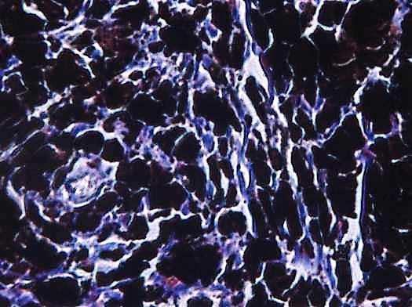
The extracellular matrix is a major component of the tumor microenvironment
Murine Mammary Tumor
(MMTV-PyMT)
Human Melanoma Patient
Masson’s Trichrome Staining: Collagen fibers
Notes:
ECM deposition is a hallmark of cancer

Slide 5
Challenges of Studying the Extracellular Matrix
Goals
Define a methodology to study the composition of the in vivo extracellular matrix.
What is the origin of tumor extracellular matrix (tumor or stroma)?
What changes in the ECM composition during tumor progression?
Invasion
Angiogenic switch
Metastatic dissemination
Can ECM proteins serve as prognostic markers or diagnostic tools in the clinic?
Notes:
The study of the extracellular matrix is accompanied by several challenges:
First, it is believed that there are hundreds of ECM genes within the genome.
Second, The ECM proteins are very large (several thousands of amino acids), and highly-cross-linked which makes their biochemical analysis challenging.
Because our goal is to characterize the composition of the ECM in vivo
To define a methodology that will allow me to study the composition of the ECM at the protein level
I am going to show you how I used the approach I defined to characterize how the ECM composition changes with tumor progression and metastatic potential
Translate our findings to the clinics as we hope to be able to define ECM proteins that could serve as prognostic markers or diagnostic tools.

Slide 6



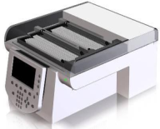
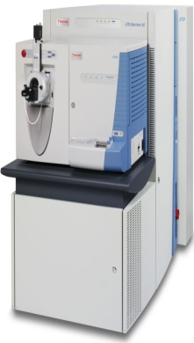
Proteomics Analysis of ECM Composition
Lung
Colon
Human
Melanoma
Xenografts
50-150 mg
ECM protein enrichment
DTT
Iodoacetamide
Solubilize
(8M urea)
Reduce/Alkylate
Cysteines
(2M urea)
Deglycosylation
(PNGaseF)
Digestion
(Lys-C, trypsin)
Desalting
(Reversed Phase)
Peptide
Fractionation
(Off-Gel Electrophoresis)
in silico
Matrisome
UniProt
human/mouse
ECM
Protein
Peptide
Lists
Peptide/Protein ID
(Spectrum Mill)
LC-MS/MS
(LTQ Orbitrap XL)
Notes:
To analyze the composition of this ECM-rich fraction, I have developed in collaboration with Karl Clauser from the Proteomics platform of the Broad Institute, a proteomics pipeline based on a tandem mass spectrometry approach.
Briefly, after resolubilizing the proteins, we deglycosylate and then digest them. The peptides are separated first by off-gel electrophoresis according to their isoelectric point and then by liquid chromatography before being analyzed by tandem mass spectrometry.

Slide 7








Sequential Depletion of Intracellular Proteins by Solubility
Whole lung extract
Purification Steps
C N M CS
ECM-rich
Fraction
Tissue: Mechanical Lysis
Chemical Lysis
(High salt Buffer)
ç Collagen VI (ECM)
180kDa
ç Laminin (ECM)
180kDa
→ ECM proteins:
8-fold enrichment
ç Integrin β1 (PM)
Membrane protein solubilization (DOC, NP-40)
120kDa
ç Tf Receptor (PM)
83kDa
55kDa
Cytoskeletal protein solubilization (SDS)
ç Tubulin (Cytoskeleton)
49kDa
ç Actin (Cytoskeleton)
Insoluble fraction
= ECM-enriched fraction
38kDa
ç GAPDH (Cytosol)
16kDa
ç Histones (Nucleus)

Slide 8
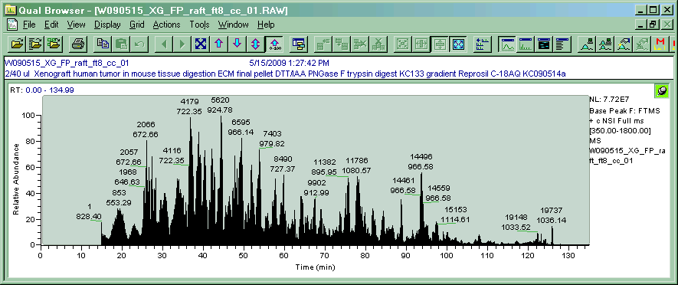
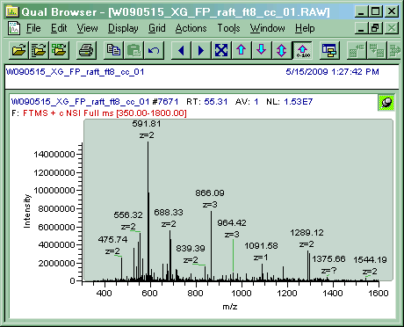
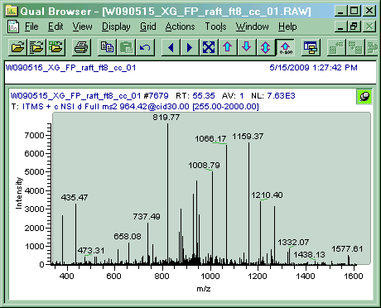
Peptide Off Gel Electrophoresis and LC-MS/MS
50-100ug total peptide
12 frxns, pI 3-10
Each frxn to LC-MS/MS
IPG gel strip
pH gradient
pI (A)
pI (B)
Liquid Chromatography
MS
8 MS/MS
Most abundant
Relative Abundance
Intensity
Retention time (min)
m/z
1 cycle: 3sec
Quantitation
Identification

Slide 9
Resolving Power of OGE fractionation
Overlap of Distinct Peptides in Fractions
Unseparated sample
1 frxn
9178
83%
pI resolution
normal murine lung 5557
LTQ Orbitrap XL

Slide 10
Factors Driving ETD Proportion, pI
z3, His Containing
Decision-tree params
CID z2 all CID
ETD z3 < 650 CID
ETD z4 < 900 CID
ETD z5 < 950 CID
Normal human colon - MGH 446
LTQ Orbitrap XL

Slide 11
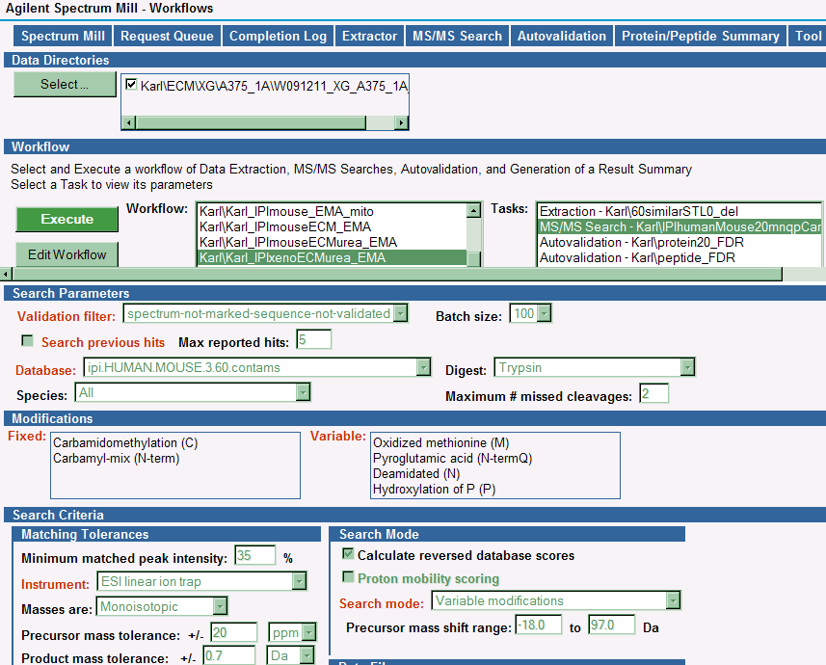
Database search parameters

Slide 12
Proteomics analysis of the lung matrisome
Total Mass Spec
Intensity
Number of Peptides
Number of Proteins
Pre-OGE
Core
Matrisome
Matrisome-
associated
Proteins
x4
x2
x~7
x3
Post-OGE
Other
Notes:
Pre OGE: 2365 peptides / 1364 Matrisome peptides (58%) and 186 proteins / 55 Matrisome proteins (30%)
Post OGE: 9328 peptides / 2719 Matrisome peptides (30%) and 1232 proteins / 168 Matrisome proteins (13.6%)

Slide 13
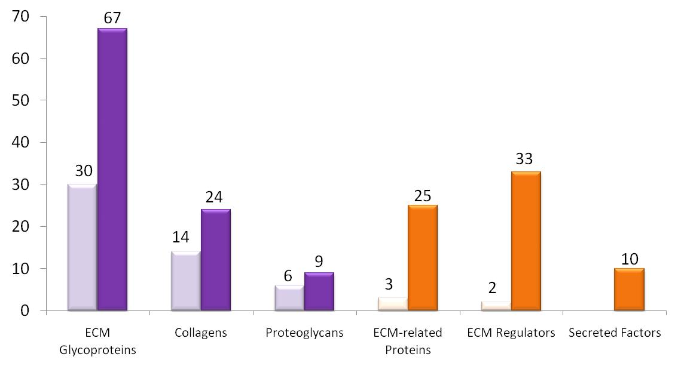
Peptide separation by off-gel electrophoresis
Core Matrisome
Matrisome-Associated
Pre-OGE
Post-OGE
Post-OGE
Pre-OGE

Slide 14
Currently Unsatisfactory GO Annotations for Cellular Compartment
Several cytosolic or cytoskeletal proteins involved in cell-matrix adhesion are mis-annotated as being a part of the extracellular matrix
Some known ECM proteins (thrombospondin 1, vWF, agrin, etc.) are defined by vague terms such as “external side of the plasma membrane” or “cell surface”
Conflicting annotations between human and mouse proteins.
More than 20 different GO categories correspond to the extracellular matrix (extracellular matrix, basal lamina, basement membrane, etc.)
Many UniProt identifiers are not associated with any GO cellular compartments.
Tgm2 Protein-glutamine gamma-glutamyltransferase 2 (human)
mitochondrion|mitochondrion|plasma membrane|plasma membrane|
Tgm2 Protein-glutamine gamma-glutamyltransferase 2 (mouse)
proteinaceous extracellular matrix|cytosol|membrane|
Lamb2 laminin, beta 2 (human)
extracellular region|basal lamina|extracellular space|nucleus|cytoplasm|endoplasmic reticulum|laminin-11 complex|
Lamb2 laminin, beta 2 (mouse)
basement membrane|basement membrane|

Slide 15
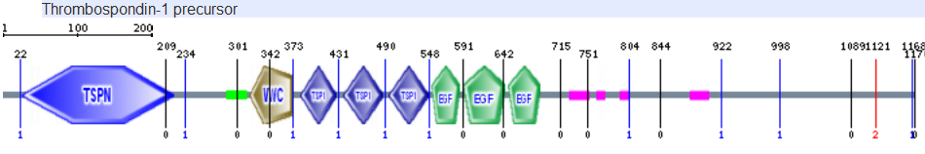
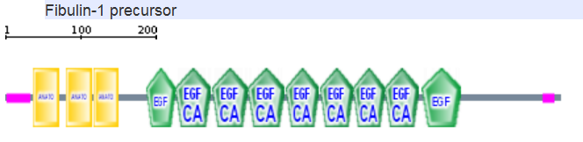
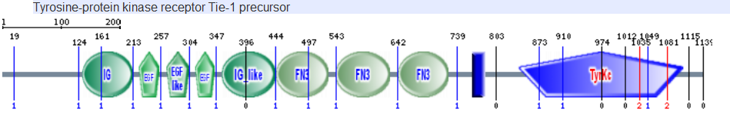
The domain-based organization of ECM proteins
List of 55 domains commonly found in ECM proteins
List of 20 domains that shouldn’t be displayed by an ECM proteins

Slide 16
In silico
Definition
of the
Matrisome
55 domains
Core Matrisome
6 domains
ECM-affiliated
27 domains
ECM regulators
39 domains
Secreted factors
Positive screen: search UniProt database entries for presence of defining domains
Make gene-centric, using EntrezGene, GenPept, and Ensembl databases and manual sequence analysis
For all candidate genes, derive all the UniProt, RefSeq and Ensembl-specific information
20 excluding domains
12 excluding domains
17 excluding domains
Domain-based negative screen: eliminate candidate genes with excluding domains in >1 member UniProt entry.
Transmembrane domain-based negative screen: (TMHMM, Phobius).
Signal peptide-based positive screen (Phobius).
Orthology comparison
Manual curation: Division and category assignment
ECM Glycoproteins
Category
Collagens
ECM-affiliated
ECM regulators
Secreted Factors
Proteoglycans
Division
Core Matrisome
Matrisome-associated

Slide 17
In silico Definition of the “Matrisome”
1024
Full matrisome
encoded by
4 - 5%
of the genome
282
ECM sensu stricto
encoded by
1.0% to 1.5%
of the genome
Growth factors,
Cytokines, etc.
Collagens (42)
MMPs, ADAMs, TIMPs, LOXs, TGs, etc.
Proteoglycans (35)
Galectins, mucins, semaphorins, plexins,
annexins, etc.
Includes quite a few
previously “unknown”
ECM proteins
Naba et al., 2012, Mol Cell Proteomics
Martin et al., 1984, Ciba Found Symp. 108, 197-212
http://mit.edu/hyneslab/matrisome/

Slide 18
Proof of concept: the lung extracellular matrix
Peptide Abundance
Number of Proteins
Number of Proteins
ECM
Glycoproteins
Secreted
Factors
Collagens
Proteoglycans
ECM-affiliated
ECM Regulators
Core Matrisome
Matrisome-associated
Core Matrisome
Matrisome-associated
Other
Naba et al., 2012, Mol. Cell. Prot.

Slide 19
Proof of concept: characterization of the lung matrisome
Interstitial extracellular matrix |  |  |  | ECM-associated Proteins
ECM Glycoproteins |  | Collagens | Proteoglycans | ECM-related Proteins | ECM regulators | Secreted Factors
Abi3bp protein | Nephronectin | Collagen, type I, alpha 1, 2 | Asporin | Annexins A1, A2, A3, A5, A6, A9 | 1810010H24Rik | Chordin-Like 1
Acetylcholinesterase collagenous tail | Netrin-1, -4 | Collagen, type III, alpha 1 | Biglycan | C1qtnf5 | Adamts7 | Egfl7
Agrin | Papilin | Collagen, type V, alpha 1, 2, 3 | Bone marrow Proteoglycan | Clec14a | Adamtsl -1, -4 | Fgf2
BMP-binding endothelial regulator protein | Periostin | Collagen, type VI, alpha 1, 2, 3, 5 | Decorin | Colectin12 | Ambp | Megf6
Dermatopontin | Peroxidasin | Collagen, type VII, alpha 1 | Lumican | CSPG4 | Elastase | Pf4
Elastin | Procollagen C-endopeptidase enhancer 2 | Collagen, type XII, alpha 1 | Mimecan | Frem-1 | F13a1, F2 | S100 -a10, -a11, -a13
EMID-1 | SPARC | Collagen, type XIV, alpha 1 | Prolargin | Intelectin-1 | Htra1 | Scube2
Emilin-1, -2 | Spondin-1 | Collagen, type XVI, alpha 1 | Versican | Galectin-1, -3, -9 | Itih-2, -5
Extracellular matrix protein- 1 | Sushi, nidogen and EGF-like domain-containing protein-1 | Collagen, type XXIII, alpha 1 |  | Plxdc2 | Lox, L1, L2, L3
Fibrillin-1 | Tenascin-X | Collagen, type XXIV, alpha 1 |  | Plexin B2 | Mmp -9, -19
Fibrinogen, alpha, beta, gamma chains | Thrombospondin type-1 domain-containing protein 4 | Collagen, type XXV, alpha 1 |  | Semaphorins 3C, 3F, 5A | Plasminogen
Fibronectin | Thrombospondin-1 | Collagen, type XXVII, alpha 1 |  | Surfactant Proteins A, D | Plod-1, -3
Fibulin (Fbln) -1,- 2, -3, -4, -5, -6 | TGFbi | Collagen, type XXVIII, alpha 1 |  |  | Pzp
Hemicentin-2 | Tubulointerstitial nephritis antigen |  |  |  | Serpin -a1a, -a3k, -c1, -f2, -g1, -h1
IGFBP-6, -7 | Tubulointerstitial nephritis antigen-like |  |  |  | Transglutaminase 2
Lactadherin | Vitronectin |  |  |  | Timp3
LTBP-1, -2, -4 | von Willebrand factor
Matrilin-4 | VWA-1, 5A
Mfap -1, 2, 4, 5 | WISP- 2
Multimerin-1, -2
Basement Membrane constituents
Laminin, subunits: a1, a2, a3, a4, a5; b2, b3; c1, c2 |  | Collagen, type IV, alpha 2, 4, 5 | Perlecan (HSPG2)
Nidogen-1 |  | Collagen, type XV, alpha 1
 |  | Collagen, type XVIII, alpha 1
Notes:
And this is what the lung matrisome looks like: a long list of proteins!
I would like to point out few interesting observations:
First we can detect proteins that belong to the basement membrane as proteins that are part of the interstitial matrix.
We have been able to identify ECM proteins that bind growth factors : IGFBPs, Fibrillin, LTBPs
We have also identified ECM cross-linking enzymes such as Lysyl oxidases or transglutaminase.
And of interest, we are also detecting members of the S100 factors that have been implicated in the formation of the pre-metastatic niche.

Slide 20
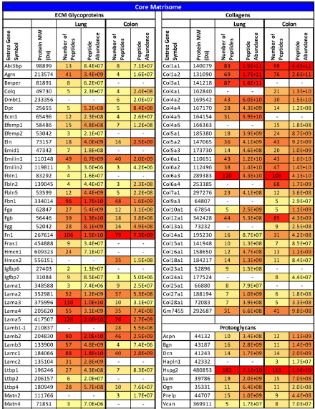
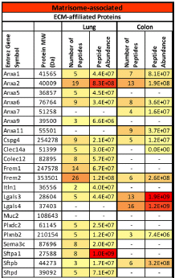
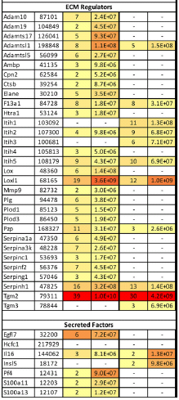
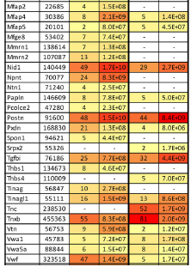
ECM proteins Observed in Normal mouse Lung & Colon
Proteins were found in 2 independent samples with at least 2 peptides in one of the 2 samples.
Table II, Naba et al., 2012, MCP

Slide 21
ECM Tissue-specificity
Lung Matrisome
Colon Matrisome
57
84
23
Thrombospondin-1
Nephronectin
Surfactant Protein A
Surfactant Protein D
Thrombospondin-3 Thrombospondin-4
Mucin-2
Galectin-4
ECM-related Proteins
ECM
Glycoproteins
Collagens
Proteoglycans
Regulators
Secreted Factors
Notes:
Thbs1: lung-specific
Thbs3 and Thbs4: colon specific
ECM-related: surfactant proteins, mucins, galectins

Slide 22
The Extracellular Matrix Proteome
The ECM of any given tissue comprises over 150 proteins
Reproducible and characteristic differences between tissues: definition of an “ECM Signature” for each tissue.
Apply our proteomic approach to understand tumor biology:
Which players of the tumor microenvironment secrete the tumor extracellular matrix?
Can we use a set of extracellular matrix proteins as prognostic and diagnostic markers?
Naba et al., 2012, Mol. Cell. Proteomics

Slide 23
Model systems: xenografts of human tumor cells in mouse
Subcutaneous Injection:
- A375: non-metastatic
- MA2: metastatic
Human Melanoma Cells
(5.10⁵ cells)
“NSG” mouse
8 week-old ♂ NSG mouse
NOD/SCID/IL2γ chainR
Tumor Growth
Tumor Collection
---
Tumor ECM preparation
Proteomics pipeline
Proteins secreted by the tumor cells:
human sequence
Proteins secreted by the stromal cells:
murine sequence
Notes:
To address this question, I used a human melanoma xenograft model system that has been characterized in the lab.
We have 2 cell lines that differ by their metastatic potential, the A375 are poorly metastatic and the MA2 are highly metastatic.
The tumor cells are injected subcutaneously in the flank of the mouse and allowed to grow for 5 weeks. The tumor is then harvested, and the ECM is extracted and submitted for analysis through the proteomics pipeline.
I will be able to identify the source of the ECM proteins as the proteins secreted by the tumor cells have a human sequence whereas the proteins secreted by the stroma will have a murine sequence.

Slide 24
Of mouse or man?
Fibrillin-1
The human and mouse protein sequences are different enough to be distinguished by mass spectrometry.
Notes:
As you can see here, the human and mouse protein sequences are indeed different enough to be distinguished by mass spectrometry.
There are of course peptides identical between the human and mouse sequences but there are also what we call “distinguishing” peptides, highlighted here in red that allow us to determine the origin of the protein. For the example of fibrillin-1, we can say that this protein is secreted by the 2 compartments as the mass spec analysis identified peptides specific to the human potein but also peptides specific to the mouse sequence.

Slide 25
Proteins expressed by the same compartment
Proteins expressed by a different compartment
Origin of the tumor ECM
Tumor cells
Both, more from tumor cells
Both equally
Both, more from the stroma
Stroma
Fig 5, Naba et al., 2012, MCP
Not detected
-

Slide 26
Proteins expressed by non-metastatic melanoma
Proteins expressed by metastatic melanoma
Origin of the tumor ECM
Tumor cells
Both, more from tumor cells
Both equally
Both, more from the stroma
Stroma
Fig 5, Naba et al., 2012, MCP
Not detected
-

Slide 27
Differences between the matrisomes of non-metastatic and metastatic human melanoma xenografts
 | Matrisome Proteins Secreted by the Tumor Cells |  |  |  |  |  | Matrisome Proteins Secreted by the Stromal Cells
 | ECM Glycoproteins | Collagens | Proteoglycans | ECM-affiliated Proteins | ECM Regulators | Secreted Factors | ECM Glycoproteins | Collagens | Proteoglycans | ECM-affiliated Proteins | ECM Regulators | Secreted Factors
Non-metastatic tumor (A375) | SRPX |  | BGN | ANXA1 | ADAMTSL1 | ANGPTL4 | Efemp1 | Col24a1 | Lumican |  | F2
 | LAMA5 |  |  | ANXA2 | CD109 | S100A11 | Fbln2 |  |  |  | Itih4
 |  |  |  | ANXA5 | CTSZ | S100A13 | Ltbp2 |  |  |  | Plg
 |  |  |  | LGALS3 | HTRA1 | S100A4 | Nid2 |  |  |  | Serpina3k
 |  |  |  | LMAN1 | LEPREL2 | S100A6 | Thbs1 |  |  |  | Serpinf2
 |  |  |  |  | LOXL2 | TGFB1 | Tnn
 |  |  |  |  | P4HA1
 |  |  |  |  | PLOD2
 |  |  |  |  | PLOD3
 |  |  |  |  | SERPINB1
 |  |  |  |  | SERPINE1
Metastatic tumor (MA2) | EMILIN1 | COL21A1 | Link1 | CSPG4 | LOXL3 |  | Cilp | Col13a1 |  |  | Itih1
 | EMILIN3 | COL8A2 |  |  | LOXL4 |  | Emilin2 | Col25a1
 | HMCN1 |  |  |  |  |  | Lama5 | Col27a1
 | PXDN |  |  |  |  |  |  | Col28a1
 |  |  |  |  |  |  |  | Col6a5
 |  |  |  |  |  |  |  | Col6a6
Notes:
Using this model system, more than a 100 matrisome proteins have been detected. The large majority of matrisome proteins are secreted by the two compartments and in the same proportion. I am showing you in this table the proteins that are either exclusively secreted by the tumor or by the stroma. You can for example see that the cross-linking enzymes are secreted by the tumor cells, so are the S100 factors.
Using this model system, we can also compare the matrisome of a non-metastatic tumor to the one of the metastatic tumor and what you can see is that, the cross linking enzymes are in the metastatic tumor still expressed by the tumor cells but it is a different subset of enzymes that is expressed. Emilins, proteins that are integrated in the elastic fibers are expressed in the metastic tumors exclusively.

Slide 28

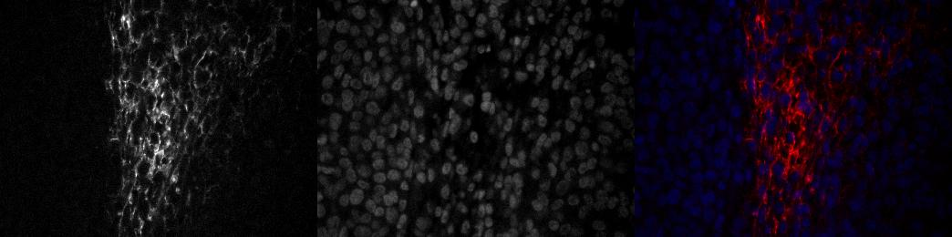
Link protein 1 localization
HAPLN1
DAPI
merge
A375 tumor section
x40
MA2 tumor section
x40

Slide 29

Breast Cancer – Mouse model
Orthotopic xenotransplant:
MDA-MB-231 (poorly metastatic) or LM2 (highly metastatic to the lungs)
Human Mammary Carcinoma Cells
♀ mouse
NOD/SCID/IL2g chainR
Primary Tumor Collection
---
Tumor ECM preparation
Proteomic pipeline
Proteins secreted by the tumor cells (human sequence)
Proteins secreted by the stromal cells (murine sequence)
Minn AJ. et al., 2005, Nature
Cells: gift from Joan Massagué – Memorial Sloan Kettering Cancer

Slide 30
ECM proteins as prognostic or diagnostic markers?
Matched patient samples:
Normal colon / colon tumor
Normal liver / liver metastasis
Questions:
Differences between normal and tumor ECM? Colon tumor ECM signature
Differences between the matrisome of a primary tumor and metastasis?
Correlation of changes in the ECM composition with tumor progression, response to therapy, etc.
Normal Colon
Colon Cancer
Stage I
Stage II
Stage III
Liver Metastasis
Can we predict, depending on the ECM composition,
whether a colon tumor will or not metastasize / respond to treatment?

Slide 31
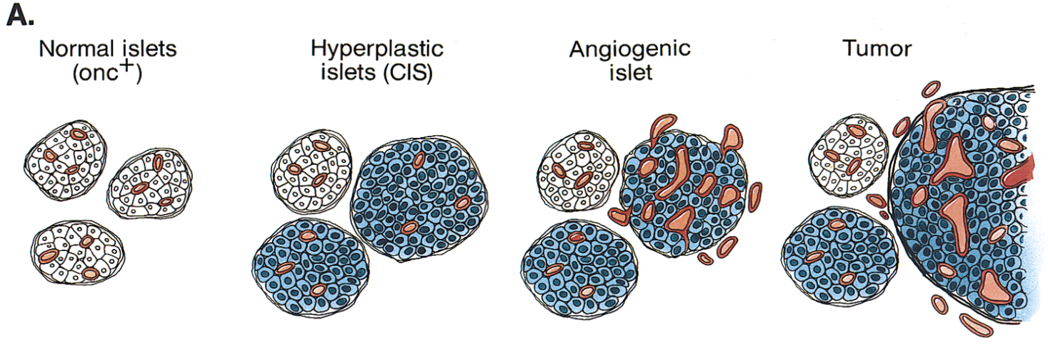
Characterization of ECM changes at the angiogenic switch
Model system: RIP-Tag mouse
SV40 large T antigen expression in the β-pancreatic islet cells
Carcinomas develop in the pancreatic islets and progress through characteristic stages
Human disease: Insulinoma
7 wks
Angiogenic Switch
9 wks 12 wks
Quantitative Proteomics (iTRAQ labeling)
Identification of the changes in ECM composition that influence tumor angiogenesis

Slide 32





THE MATRIX DECODED
Joe
Pantoliano
(Cypher)
Laurence
Fishburne
(Morpheus)
Keanu
Reeves
(Neo)
Carrie-Anne
Moss
(Trinity)
Sebastian
Hoersch
Steve
Carr
Richard
Hynes
Alexandra
Naba

Slide 33




Acknowledgments
Richard Hynes Lab
Alexandra Naba
Hui Liu
Bioinformatics Core Facility (KI)
Sebastian Hoersch
Proteomics Platform
Steve Carr
Jake Jaffe
TMEN (TUMOR MICROENVIRONMENT NETWORK NCI) U54-CA126515

