Slide 1
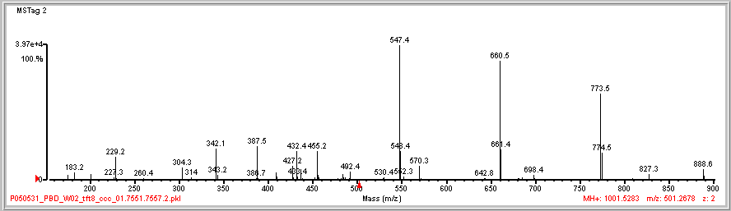
175.2

Slide 2
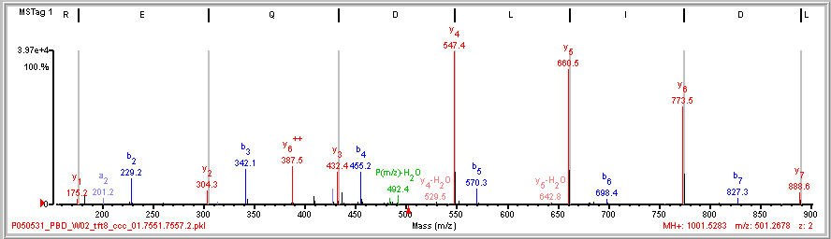
Dual Picket Fence
(K)L/D|I|L|D|Q|E|R(A)
129 128 115 113 113 115
113 113 115 128 129
175.2

Slide 3
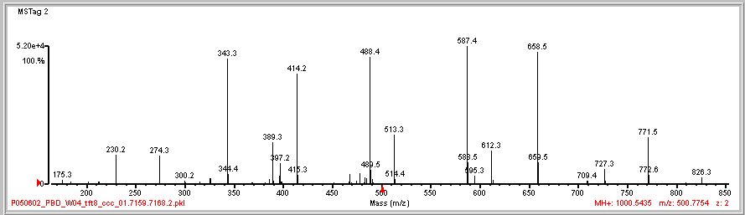

Slide 4
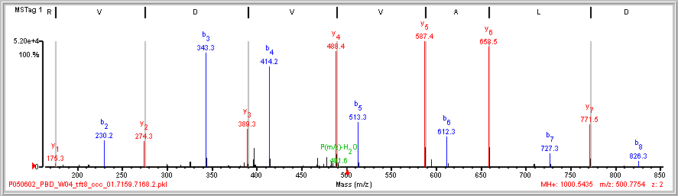
Dual Picket Fence
(K)N D|L|A|V|V|D|V\R(I)
99 115 99 99 71 113
113 71 99 99 115

Slide 5
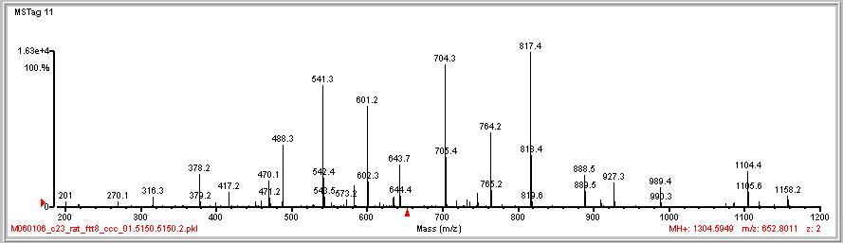

Slide 6
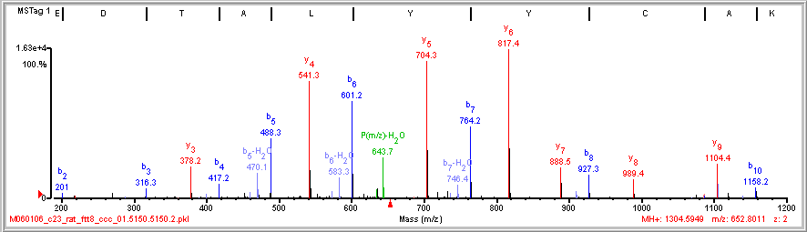
Dual Picket Fence
A E/D|T|A|L|Y|Y|C\A\K
163 163 113 71 101 115
115 101 71 113 163 163

Slide 7
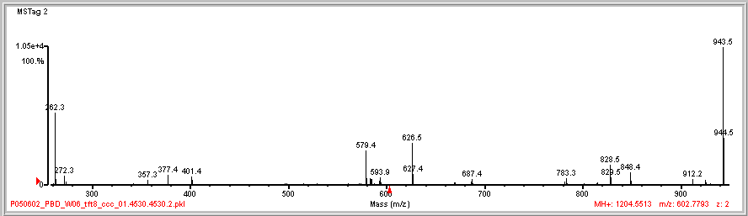

Slide 8
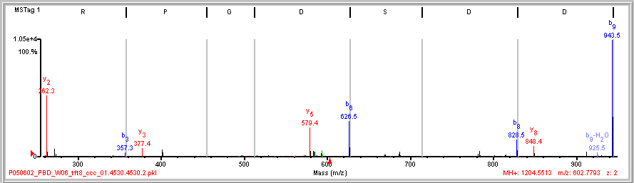
Sparse Dominant Fragmentation
(K)I S R|P G D|S D|D|S R(S)
Non-mobile proton
z_{pre} < #Arg
202 115
115 202

Slide 9
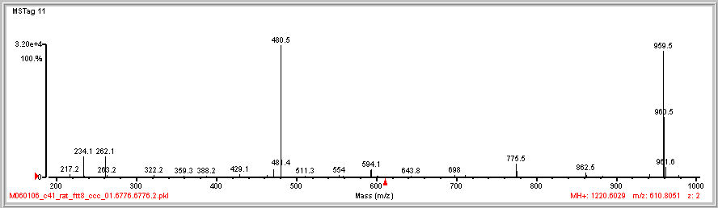

Slide 10
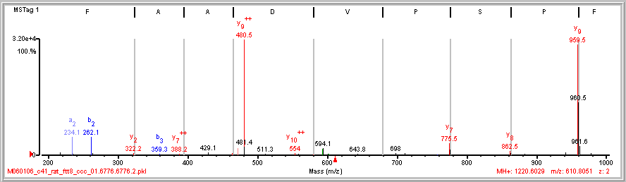
Dominant Cleavage Proline N-side
b₂
N F|P/S/P V D/A A F R
y₉
28
87 97

Slide 11
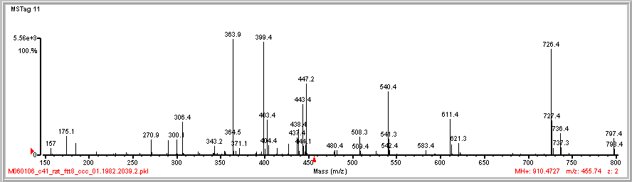

Slide 12
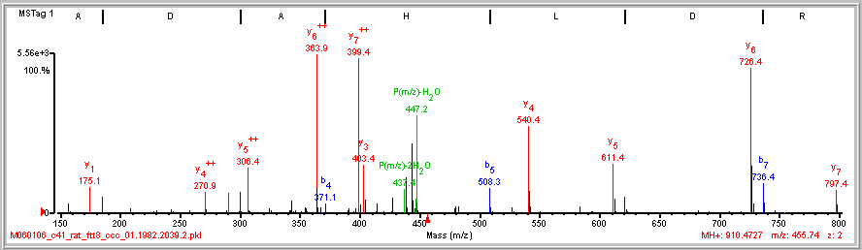
Diagnose Doubly Charged Fragment Ions
I/A|D|A|H|L|D|R

Slide 13
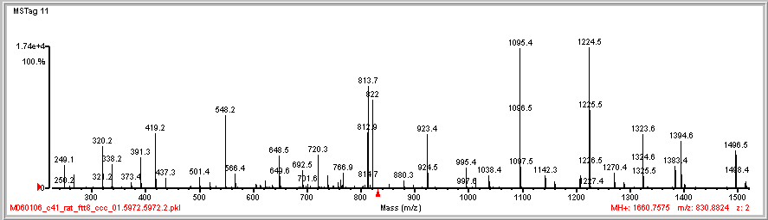

Slide 14
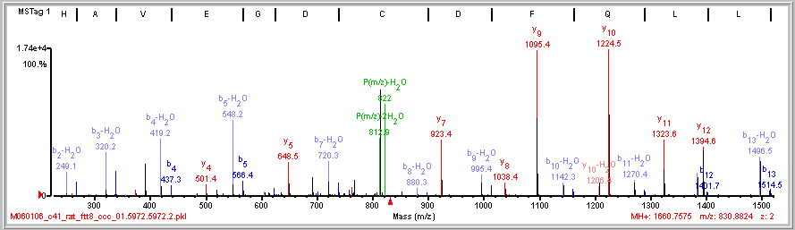
Cry Babies (b-H₂O & b pairs)
E/H/A|V/E|G/D|C D|F Q L L K
P(m/z)-2H₂O
P(m/z)-H₂O

Slide 15
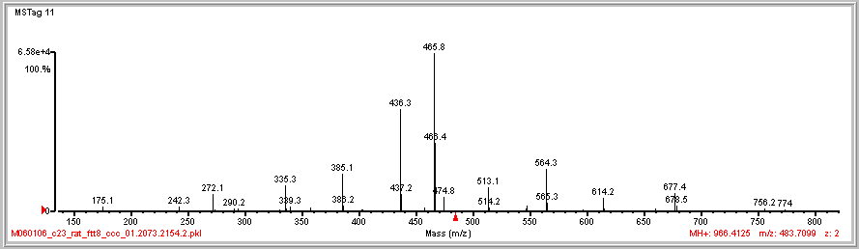

Slide 16
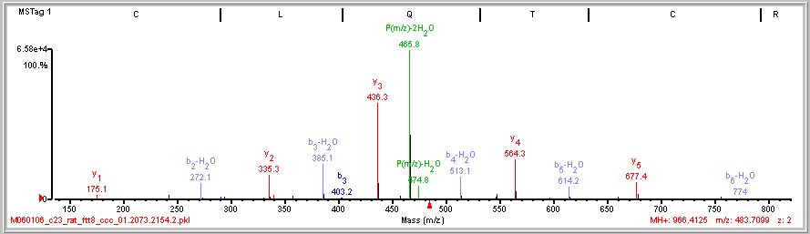
Cry Babies (b-H₂O w/o b)
E/C|L/Q/T/C/R
113 128 101 160
P(m/z)-2H₂O
160 101 128 113
P(m/z)-H₂O

Slide 17
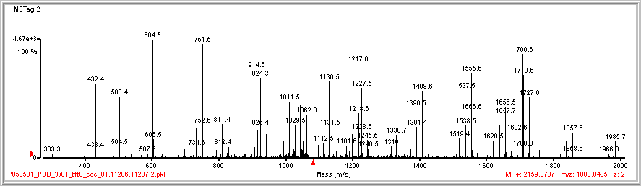
1043.6
1691.4
1638.7
733.5
942.4
1838.7
1443.7

Slide 18
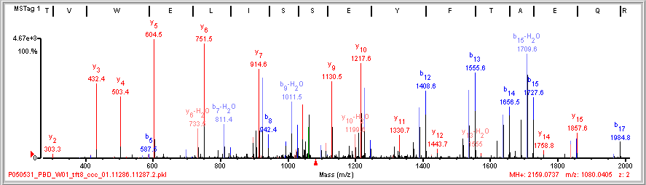
Long & Extensive
(R)T V T/V/W E/L/I|S|S/E/Y|F|T|A|E|Q R(Q)
1043.6
1691.4
1638.7
733.5
942.4
1838.7
1443.7

Slide 19
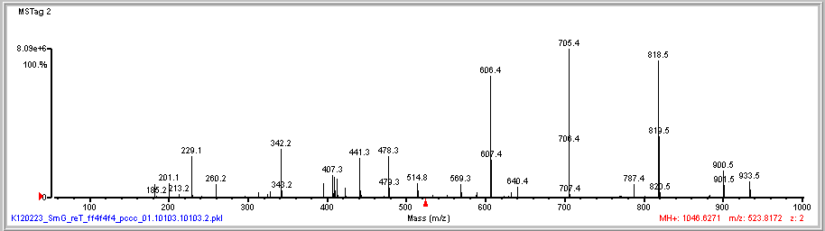
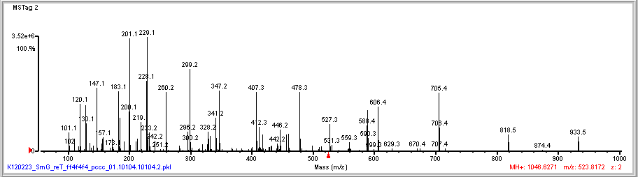
CID
HCD
129.1

Slide 20
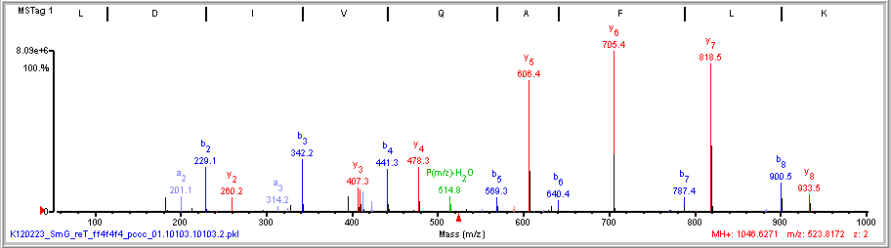
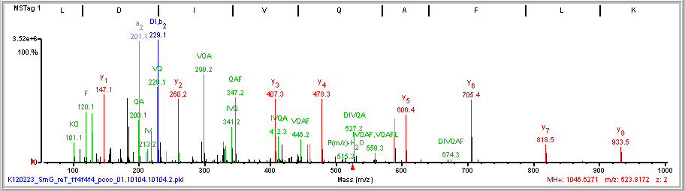
CID/HCD internal ions
CID
HCD

Slide 21
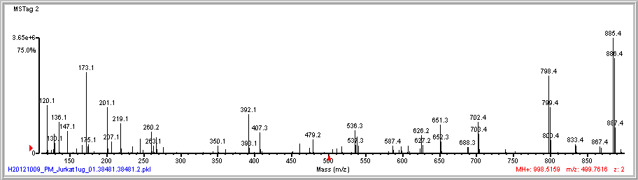
245.1
235.1

Slide 22
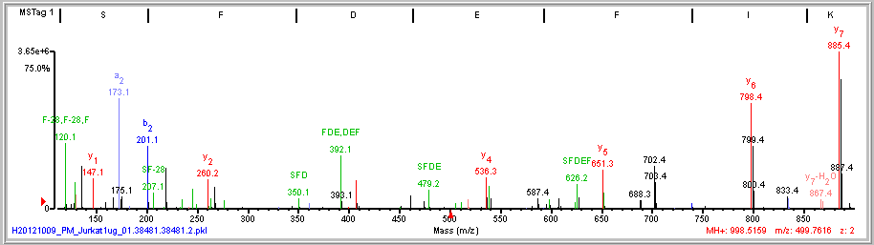
HCD - Internal ions
(R)I/S|F/D/E/F/I/K(I)
245.1
235.1

Slide 23
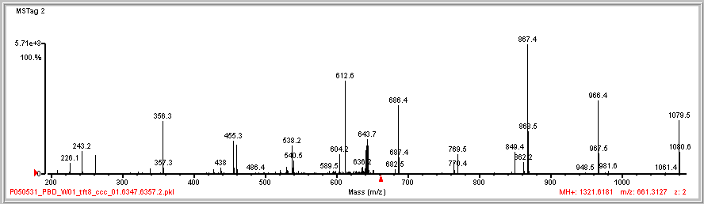
460.4
262.2
764.4
338.5

Slide 24
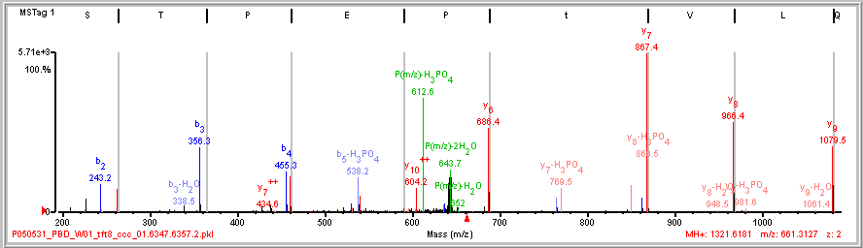
Phosphopeptide Unambiguous Site
(R)N Q|L|V|t/P E|P T/S R(A)
460.4
262.2
764.4
338.5

Slide 25
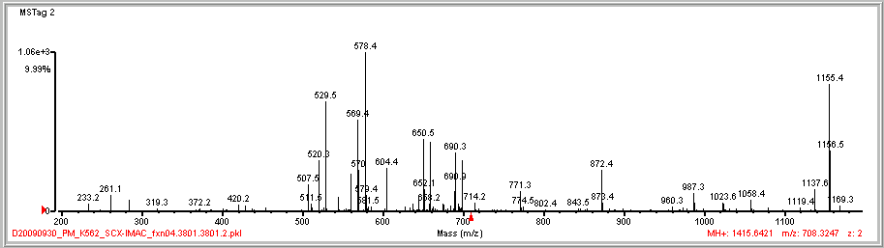
659.6
560.2
699.3
429.4
544.3

Slide 26
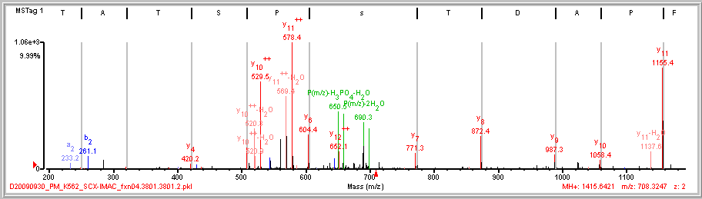
Localizing a Phosphorylation Site Unambiguous
L/F|P/A/D|T/s/P/S T A\T K
659.6
560.2
699.3
429.4
544.3

Slide 27
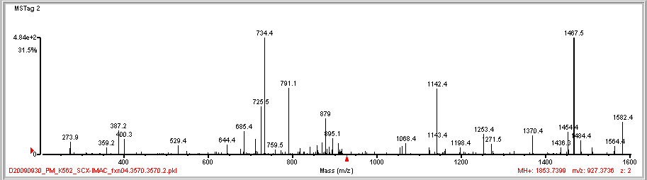
712.3
1511.2

Slide 28
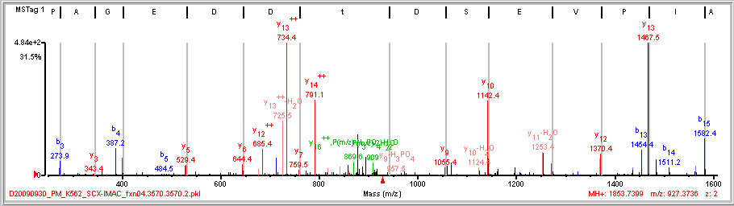
Localizing a Phosphorylation Site Ambiguous
D S A|I|P/V/E|S D t D/D E|G\A\P R
P(m/z) -H₃PO₄
879
712.3
1511.2

Slide 29
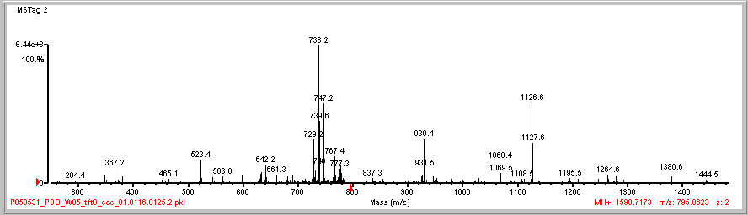
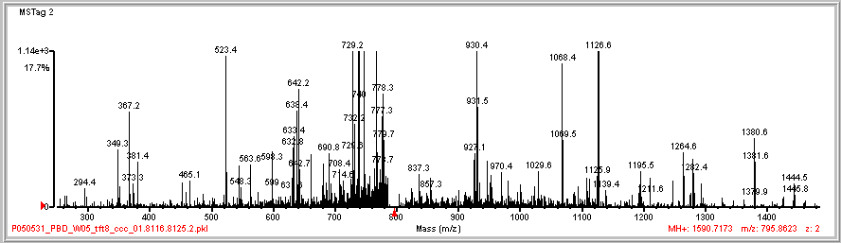
545.4
598.7
1247.7
1279.6
452.4
1210.4
1293.5

Slide 30
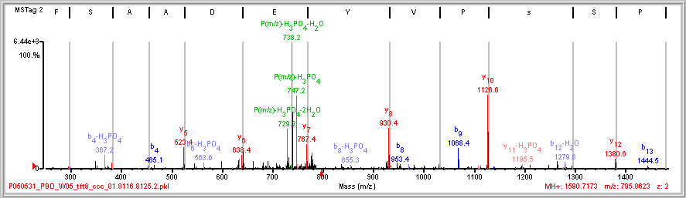
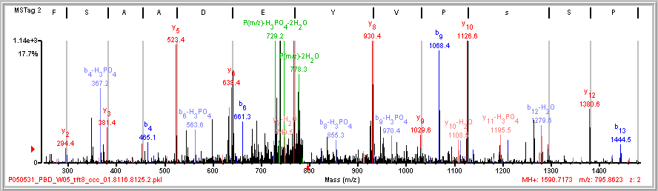
Phosphopeptide Ambiguous Site
(R)L P/S s|P/V|Y/E/D|A|A/S|F K(A)

Slide 31
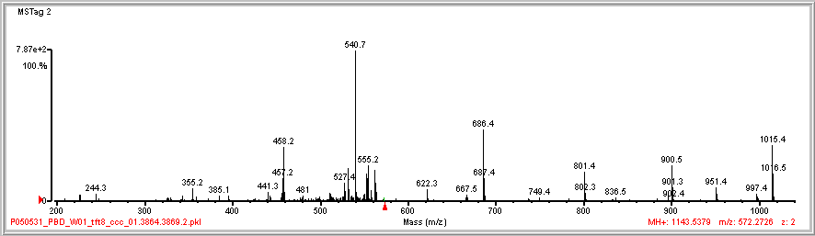
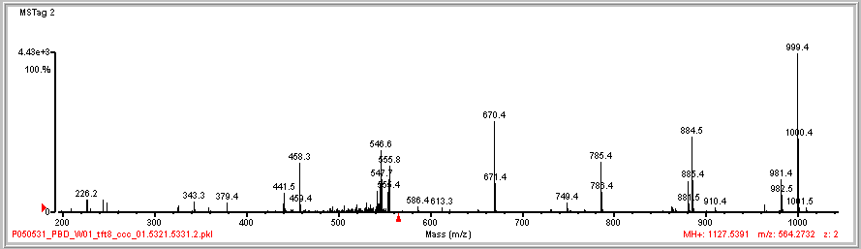
343.3

Slide 32
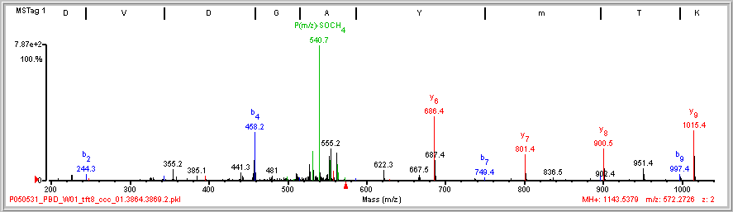
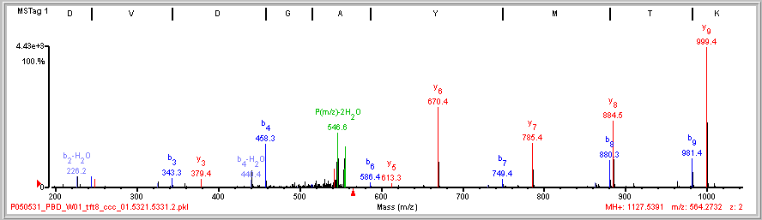
Met Oxidation
(K)K/D|V|D|G A\Y\m\T\K(V)
y₆-SOCH₄
y₈-SOCH₄
y₉-SOCH₄

Slide 33
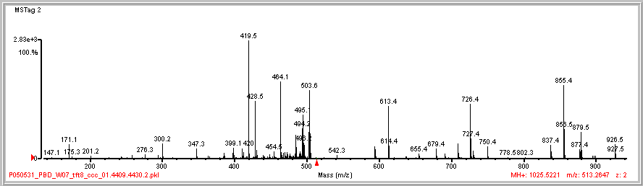
594.4
709.4

Slide 34
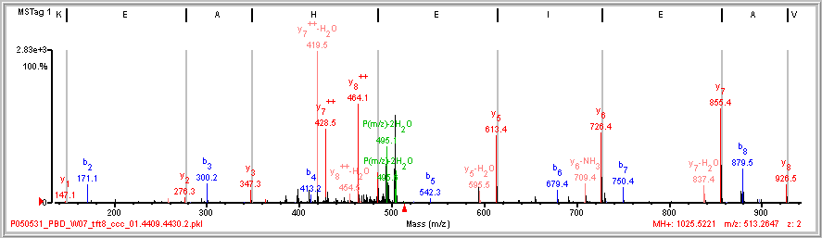
Dominant Ions – PM y++-h2o @ yn-2 DnEST
(K)V/A|E|I/E|H|A\E\K(E)
594.4
709.4

Slide 35
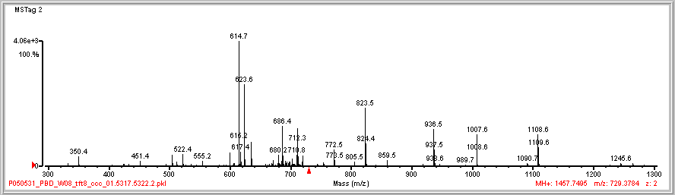
599.4

Slide 36
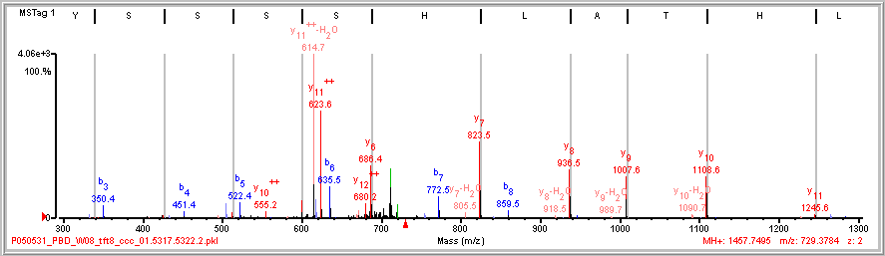
Dominant Ions – PM y++-h2o @ yn-2 DnEST
(R)V L/H|T|A|L|H|S|S S S Y R(E)
599.4

Slide 37
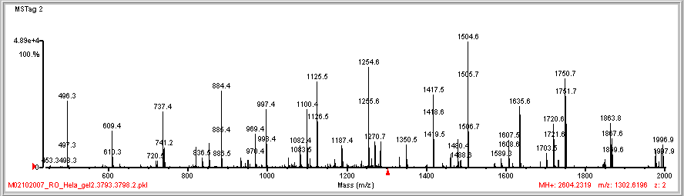
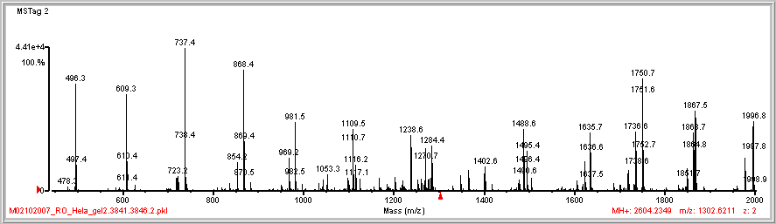

Slide 38
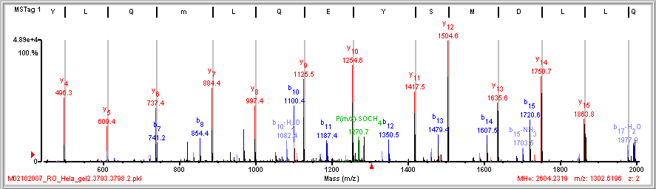
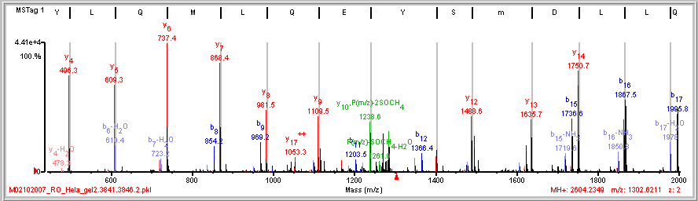
Met Oxidation – localizing the site
(R)G V D L D Q L/L|D|M|S|Y|E|Q|L|m|Q|L/Y S A R(Q)
(R)G V D L D Q L/L|D|m|S/Y/E|Q|L|M|Q|L/Y S A R(Q)

Slide 39
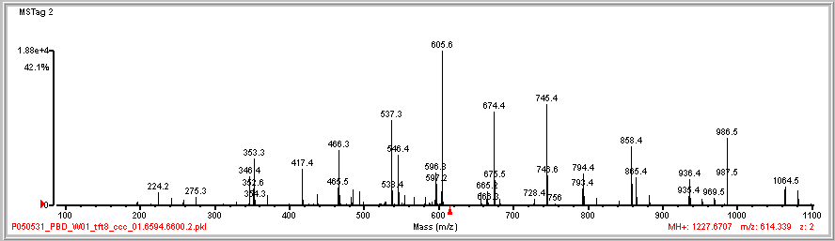
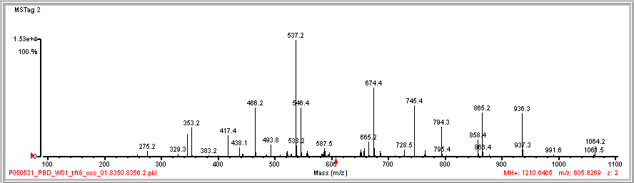

Slide 40
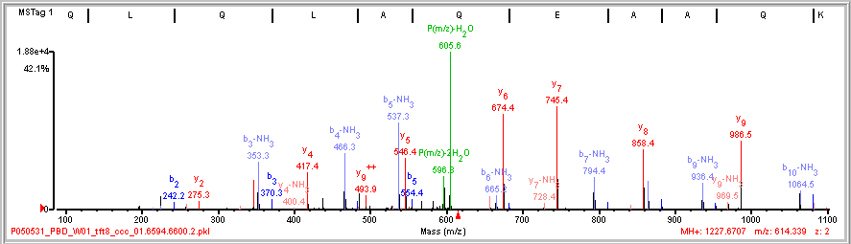
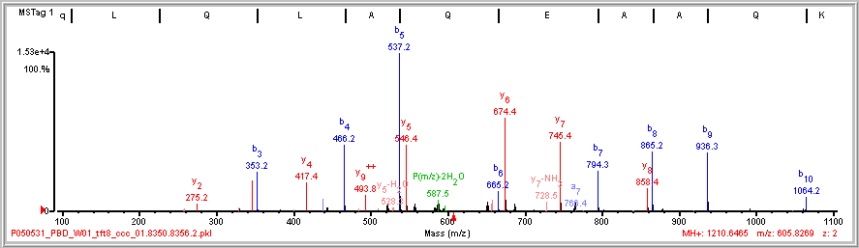

Stinkers (b-NH₃) & Pyroglutamic Acid
(R)Q L/Q/L/A|Q/E/A|A Q\K(R)
P(m/z)-NH₃
(R)q L/Q|L|A|Q|E|A|A\Q\K(R)
-17 Da
Q to q

Slide 41


Slide 42


(R)R G G P P\F A\F|V|E|F|E|D|P R(D)
(R)N P P R\F A\F|V|E|F|E|D|P R(D)

Slide 43


(R)R G G P P\F|A|F|V|E|F|E|D|P R(D)
Zhang Model Spectra
(R)N/P/P R F A|F|V|E|F|E|D|P R(D)

