Slide 1
Manual De Novo Peptide MS/MS Interpretation For Evaluating Database Search Results
Karl R. Clauser
Broad Institute of MIT and Harvard
Cold Spring Harbor Proteomics Course
July, 2015

Slide 2
Topics Covered
AA properties
Fragmentation pathways and ion types
b/y pairs
Non-mobile proton
Neutral loss ion types
CID/HCD/ETD
Basics of phospho site identification and localization
Sample handling chemistry artifacts
Isobaric co-eluters
Mass tolerance units and isobaric AA’s
Other Tutorials

Slide 3



















AA Structures & Masses
pK: N-term 7.5
pK: C-term 3.5
pK: 10 6 12
pK: 4.0 4.5
K H R
128 137 156
D E
115 129
Name AA Mass
Gly G 57
Ala A 71
Ser S 87
Val V 99
Thr T 101
Leu/Ile L/I 113
Asn N 114
Asp D 115
Lys/Gln K/Q 128
Glu E 129
Met M 131
His H 137
Phe/Met-ox F/m 147
Arg R 156
Cys-IAA C 160
Tyr Y 163
Trp W 186
S T Y
87 101 163
N Q
114 128
P
97
L I
113 113
M C
131 103 (+57 IAA)
G A V
57 71 99
F W
147 186
http://ionsource.com/Card/clipart/aaclipart.htm

Slide 4
Charge-directed Fragmentation Scheme
O
O
O
O
zH^{z+}
+
H₂N CH C NH CH C NH CH C NH CH C OH
R₁
R₂
R₃
H
R₄
b ion formation
and/or
y ion formation
O
O
O
O
+
y₁
b₃
+
H₂N CH C NH CH C NH CH C
H
NH CH C OH
R₁
R₂
R₃
H
R₄
+
Neutral pumped away by vacuum system
+
Neutral pumped away by vacuum system
Proton Mobility
Mobile: z_{pre} > #Arg + #Lys + #His
Partially mobile: z_{pre} < #Arg + #Lys + #His and > #Arg
Non-mobile: z_{pre} < #Arg
For peptides with non-mobile protons, fragmentation tends to proceed via charge-remote mechanisms. MS/MS spectra will be dominated by a few ions, typically:
C-term side of D, E
N-term side of P

Slide 5
Sequence Specific Fragment Ion Types
a₃
b₃
c₃
O
O
O
O
nH^{n+}
H₂N CH C NH CH C NH CH C NH CH C OH
R₁
R₂
R₃
R₄
x₁
y₁
z₁
Ion type restrictions residues delta
a-NH₃ contains NH₃ residue RK NQ -17
b-NH₃, y-NH₃ contains NH₃ residue RK NQ -17
b-H₂O, y-H₂O contains H₂O residue ST DE -18
b-H₃PO₄, y-H₃PO₄ contains H₃PO₄ residue st -98
y++, b++ contains charged residues RHK

Slide 6
Immonium ions
O
O
O
O
nH^{n+}
H₂N CH C NH CH C NH CH C NH CH C OH
R₁
R₂
R₃
R₄
Amino Acid |  | m/z
S | Ser | 60
V | Val | 72
T | Thr | 74
I,L | Leu,Ile | 86
N | Asn | 87
D | Asp | 88
K,Q | Lys, Gln | 84,101,129
E | Glu | 102
M | Met | 104
H | His | 110
R | Arg | 70, 73, 87,100,112,185
F | Phe | 120
P | Pro | 70, 126
C | C-iodoacetamide | 133
Y | Tyr | 136
W | Trp | 117, 130, 159, 170
Provide partial AA composition,
but not stoichiometry

Slide 7
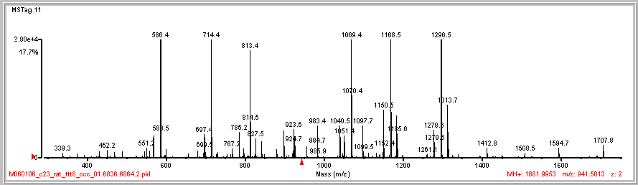
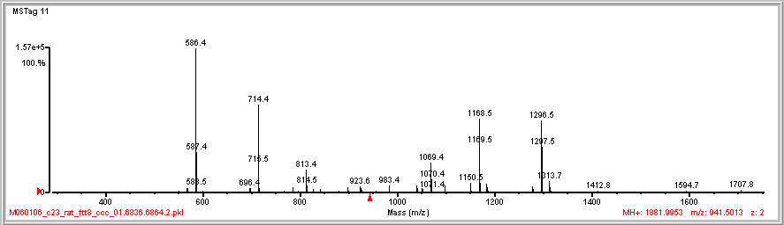
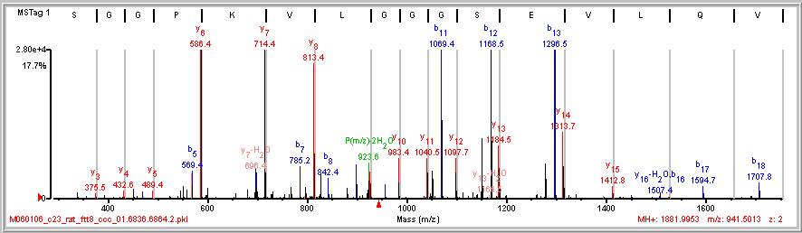
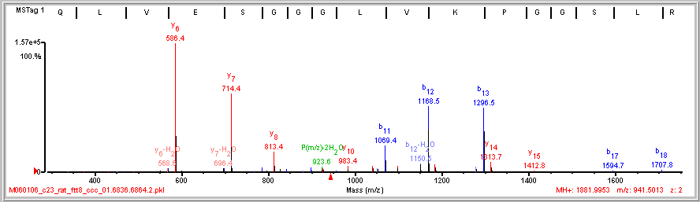
Complementary Ions b/y pairs
128 99
99 128
E V Q L V|E/S|G|G|G L|V|K|P G G\S\L\R

Slide 8
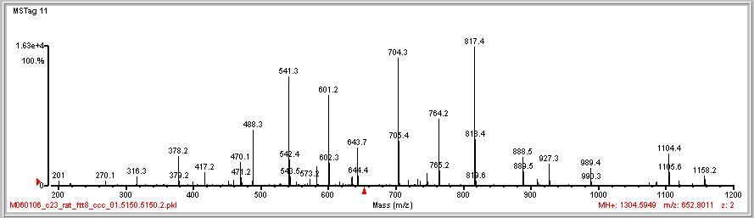
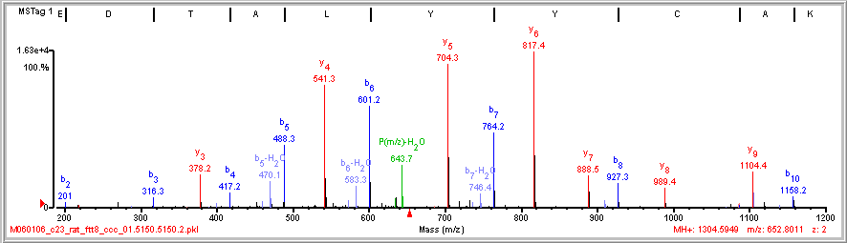
Dual Picket Fence
163 163 113 71 101 115
115 101 71 113 163 163
A E/D|T|A|L|Y|Y|C A\K

Slide 9
Uniqueness of a Peptide Sequence
Clauser, K. R.; Baker, P. R.; Burlingame, A. L. " Role of Accurate Mass Measurement ( +/- 10ppm) in Protein Identification Strategies Employing MS or MS/MS and Database Searching", Anal. Chem. 1999, 71, 2871-2882.

Slide 10
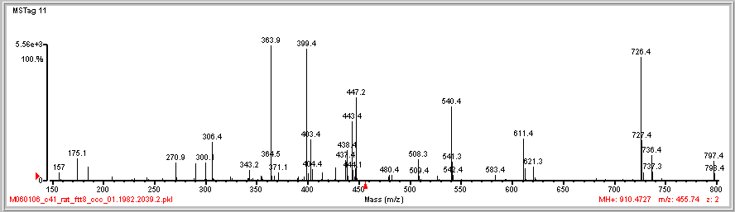
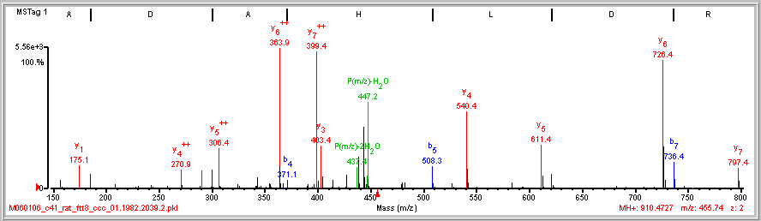
Diagnose Doubly Charged Fragment Ions
(M+2H)⁺⁺
(M+2H)⁺⁺
MH⁺
MH⁺
(M+2H)⁺⁺
MH⁺
MH⁺
(M+2H)⁺⁺
Multiple ions, different charge
Mass defect
Isotope spacing (high resolution)
I/A|D|A|H|L|D|R

Slide 11
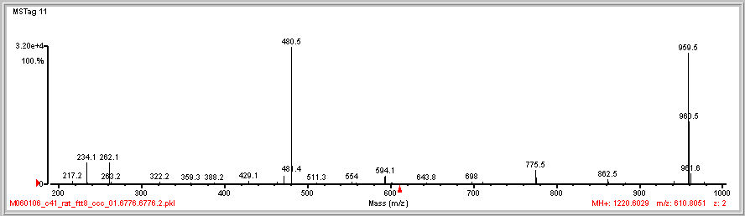
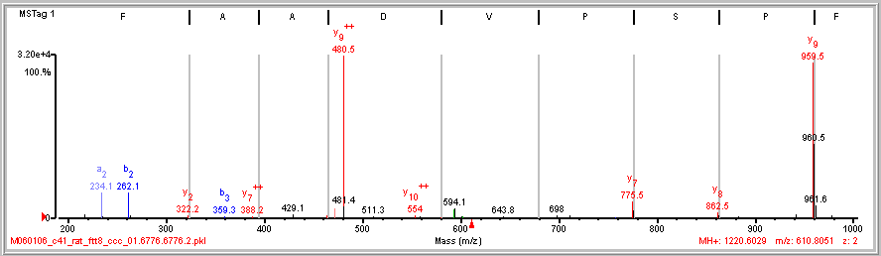
Dominant Cleavage Proline N-side
28
87 97
b₂
N F|P/S/P V D A A F R
y₉

Slide 12
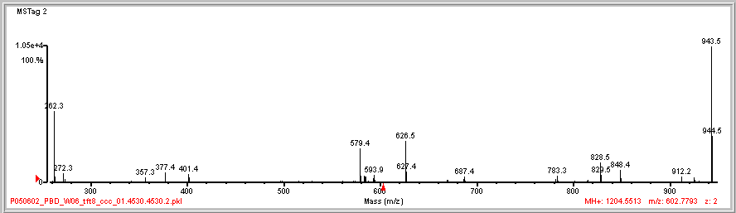
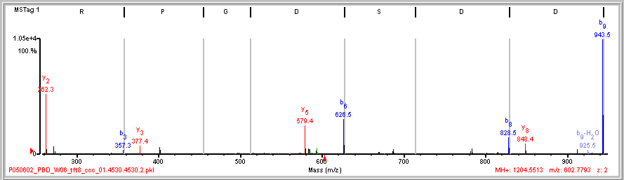
Sparse Dominant Fragmentation
202 115
115 202
(K)I S R|P G D|S D|D|S R(S)
Non-mobile proton
z_{pre} < #Arg

Slide 13
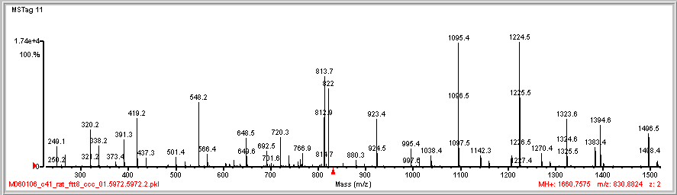
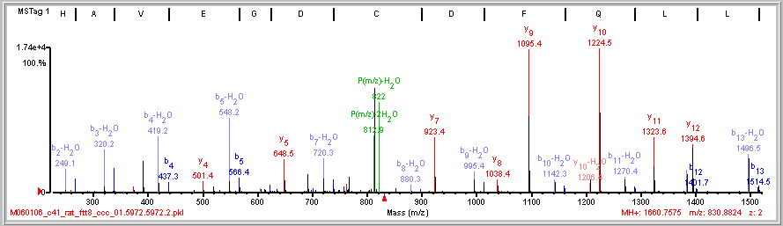
Cry Babies (b-H₂O & b pairs)
-18Da
P(m/z)-2H₂O
P(m/z)-H₂O
N-term E
E/H/A|V/E|G/D|C D|F Q L L K

Slide 14

Interpreting MS/MS Spectra is Fun!!
Karl
Aidan
Kaitlin
Andrea
Jack

Slide 15
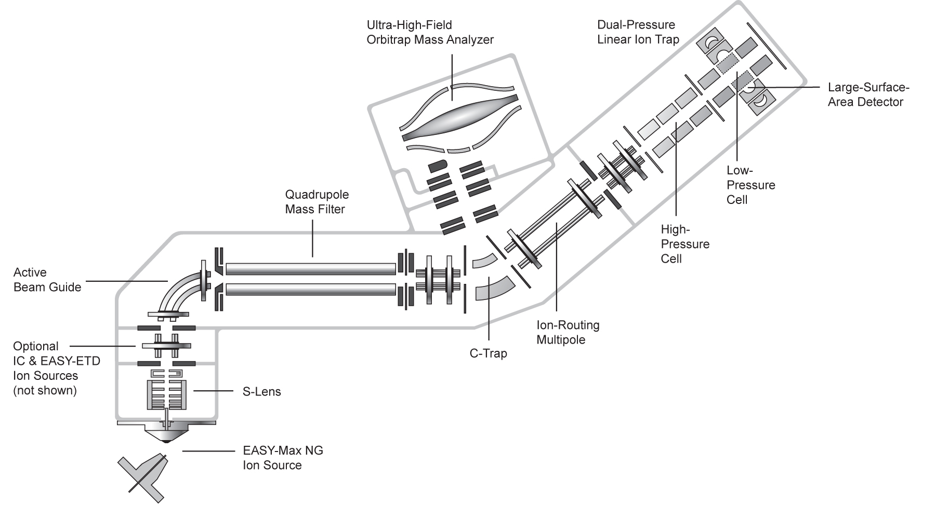
Orbitrap Fusion, High Resolution MS/MS by CID, HCD, or ETD
Mass Analyzer
for each
Dissociation
by CID or ETD
Fluoranthene
for ETD
Dissociation
by HCD
Precursor Isolation
for each
CID by resonant excitation <2eV
HCD beam-type collisions with N₂ ~100eV
ETD electron transfer dissociation
CID /ETD 1/3 precursor m/z cut-off
HCD, no cutoff for Separation in space of precursor isolation and fragmentation
http://planetorbitrap.com/orbitrap-fusion

Slide 16
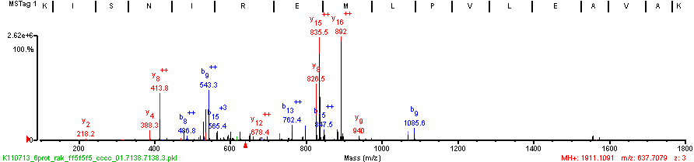
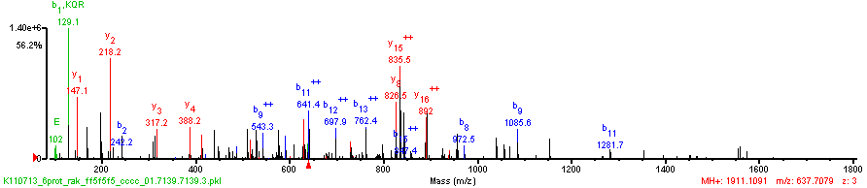
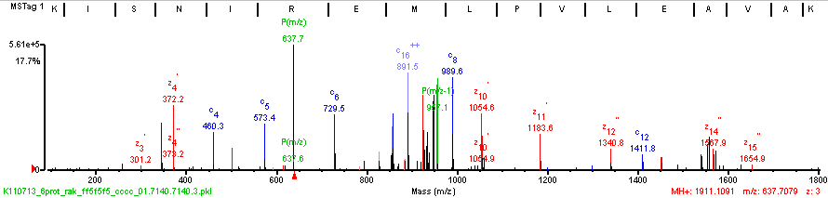
CID/HCD/ETD triplets on same precursor z=3
CID
(K)K/I/S/N I R E M L|P/V L\E|A\V\A\K(A)
(K)K|I/S N I R E M L|P|V|L\E|A V/A/K(A)
HCD
(K)K/I/S/N|I|R|E|M\L P V L|E|A V\A\K(A)
ETD

Slide 17
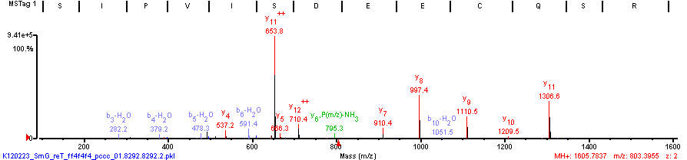
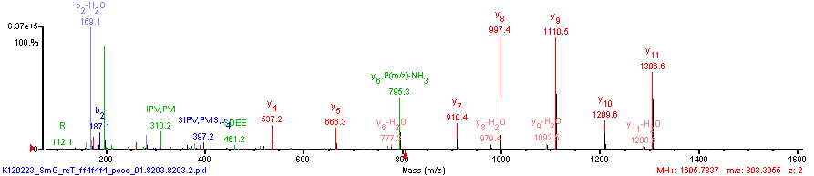
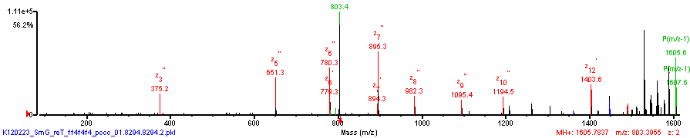
CID/HCD/ETD triplets on same precursor z=2
(K)V S/I/P/V|I|S/D E/E|C/Q S R(F)
(K)V S\I/P|V/I/S/D E/E/C Q/S/R(F)
CID
(K)V/S/I P/V/I/S/D E/E C/Q S\R(F)
HCD
ETD

Slide 18
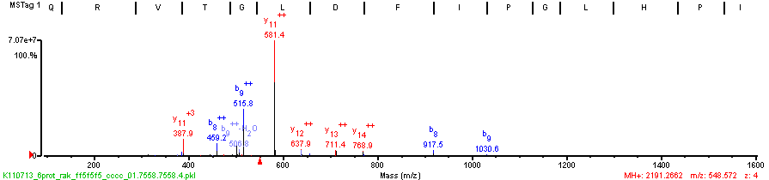
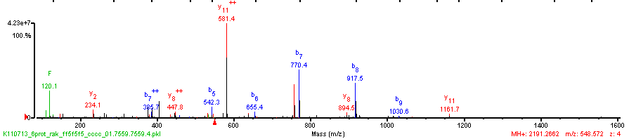
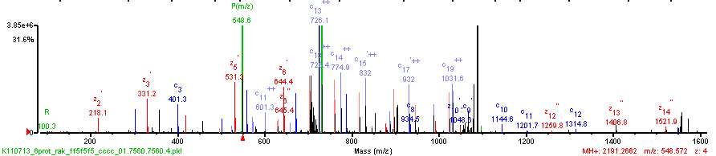
CID/HCD/ETD triplets on same precursor z=4
(K)Q R V T G L|D|F|I|P/G L H P I L S L S K(M)
(K)Q R V T G\L\D\F|I/P/G L/H/P I L/S L/S K(M)
CID
(K)Q/R|V|T|G|L|D|F/I P\G|L\H P|I\L|S|L|S\K(M)
HCD
ETD

Slide 19
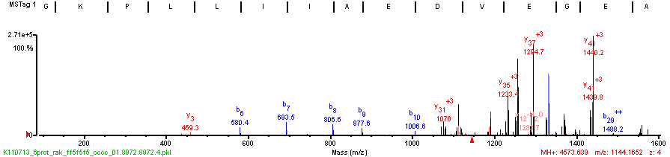
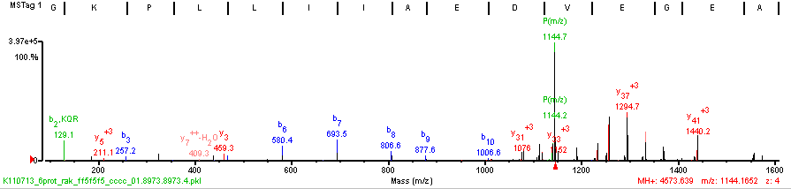
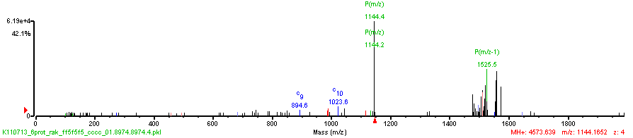
ETD doesn’t work well at high m/z
(K)A G/K/P L/L|I|I|A/E/D V E G E A L A T L V V N T M R G I V K V A A V K A P G F G D/R R K(A)
(K)A G/K/P L L/I|I|A/E/D V E/G E A L A T L V V N T M R G I V K V A A V K A P G F G D R R K(A)
CID
HCD
ETD

Slide 20
Physiochemical Complications to Computational Interpretation
Incomplete Fragmentation
Inconsistent intensity of fragment ion types
Instrument type dependent
Amino acid dependent
Chemical or post-translational modifications
Parent charge uncertainty
Fragment charge uncertainty
Isobaric AA’s
I = L (C6 H11 N1 O) = 113.08406
K ~ Q (C6 H12 N2 O, C5 H8 N2 O2) 128.09496 ~ 128.05858 Δ =0.03638
F~m (C9 H9 N O, C5 H9 N O S) 147.06841 ~ 147.0354 Δ =0.0330
Isobaric AA combinations
GG=N (C4 H6 N2 O2 , C4 H6 N2 O2) 114.04293
GA=Q~K (C5 H8 N2 O2, C5 H8 N2 O2, C6 H12 N2 O) 128.09496 ~ 128.05858 Δ =0.03638
DA~W~VS (C7 H10 N2 O4, C11 H11 N2 O, C8 H14 N2 O3) 186.06405 ~ 186.07931 ~ 186.10044
Δ =0.01526 Δ =0.02113

Slide 21
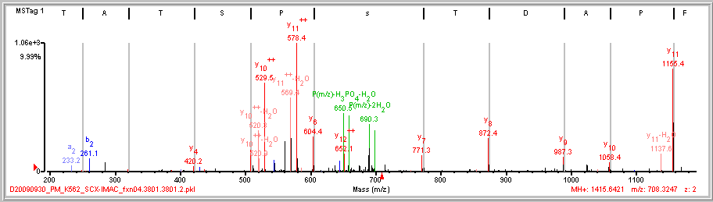
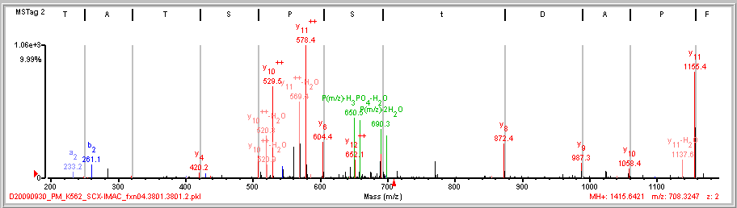
Localizing a Phosphorylation Site
same spectrum
2 different interpretations
L/F|P/A/D|T/s/P/S T A\T K
167 101
L/F|P/A/D|t S/P/S T A\T K

Slide 22
Localizing a Phosphorylation Site
L/F|P/A/D|T/s/P/S T A\T K
L/F|P/A/D|t S/P/S T A\T K

Slide 23
PTM Site Localization Test all Locations, Examine Score Gaps
Locations Tested Conclusion
No possible
ambiguity
AVsEEQQPALK
AVS(1.0)EEQQPALK
# PO₄ sites = # S,T, or Y
Single
Site
APsLTDLVK *
APSLtDLVK -
APS(0.99)LT(0.0)DLVK
sSSAGPEGPQLDVPR *
SsSAGPEGPQLDVPR *
SSsAGPEGPQLDVPR -
S(0.50)S(0.50)S(0.0)AGPEGPQLDVPR
Multiple
Sites
VTNDIsPEsSPGVGR *
VTNDIsPESsPGVGR *
VTNDISPEssPGVGR -
VtNDIsPESSPGVGR -
VtNDISPEsSPGVGR -
VtNDISPESsPGVGR -
VT(0.0)NDIS(0.99)PES(0.50)S(0.50)PGVGR

Slide 24
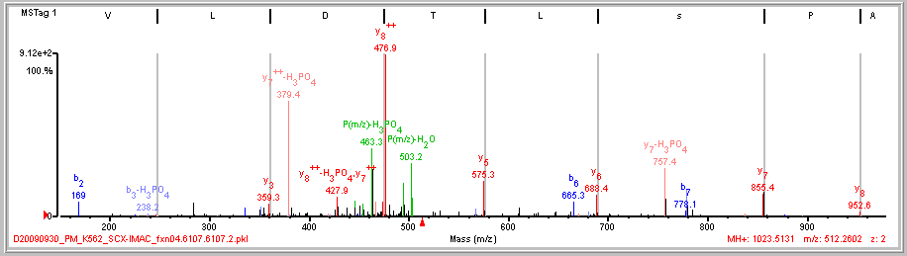
PTM Site Localization – Confident Localization
(K)A/P|s/L/T D|L\V K(S)
APS(0.99)LT(0.0)DLVK
y₆, y₇ ions provide confident localization to the Ser

Slide 25
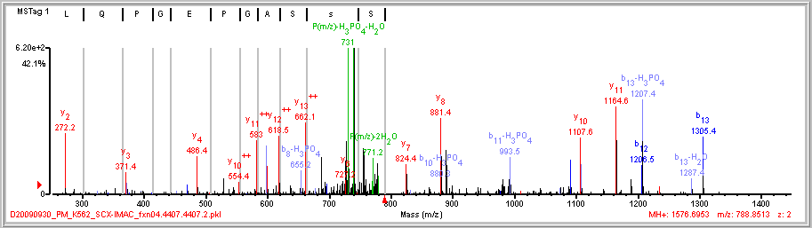
PTM Site Localization – Ambiguous Localization
(R)S s/S/A/G/P E/G/P Q L|D|V|P R(E)
S(0.50)S(0.50)S(0.0)AGPEGPQLDVPR
y₁₃⁺⁺ ion excludes localization to Ser 3

Slide 26
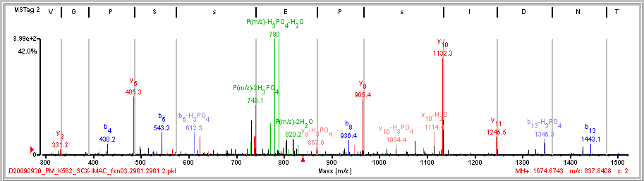
PTM Site Localization – Ambiguous Localization 2 sites: 1 confident, 1 ambiguous
(R)V T N D|I|s/P E|s S/P G V\G R(R)
VT(0.0)NDIS(0.99)PES(0.50)S(0.50)PGVGR
y₉, y₁₀ ions provide confident localization to the Ser -6
y₅, y₉ ions provide ambiguous localization to Ser-9, Ser-10

Slide 27
Key Aspects of Scoring Localizations
Select peaks in spectrum to be used for identification/localization
Test all sequence/location possibilities
Assign fragment ion types to peaks
Allow for peaks to have different ion type assignments for conflicting localization possibilities
Use score differences to make decision on localization certainty/ambiguity
Decide upon conservative/aggressive thresholds.
Provide a clear representation of the certainty/ambiguity in localization of each site
Allow for multiple sites with mix of certainty and ambiguity in localization
Distinguish between:
Ambiguity – no distinguishing evidence, i.e. either possibility
Ambiguity – conflicting evidence, multiple co-eluting isoforms present
How can we calculate a false localization rate as a standard measure of certainty for phosphosite assignment across a dataset?

Slide 28
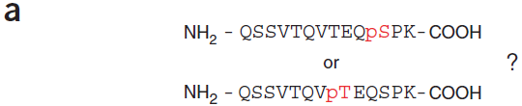
Phosphosite Localization Scoring - Ascore
Typical score thresholds are equivalent to 2 peaks supporting localization
Peak selection probability term requires Da tolerance instead of ppm
7
0.07
0.07
http://ascore.med.harvard.edu/
Supports Sequest results only, Linux only
Beausoleil SA, Villen J, Gerber SA, Rush J, Gygi SP (2006) Nat Biotechnol 24:1285–1292.
Notes:
Figure 3 Resolving ambiguity in phosphorylation site localization. (a) Peptides containing multiple serine, threonine and/or tyrosine residues should be evaluated for precise site assignment. This phosphopeptide is from Zinc finger protein 638. (b) General scheme for calculating a probability-based ion matching score (Peptide Score) for each potential phosphorylation site. The tandem mass (MS/MS) spectrum for the phosphopeptide from panel a is shown. The spectrum was separated into 100 m/z windows where the top N most-intense peaks per window were matched to predicted b- and y-type ions for each possibility. This was repeated using from 1 to 10 ions in each window (6 is shown). The cumulative binomial probability P was calculated using the number of trials (all b- and y-type ions) and the number of successes (matched ions) for each possibility and plotted as -10 log (P) vs peak depth (peaks per 100 m/z). The peptide corresponding to the red line matched more ions at every peak depth than any other possibility. The actual ambiguity score (Ascore) for this peptide is calculated using only site-determining ions as shown in Figure 3c using information from this plot. (c) The Ascore is a probability-based metric that measures the likelihood that a difference in site-determining ions between two site positions was matched by random chance. In this example, only six b- or y-type ions could potentially differentiate the two phosphorylation sites. A peak depth of six was determined from Figure 3b as the earliest maximal difference in the number of matched ions. The cumulative binomial probability was applied as in Figure 3b but using only the site-determining subset of ions. An Ascore of 53.57 would represent a probability of less than 1 in 200,000 of matching a difference of at least 5 ions in 6 trials by random chance. Any of these 5 ions, if not due to chance, can differentiate between the two potential sites.

Slide 29
Expect Woes & Nuisances
Sample Handling Chemistry
Carbamylation +43 nterm, Lys urea in digest buffer
Deamidation +1 N -> D sample in acid
pyroGlutamic acid -17 nterm Q sample in acid
pyroCarbamidomethyl Cys -17 nterm C sample in acid
Oxidized Met +16 M gels
Cys alkylation reagent +x n-term, W
Data Dependent Acquisition Parameters
Isobaric Co-eluters
Protein Isoforms / Family Members
Isobaric peptides from related proteins

Slide 30
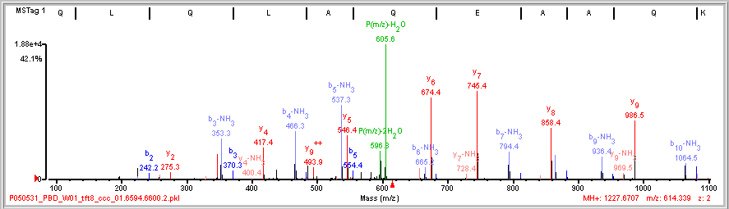
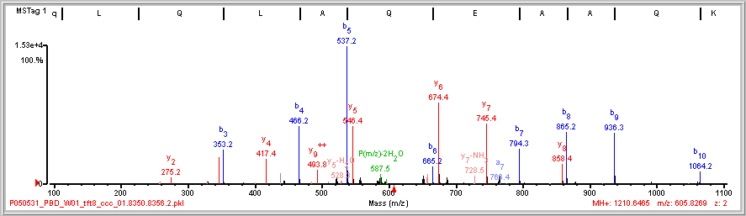

Stinkers (b-NH₃) & Pyroglutamic Acid
(R)Q L/Q/L/A|Q/E/A|A Q\K(R)
P(m/z)-NH₃
N-term Q
(R)q L/Q|L|A|Q|E|A|A\Q\K(R)
-17 Da
Q to q

Slide 31
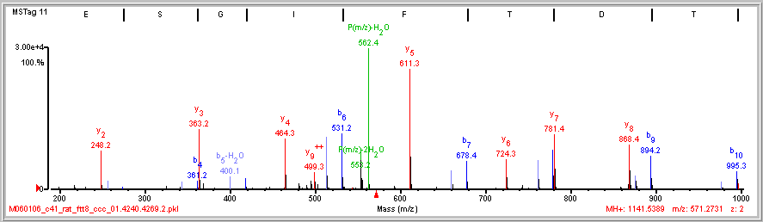
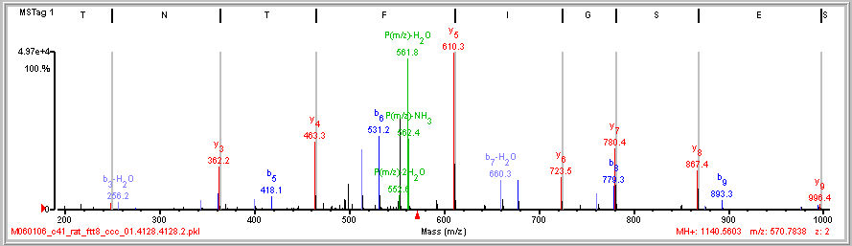

Deamidation
G S/E/S|G|I|F|T|n\T K
18.35
96.9%
+0.007
Da
G S/E/S|G|I|F|T|D\T K
G S/E S\G\I\F\T\N/T K
6.62
43.4%
+0.986
Da

Slide 32
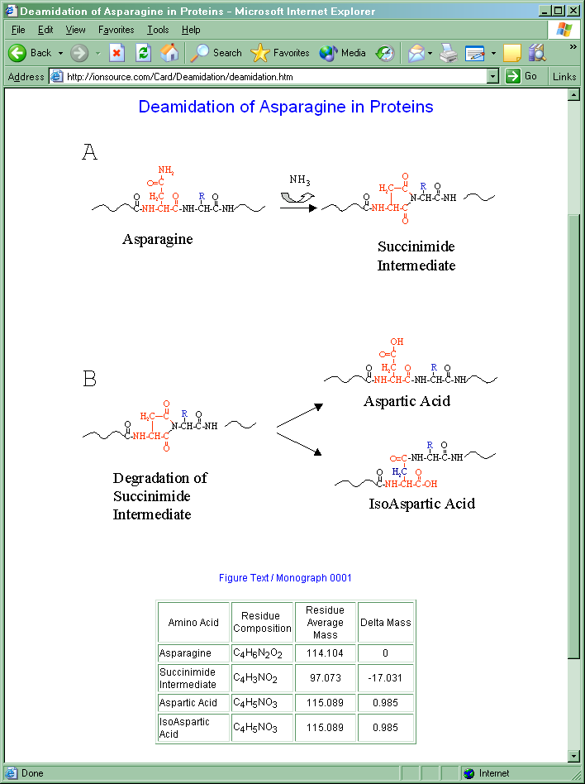
Deamidation of Asn (+1Da)
Asn –NH + O = Asp
ionsource.com

Slide 33
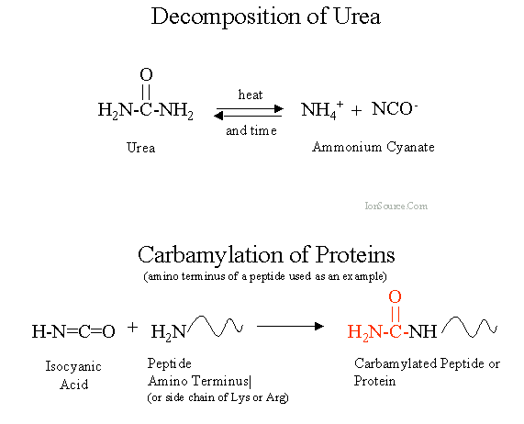
Carbamylation from Urea in Digest Buffer +43Da
CNHO +43Da

Slide 34
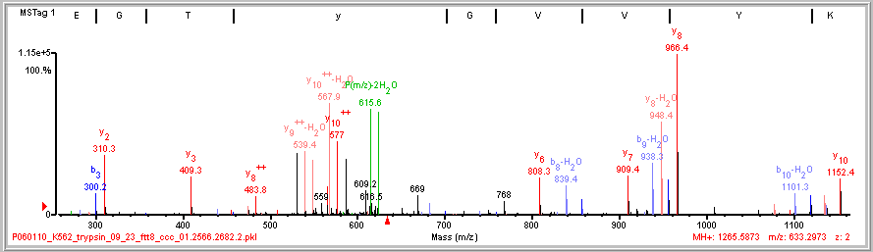
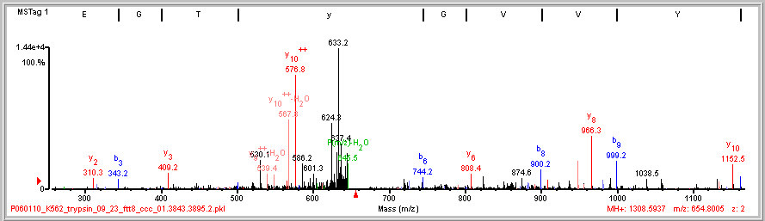
Carbamylated N-term
I/G/E|G/T/y/G V|V|Y\K
P(m/z)-CNHO
+43
b ions
P(m/z)-CNHO-H₂O

Slide 35
Source of Incorrect MS/MS Interpretations
Major
Unanticipated Protein Chemistry
Chemical modification, post-translational modification.
Enzyme/Ion Source
Non-specific cleavage. In-source fragmentation yields MS³.
Precursor Mass
Wrong monoistopic assignment
Database
Peptide not in database. Mutation. MS/MS not from a peptide.
Minor
Instrument Resolution
Wrong parent charge. Wrong fragment charge.
Algorithm
Fragment ion types of instrument not accounted for. Peak Detection.
User Competence
Wrong parameters selected.

Slide 36
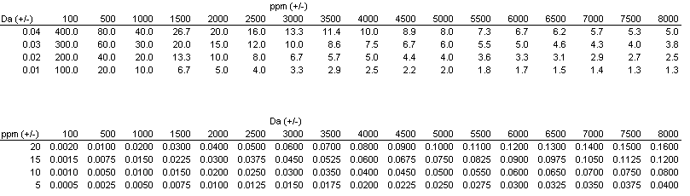
Consequences of Inappropriate Tolerance Units
(using Da tolerance when instrument errors are in ppm)
Da mass error analyzers: ion trap, quadrupole
ppm mass error analyzers: time-of-flight, orbitrap, ion cyclotron resonance
Too loose
Too tight
just right
Isobaric AA’s
I = L (C6 H11 N1 O) = 113.08406
K ~ Q (C6 H12 N2 O, C5 H8 N2 O2) 128.09496 ~ 128.05858 Δ =0.03638
F~m (C9 H9 N O, C5 H9 N O S) 147.06841 ~ 147.0354 Δ =0.0330
Isobaric AA combinations
GG=N (C4 H6 N2 O2 , C4 H6 N2 O2) 114.04293
GA=Q~K (C5 H8 N2 O2, C5 H8 N2 O2, C6 H12 N2 O) 128.09496 ~ 128.05858 Δ =0.03638
DA~W~VS (C7 H10 N2 O4, C11 H11 N2 O, C8 H14 N2 O3) 186.06405 ~ 186.07931 ~ 186.10044 Δ =0.01526 Δ =0.02113

Slide 37
Additional Resources
Google: “de novo sequencing tutorial”
Don Hunt and Jeff Shabanowitz – manual
http://www.huntlab.org/ (ETD)
http://www.ionsource.com/tutorial/DeNovo/DeNovoTOC.htm (CID/HCD)
Rich Johnson - manual
http://www.abrf.org/ResearchGroups/MassSpectrometry/EPosters/ms97quiz/SequencingTutorial.html
PEAKS - automated
http://www.bioinformaticssolutions.com/peaks/tutorials/denovo.html
http://www.youtube.com/watch?v=lyhpRu6s7Ro
Bin Ma and Richard Johnson Tutorial article
http://www.broadinstitute.org/~clauser/CSHL_Proteomics_course/
Ma B, Johnson R. “De Novo Sequencing and Homology Searching”.
Mol Cell Proteomics 11: 10.1074/mcp.O111.014902, 1–16, 2012.
Kati Medzihradszky and Robert Chalkley Tutorial article
http://www.broadinstitute.org/~clauser/CSHL_Proteomics_course/
Medzihradszky KF, Chalkley RJ. “Lessons in de novo peptide sequencing by tandem mass spectrometry”. Mass Spec Rev DOI 10.1002/mas, 2013.

Slide 38
Acknowledgements
Broad Institute
Terri Addona
Namrata Udeshi
Philipp Mertins
Steve Carr
MIT
Drew Lowery
Majbrit Hjerrld
Michael Yaffe
University of California San Diego
Adrian Guthals
Nuno Bandeira
University of Queensland
David Morgenstern
Eivind Undheim
Glenn King
http://www.broadinstitute.org/~clauser/CSHL_Proteomics_course/

