Slide 1
Manual De Novo Peptide MS/MS Interpretation
For Evaluating Database Search Results
Karl R. Clauser
Broad Institute of MIT and Harvard
Cold Spring Harbor Proteomics Course
July, 2013

Slide 2
Topics Covered
AA properties
Fragmentation pathways and ion types
b/y pairs
Non-mobile proton
Neutral loss ion types
CID/HCD/ETD
Basics of phospho site identification and localization
Sample handling chemistry artifacts
Isobaric co-eluters
Mass tolerance units and isobaric AA’s
Other Tutorials

Slide 3



















AA Structures & Masses
pK: N-term 7.5
pK: C-term 3.5
pK: 10 6 12
pK: 4.0 4.5
K H R
128 137 156
D E
115 129
Name AA Mass
Gly G 57
Ala A 71
Ser S 87
Val V 99
Thr T 101
Leu/Ile L/I 113
Asn N 114
Asp D 115
Lys/Gln K/Q 128
Glu E 129
Met M 131
His H 137
Phe/Met-ox F/m 147
Arg R 156
Cys-IAA C 160
Tyr Y 163
Trp W 186
S T Y
87 101 163
N Q
114 128
P
97
L I
113 113
M C
131 103 (+57 IAA)
G A V
57 71 99
F W
147 186
http://ionsource.com/Card/clipart/aaclipart.htm

Slide 4
Charge-directed Fragmentation Scheme
O
O
O
O
zH^{z+}
+
H₂N CH C NH CH C NH CH C NH CH C OH
R₁
R₂
R₃
H
R₄
b ion formation
and/or
y ion formation
O
O
O
O
+
y₁
b₃
+
H₂N CH C NH CH C NH CH C
H
NH CH C OH
R₁
R₂
R₃
H
R₄
+
Neutral pumped away by vacuum system
+
Neutral pumped away by vacuum system
Proton Mobility
Mobile: z_{pre} > #Arg + #Lys + #His
Partially mobile: z_{pre} < #Arg + #Lys + #His and > #Arg
Non-mobile: z_{pre} < #Arg
For peptides with non-mobile protons, fragmentation tends to proceed via charge-remote mechanisms. MS/MS spectra will be dominated by a few ions, typically:
C-term side of D, E
N-term side of P

Slide 5
Sequence Specific Fragment Ion Types
a₃
b₃
c₃
O
O
O
O
nH^{n+}
H₂N CH C NH CH C NH CH C NH CH C OH
R₁
R₂
R₃
R₄
x₁
y₁
z₁
Ion type restrictions residues delta
a-NH₃ contains NH₃ residue RK NQ -17
b-NH₃, y-NH₃ contains NH₃ residue RK NQ -17
b-H₂O, y-H₂O contains H₂O residue ST DE -18
b-H₃PO₄, y-H₃PO₄ contains H₃PO₄ residue st -98
y++, b++ contains charged residues RHK

Slide 6
Immonium ions
O
O
O
O
nH^{n+}
H₂N CH C NH CH C NH CH C NH CH C OH
R₁
R₂
R₃
R₄
Amino Acid |  | m/z
S | Ser | 60
V | Val | 72
T | Thr | 74
I,L | Leu,Ile | 86
N | Asn | 87
D | Asp | 88
K,Q | Lys, Gln | 84,101,129
E | Glu | 102
M | Met | 104
H | His | 110
R | Arg | 70, 73, 87,100,112,185
F | Phe | 120
P | Pro | 70, 126
C | C-iodoacetamide | 133
Y | Tyr | 136
W | Trp | 117, 130, 159, 170
Provide partial AA composition,
but not stoichiometry

Slide 7
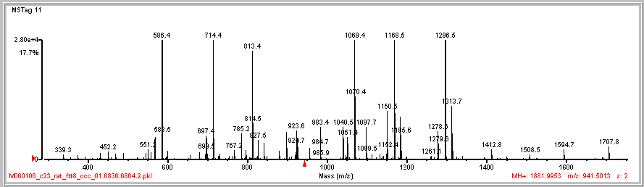
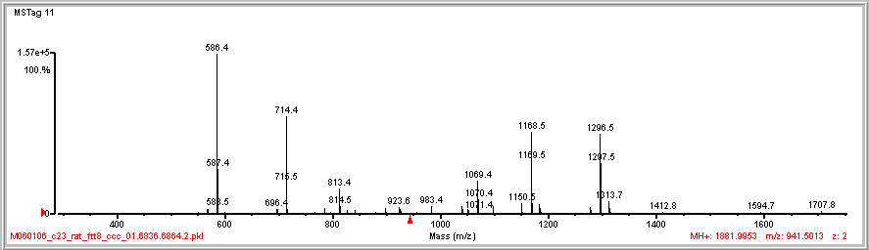
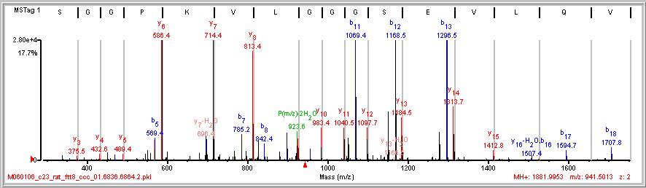
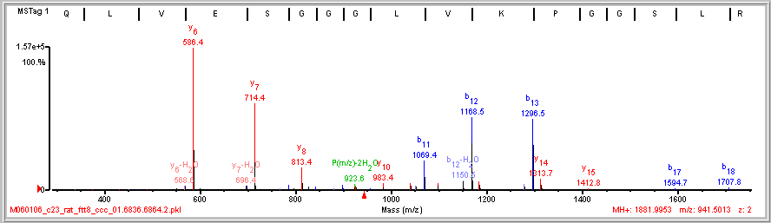
Complementary Ions b/y pairs
128 99
99 128
E V Q L V|E/S|G|G|G L|V|K|P G G\S\L\R

Slide 8
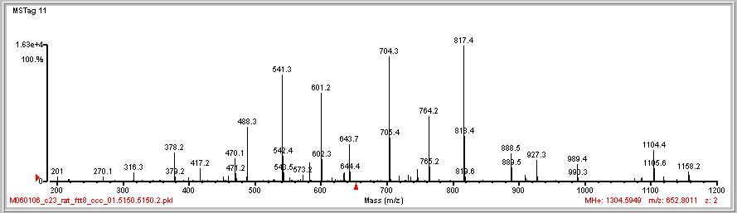
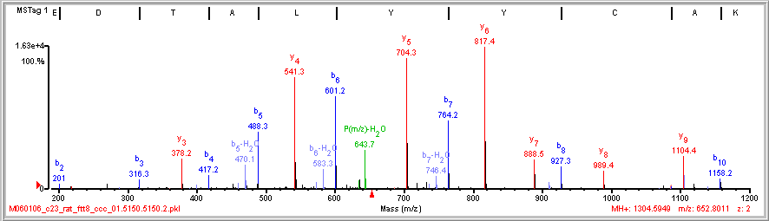
Dual Picket Fence
163 163 113 71 101 115
115 101 71 113 163 163
A E/D|T|A|L|Y|Y|C A\K

Slide 9
Uniqueness of a Peptide Sequence
Clauser, K. R.; Baker, P. R.; Burlingame, A. L. " Role of Accurate Mass Measurement ( +/- 10ppm) in Protein Identification Strategies Employing MS or MS/MS and Database Searching", Anal. Chem. 1999, 71, 2871-2882.

Slide 10
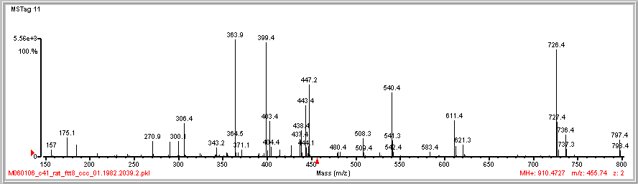
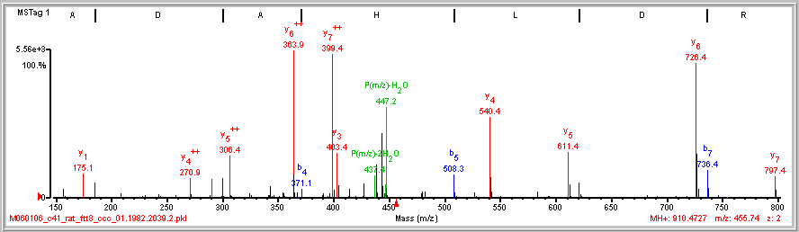
Diagnose Doubly Charged Fragment Ions
I/A|D|A|H|L|D|R

Slide 11
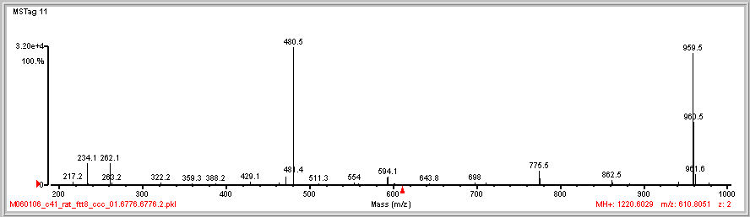
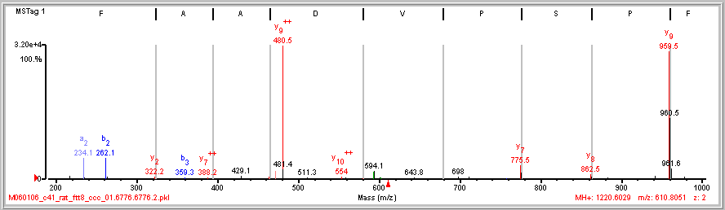
Dominant Cleavage Proline N-side
28
87 97
b₂
N F|P/S/P V D A A F R
y₉

Slide 12
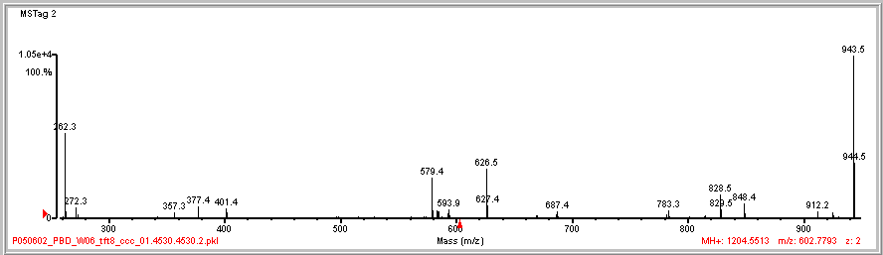
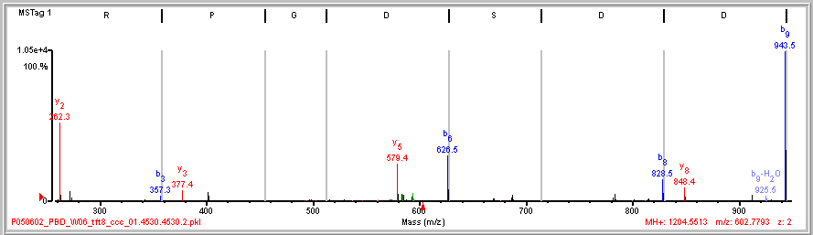
Sparse Dominant Fragmentation
202 115
115 202
(K)I S R|P G D|S D|D|S R(S)
Non-mobile proton
z_{pre} < #Arg

Slide 13
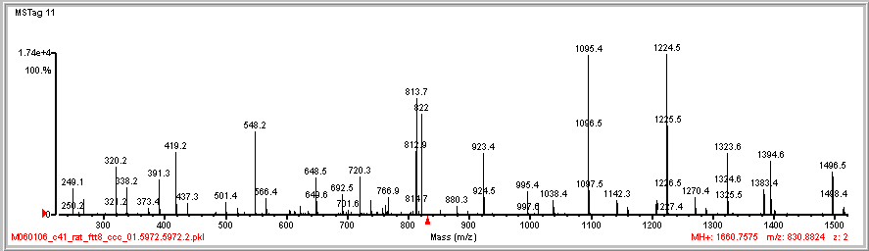
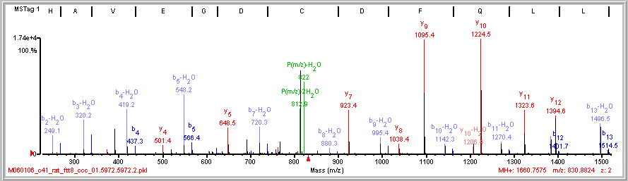
Cry Babies (b-H₂O & b pairs)
-18Da
P(m/z)-2H₂O
P(m/z)-H₂O
N-term E
E/H/A|V/E|G/D|C D|F Q L L K

Slide 14
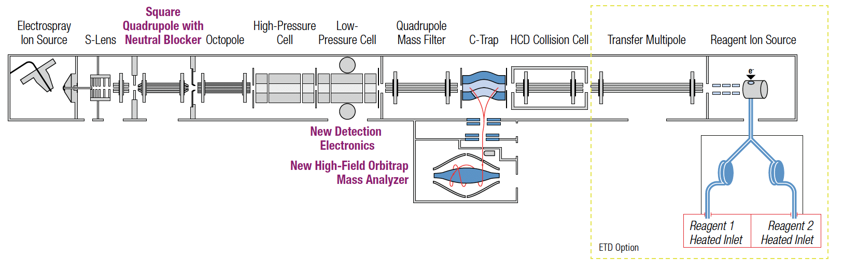
Orbitrap Elite, High Resolution MS/MS by CID, HCD, or ETD
Precursor Isolation
for each
Dissociation
by CID or ETD
Dissociation
by HCD
Fluoranthene
for ETD
Mass Analyzer
for each
CID by resonant excitation <2eV
HCD beam-type collisions with N₂ ~100eV
ETD electron transfer dissociation
CID /ETD 1/3 precursor m/z cut-off
HCD, no cutoff for Separation in space of precursor isolation and fragmentation
http://planetorbitrap.com/orbitrap-elite

Slide 15
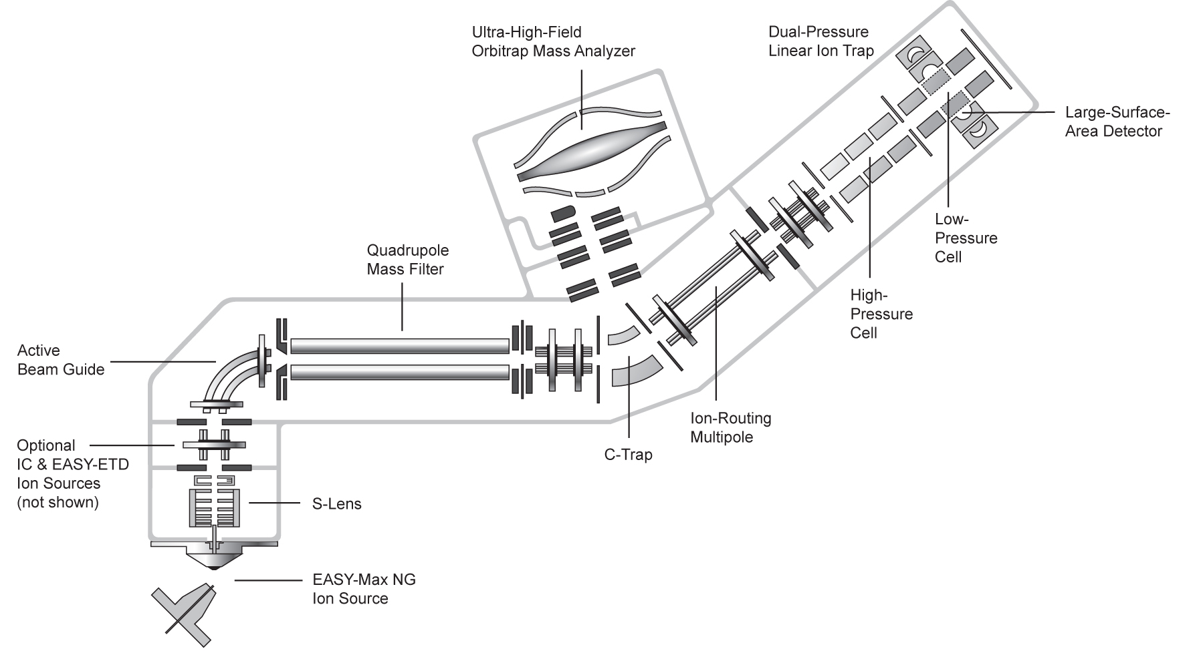
Orbitrap Fusion, High Resolution MS/MS by CID, HCD, or ETD
Mass Analyzer
for each
Dissociation
by CID or ETD
Fluoranthene
for ETD
Dissociation
by HCD
Precursor Isolation
for each
CID by resonant excitation <2eV
HCD beam-type collisions with N₂ ~100eV
ETD electron transfer dissociation
CID /ETD 1/3 precursor m/z cut-off
HCD, no cutoff for Separation in space of precursor isolation and fragmentation
http://planetorbitrap.com/orbitrap-fusion

Slide 16
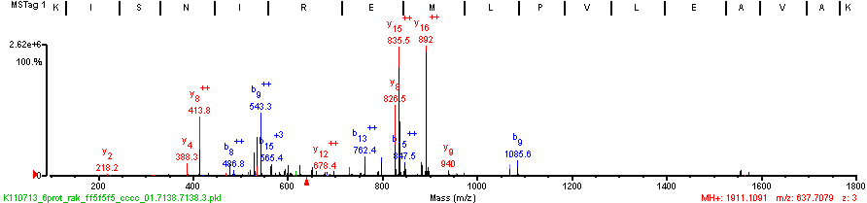
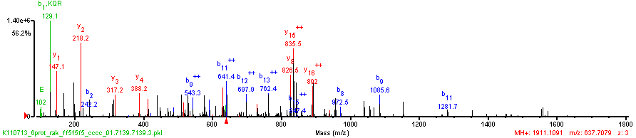
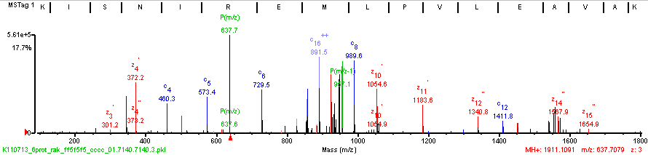
CID/HCD/ETD triplets on same precursor z=3
CID
(K)K/I/S/N I R E M L|P/V L\E|A\V\A\K(A)
(K)K|I/S N I R E M L|P|V|L\E|A V/A/K(A)
HCD
(K)K/I/S/N|I|R|E|M\L P V L|E|A V\A\K(A)
ETD

Slide 17
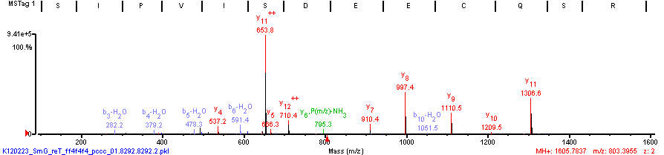
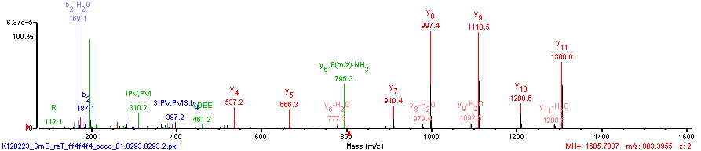
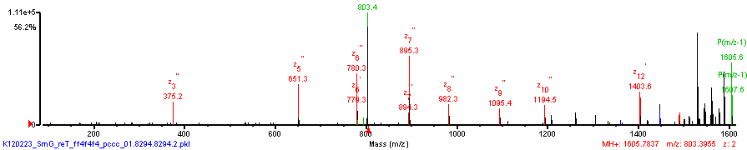
CID/HCD/ETD triplets on same precursor z=2
(K)V S/I/P/V|I|S/D E/E|C/Q S R(F)
(K)V S\I/P|V/I/S/D E/E/C Q/S/R(F)
CID
(K)V/S/I P/V/I/S/D E/E C/Q S\R(F)
HCD
ETD

Slide 18
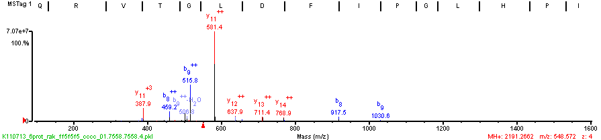
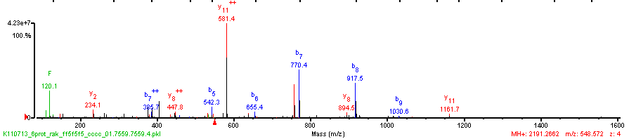
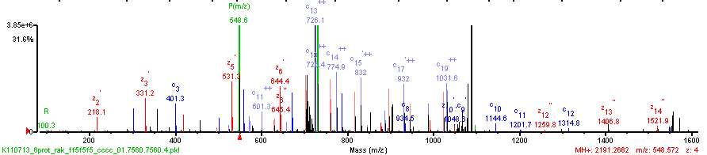
CID/HCD/ETD triplets on same precursor z=4
(K)Q R V T G L|D|F|I|P/G L H P I L S L S K(M)
(K)Q R V T G\L\D\F|I/P/G L/H/P I L/S L/S K(M)
CID
(K)Q/R|V|T|G|L|D|F/I P\G|L\H P|I\L|S|L|S\K(M)
HCD
ETD

Slide 19
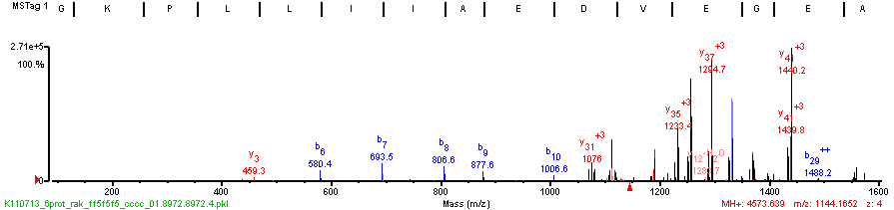
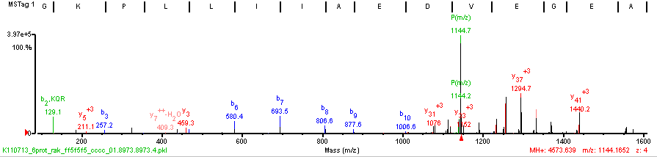
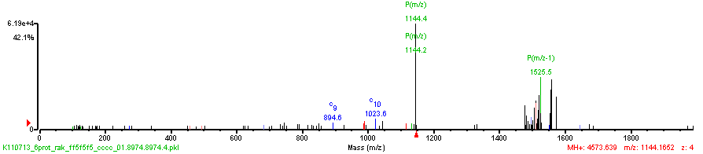
ETD doesn’t work well at high m/z
(K)A G/K/P L/L|I|I|A/E/D V E G E A L A T L V V N T M R G I V K V A A V K A P G F G D/R R K(A)
(K)A G/K/P L L/I|I|A/E/D V E/G E A L A T L V V N T M R G I V K V A A V K A P G F G D R R K(A)
CID
HCD
ETD

Slide 20
Physiochemical Complications to Computational Interpretation
Incomplete Fragmentation
Inconsistent intensity of fragment ion types
    Instrument type dependent
    Amino acid dependent
  Chemical or post-translational modifications
Parent charge uncertainty
Fragment charge uncertainty
Isobaric AA’s
  I = L (C6 H11 N1 O) = 113.08406
  K ~ Q (C6 H12 N2 O, C5 H8 N2 O2) 128.09496 ~ 128.05858 Δ =0.03638
  F~m (C9 H9 N O, C5 H9 N O S) 147.06841 ~ 147.0354 Δ =0.0330
Isobaric AA combinations
  GG=N (C4 H6 N2 O2 , C4 H6 N2 O2) 114.04293
  GA=Q~K (C5 H8 N2 O2, C5 H8 N2 O2, C6 H12 N2 O) 128.09496 ~ 128.05858 Δ =0.03638
  DA~W~VS (C7 H10 N2 O4, C11 H11 N2 O, C8 H14 N2 O3) 186.06405 ~ 186.07931 ~ 186.10044
                Δ =0.01526 Δ =0.02113

Slide 21
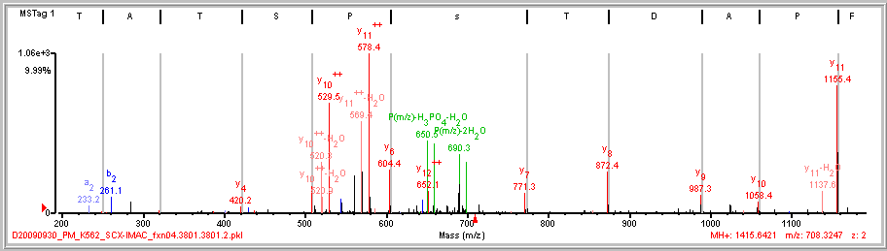
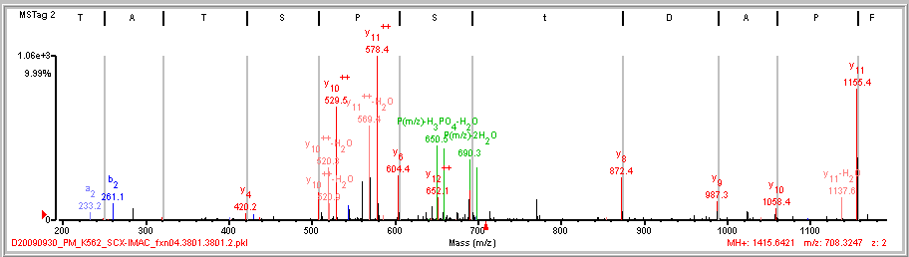
Localizing a Phosphorylation Site
L/F|P/A/D|T/s/P/S T A\T K
L/F|P/A/D|t S/P/S T A\T K

Slide 22
PTM Site Localization
Test all Locations, Examine Score Gaps
Locations Tested Conclusion
No possible
ambiguity
AVsEEQQPALK
AVS(1.0)EEQQPALK
# PO₄ sites = # S,T, or Y
Single
Site
APsLTDLVK *
APSLtDLVK -
APS(0.99)LT(0.0)DLVK
sSSAGPEGPQLDVPR *
SsSAGPEGPQLDVPR *
SSsAGPEGPQLDVPR -
S(0.50)S(0.50)S(0.0)AGPEGPQLDVPR
Multiple
Sites
VTNDIsPEsSPGVGR *
VTNDIsPESsPGVGR *
VTNDISPEssPGVGR -
VtNDIsPESSPGVGR -
VtNDISPEsSPGVGR -
VtNDISPESsPGVGR -
VT(0.0)NDIS(0.99)PES(0.50)S(0.50)PGVGR

Slide 23
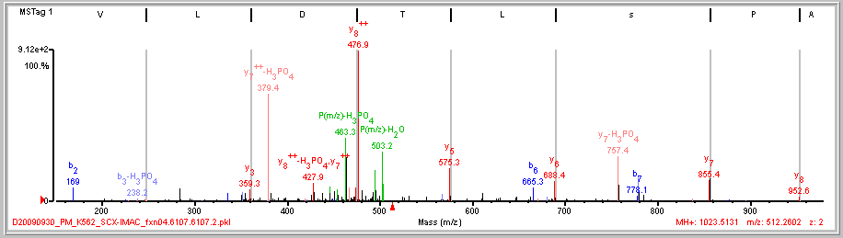
PTM Site Localization – Confident Localization
(K)A/P|s|L/T D|L\V K(S)
APS(0.99)LT(0.0)DLVK

Slide 24
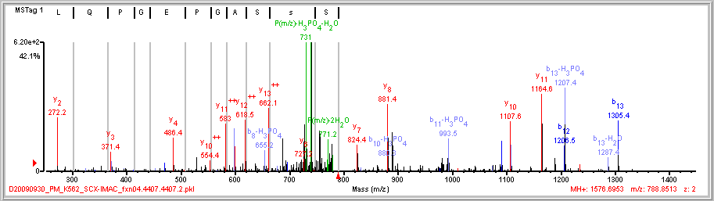
PTM Site Localization – Ambiguous Localization
(R)S s/S/A/G/P E/G/P Q L|D|V|P R(E)
S(0.50)S(0.50)S(0.0)AGPEGPQLDVPR

Slide 25
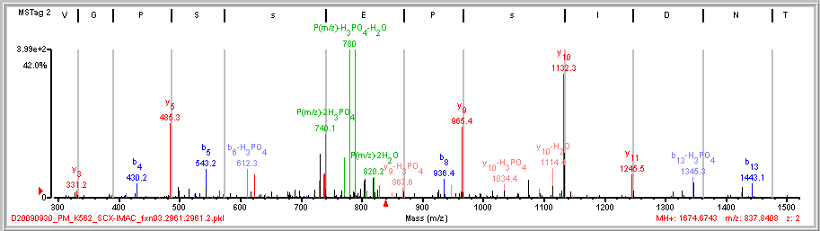
PTM Site Localization – Ambiguous Localization
2 sites: 1 confident, 1 ambiguous
(R)V T N D|I|s/P E|s S/P G V\G R(R)
VT(0.0)NDIS(0.99)PES(0.50)S(0.50)PGVGR

Slide 26
Key Aspects of Scoring Localizations
Select peaks in spectrum to be used for identification/localization
Test all sequence/location possibilities
Assign fragment ion types to peaks
  Allow for peaks to have different ion type assignments for conflicting localization possibilities
Use score differences to make decision on localization certainty/ambiguity
  Decide upon conservative/aggressive thresholds.
Provide a clear representation of the certainty/ambiguity in localization of each site
  Allow for multiple sites with mix of certainty and ambiguity in localization
  Distinguish between:
    Ambiguity – no distinguishing evidence, i.e. either possibility
    Ambiguity – conflicting evidence, multiple co-eluting isoforms present
How can we calculate a false localization rate as a standard measure of certainty for phosphosite assignment across a dataset?

Slide 27
Expect Woes & Nuisances
Sample Handling Chemistry
  Carbamylation +43 nterm, Lys urea in digest buffer
  Deamidation +1 N -> D sample in acid
  pyroGlutamic acid -17 nterm Q sample in acid
  pyroCarbamidomethyl Cys -17 nterm C sample in acid
  Oxidized Met +16 M gels
  Cys alkylation reagent +x n-term, W
Data Dependent Acquisition Parameters
  Isobaric Co-eluters
Protein Isoforms / Family Members
  Isobaric peptides from related proteins

Slide 28
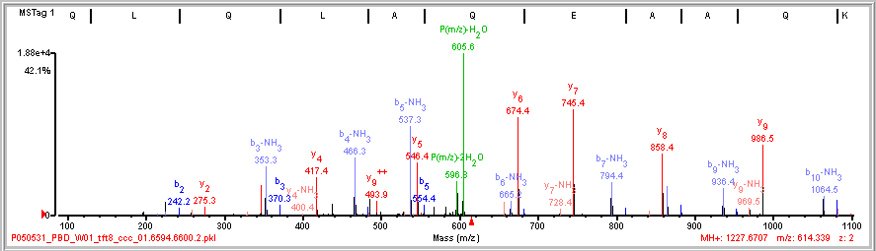
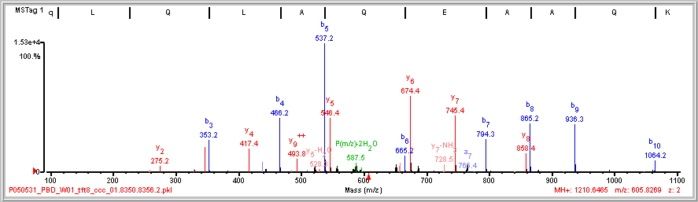

Stinkers (b-NH₃) & Pyroglutamic Acid
(R)Q L/Q/L/A|Q/E/A|A Q\K(R)
P(m/z)-NH₃
N-term Q
(R)q L/Q|L|A|Q|E|A|A\Q\K(R)
-17 Da
Q to q

Slide 29
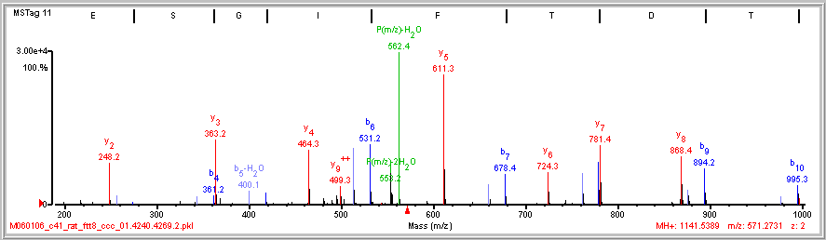
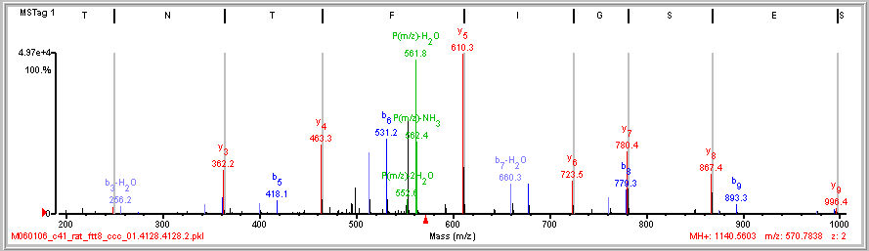

Deamidation
G S/E/S|G|I|F|T|n\T K
18.35
96.9%
+0.007
Da
G S/E/S|G|I|F|T|D\T K
G S/E S\G\I\F\T\N/T K
6.62
43.4%
+0.986
Da

Slide 30
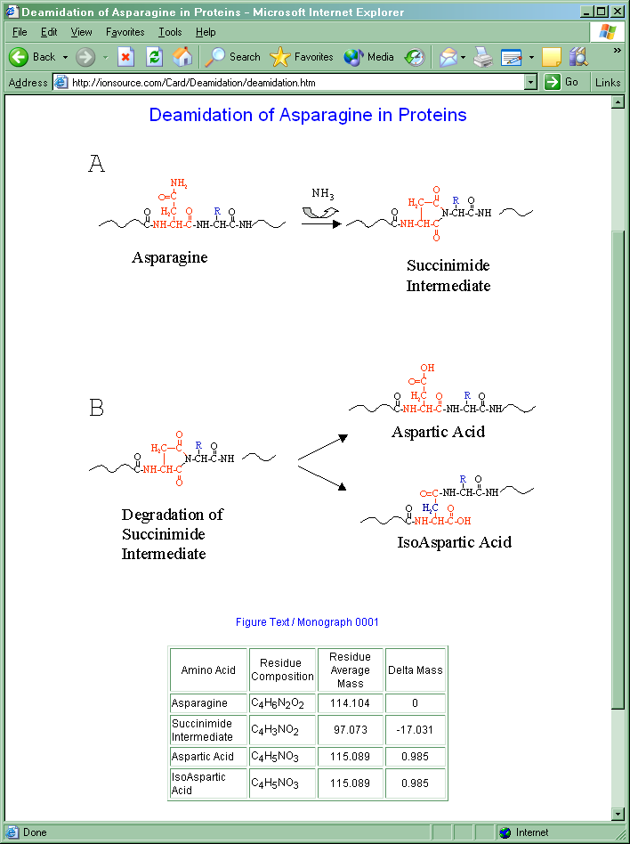
Deamidation of Asn (+1Da)
Asn –NH + O = Asp
ionsource.com

Slide 31
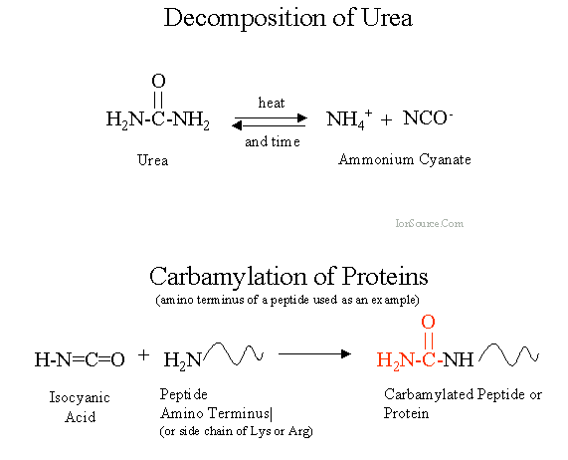
Carbamylation from Urea in Digest Buffer +43Da
CNHO +43Da

Slide 32
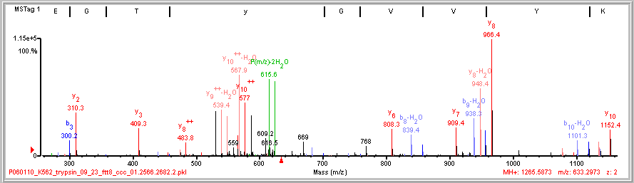
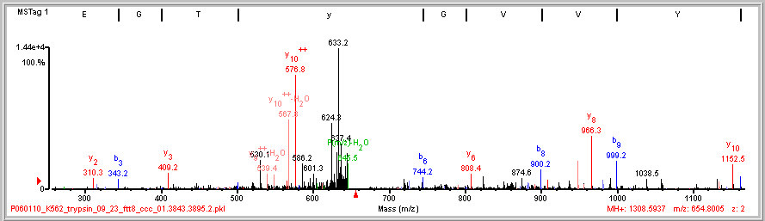
Carbamylated N-term
I/G/E|G/T/y/G V|V|Y\K
P(m/z)-CNHO
+43
b ions
P(m/z)-CNHO-H₂O

Slide 33
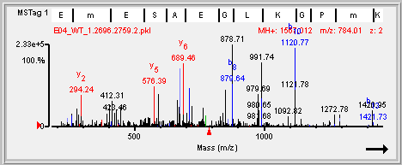
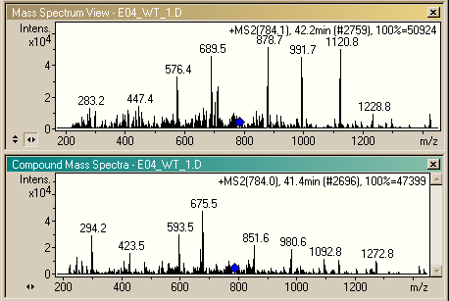
Know Your Chromatographic Peak Widths
(K)E E m E S A E G|L|K\G P/m\K(S)
Top
Database
Search
Result
8.78
71.0%
ΔFwdRev: 3.49
Merged 4 spectra
same precursor
50 sec window
different peptides

Slide 34
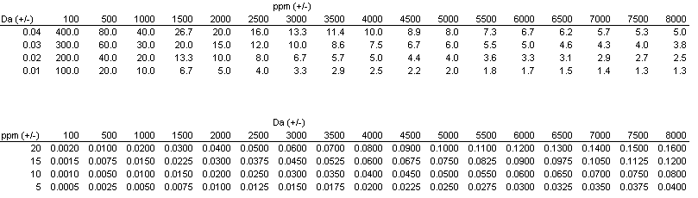
Consequences of Inappropriate Tolerance Units
(using Da tolerance when instrument errors are in ppm)
Da mass error analyzers: ion trap, quadrupole
ppm mass error analyzers: time-of-flight, orbitrap, ion cyclotron resonance
Too loose
Too tight
just right
Isobaric AA’s
  I = L (C6 H11 N1 O) = 113.08406
  K ~ Q (C6 H12 N2 O, C5 H8 N2 O2) 128.09496 ~ 128.05858 Δ =0.03638
  F~m (C9 H9 N O, C5 H9 N O S) 147.06841 ~ 147.0354 Δ =0.0330
Isobaric AA combinations
  GG=N (C4 H6 N2 O2 , C4 H6 N2 O2) 114.04293
  GA=Q~K (C5 H8 N2 O2, C5 H8 N2 O2, C6 H12 N2 O) 128.09496 ~ 128.05858 Δ =0.03638
  DA~W~VS (C7 H10 N2 O4, C11 H11 N2 O, C8 H14 N2 O3) 186.06405 ~ 186.07931 ~ 186.10044 Δ =0.01526 Δ =0.02113

Slide 35
Additional Resources
Google: “de novo sequencing tutorial”
Don Hunt and Jeff Shabanowitz - manual
http://www.ionsource.com/tutorial/DeNovo/DeNovoTOC.htm
Rich Johnson - manual
http://www.abrf.org/ResearchGroups/MassSpectrometry/EPosters/ms97quiz/SequencingTutorial.html
PEAKS - automated
http://www.bioinformaticssolutions.com/peaks/tutorials/denovo.html
http://www.youtube.com/watch?v=lyhpRu6s7Ro
Bin Ma and Richard Johnson Tutorial article
http://www.broadinstitute.org/~clauser/CSHL_Proteomics_course/
Ma B, Johnson R. “De Novo Sequencing and Homology Searching”. Mol Cell Proteomics
11: 10.1074/mcp.O111.014902, 1–16, 2012.

Slide 36
Source of Incorrect MS/MS Interpretations
Major
  Database
  Peptide not in database. Mutation. MS/MS not from a peptide.
  Unanticipated Protein Chemistry
  Chemical modification, post-translational modification.
  Enzyme/Ion Source
  Non-specific cleavage. In-source fragmentation yields MS³.
Minor
  Algorithm
  Fragment ion types of instrument not accounted for. Peak Detection.
  Instrument Resolution
  Wrong parent charge. Wrong fragment charge.
  User Competence
  Wrong parameters selected.

Slide 37
Acknowledgements
Broad Institute
Terri Addona
Namrata Udeshi
Philipp Mertins
Steve Carr
MIT
Drew Lowery
Majbrit Hjerrld
Michael Yaffe
University of California San Diego
Adrian Guthals
Nuno Bandeira
University of Queensland
David Morgenstern
Eivind Undheim
Glenn King
http://www.broadinstitute.org/~clauser/CSHL_Proteomics_course/

