Slide 1
Breast Cancer Proteomics and the use of TCGA Mutational Data - Broad Institute update/issues
Karl Clauser
CPTAC Data Jamboree
October 16, 2012
Bethesda, MD

Slide 2
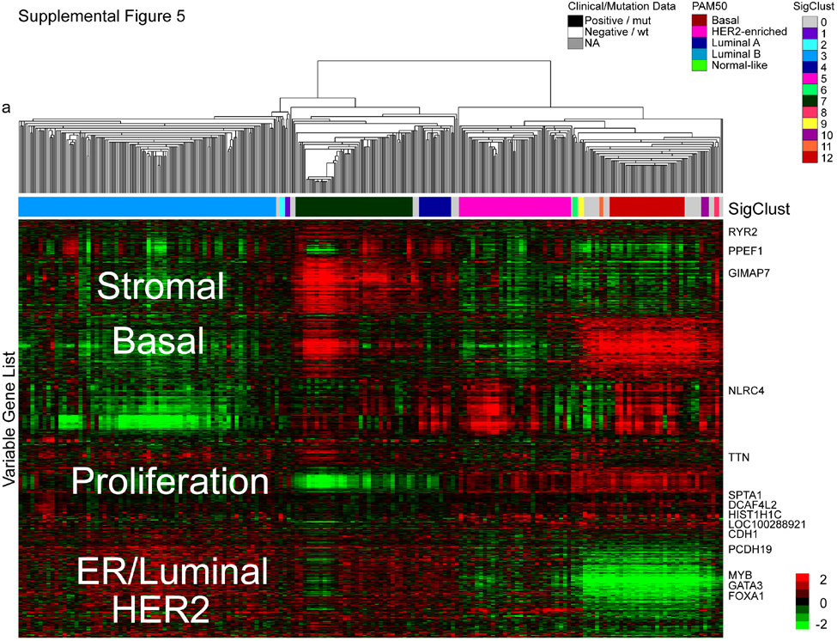
Clustering of mRNA Expression and Breast Cancer Subtypes
TCGA Nature 2012
A CPTAC goal is
to produce a
Proteomic
Equivalent
Rows -ID
PO₄ site
Protein
Color - Quant
iTRAQ Ratio
Column - patient
Notes:
Supplemental Figure 5. mRNA expression analyses. 522 primary breast tumors, 3 metastatic tumors and 22 normal samples were used for two different hierarchical clustering analyses. a) a unsupervised hierarchical clustering analysis using the ~3600 most variably expressed genes was performed with the resulting data tested by SigClust to identify twelve possible groups. b) The unsupervised mRNA expression subtypes showed a high correlation to the previously defined PAM50 subtypes, as well as high correlation to ER, PR, and HER2 status, and to TP53, GATA3, MAP3K1 and MAP2K4 mutation status
ALSO USED A PREVIOUSLY PUBLISHED INTRINSIC GENE LIST (13 CLASSES) AND A PAM50 CLASSIFICATION; HIGH AND SIGNIFICANT CONCORDANCE WAS OBSERVED SO PAM50 WAS USED AS A COMMON CLASSIFICATION METRIC

Slide 3
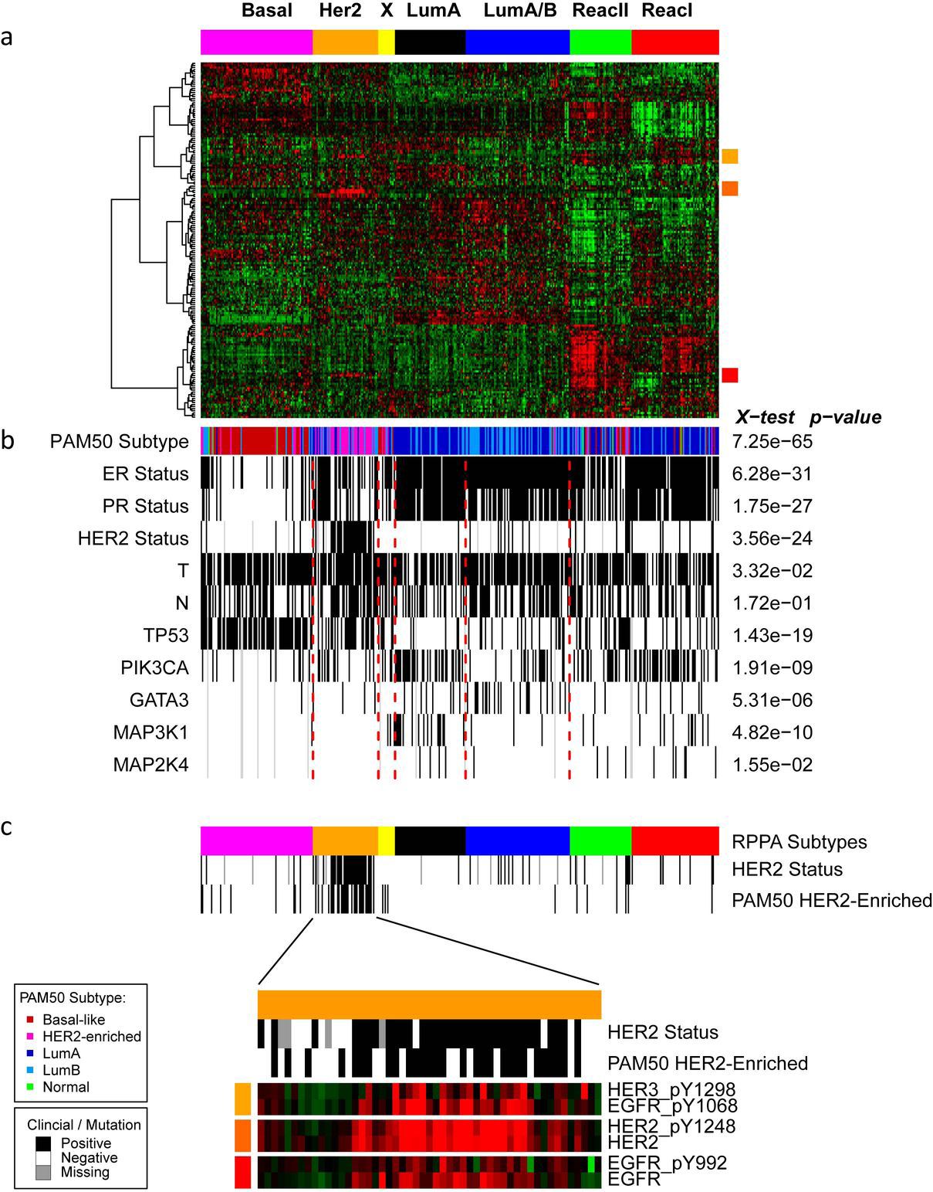
Clustering of RPPA data hints at complementarity of proteomics
TCGA Nature 2012
Sup fig 12
171 cancer related proteins and phosphoproteins (n=403)
HIGHLY concordant with mRNA subtypes
Two potentially novel groups identified
Suspected stromal derivation
No difference in % tumor cell content
Not recapitulated by miR, DNA methylation, mutation or copy number
Supervised analysis shows many differential mRNA transcripts
Difference appears a QUALITATIVE biological difference
Notes:
Supplemental Figure 12. Disease subtypes defined using the expression patterns proteins and phosphoproteins.
a) Samples (n=403) were ordered by unsupervised clustering using non-negative matrix factorization (NMF) with 7 clusters. Proteins were ordered using hierarchical clustering.
Colored squares on right of heatmap represent regions expanded in C. b) Sample annotation ordered as in a. ER, PR, HER2, T (tumor size), and N (node) status: white, negative or T1; black, positive or T2-4; gray, unknown. Mutation status of TP53, PIK3CA, GATA3, MAP3K1 and MAP3K4: white, wild type; black, mutated; gray, unknown. c) Expanded view of the HER2
group with expression shown for EGFR, HER2, and HER3 antibodies.

Slide 4
Initial 100 (of 150-200) samples selected from published TCGA breast cancer subset
348 Primary breast cancers “comprehensively” analyzed
Genomic DNA copy number arrays (Affy; n=547)
DNA methylation (Illumina Infinium; n= 802)
Exome sequencing (n=507)
Whole Genome sequencing (?n << 348)
mRNA arrays (Affy; n=547)
microRNA sequencing (n=697)
RNASeq (?n > 348)
Reverse phase protein arrays (Gordon Mills RPPA; n=403)

Slide 5
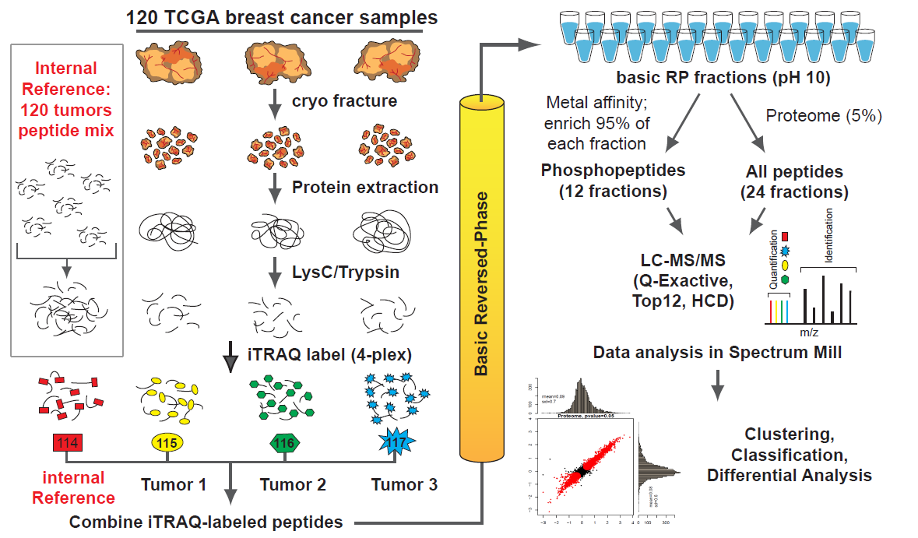
Quantitative Proteome and Phosphoproteome Analysis (Broad)
Protein
Sequence
Database?
1 mg peptide per iTRAQ channel
1,440 LC-MS/MS runs = 40 patient triplets x (12 phospho frxns + 24 proteome frxns)

Slide 6
Utilizing TCGA Mutational Data for MS/MS Identifications
Extension of conventional search methods
Assemble all mutations that can lead to AA changes
Encode information into FASTA sequence file
Allows use with any data analysis pipeline
CompRef mutational data being assembled by
Bing Zhang (Vanderbilt)
Brian Risk (UNC)
David Fenyo (NYU)
others?

Slide 7
MS/MS Search Strategies w/ Individualized Mutational Data
Multiple Serial searches
of multiple FASTA files
Canonical, patient 1, patient 2,…
Single FASTA Concatenated
Canonical, mutant
Protein Entries
Single FASTA
Mutant peptides
Integrated w/ spacers
All spectra
All spectra
All spectra
>Canonical Protein
CRITICALSIKNALINGPATHWAYREGULATOR
>Canonical Protein – Patient 1 mutant
CRITICALSIKNALINGPATHWAHREGULATOR
>Canonical Protein – Patient 2 mutant
CRITICALTIKNALINGPATHWAYREGULATOR
Define trypsin as cleaving at K,R,J
>Canonical Protein
CRITICALSIKNALINGPATHWAYREGULATOR
>Canonical Protein
CRITICALSIKNALINGPATHWAYREGULATOR
JCRITICALTIKJNALINGPATHWAHR
Can phosphosite position
numbering be retained?
S9 and T42/T9
Can search engine retain speed
by skipping redundant peptides?
leftover spectra
>Canonical Protein – Patient 1 mutant
CRITICALSIKNALINGPATHWAHREGULATOR
Choose approach that balances
Required search time
Number of CPU’s
Ability to calculate FDR
Ease & Clarity of Result Organization
>Canonical Protein – Patient 2 mutant
CRITICALTIKNALINGPATHWAYREGULATOR
Can combined FDR be calculated?

Slide 8
Individual Mutations and Organization of Protein Quant
Patient | Patient | Patient | Patient | observed
1 | 2 | 3 | 4 | peptide
 |  |  |  | 1 | shared
 |  |  |  | 2 | shared
xxxWxxR | xxxSxxR | xxxFxxR | xxxHxxR | 3 | distinct
Possible Contributions to
Protein Quant Tables
Patient | Patient | Patient | Patient | Protein | Protein
1 | 2 | 3 | 4 | Group | Subgroup
3 | 2 | 2 | 2 | 1 | 1 | Canonical protein
2 | 3 | 2 | 2 | 1 | 2 | Variant 1
2 | 2 | 3 | 2 | 1 | 3 | Variant 2
2 | 2 | 2 | 3 | 1 | 4 | Variant 3
Patient | Patient | Patient | Patient
1 | 2 | 3 | 4 | Group | Subgroup
1 | - | - | - | 1 | 1 | Canonical protein
- | 1 | - | - | 1 | 2 | Variant 1
- | - | 1 | - | 1 | 3 | Variant 2
- | - | - | 1 | 1 | 4 | Variant 3
Patient | Patient | Patient | Patient
1 | 2 | 3 | 4 | Group | Subgroup
3 | 2 | 2 | 2 | 1 | 1 | Canonical protein
- | 1 | - | - | 1 | 2 | Variant 1
- | - | 1 | - | 1 | 3 | Variant 2
- | - | - | 1 | 1 | 4 | Variant 3
SM Grouping
Mode
Normal
Subgroup
Specific
Not
Yet
built
All shared + distinct peptides
Only distinct peptides
Only canoncial peptides
Only variant 1 peptides
Only variant 2 peptides
Only variant 3 peptides

Slide 9
Acknowledgements
Broad Institute
Steve Carr
Karl Clauser
Mike Gillette
Jana Qiao
Philipp Mertins
DR Mani
Washington University
Sherri Davies
Robert Kitchens
Petra Gilmore
Matthew Ellis
Reid Townsend
Covaris

