Slide 1
Proteogenomic Novelty in 105 TCGA Breast Tumors
Karl Clauser
CPTAC Breast Cancer Analysis Group
Broad Institute of MIT and Harvard
Fred Hutchinson Cancer Research Center
Washington University
New York University
CPTAC Data Jamboree
November 12, 2013
National Institutes of Health
Bethesda, Maryland

Slide 2
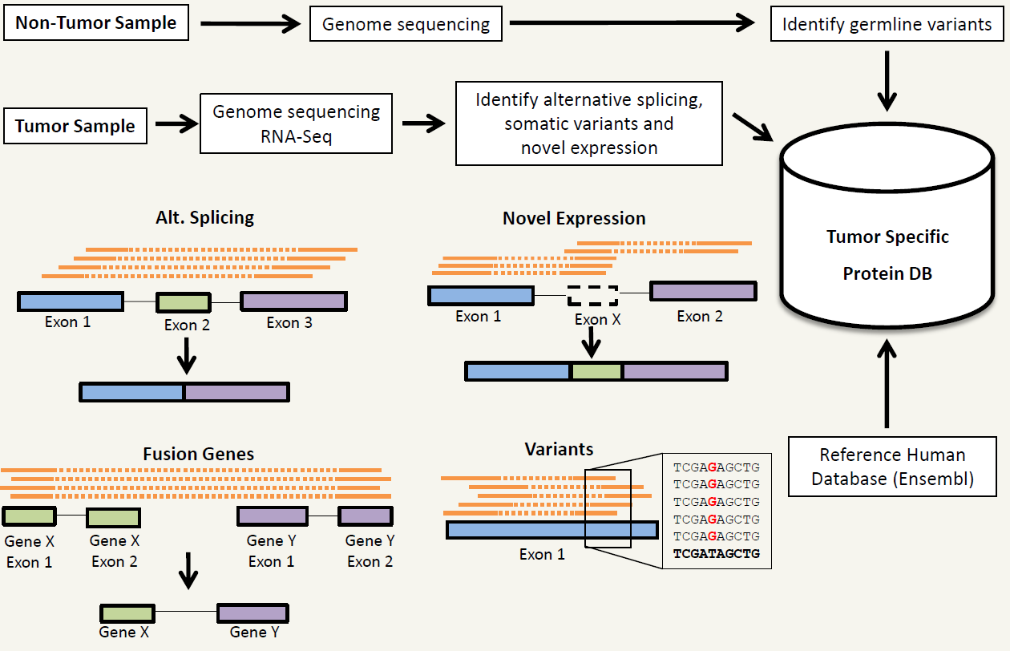
Tumor-specific protein databases for
MS/MS-spectra searches
Kelly Ruggles, David Fenyo, NYU

Slide 3
Proteogenomic mapping: Genetic alterations can be observed on protein level (81 tumors)
      |
      |
      |
      |
      |
      |
      |
      work in
      progress
      |
      |
      |
      |
      |
      |
      |
      |
Preliminary novel findings
      |
      |
      |
      work in
      progress
      |
      |
      |
Low confidence thresholds applied to Genome calls
High confidence thresholds applied to Proteome calls (<1% FDR)
0.7-2.5% of alternative splice junctions and single AA variants observable by proteomics
  mRNA may not be translated or at low abundance
  Proteome coverage is incomplete
Notes:
Low confidence thresholds applied to Genome calls
Variants: >2 QUAL phred-scaled quality score in ALT
Alternative splices: >1 read
This document http://www.1000genomes.org/node/101 defines the quality value as:
"QUAL phred-scaled quality score for the assertion made in ALT. i.e. give -10log_10 prob(call in ALT is wrong). If ALT is ”.” (no variant) then this is -10log_10 p(variant), and if ALT is not ”.” this is -10log_10 p(no variant). High QUAL scores indicate high confidence calls. Although traditionally people use integer phred scores, this field is permitted to be a floating point to enable higher resolution for low confidence calls if desired. (Numeric)”

Slide 4
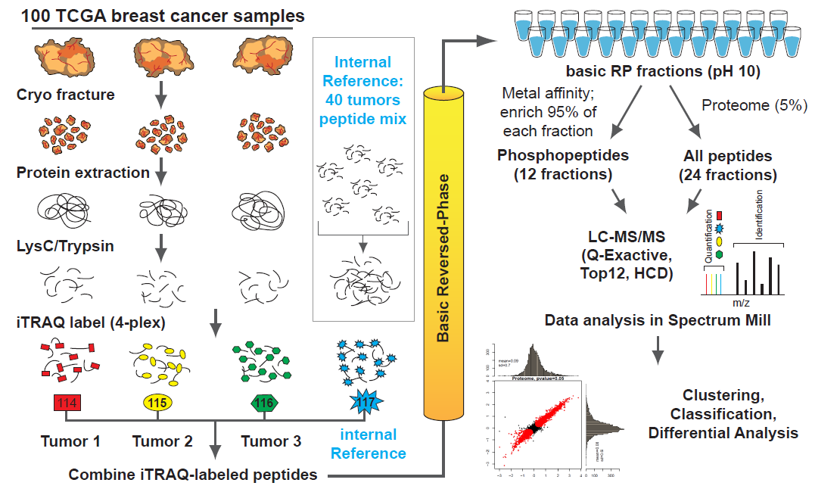

Global proteome and phosphoproteome
discovery workflow for TCGA breast tumors
1 mg total protein per tumor
Internal reference: equal representation of basal, Her2 and Luminal A/B subtypes

Slide 5
Serial Search Strategy with Personalized Databases
Concatenated FASTA files, 102 patients
  Altered proteins only
Removed redundant entries
19,673,636 Spectra
(81 patients)
(27 iTRAQ experiments)
(25 LC-MS/MS runs / experiment)
Variants: 132,181
> Refseq Protein – Variant Patient 1
SIGNALINGPATHWAHREGULATOR
>Canonical Protein – Variant Patient 2
SIKNALINGPATHWAYREGULATOR
3028 Variants Matched
(N Spectra)
(2294 proteins)
RefSeq-Human-37: 32,800
>Refseq Protein
SIGNALINGPATHWAYREGULATOR
  Alternate Spliceforms: 67,035
> Refseq Protein – Alternate splice Patient 1
SIGNALINGREGULATOR
>Canonical Protein – Alternate splice Patient 2
SIGNALINGPATHREGULATOR
279 Splice Junctions Matched
(y Spectra)
8,037,319 Spectra Matched
(41% of total)
(1% FDR)
11,636,317
leftover
spectra
Low confidence thresholds applied to Genome calls
    Variants: >2 QUAL score (phred-scaled)
    Alternative splices: >1 read
Can combined FDR be calculated?
Can search engine retain speed by skipping unchanged peptides?

Slide 6
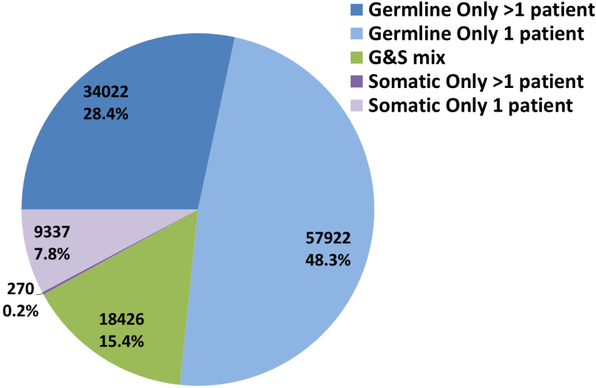
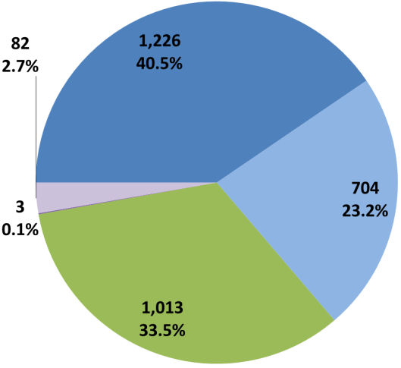
Single AA Variants may be Somatic in Some Patients, Germline in Others
Genomic
Highly Interesting, should correlate with prognosis and/or subtype.
May correlate with prognosis?
Might as well be canonical isoforms?
Detectable, but too rare to indicate biology.
Proteomic
G&S mix genomic variants have the highest observation rate by Proteomics.
Genomic variants present in only a single patient are observable by Proteomics

Slide 7
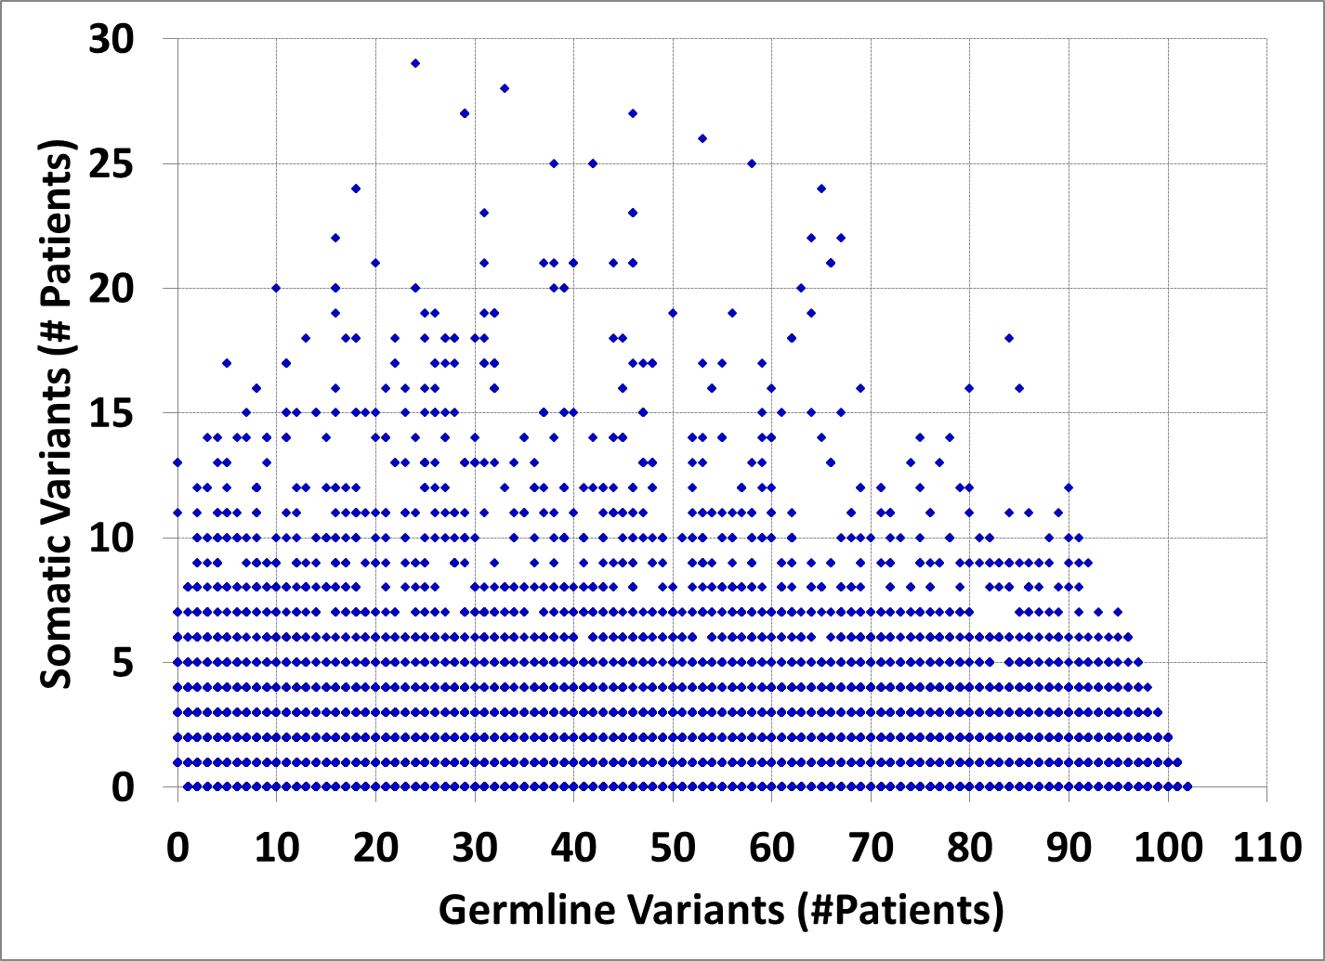
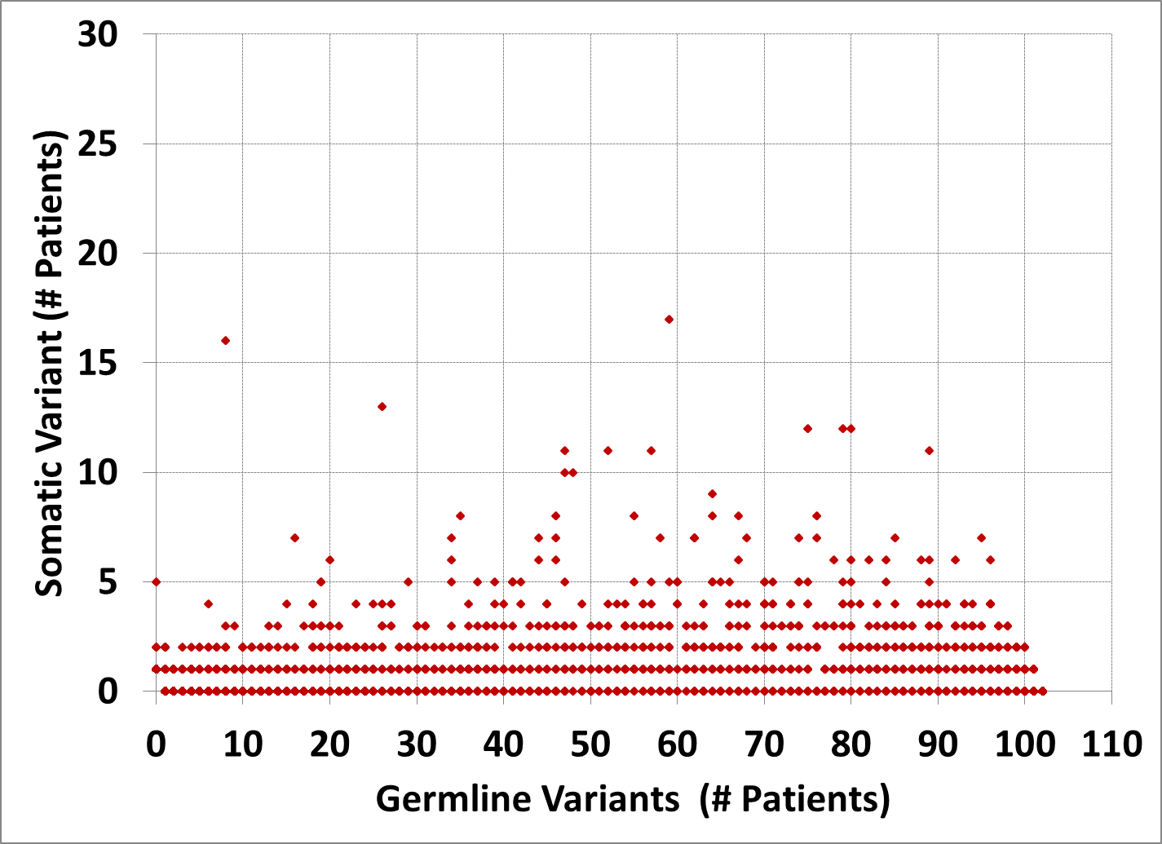
Not all Germline &Somatic mix Single AA Variants are “Essentially” Germline
Genomic
Proteomic
Is G&S mix status primarily an artifact of variant calling accuracy/sensitivity?
Is there some cancer biology involved for high S/G ratio variants?
    Are patients with germline form more cancer prone?
    Does somatic form correlate with prognosis, development of drug-resistance?

Slide 8
155/279 Alternative Splice Junctions were observed in >1 Proteomics Experiment
279 Alternative Splice Junctions observed in 27 proteomics experiments (iTRAQ 4-plex)
1 experiment: 3 individual patients + 1 Common control (40 patients)

Slide 9
Wide Range of Somatic Single AA Variants/Patient
Low confidence thresholds applied to calls
    Variants: >2 QUAL score (phred-scaled)
    Alternative splices: >1 read

Slide 10
Frequency of Single AA Variants and Alternative Splices Across Patients
Somatic variants are less frequent than germline variants
Some germline variants are very common
  Rare germline variants present in the reference sequence (RefSeq)
Some alternative splice forms are very common
  Should be in RefSeq
very
common

Slide 11
Next steps:
Analyze data from all tumors (81/105 so far)
Examine “other” category
  Fusion genes (junction-spanning)
  Novel exon
  Novel gene
  Frame shift
  Novel splicing (junction-spanning)
Analyze phosphoproteomics data
Use updated output of Genomic analysis pipeline
Employ more thorough FDR calculation for PSM’s
  Single-pass search of all spectra against concatenated database
    Reference proteome, Variants, Alternate splice forms, “Other”

Slide 12
Acknowledgments
Broad Institute/FHCRC
  Steve Carr
  Karl Clauser
  Michael Gillette
  Jana Qiao
  Philipp Mertins
  DR Mani
  Eric Kuhn
  Sue Abbatiello
  Amanda Paulovich
  Pei Wang
  Sean Wang
  Ping Yan
Washington U./MD Anderson/NYU
  Sherri Davies
  Matthew Ellis
  David Fenyo
  Kelly Ruggles
  Reid Townsend
  Li Ding
NCI Staff
  Emily Boja
  Mehdi Mesri
  Rob Rivers
  Chris Kinsinger
  Henry Rodriguez
Funding
National Cancer Institute

