Slide 1
Use of Personalized Sequence Databases for Peptide MS/MS Spectrum Matching in the Proteogenomic Analysis of
105 TCGA Breast Tumors
Karl R. Clauser¹, David Fenyo ², Kelly V. Ruggles ², Philipp Mertins¹, Jana W. Qiao, D. R. Mani¹, Michael A. Gillette¹, Sherri R. Davies ³, Christopher Maher ³, Li Ding ³, Matthew J. Ellis ³, Steven A. Carr¹
¹ Broad Institute of MIT and Harvard, Cambridge, MA
² NYU Langone Medical Center, New York, NY
³ Washington University, St. Louis, MO
11th International Symposium on Mass Spectrometry in the Health & Life Sciences.
San Francisco, CA
August 18, 2014

Slide 2
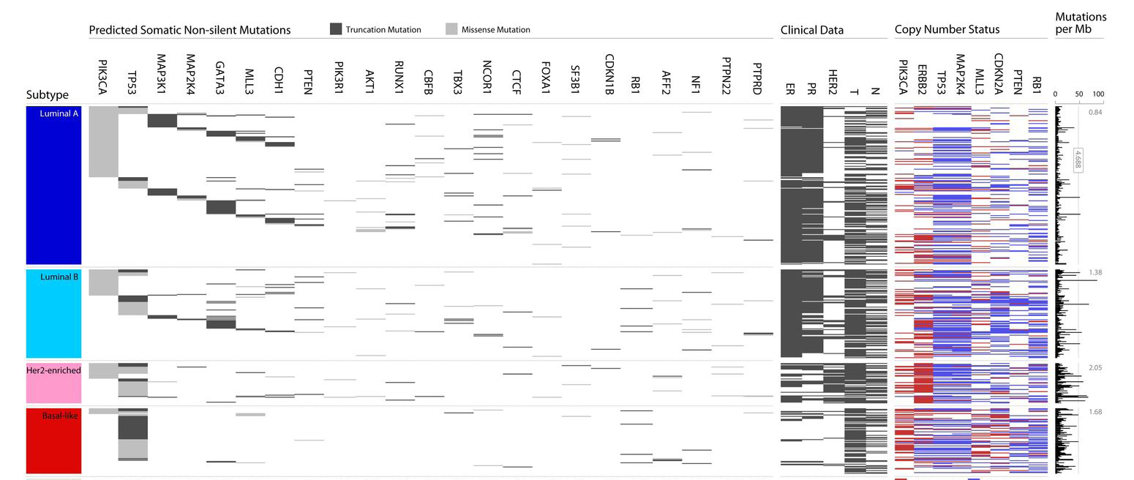
TCGA has illuminated the genomic landscape and highlighted the heterogeneity of breast cancer
Luminal A
Luminal B
Her2
Basal
30,626 somatic mutations across 507 tumors
After correcting for background mutation rate, 35 significant by at least 2 tests with FDR < 5%
Only TP53, PIK3CA and GATA3 occurred at >10% incidence across all breast cancers
Known mutations were reaffirmed: PTEN, AKT1, CDH1, RB1, MLL3, MAP3K1, CDKN1B
TCGA Consortium, Nature 2012

Slide 3
Proteomics analysis addresses central questions in breast cancer biology
Which genomic characteristics of breast cancer are executed at the protein level?
Are the genomic relationships of breast cancer subtypes recapitulated at the protein level?
How does protein phosphorylation / pathway activation inform our understanding of breast cancer biology?
Notes:
1. Can differential protein expression be used to identify the functionally relevant copy number changes?
Which genetic alterations are expressed as proteins?
2. How is the molecular taxonomy of breast cancer reinforced and revised by protein data?
3. Which networks are driven by genomics, and which emerge post-translationally?

Slide 4
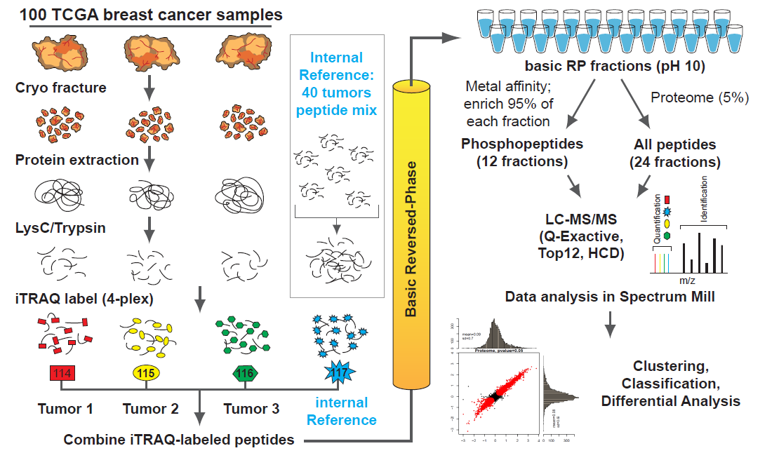

Global proteome and phosphoproteome discovery workflow for TCGA breast tumors
1 mg total protein per tumor
Internal reference: equal representation of basal, Her2 and Luminal A/B subtypes

Slide 5
Classification of TCGA Breast tumors, subset analyzed by proteomics
TCGA 2012
CPTAC Proteomics
93
25
29
57
225
18
126
33
Subgroup representation was made more uniform for proteomics to improve statistics and enhance biological insight
Notes:
Limited total number of samples that can be analyzed; more equivalent or balanced representation of subtypes; reduce numbers of LumA

Slide 6
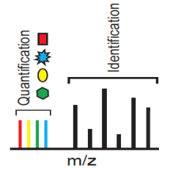
Dataflow for Proteomics with
Personalized Sequence Databases
CPTAC
TCGA
Whole Exome sequencing
RNA-Seq
Copy number arrays (Affy)
DNA methylation
Whole genome sequencing
mRNA arrays (Affy)
miRNA sequencing
RPPA
Global Proteomics
Phospho Proteomics
105
Tumors
germline
RefSeq
Reference
database
MS/MS
.VCF
.BED
.Raw
.fasta
QUILTS
quilts.fenyolab.org
Sequence Analysis (TopHat, BowTie, GATK )
Identified/Quantitated
Peptides and Proteins
+ tumor specific peptides
+ patient specific peptides
Spectrum
Mill
Tumor Specific
Databases
.fasta
(4x105)
Variants,
Alternative Splicing, Frameshifts,
Novel Expression,
Fusion Genes,
Indels,
Variants
Alternative
Proteogenomic mapping
and integration
Frameshift
Other

Slide 7
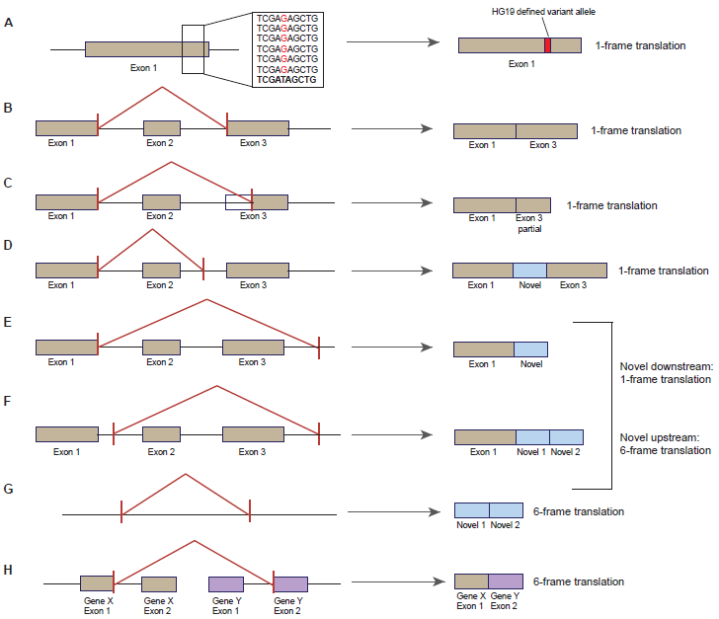
QUILTS: Treatment of Different Types of Genome and Transcriptome Alterations
Variants
Variants
Unannotated
Alternative
Splicing
Alternative
Frameshift*
Deletion
Insertion
Partially
Novel
Splicing
Frameshift*
Insertion
Completely
Novel
Expression
Other
Fusion Genes
* When nucleotides inserted/deleted not a multiple of 3, early truncation of protein results

Slide 8
Serial Search Strategy with Personalized Databases
25,776,160 Spectra
(105 patients)
(36 iTRAQ experiments)
(25 LC-MS/MS runs / experiment)
Concatenated FASTA files, 105 patients
Removed redundant entries
Variants: 132,769
> Canonical – Variant Patient 1
SIGNALINGPATHWAHREGULATOR
>Canonical Protein – Variant Patient 2
SIKNALINGPATHWAYREGULATOR
3,330 Variants Matched
RefSeq-Hs-7/2013: 31,852
  Alternative Splices: 68,434
> Canonical Protein
SIGNALINGPATHWAYREGULATOR
> Canonical – Alternate splice Patient 1
SIGNALINGREGULATOR
>Canonical – Alternate splice Patient 2
SIGNALINGPATHREGULATOR
196 Splice Junctions Matched
14,662,911
Leftover
Spectra
11,113,249 Spectra
355,654 Peptides
15,402 Proteins
(43% of total)
(0.43% FDR)
  Frameshifts: 187,059
> Canonical – Truncation Patient 1
SIGNALINGPATFRAMESHIF
>Canonical – Novel Exon Insert Patient 2
SIGNALINGPATHWAYINSERTREGULATOR
>Canonical – Partial Exon Deletion Patient 3
SIGNALINGPATHWAYULATOR
476 Truncations Matched
12 Insertions Matched
68 Deletions Matched
  Concatenated: 420,114
Low confidence thresholds for Genome Transcriptome calls
    Variants: >2 QUAL score (phred-scaled)
    Alternative splices, frameshifts: >1 read
High confidence for Proteome IDs
    <0.1% FDR peptide spectrum match

Slide 9
Genome and Transcriptome Alterations can be Observed at the Protein Level (105 tumors)
      Σ
      Σ
      Σ
      Σ
Low thresholds applied to Genome calls (>1 read RNA-seq, >2 QUAL phred-scaled Variants)
High thresholds applied to Proteome calls (<0.1% FDR)
0.2-2.8% of frameshifts, alternative splices & single AA variants observable by proteomics
  mRNA may not be translated or at low abundance
  Proteome coverage is incomplete
  ~30% of alterations NOT observable by proteomics (tryptic peptide length 6-30)
Notes:
Low confidence thresholds applied to Genome calls
Variants: >2 QUAL phred-scaled quality score in ALT
Alternative splices: >1 read
This document http://www.1000genomes.org/node/101 defines the quality value as:
"QUAL phred-scaled quality score for the assertion made in ALT. i.e. give -10log_10 prob(call in ALT is wrong). If ALT is ”.” (no variant) then this is -10log_10 p(variant), and if ALT is not ”.” this is -10log_10 p(no variant). High QUAL scores indicate high confidence calls. Although traditionally people use integer phred scores, this field is permitted to be a floating point to enable higher resolution for low confidence calls if desired. (Numeric)”

Slide 10
Frequency of Single AA Variants, Alternative Splices, Frameshifts Across 105 Patients
Somatic variants are less frequent than germline variants
Some germline variants are very common
  Rare germline variants present in RefSeq
Some alternative splice forms and frameshifts are very common
  Should be added to RefSeq
Genome &
Transcriptome
Data
very
common

Slide 11
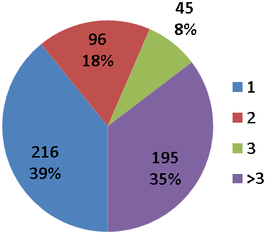
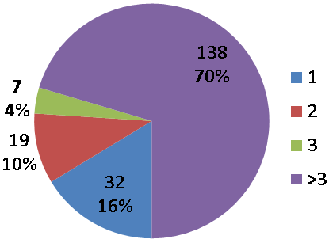
How many RNA-seq reads to yield a proteomics observation of an alternate splice or frameshift?
1 experiment: 3 individual patients + 1 Common control (40 patients)
196 Alternative splices
552 Frameshifts
18
observed
in >1
Expmt
Max #
Reads
105
observed
in >1
Expmt
Max #
Reads

Slide 12
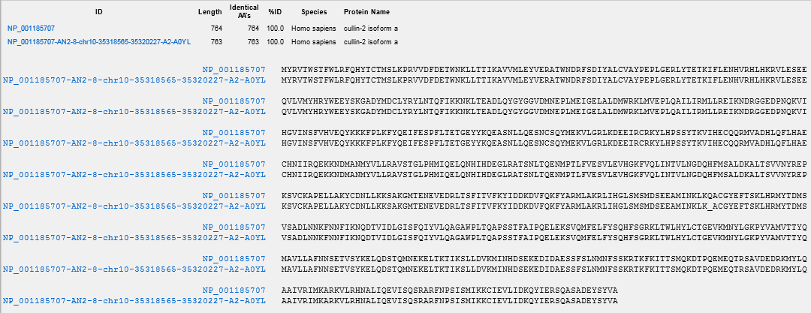
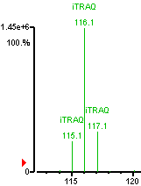
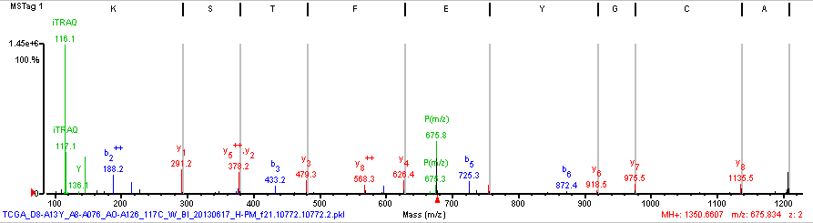
Deletion: Cullin-2 isoform a
Observed in 3 Proteomics Experiments
Max RNA-Seq Reads: 1
Transcript present:
1/40 Common control members
4/105 patients
log2 116/117 3.5
PIP 86%

Slide 13
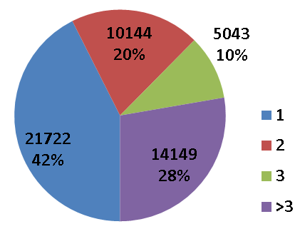
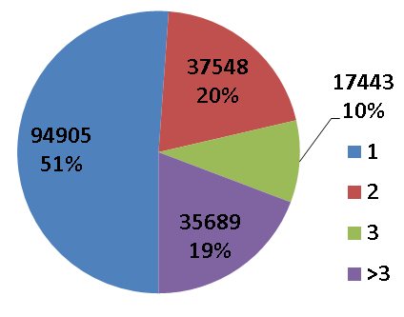
Alternative splice is more likely to yield active protein than a frameshift
196 Alternative splices
552 Frameshifts
Proteome
Max #
Reads
Max #
Reads
Transcriptome
Max #
Reads
51,058 Alternative splices
187,357 Frameshifts
Transcript: read must span a splice junction, similar for alt splice, truncation and indel.
Protein: peptide must span the junction AA’s, alt splice/indel (1-3 AA), truncation (many AA’s).

Slide 14
Current RNA-Seq and Proteomics Approaches Achieve Comparable Depth of Coverage
RNA-Seq
Reads: 50-130 million (high coverage) for each tumor
TCGA-E2-A154.cgquery
  Upload Date: 5/2012
  Read Length: 50
  Instrument: Illumina HiSeq 2000
  Library (name, strategy, source, selection)
    Illumina TruSeq, RNA-Seq, Genomic, Random, Paired
Now
Read length 76 or 101
Strand-specific
Proteomics
For each iTRAQ 4-plex (3 tumors, control)
  Peptide Spectrum Matches(PSMs): 215-380 thousand
  Distinct Peptides: 100-175 thousand
Tumor amount: 1mg (5% whole proteome, 95% phosphoproteome)
Year: 2013
Mass Spectrometer: Thermo-Fisher QExactive
Quantitation chemistry: iTRAQ
Offline Peptide Fractionation: Basic reversed-phase (pH 10)
LC-MS/MS time: 1 iTRAQ 4-plex, 24 fractions, 2hr run/fraction
Dynamic exclusion
Measure abundant peptides only once
Notes:
The state of the art in rna-seq involves longer and paired-end rna-seq reads, and using strand-specific data. With 50 base reads, detection of alt-splicing could be somewhat limited as compared to 76 or 101 base reads, that we now routinely use.

Slide 15
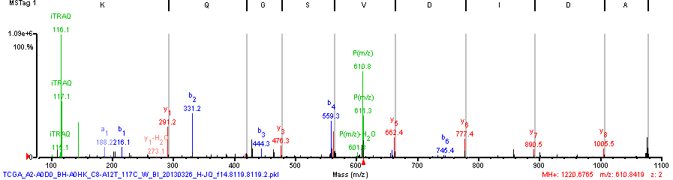
Proteomics Can Detect Variant Peptides with Marginal Base Calling Phred Qual Score
Phred quality scores are logarithmically linked to error probabilities
Phred Quality Score | Probability of incorrect base call | Base call accuracy
10 | 1 in 10 | 90%
20 | 1 in 100 | 99%
30 | 1 in 1000 | 99.9%
40 | 1 in 10,000 | 99.99%
DCK deoxycytidine kinase variant I24V
Phred: 6 1/105 patients somatic
SM: 10.4 1/36 Proteomics Experiment

Slide 16
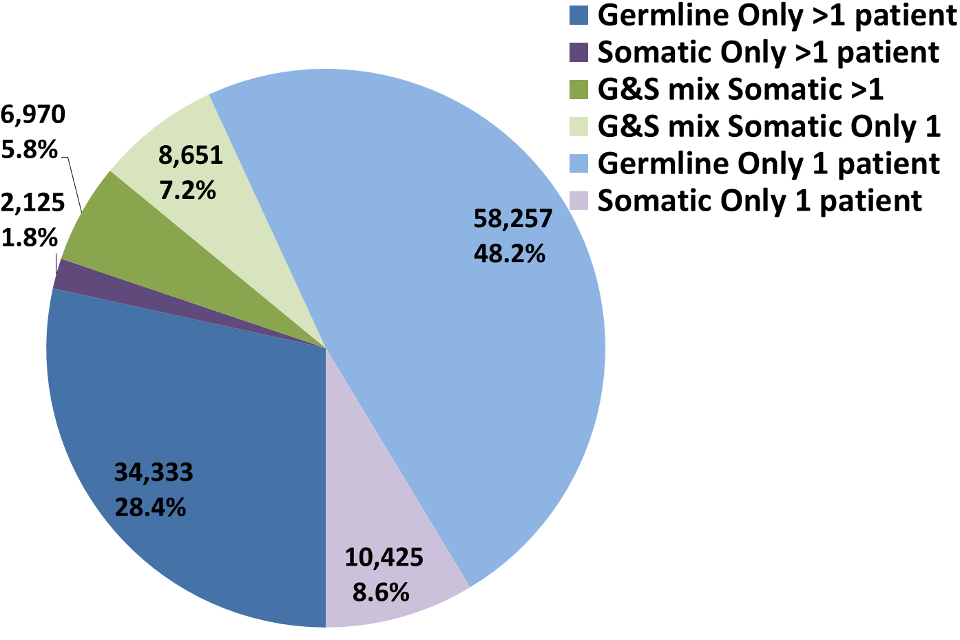
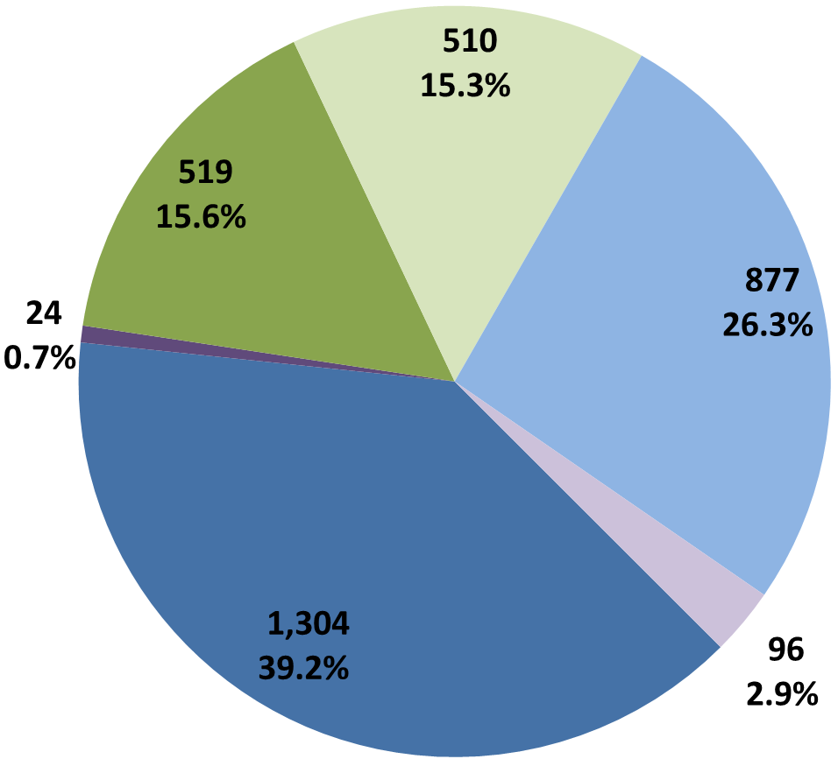
Single AA Variants May be Somatic in Some Patients, Germline in Others
Genomic
Highly Interesting, should correlate with prognosis and/or subtype.
May correlate with prognosis?
Might as well be canonical isoforms?
Detectable, but too rare to indicate biology.
G&S mix genomic variants have the highest observation rate by Proteomics.
Proteomic
S G G&S
>1 patient
1 patient
S

Slide 17
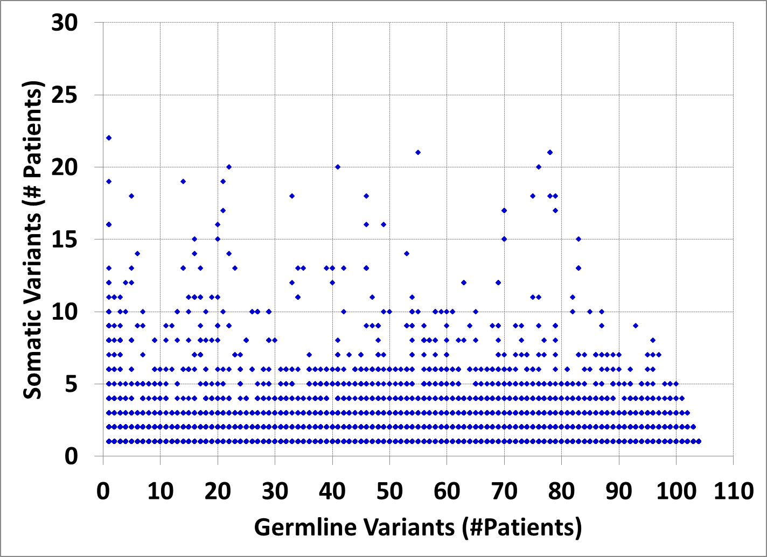
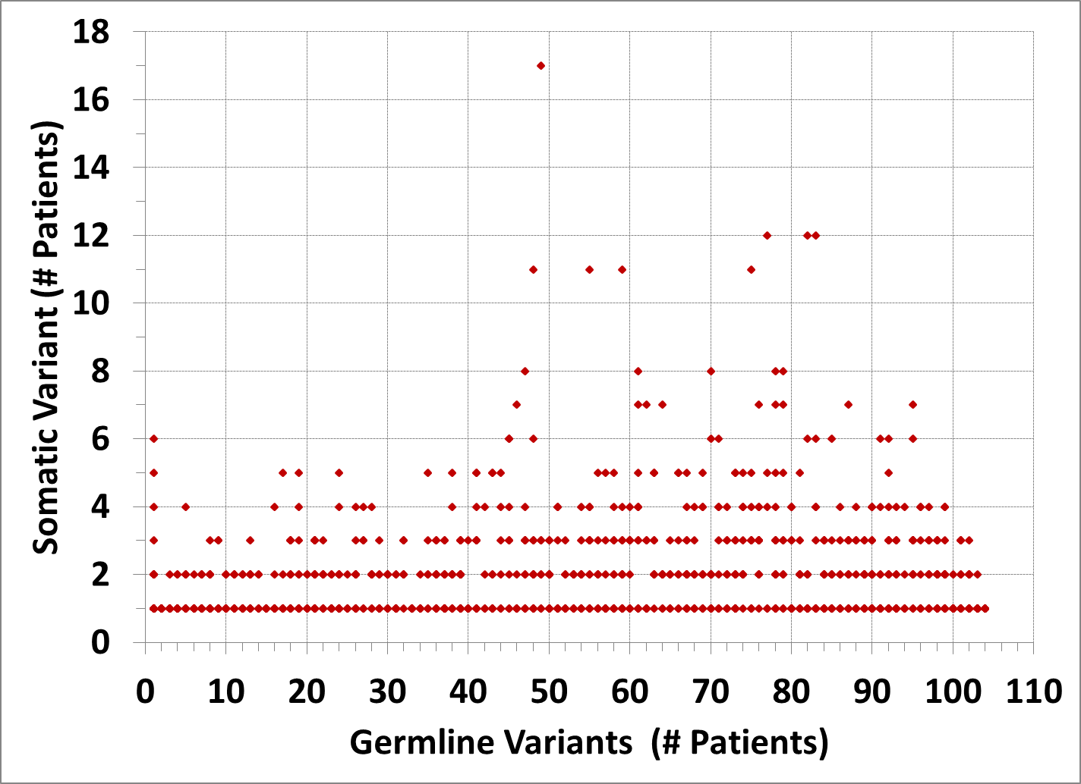
Not all Germline & Somatic mix Single AA Variants are “Essentially” Germline
Genomic
G&S mix
Phred >20
Proteomic
G&S mix
S > 8, G >11
Is G&S mix status primarily an artifact of variant calling accuracy/sensitivity?
Is there some cancer biology involved for high S/G ratio variants?
    Are patients with germline form more cancer prone?
    Does somatic form correlate with prognosis, development of drug-resistance?

Slide 18
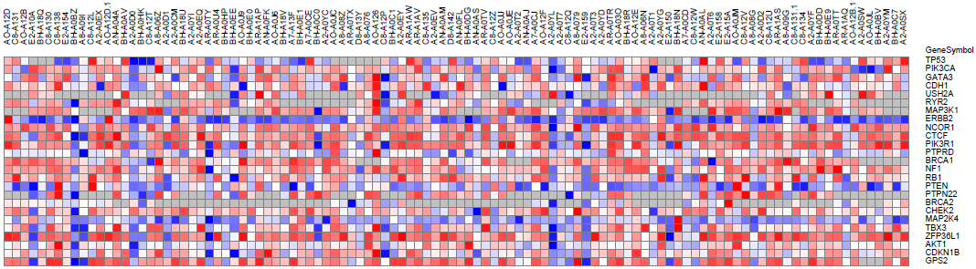
Significantly Mutated Genes, Detection at Protein-level and Variant Peptide-level
TP53, PIK3CA & GATA3 mutations occurred at >10% incidence across 507 tumors
TCGA Consortium, Nature 2012
Protein level
iTRAQ
105 patients --->
Variant Peptide detected
Good Tryptic Not detected
Poor Tryptic Not detected

Slide 19
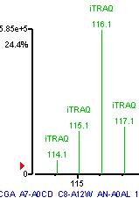
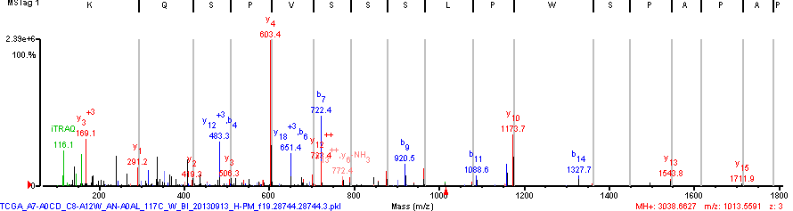
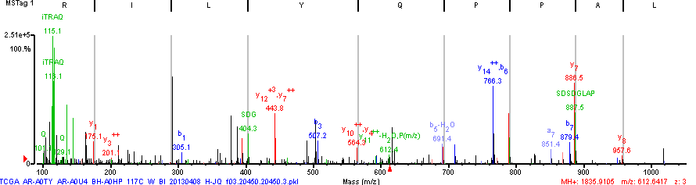
Proteomics Detection of Variant Peptides for Tumor antigen p53
log2 116/117 3.0
PIP 100%
TP53 tumor antigen p53 variant P72R (new tryptic site)
Phred: 3403 2/105 Somatic, 89/105 Patients Germline
SM: 22.9 15/36 Proteomics Experiments
TP53 tumor antigen p53 variant H193Y
Phred: 30 2/105 Patients Somatic
SM: 7.8 1/36 Proteomics Experiments, PIP 56%

Slide 20
Conclusions and Next steps
  RNA-Seq and Proteomics can currently achieve comparable depth of coverage for alternative splices and frameshifts
    Search MS/MS data against databases from a larger patient population
    Search WHIM Xenograft data (newer RNA-Seq)
  Proteomics can detect variants with marginal base-calling Phred scores
Reference database should include more common alterations
  RefSeq 2013->2014, 2X more entries (mostly spliceform additions)
Validate variant peptide detection with MRM and synthetic peptides
Sort out Germline/Somatic variant classification across patients
Correlate quantitative info with disease sub-type
Calculate variant allele frequency using corresponding wildtype peptide

Slide 21
Acknowledgments
Broad Institute/FHCRC
  Steve Carr
  Karl Clauser
  Michael Gillette
  Jana Qiao
  Philipp Mertins
  DR Mani
  Eric Kuhn
  Sue Abbatiello
  Amanda Paulovich
  Jeffrey Whiteaker
  Pei Wang
  Sean Wang
  Ping Yan
  Yuzheng Zhang
Washington U./NYU
  Sherri Davies
  Matthew Ellis
  Reid Townsend
  Song Cao
  Michael McLellan
  Li Ding
  David Fenyo
  Kelly Ruggles
NCI Staff
  Emily Boja
  Mehdi Mesri
  Rob Rivers
  Chris Kinsinger
  Henry Rodriguez
Funding
National Cancer Institute

Slide 22

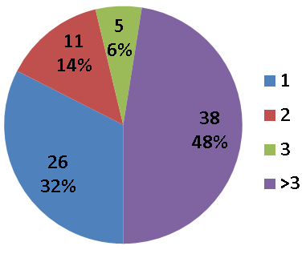
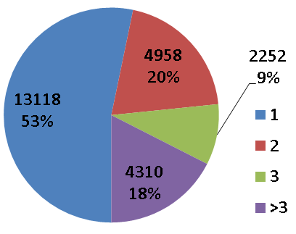
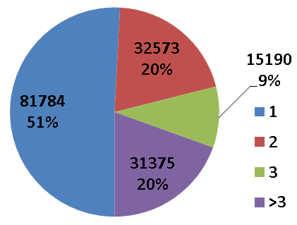
40-50% of Transcriptome level Spliceform Observation is Based on Single RNA-Seq reads
196 Alternative splices
80 Indels
472 Truncations
Proteome
Max #
Reads
Max #
Reads
Transcriptome
51,058 Alternative splices
24,638 Indels
160,922 Truncations
Transcript: read must span a splice junction, similar for alt splice, truncation and indel.
Protein: peptide must span the junction AA’s, alt splice/indel (1-3 AA), truncation (many AA’s).

