Slide 1
Taming Errors for Peptides with Post-Translational Modifications Bioinformatics for MS Interest Group ASMS June 16, 2014 Baltimore, MD
Karl Clauser
Broad Institute of MIT and Harvard

Slide 2
Making Inaccurate FDR Estimates
FDR: 0.85%
FDR: 7.97%
2% Lys-Ac
Unenriched
FDR: 1.30%
FDR: 1.24%
92% PO₄ sty
IMAC -enriched

Slide 3
Variable Modifications Expand the Search Space
Fixed
Mods
only
Allow
Variable
Mods
precursor mass filter
Calculate
MH+ fixed mods only
tolerance
filter
Shift range
filter
Candidates passing precursor mass filter
AA composition
filter
Precursor
MH+ shift
-256 -176 -160 -97 -81 -80 -32 -16 -2 -1 0 17
3ST 2ST 2ST 1ST 1ST 1ST 2M 1M 2N 1N * ^Q
1M 1M 1M 1N? ? ? ? ? ? ? ? ?
Calculate MH+
Variable mod
combinations
AA
composition
tolerance
filter
Total candidates = Σ(M0) + Σ(M1)_{N} + Σ(M2)_{2N} + Σ(M16)_{M} + Σ(M32)_{2M} + Σ(M80)_{ST} + …
Relative # candidates: Σ(M0) > Σ(M80)_{ST} > Σ(M1)_{N} >> Σ(M1)_{M} > Σ(M1)_{^Q}
Σ(M80)_{STY} > Σ(M160)_{2STY} > Σ(M240)_{3STY}

Slide 4
FDR across Multiple Experiments or Replicates
92% PO₄ sty
IMAC -enriched
FDR: 1.30%
FDR: 6.18%
1 experiment 36 experiments
FDR: 1.30%
True peptides tend to repeat
False peptides tend to not
True spectra/peptide: 2.3 28.1
False spectra/peptide: 1.2 3.0

Slide 5
Where can we make Improvements?
Enrichment peptide/protein
Digestion enzyme
Chemical label
Chromatographic resolution
gradient time
particle size (<2 micron)
Choose Precursor m/z
m/z, delta m/z
abundance
charge
time – chromatographic apex
Choose Dissociation mode: CID,HCD, ETD
Combine precursor ions before MS/MS
+2, +3, +4
Light, medium, heavy
SWATH, DIA
Combine fragment ions before mass analyzing
+2, +3, +4
CID,HCD, ETD
Combine spectra to interpret, localize
+2, +3, +4
CID, HCD, ETD
Reference
Patient Specific Sequence Databases (RNA-Seq, Whole Exome)
Spectral libraries (dissociation mode, chemical label, organism)
Error rate
FDR: match subsets for score threshold, reporting
FLR: widely used metric
To observe precursor must enrich
concentrate
ionize
To select precursor must observe precursor
have time
To fragment must select precursor
To identify must fragment
To localize must cleave backbone
Sample Preparation
Data Acquisition Hardware
Data Acquisition Software Control
Data Interpretation

Slide 6
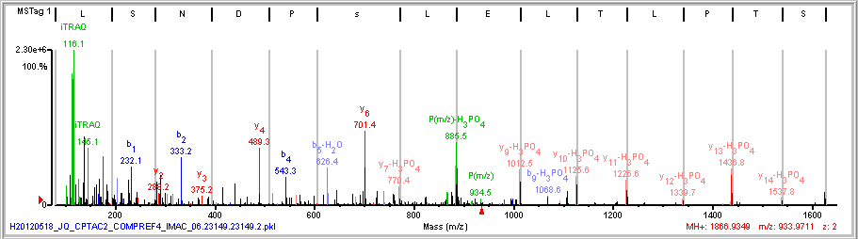
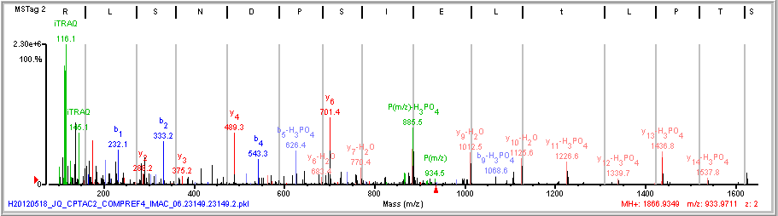
y-H₃PO₄ or y-H₂O Ions?
H₃PO₄
(R)S\T\P L\T L E I s/P D/N S L/R(R)
H₂O
(R)S\T\P L\t L E I S/P D/N S L/R(R)
Notes:
2 different fragment ion types, y-h2o and y-h3po4, can explain the same peaks (with the exact same mass) for 2 different phosphosite localization possibilities, T5t or S9s. There are no accompanying primary y ions, y9-y14, to resolve the ambiguity.

Slide 7
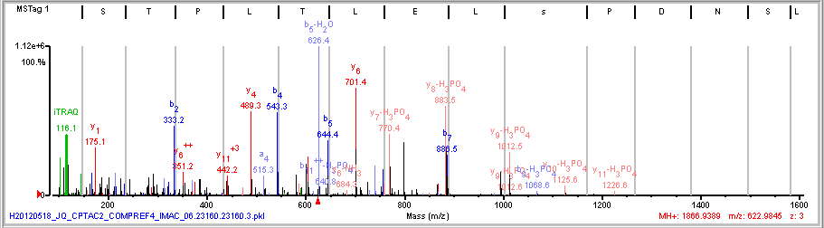
y-H₃PO₄ not y-H₂O Ions
H₃PO₄
(R)S\T\P L\T L E I s/P D/N S L/R(R)
+2
+3
(R)S T\P L\T\L\E I s/P/D/N S L/R(R)
+2
precursor
+3
precursor
b₆
757.5
Notes:
MS/MS spectra of this peptide were obtained for 2 different precursor charge. Since the b5 and b6 ions localize the phosphosite to S9s, the ambiguous fragment ion types in the +2 spectrum can be assigned b5-H2O, y7-H3PO4, y8-H3PO4, y9-H3PO4.

Slide 8
Performance of Spectrum Mill ID/Localization Algorithm Revisions
For alternate localizations
should H₃PO₄ loss ions be
preferred to H₂O loss?
Recover accompanying
b/y ions by decreasing CE?
Is this more an iTRAQ issue or an HCD feature?
Comparing different parent charge MS/MS of same
peptide very helpful.
NPA: no possible ambiguity (only 1 STY in peptide)
SM_35
Score: y- H₃PO₄ = y-H₂O
Score: b- H₃PO₄ = b-H₂O
SM_35_NLPpref
(neutral loss of phosphate preferred)
Distort fragment ion type scores
So that
2 H₃PO₄ loss
beats
2 H₂O loss

